Slide 1
Presentation Title

Slide 2
Open-Closed Principle

Slide 3
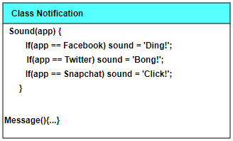
Table Template

Slide 4
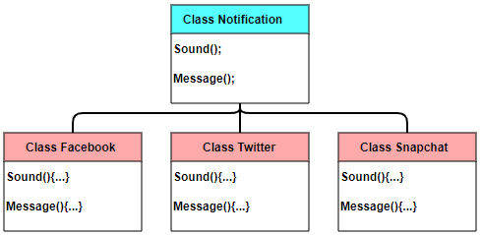
Table Template

Slide 5
Interface Segregation Principle

Slide 6
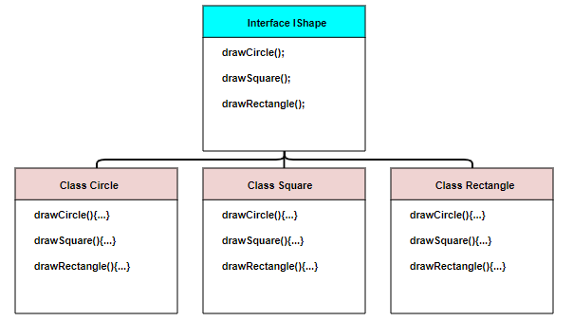
Table Template

Slide 7
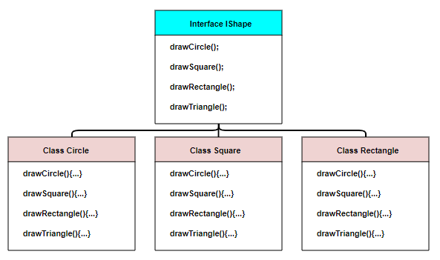
Table Template

Slide 8
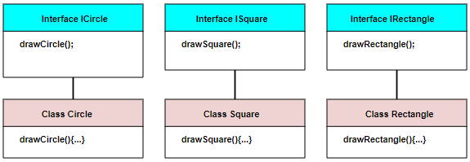
Table Template

Slide 9
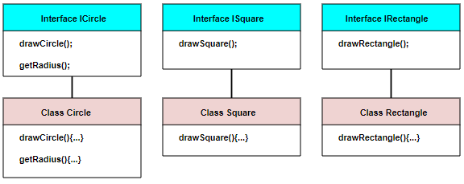
Table Template

