Slide 1
Presentation Title

Slide 2
Single Responsibility Principle

Slide 3
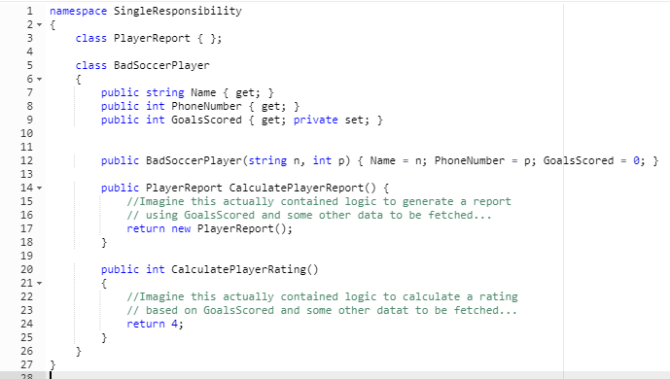
Bad Soccer Player
Notes:
Building a SoccerPlayer class
You want to keep stats, but it’s clear that it probably wouldn’t work to keep the values on the soccer player. Some stats require comparing other players on the team/in the league. A single player’s data shouldn’t rely on others you feel.
So build a PlayerReport class to hold calculated stats. But leave the calculations in the player class.

Slide 4
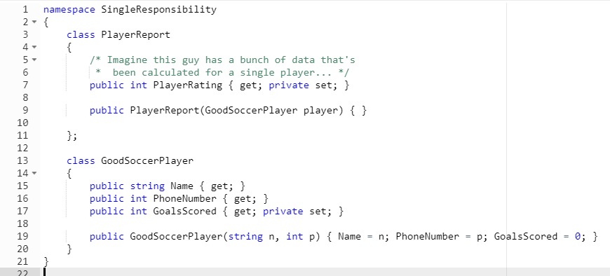
Bad Soccer Player
Notes:
Building a SoccerPlayer class
You want to keep stats, but it’s clear that it probably wouldn’t work to keep the values on the soccer player. Some stats require comparing other players on the team/in the league. A single player’s data shouldn’t rely on others you feel.
So build a PlayerReport class to hold calculated stats. But leave the calculations in the player class.

Slide 5
Open-Closed Principle

Slide 6
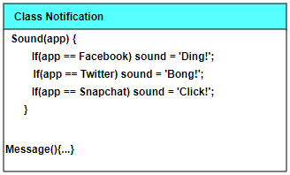
Table Template

Slide 7
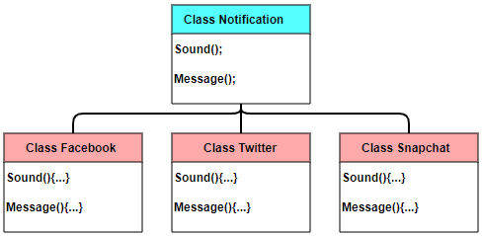
Table Template

Slide 8
Liskov Substitution Principle

Slide 9
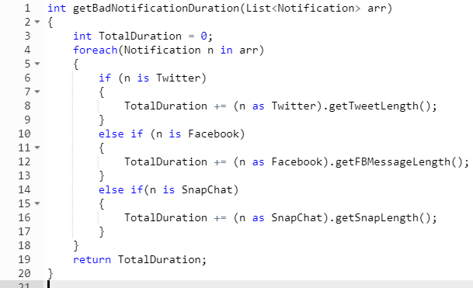
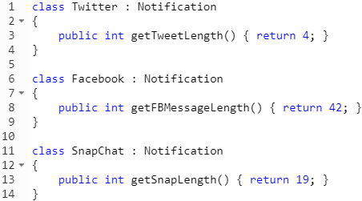
Bad Notifications

Slide 10
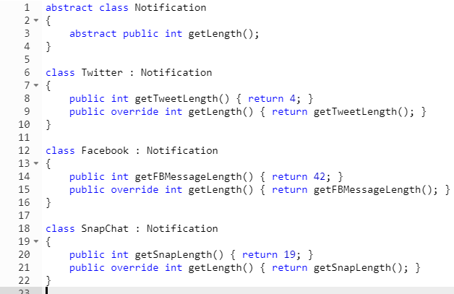

Good Notifications

Slide 11
Interface Segregation Principle

Slide 12
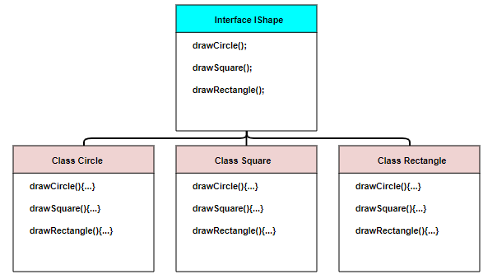
Table Template

Slide 13
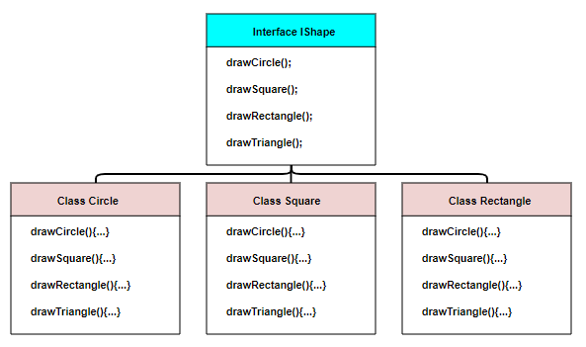
Table Template

Slide 14
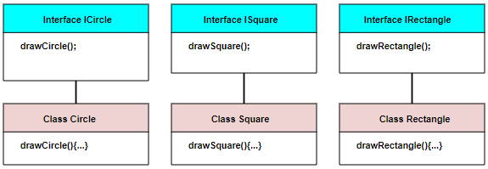
Table Template

Slide 15
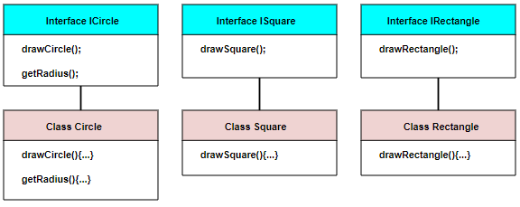
Table Template

Slide 16
Dependency Inversion Principle

