Slide 1
S.O.L.I.D.
Ari Cohen & Colton Heinrich

Slide 2
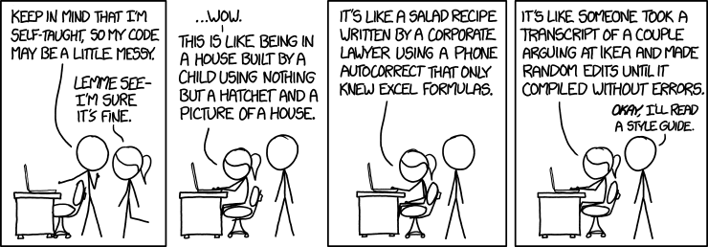
Bad Code

Slide 3
Bad Code
Rigid
Fragile
Immobile
Overly Complex
Overly Redundant
Difficult to understand
Difficult to modify/update
Difficult to test
Difficult.

Slide 4
Good Code
Reliability
Flexibility
Separation of Concerns
Reusability
Maintainability

Slide 5
SOLID Principles
S – Single Responsibility Principle
O – Open Closed Principle
L – Liskov Substitution Principle
I – Interface Segregation Principle
D – Dependency Inversion Principle

Slide 6
Single Responsibility Principle

Slide 7
Single Responsibility Overview
A single module/class should have exactly one functional responsibility
“Responsibility” can be thought of as a “reason to change”
Each module/class should have one (and only one) reason to be rewritten/changed
Forces code to be more modular/robust
Easier to modify/test
Notes:
Building a SoccerPlayer class
You want to keep stats, but it’s clear that it probably wouldn’t work to keep the values on the soccer player. Some stats require comparing other players on the team/in the league. A single player’s data shouldn’t rely on others you feel.
So build a PlayerReport class to hold calculated stats. But leave the calculations in the player class.

Slide 8
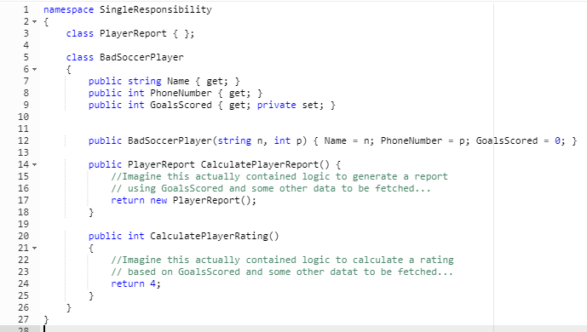
Bad Soccer Player
Notes:
Building a SoccerPlayer class
You want to keep stats, but it’s clear that it probably wouldn’t work to keep the values on the soccer player. Some stats require comparing other players on the team/in the league. A single player’s data shouldn’t rely on others you feel.
So build a PlayerReport class to hold calculated stats. But leave the calculations in the player class.

Slide 9
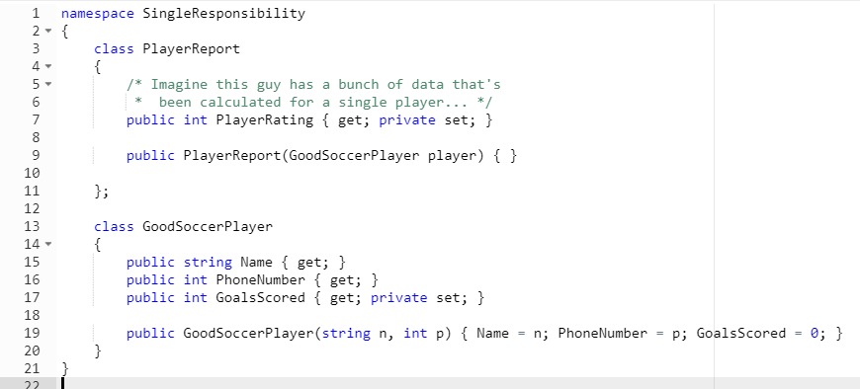
Good Soccer Player
Notes:
Building a SoccerPlayer class
You want to keep stats, but it’s clear that it probably wouldn’t work to keep the values on the soccer player. Some stats require comparing other players on the team/in the league. A single player’s data shouldn’t rely on others you feel.
So build a PlayerReport class to hold calculated stats. But leave the calculations in the player class.

Slide 10
Open-Closed Principle

Slide 11
Open-Closed Principle Overview
“Software entities (classes, modules, functions, etc.) should be open for extension, but closed for modification"

Slide 12
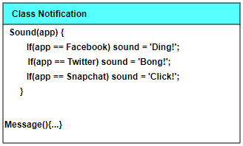
Bad Example

Slide 13
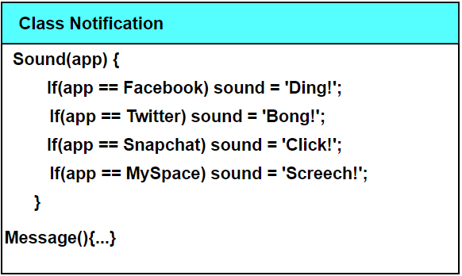
Bad Example Expansion

Slide 14
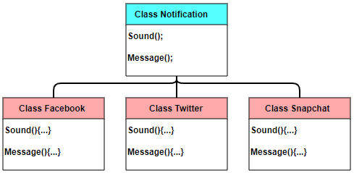
Good Example

Slide 15
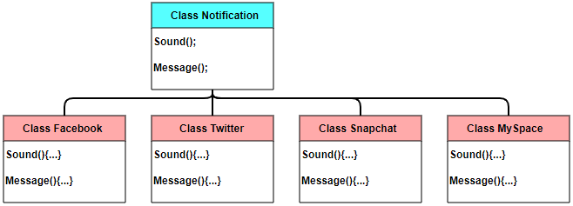
Good Example Expansion

Slide 16
Liskov Substitution Principle

Slide 17
Liskov Substitution Overview
If S is a subtype of T, then objects of type T may be replaced with objects of type S without breaking core functionality.
(More formally called “Strong Behavioral Subtyping”)
“A sub-class can assume the place of its super-class without errors”
Liskov should be a test of whether or not your abstraction is correct
Notes:
Building a SoccerPlayer class
You want to keep stats, but it’s clear that it probably wouldn’t work to keep the values on the soccer player. Some stats require comparing other players on the team/in the league. A single player’s data shouldn’t rely on others you feel.
So build a PlayerReport class to hold calculated stats. But leave the calculations in the player class.

Slide 18
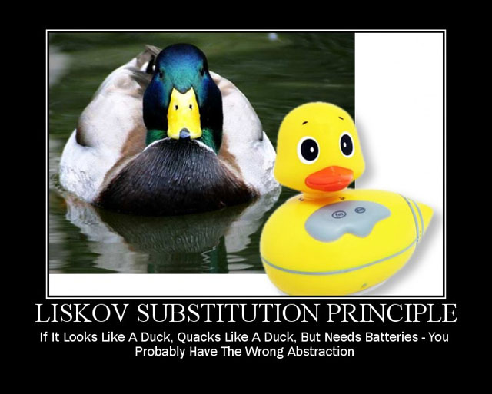
Liskov Substitution Overview
Notes:
Square/Rectangle Example:
- ”Is A” relationships
- Square “is a” Rectangle, so inherit!
What do get/setWidth/Height mean if the Rectangle reference points to a Square?
Square as an abstraction of Rectangle is BAD
Could also do a Board/3DBoard Example:
Board has some width/height
3DBoard extends this and has a depth
All of Board’s functions (AddUnit, GetTile, RemoveUnit, etc…) take an x and y but no z
3DBoard will have to shadow all of these with new functions that take x,y,z

Slide 19
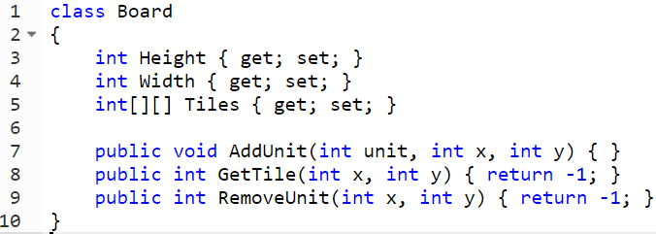
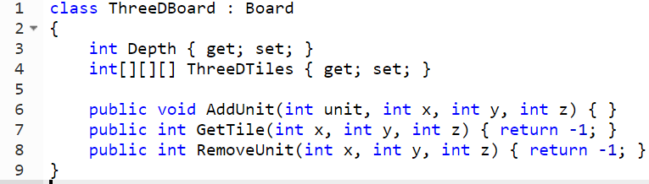
Bad Liskov

Slide 20
Interface Segregation Principle

Slide 21
Interface Segregation Principle Overview
No client should be forced to depend on methods it does not use.
Splits interfaces that are very large into smaller and more specific ones so that clients will only have to know about the methods that are of interest to them.

Slide 22
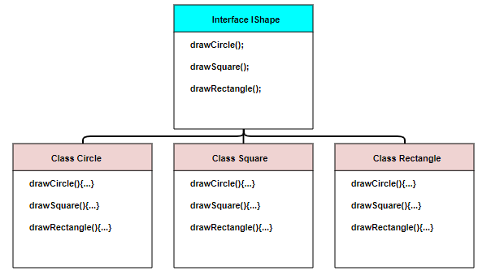
Bad Example

Slide 23
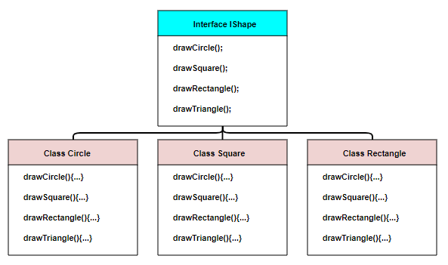
Bad Example Expansion

Slide 24
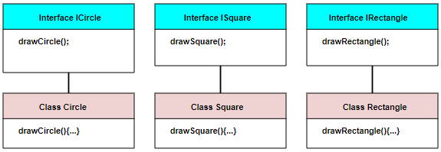
Good Example

Slide 25
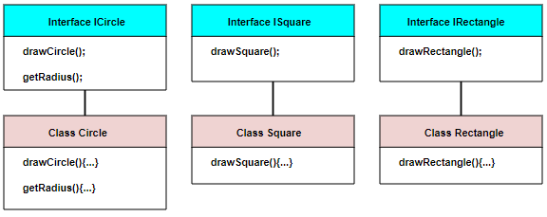
Good Example Expansion

Slide 26
Dependency Inversion Principle

Slide 27
Dependency Inversion Overview
Many people think of OOP as high-level objects depending on low-level objects
ie: A data processor should be dependent on the data output source
Dependency Inversion works to decouple modules by making both high and low-level objects be independent
This is accomplished by having their requirements/behaviors generalized through interfaces

Slide 28
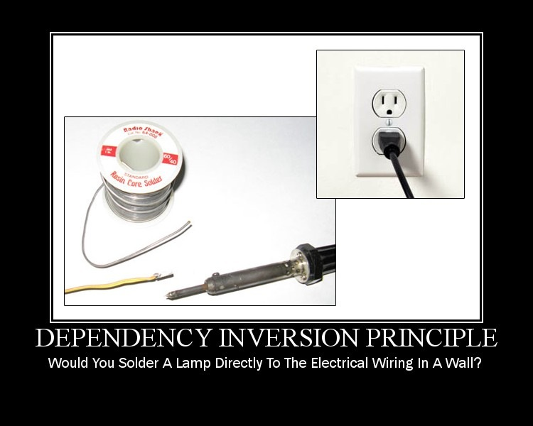
Dependency Inversion Overview

Slide 29
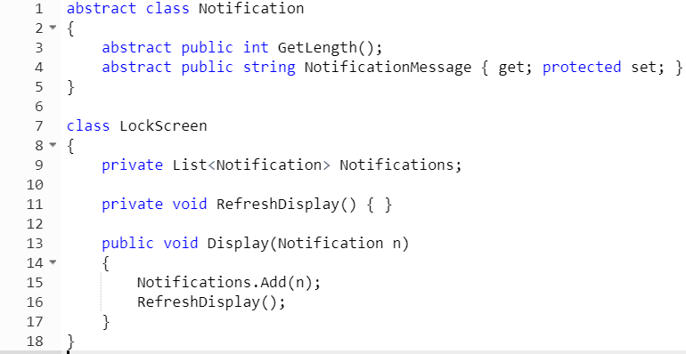
Bad LockScreen

Slide 30
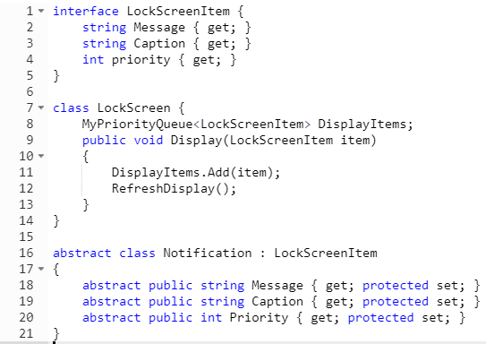
Good LockScreen

