Slide 1


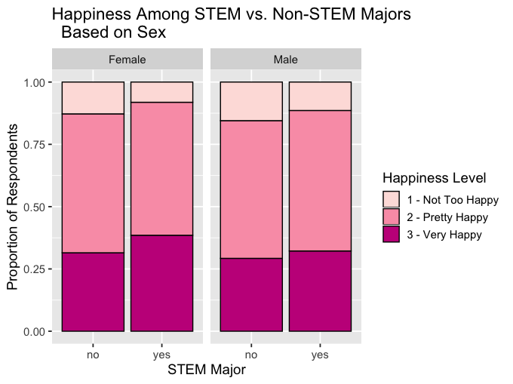
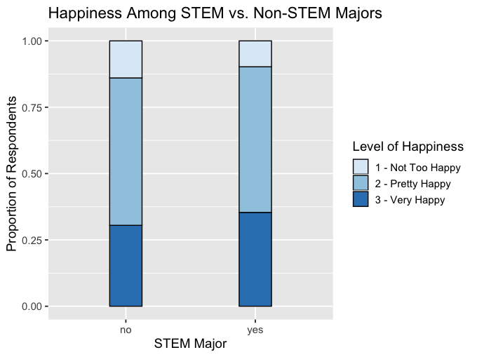
Does Happiness STEM From College Major?
Sophie Cohen, Quantitative Analysis Center, Wesleyan University
\Introduction
\Results
Logistic regression analysis revealed a significant association between majoring in STEM and happiness based on sex. The equation of the line is y = 0.2294x - 2.1423 and the p-value is 0.0185 < 0.05. Thus, STEM majors who are female are happier.
Throughout the last decade, there have been strides to reform STEM education in primary and secondary education. National assessments of students indicate that the United States is failing to compete with other countries in terms of performance and interest in STEM (Daugherty, 2013).
A study at the University of California, Berkeley in 2015 showed that depression afflicts almost half of STEM graduate students. Science and engineering Ph.D. students also reported minimal career optimism and academic engagement (Bernstein, 2015).
Another study concluded that self-esteem, optimism, interpersonal relations, and satisfaction with major are factors that affect happiness among first year women nursing students (Kim & Kim, 2012).
Literature shows that there has been a range of assertions about the association between STEM majors and happiness.
Univariate
11.78% of respondents in the sample majored in a STEM discipline.
A total of 87% reported that they were very or pretty happy.
Bivariate
Chi-Square analysis revealed that there is not a significant association between these variables. The test statistic is 5.4536 and the p-value is 0.06543 > 0.05.
Overall, STEM majors are a little happier than non-STEM majors (Figure 1).
Logistic regression analysis indicated a significant association. The equation of the line for STEM and HAPPY is y = 0.22149x - 2.50704 and the p-value is 0.0228. Thus, STEM majors are happier.
Figure 2
\Research Questions
Figure 1
\Discussion
Is there an association between studying STEM in college and general happiness?
How does sex moderate this relationship?
Contrary to what was expected, individuals who study STEM majors are overall happier.
Women in STEM majors are the happiest.
There is a need to enhance non-STEM disciplines. This could be done by restructuring class assignments or providing better support in career aspirations.
The present study does not take into account the profession of the respondents.
Further research could be done on how other factors, such as income or age, affect happiness among STEM and non-STEM majors.
\Methods
Sample
Adults (ages 18 and up) that attend or attended college who reported their general level of happiness in 2014 (n=2,538) were drawn from the General Social Survey (GSS).
GSS is a nationally representative sample of adults in the U.S.
Measures
Major was classified as STEM or Not STEM based on the U.S. Immigration and Customs Enforcement STEM disciplines.
Happiness was a self-reported measurement of the respondent’s general level (Very, Pretty, or Not too) of happiness.
Multivariate
After controlling for sex, people in STEM majors are happier.
Women in STEM majors are the most happy and men in non-STEM majors are the least happy (Figure 2).
Chi-Square analysis showed that there is still not a significant association between these variables. For men, the test statistic is 1.8516 and the p-value is 0.3962. For women, the test statistic is 4.5029 and the p-value is 0.1052.
\References
Bernstein, R. (2015). Depression Afflicts Almost Half of STEM Graduate Students at UC Berkeley. ScienceMag, American Association for the Advancement of Science, 33-35.
Daugherty, M. (2013). The Prospect of an "A" in STEM Education. JSTEM, Institute for STEM Education and Research, 14(2).
Kim, G. & Kim, K. (2012). Factors related to Happiness in First year Women Nursing Students. KoreaMed Synapse, Journal of Korean Academy of Psychiatric and Mental Health Nursing, 21(2), 149-157.

