Slide 1
Module11
Controlling Access to ASP.NET MVC Core Web Applications
Notes:
20486B
11: Controlling Access to ASP.NET MVC 4 Web Applications

Slide 2
Module Overview
Authentication Authorization
Notes:
20486B
11: Controlling Access to ASP.NET MVC 4 Web Applications

Slide 3
Lesson 1: Authentication
ASP.NET Core Identity
Authentication Middleware
Notes:
20486B
11: Controlling Access to ASP.NET MVC 4 Web Applications

Slide 4
ASP.NET Core Identity
Membership system for building ASP.NET Core web applications
Membership
Login
User data
Allows to add login features
Makes it easy to customize data about the logged in user
Notes:
https://github.com/aspnet/Identity

Slide 5
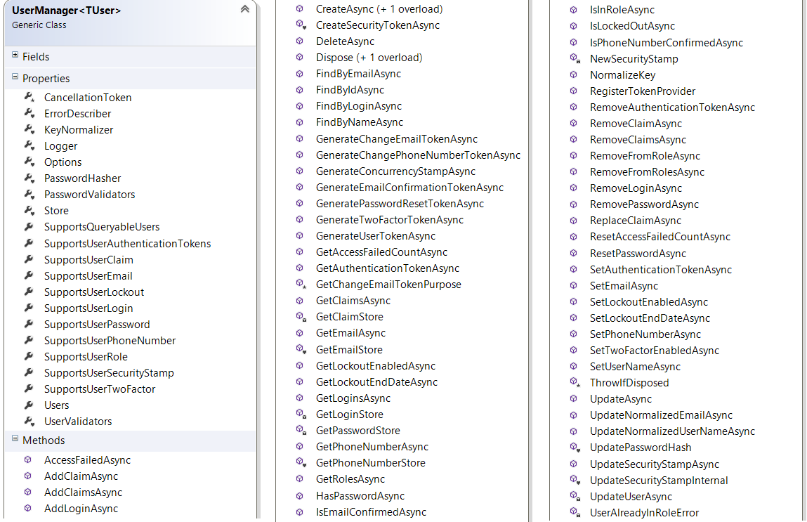
UserManager
Notes:
Identity Framework Core contains a UserManager class capable of creating, updating, deleting users and so on. The UserManager has the logic (it knows when and how to hash passwords, it can normalize names, emails and so on) but it does not know WHERE to store the users.
A UserManager works together with a UserStore, a class that knows where to save the users.
The UserManager class is actually connected to an interface (IUserStore). It’s up to the developers to select an actual implementation of an IUserStore.
Microsoft provides an EntityFramework implementation of the IUserStore that talks to SQL Server, but thanks to the interfaces it could be possible to create a different UserStore that could save the users in a different DB (there’s already a MongoDB provider, for example)

Slide 6
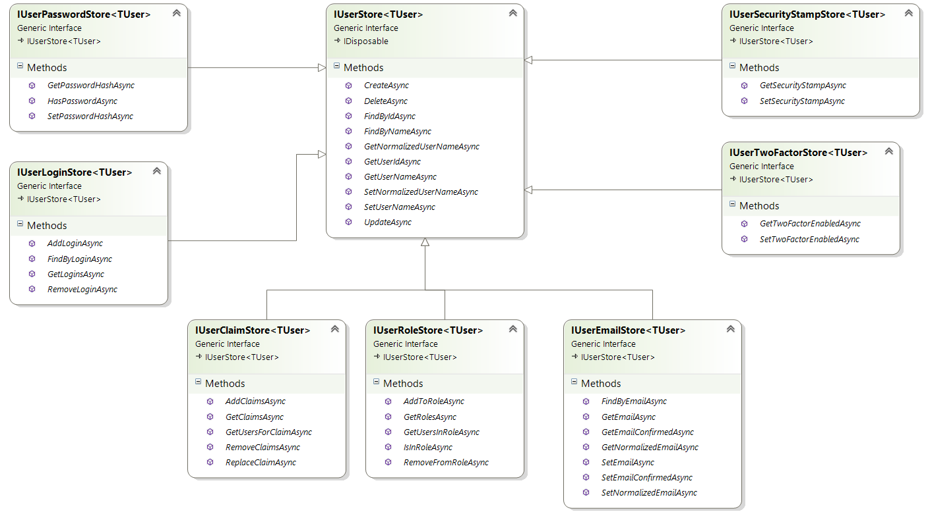
IUserStore
Notes:
The interface IUserStore is then extended by many others, that take care of Claims, Roles, Emails, Passwords, Logins and so on.

Slide 7
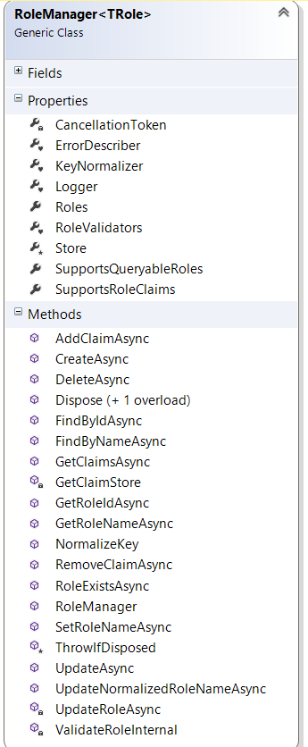
RoleManager
Notes:
There’s also a RoleManager class that can work with Roles. It is connected to an IRoleStore.

Slide 8
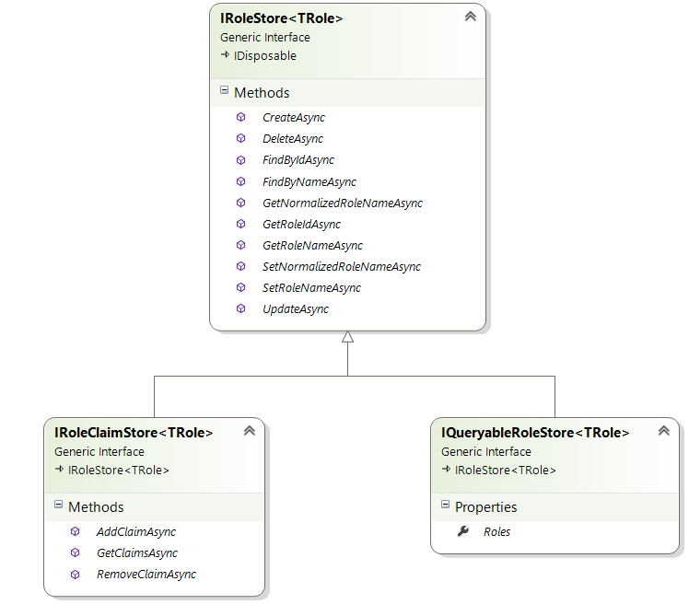
IRoleStore
Notes:
Th IRoleStore interface is also extended by a IRoleClaimStore that takes care of Claims per Role

Slide 9
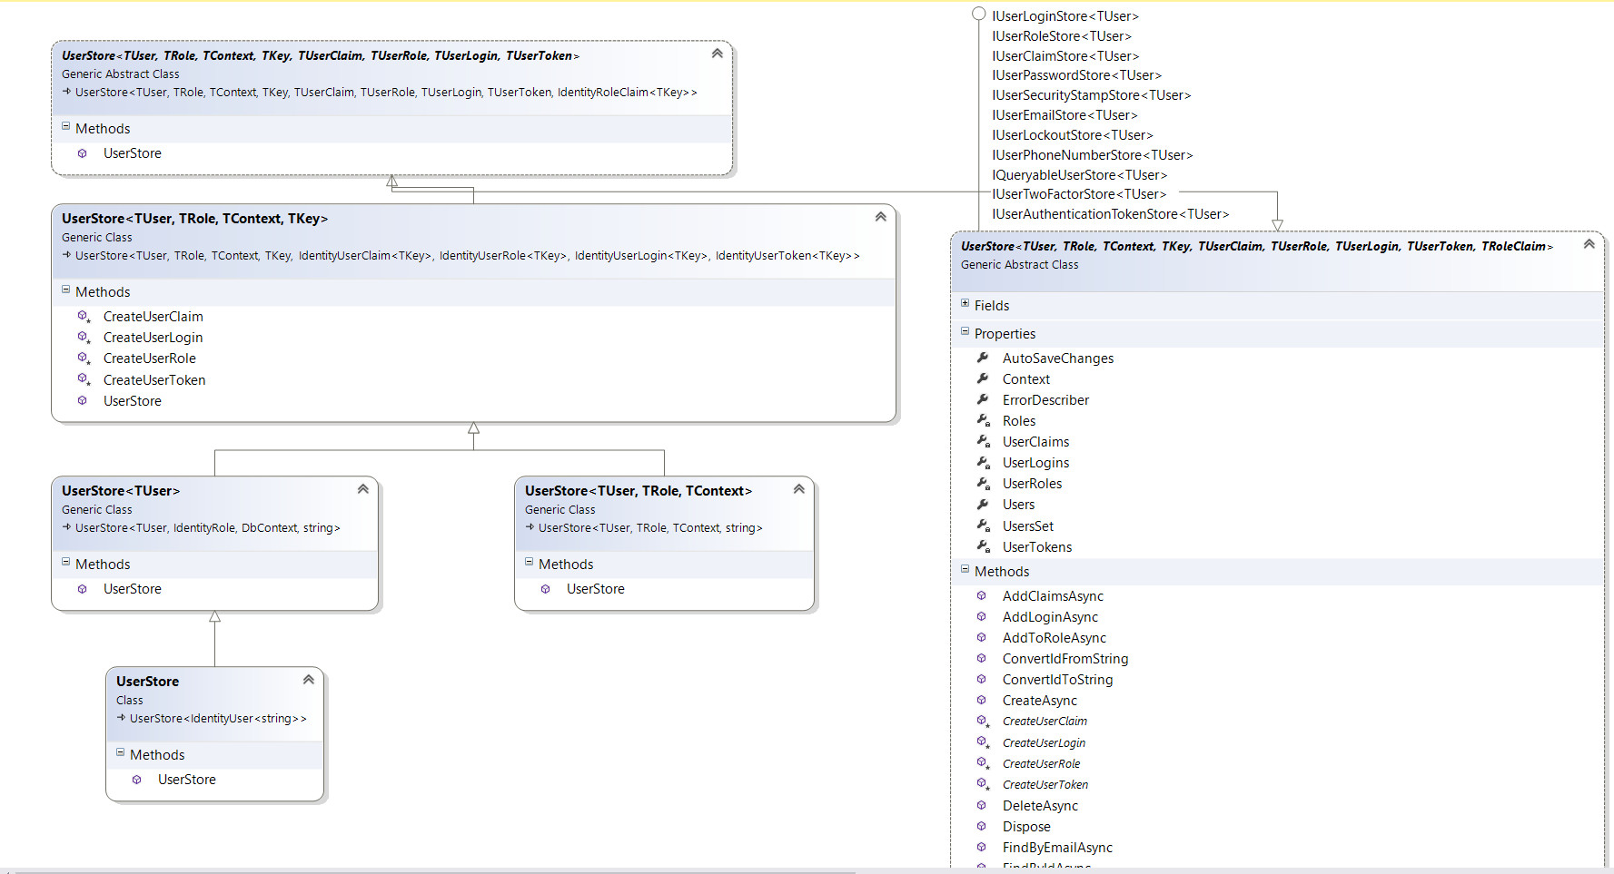
Identity EntityFramework - UserStore
Notes:
Microsoft provides an implementation of the IUserStore in an EntityFramework Package.
The UserStore class works with IdentityUser with a String key and a DBContext to store the data in a Sql Database.
It implements all the interfaces to manage Users, logins, passwords, phone numbers, email, authentication tokens and so on.
In a new MVC Core application we get a class

Slide 10
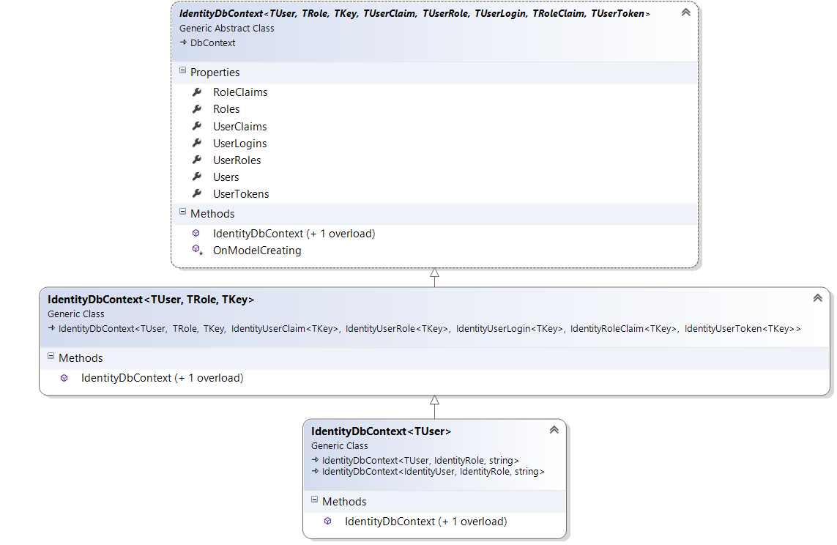
IdentityDbContext
Notes:
An IdentityDbContext is an EntityFramework class deriving from DbContext that already contains DbSet for Users, Claims, Roles, Tokens and so on

Slide 11
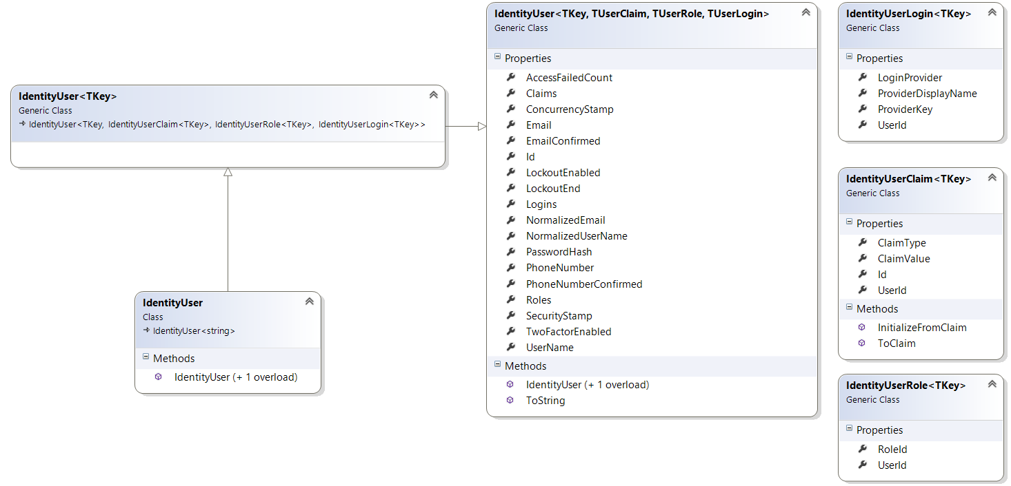
IdentityUser
Notes:
An IdentityUser is a class with a String Id plus many properties such as a UserName, Email, PasswordHash, PhoneNumber but also a collection of Claims, Roles, Logins.

Slide 12
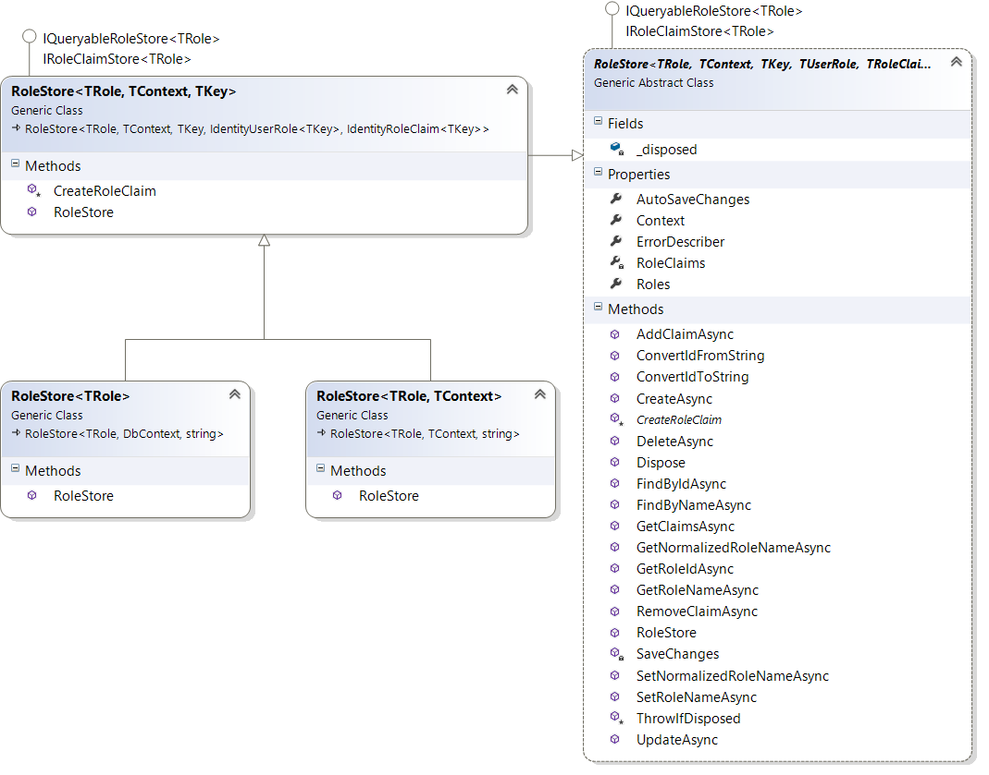
RoleStore
Notes:
The RoleStore implementation works with a DbContext to store the roles in a Sql Database and it can handle roles and claims associated to each role.

Slide 13
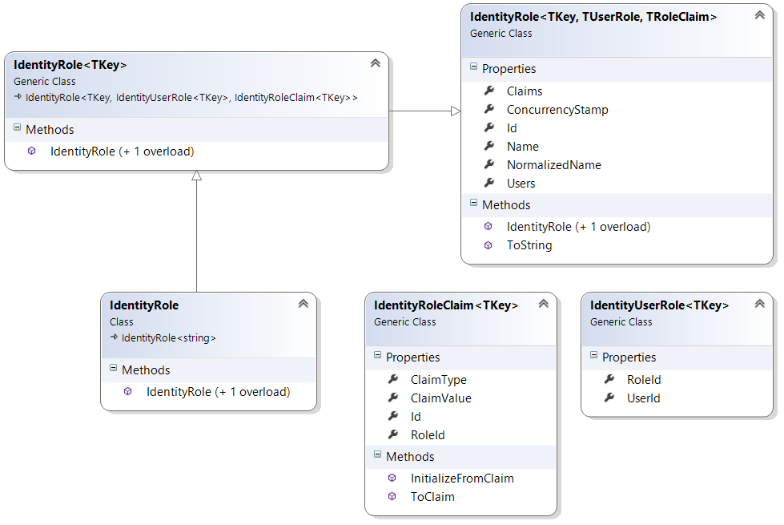
IdentityRole
Notes:
An IdentityRole has a collection of Users and Claims

Slide 14
Extension Points - ApplicationUser
Add profile data for application users by adding properties to the ApplicationUser class
public class ApplicationUser : IdentityUser {
public string City { get; set; }
public List<Photo> Photos { get; set; }
}

Slide 15
Extension Points - ApplicationDbContext
Customize the ASP.NET Identity model and override the defaults if needed
public class ApplicationDbContext :
IdentityDbContext<ApplicationUser> {
public ApplicationDbContext(
DbContextOptions<ApplicationDbContext> options): base(options) {
}
protected override void OnModelCreating(ModelBuilder builder) {
base.OnModelCreating(builder);
}
public DbSet<Photo> Photos { get; set; }
}
public class Photo {
public int Id { get; set; }
public string Name { get; set; }
public string ApplicationUserId { get; set; }
public ApplicationUser Owner { get; set; }
}

Slide 16
Authentication Middleware
The Authentication Middleware handles
Authenticate
SignIn
Signout

Slide 17
Identity Configuration - Services
During Startup, the AddIdentity registers many default Services
Microsoft.AspNetCore.Identity / IdentityServiceCollectionExtensions.cs
//Startup class
public void ConfigureServices(IServiceCollection services){
services.AddIdentity<ApplicationUser, IdentityRole>()
.AddEntityFrameworkStores<ApplicationDbContext>()
.AddDefaultTokenProviders();
services.TryAddScoped<IUserClaimsPrincipalFactory<TUser>, UserClaimsPrincipalFactory<TUser, TRole>>();
services.TryAddScoped<UserManager<TUser>, UserManager<TUser>>();
services.TryAddScoped<SignInManager<TUser>, SignInManager<TUser>>();
services.TryAddScoped<RoleManager<TRole>, RoleManager<TRole>>();
Notes:
During the Startup.ConfigureServices, lots of services get added to the ServiceCollection (thanks to the services.AddIdentity which in turn registers the UserManager, SignInManager, RoleManager, UserClaimsPrincipalFactory and a lot more, check the Microsoft.AspnetCore.Identity / IdentityServiceCollectionExtension AddIdentity method)
The AddIdentity gets invoked with the ApplicationUser class of your application, which means that UserManager, SignInManager and ClaimsPrincipalFactory will work with the type defined in your web application.
The AddEntityFrameworkStores ensures that every time a UserStore is needed, your ApplicationDbContext will be used

Slide 18
Identity Configuration - Middleware
During Startup, Identity Authentication Middleware is added
Microsoft.AspNetCore.Identity / BuilderExtensions.cs
//Startup class, Configure Method
app.UseIdentity();
var options = app.ApplicationServices
.GetRequiredService<IOptions<IdentityOptions>>().Value;
app.UseCookieAuthentication(options.Cookies.ExternalCookie); app.UseCookieAuthentication(options.Cookies.TwoFactorRememberMeCookie);
app.UseCookieAuthentication(options.Cookies.TwoFactorUserIdCookie);
app.UseCookieAuthentication(options.Cookies.ApplicationCookie);
Notes:
Between the Middleware that gets added on the Startup.Configure we find UseIdentity, which in turn calls the UseCookieAuthentication.
This Middleware is invoked on each request (just like any other middleware) and is in charge of creating and retrieving an authentication cookie and to create a ClaimsPrincipal and ClaimsIdentity that get saved in HttpContext.User, so that any action of a controller can find the UserName, the Roles and the Claims.

Slide 19
CookieAuthenticationMiddleware
Microsoft.AspNetCore.Authentication.Cookies / CookieAppBuilderExtensions.cs
Microsoft.AspNetCore.Authentication.Cookies / CookieAuthenticationMiddleware.cs
//UseCookieAuthentication method
app.UseMiddleware<CookieAuthenticationMiddleware>();
class CookieAuthenticationMiddleware : AuthenticationMiddleware<CookieAuthenticationOptions> {
…
protected override
AuthenticationHandler<CookieAuthenticationOptions> CreateHandler(){
return new CookieAuthenticationHandler();
}
Notes:
UseCookieAuthentication calls UseMiddleware<CookieAuthenticationMiddleware> which creates a new CookieAuthenticationHandler.
A CookieAuthenticationMiddleware extends the base abstract class AuthenticationMiddleware. Here we find a lot of methods and we can follow what happens on each request / response.
public async Task Invoke(HttpContext context) //gets invoked for every request/response by the previous handler in the chain
{
var handler = CreateHandler(); //this is overridden in the CookieAuthenticationHandler in order to return a CookieAuthenticationHandler
await handler.InitializeAsync(Options, context, Logger, UrlEncoder); //step 1: the handler gets initialized
try
{
if (!await handler.HandleRequestAsync()) //step 2: the handler handles the request
{
await _next(context); //step 3, we move to the next handler in the chain (so that eventually we get to the action)
}
}
finally
{
try
{
await handler.TeardownAsync(); //step 4: the action has been executed, now we prepare the response
}
catch (Exception)
{
// Don't mask the original exception, if any
}
}
}

Slide 20
CookieAuthenticationHandler
The CookieAuthenticationHandler gets invoked
On each request to create the UserPrincipal
When the user signs in
Every time the user needs to be authorized
Notes:
There are different moments in which the CookieAuthenticationHandler is used.
During SignIn, at each request and during authorization

Slide 21
CookieAuthenticationMiddleware Invoke
On every request the CookieAuthenticationMiddleware.Invoke is called
A CookieAuthenticationHandler is
Created
Registered as the Context.Authentication.Handler
Asked to HandleAuthenticate
The HandleAuthenticate
Reads a Cookie Ticket
If not found, authentication is skipped
If found, the Context.User gets initialized with the Principal found in the cookie ticket

Slide 22
AccountController
The AccountController contains actions to Register a user, Login and so on
It works together with
UserManager
SignInManager

Slide 23
AccountController - Register
The UserManager asks the UserStore to save the ApplicationUser in the DbContext
The SignInManager asks the CookieAuthenticationHandler to Handle the SignIn
//Register
var result = await _userManager.CreateAsync(user, model.Password);
await _signInManager.SignInAsync(user, isPersistent: false);
Notes:
When the AccountController asks the SignInManager to SignIn the user, the SignInManager calls the CookieAuthenticationHandler.HandleSignIn
This creates an authentication ticket with a SessionKey.
The ticket in put in a claim to send it to the client through a cookie.
A SessionId is also saves it in the SessionStore in order to retrieve it every time the user has to be authenticated again.

Slide 24
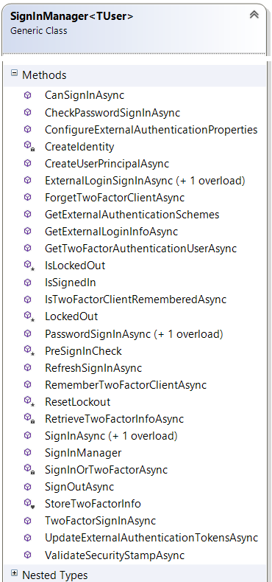
SignInManager
Notes:
The SignInManager is responsible of talking to the Authentication service middleware on one side and the UserManager on the other side.
When the AccountController calls the SignInManager.SignInAsync, the SignInManager asks the ClaimsPrincipalFactory to create a ClaimsPrincipal with a ClaimsIdentity filled up with the UserName, UserId, Roles and Claims retrieved thanks to the UserManager.
It then goes to the AuthenticationManager to ask it to SignIn the userprincipal.

Slide 25
Lesson 2 - Authorization
Introduction
Simple Authorization
Role based Authorization
Claims-Based Authorization
Custom Policy-Based Authorization
Dependency Injection in requirement handlers
Resource Based Authorization
View Based Authorization

Slide 26
Authorization - Introduction
Process that determines what a user is able to do
Independent from authentication
Declarative
Imperative
Role Based
Policy Based
Notes:
https://docs.microsoft.com/en-us/aspnet/core/security/authorization/introduction

Slide 27
Simple Authorization
Controlled through the AuthorizeAttribute attribute
Apply to a controller or action to limit access to any authenticated user
Use the AllowAnonymousAttribute attribute to allow access by non-authenticated users to individual actions
[Authorize] // allow access only for authenticated users
public class AccountController : Controller {
[AllowAnonymous] //bypasses all authorization statements
public ActionResult Login() { }
public ActionResult Logout() { }
}
Notes:
https://docs.microsoft.com/en-us/aspnet/core/security/authorization/simple

Slide 28
Role Based Authorization
Adding role checks
Policy based role checks
[Authorize(Roles = "HRManager,Finance")] // OR
public class SalaryController : Controller { }
[Authorize(Roles = "PowerUser")] //AND
[Authorize(Roles = "ControlPanelUser")]
public class ControlPanelController : Controller { }
public void ConfigureServices(IServiceCollection services) {
services.AddMvc();
services.AddAuthorization(options =>{
options.AddPolicy("RequireAdministratorRole", policy =>
policy.RequireRole("Administrator"));
});
}
[Authorize(Policy = "RequireAdministratorRole")]
public IActionResult Shutdown() { }
Notes:
https://docs.microsoft.com/en-us/aspnet/core/security/authorization/roles

Slide 29
Claims-Based Authorization
When an identity is created it may be assigned one or more claims issued by a trusted party
A claim is name value pair that represents what the subject is, not what the subject can do
Claims based authorization checks the value of a claim and allows access to a resource based upon that value
Notes:
https://docs.microsoft.com/en-us/aspnet/core/security/authorization/claims

Slide 30
Claims Based Authorization
Build and register a policy expressing the claims requirements
Apply the policy using the Policy property on the AuthorizeAttribute
public void ConfigureServices(IServiceCollection services) {
services.AddMvc();
services.AddAuthorization(options => {
options.AddPolicy("EmployeeOnly", policy =>
policy.RequireClaim("EmployeeNumber"));
});
}
[Authorize(Policy = "EmployeeOnly")]
public IActionResult VacationBalance() {
return View();
}

Slide 31
Claims Based Authorization
Specify a list of allowed values when creating the policy
public void ConfigureServices(IServiceCollection services) {
services.AddMvc();
services.AddAuthorization(options => {
options.AddPolicy("Founders", policy =>
policy.RequireClaim("EmployeeNumber", "1", "2", "3", "4", "5"));
}
}

Slide 32
Custom Policy Based Authorization
Make use of a Requirement, a Handler for the requirement and a pre-configured Policy
An authorization policy is made up of one or more requirements and registered at application Startup
Policies are applied using the Authorize attribute by specifying the policy name
public void ConfigureServices(IServiceCollection services) {
services.AddMvc();
services.AddAuthorization(options => {
options.AddPolicy("Over21",
policy => policy.Requirements.Add(new MinimumAgeRequirement(21)));
}
});
[Authorize(Policy="Over21")]
public class AlcoholPurchaseRequirementsController : Controller
Notes:
https://docs.microsoft.com/en-us/aspnet/core/security/authorization/policies

Slide 33
Custom Policy Based Authorization
Authorization Requirement
Collection of data parameters that a policy can use to evaluate the current user principal
Must implement IAuthorizationRequirement interface
public class MinimumAgeRequirement : IAuthorizationRequirement {
public MinimumAgeRequirement(int age)
{
MinimumAge = age;
}
protected int MinimumAge { get; set; }
}

Slide 34
Custom Policy Based Authorization
Authorization Handler
Responsible for the evaluation of any properties of a requirement
Must inherit AuthorizationHandler<T> where T is the requirement it handles
public class MinimumAgeHandler :
AuthorizationHandler<MinimumAgeRequirement> {
protected override Task HandleRequirementAsync(
AuthorizationHandlerContext context,
MinimumAgeRequirement requirement) {
if (!context.User.HasClaim(c => c.Type == ClaimTypes.DateOfBirth)
return Task.CompletedTask;
var dateOfBirth = Convert.ToDateTime(context.User.FindFirst(
c => c.Type == ClaimTypes.DateOfBirth).Value);
int calculatedAge = DateTime.Today.Year - dateOfBirth.Year;
if (calculatedAge >= requirement.MinimumAge)
context.Succeed(requirement);
return Task.CompletedTask; } }

Slide 35
Custom Policy Based Authorization
Handlers must be registered in the services collection during configuration
A handler indicates success by calling context.Succeed(IAuthorizationRequirement requirement)
To guarantee failure even if other handlers for a requirement succeed, call context.Fail
public void ConfigureServices(IServiceCollection services) {
…
services.AddSingleton<IAuthorizationHandler, MinimumAgeHandler>();
}

Slide 36
Custom Policy Based Authorization
A Requirement may have multiple Handlers
public class EnterBuildingRequirement : IAuthorizationRequirement { }
public class BadgeEntryHandler :
AuthorizationHandler<EnterBuildingRequirement> { … }
public class HasTemporaryStickerHandler :
AuthorizationHandler<EnterBuildingRequirement> {… }
public void ConfigureServices(IServiceCollection services)
{
services.AddAuthorization(options => {
options.AddPolicy("EnterBuilding", policy =>
policy.Requirements.Add(new EnterBuildingRequirement())));
});
services.AddSingleton<IAuthorizationHandler, BadgeEntryHandler>();
services.AddSingleton<IAuthorizationHandler,
HasTemporaryStickerHandler>();
}

Slide 37
Custom Policy Based Authorization
Using a func to fufill a policy
services.AddAuthorization(options => {
options.AddPolicy("BadgeEntry",
policy => policy.RequireAssertion(context =>
context.User.HasClaim(c =>
(c.Type == ClaimTypes.BadgeId ||
c.Type == ClaimTypes.TemporaryBadgeId)
&& c.Issuer == "https://microsoftsecurity"));
}));
}
}

Slide 38
Custom Policy Based Authorization
Accessing MVC Request Context In Handlers
The Resource property on the AuthorizationContext is used by frameworks as MVC or Jabbr to pass through extra information
var mvcContext = context.Resource as Microsoft.AspNetCore.Mvc.Filters.AuthorizationFilterContext;
if (mvcContext != null)
{
// Examine MVC specific things like routing data.
}

Slide 39
Dependency Injection in requirement handlers
Use Dependency Injection to request any service in the Handler constructor
public class CityAuthorizationHandler
: AuthorizationHandler<CityRequirement> {
private readonly UserManager<ApplicationUser> _userManager;
public CityAuthorizationHandler(UserManager<ApplicationUser> um)
{ _userManager = um; }
protected override Task HandleRequirementAsync(
AuthorizationHandlerContext context, CityRequirement requirement) {
ApplicationUser user =
_userManager.FindByNameAsync(context.User.Identity.Name).Result;
if (user.City == requirement.City)
context.Succeed(requirement);
return Task.CompletedTask;
}
}
Notes:
https://docs.microsoft.com/en-us/aspnet/core/security/authorization/dependencyinjection

Slide 40
Resource Based Authorization
When authorization depends upon the resource being accessed, use imperative authorization
Authorization is implemented as a service, IAuthorizationService, available via dependency injection
public class PhotosController : Controller {
private readonly IAuthorizationService _authorizationService;
public PhotosController(IAuthorizationService authorizationService) {
_authorizationService = authorizationService;
}
Notes:
https://docs.microsoft.com/en-us/aspnet/core/security/authorization/resourcebased

Slide 41
Resource Based Authorization
IAuthorizationService has two AuthorizeAsync
principal, resource and policy name
principal, resource and list of requirements to evaluate
public async Task<IActionResult> Edit(int? id) {
var photo = await
_context.Photos.SingleOrDefaultAsync(m => m.Id == id);
if (await _authorizationService.AuthorizeAsync(
User, photo, “PhotoEdit”))
return View(photo);
else
return new ChallengeResult();
}

Slide 42
Resource Based Authorization
Create a Requirement or use a built in one
Create a Policy with the Requirement
Implement a Handler for the Requirement
specify Requirement and Resource type
Register the Handler as a service

Slide 43
Resource Based Authorization
Operational Requirements
OperationAuthorizationRequirement class in the Microsoft.AspNetCore.Authorization.Infrastructure namespace
parameterized operation name
services.AddAuthorization(options => {
options.AddPolicy(“PhotoEdit”, policy =>
policy.Requirements.Add(
new OperationAuthorizationRequirement() { Name = "Edit" }));
});

Slide 44
Resource Based Authorization
Resource based handler
public class PhotoEditAuthorizationHandler : AuthorizationHandler<OperationAuthorizationRequirement, Photo> {
private readonly UserManager<ApplicationUser> _userManager;
public PhotoEditAuthorizationHandler(
UserManager<ApplicationUser> userManager) {
_userManager = userManager;
}
protected override Task HandleRequirementAsync(
AuthorizationHandlerContext context,
OperationAuthorizationRequirement requirement, Photo resource) {
ApplicationUser user =
_userManager.FindByNameAsync(context.User.Identity.Name).Result;
if (requirement.Name == "Edit" && resource.ApplicationUserId == user.Id)
context.Succeed(requirement);
return Task.CompletedTask;
}
}

Slide 45
View Based Authorization
Access the authorization service within MVC views via dependency injection
Call the AuthorizeAsync method
@using Microsoft.AspNetCore.Authorization
@inject IAuthorizationService authorizationService
@if (await authorizationService.AuthorizeAsync(User, item, “PhotoEdit”)){
<a asp-action="Edit" asp-route-id="@item.Id">Edit</a>
}
Notes:
https://docs.microsoft.com/en-us/aspnet/core/security/authorization/views

Slide 46
Demonstration: How to Authorize Access to Controller Actions
In this demonstration, you will see how to:
Generate authentication for a controller action
Handle unauthenticated requests for actions that require authentication by using ASP.NET
Notes:
Preparation Steps
Log on to the virtual machine, 20486B-SEA-DEV11, with the user name, admin, and the password, Pa$$w0rd.
Start File Explorer.
Navigate to Allfiles (D):\Democode\Mod11\OperasWebSite.
Double-click OperasWebSite.sln.
Enable the Allow NuGet to download missing packages during build option, by performing the following steps:
On the TOOLS menu of the Microsoft Visual Studio window, click Options.
In the navigation pane of the Options dialog box, click Package Manager.
Under the Package Restore section, select the Allow NuGet to download missing packages during build checkbox, and then click OK.
Note: In Hyper-V Manager, start the MSL-TMG1 virtual machine if it is not already running.
Demonstration Steps
1. On the DEBUG menu of the OperasWebSite ­- Microsoft Visual Studio window, click Start Debugging.
2. On the Operas I Have Seen page, click All Operas.
3. On the Index of Operas page, click the Create New link.
Note: The Create an Opera page is displayed without logging on to the application. This enables anonymous users to create new operas.
4. In the Windows Internet Explorer window, click the Close button.
5. In the Solution Explorer pane of the OperasWebSite ­- Microsoft Visual Studio window, expand OperasWebSite, expand Controllers, and then click OperaController.cs.
6. In the OperaController.cs code window, locate the following code.
public ActionResult Create()
7. Place the mouse cursor before the located code, type the following code, and then press Enter.
[Authorize]
20486B
11: Controlling Access to ASP.NET MVC 4 Web Applications

Slide 47
Notes:
8. In the OperaController.cs code window, locate the following code.
[HttpPost]
public ActionResult Create(Opera newOpera)
9. Place the mouse cursor before the located code, type the following code, and then press Enter.
[Authorize]
10. On the FILE menu of the OperasWebSite ­- Microsoft Visual Studio window, click Save All.
11. On the DEBUG menu of the OperasWebSite ­- Microsoft Visual Studio window, click Start Debugging.
12. On the Operas I Have Seen page, click All Operas.
13. On the Index of Operas page, click the Create New link.
Note: The Login view is now displayed and this prevents anonymous users from creating new operas.
14. On the Index of Operas page, click the Register link.
15. In the User name box of the Register page, type David Johnson.
16. In the Password box, type Pa$$w0rd, in the Confirm password box, type Pa$$w0rd, and then click Register.
17. On the Operas I Have Seen page, click All Operas.
18. On the Index of Operas page, click the Create New link.
Note: The Add an Opera page is displayed because the request is authenticated.
19. In the Windows Internet Explorer window, click the Close button.
20. In the OperasWebSite ­- Microsoft Visual Studio window, click the Close button.

Slide 48
Lab: Controlling Access to ASP.NET MVC 4 Web Applications
Exercise 1: Configuring Authentication and Membership Providers Exercise 2: Building the Logon and Register Views Exercise 3: Authorizing Access to Resources Exercise 4: Optional—Building a Password Reset View
Estimated Time: 90 minutes
Notes:
You need to instruct the students to take a Snapshot after completing the lab exercise. This Snapshot should be applied before initiating the lab in module 13.
In Exercise 1, Task 1, the students create a new database in Windows Azure SQL database and add a range of allowed IP addresses to the new database. You must provide the correct range or ranges of IP addresses to allow. The correct range includes all the Internet-facing IP addresses your ISP can assign to connections from your location. You must determine this range before students perform this lab. This is the same range of IP addresses that the students used in Task 3 in Exercise 4 of Lab 3. If you do not provide the correct range in this lab, students may see exceptions in later labs because their Internet-facing IP address has changed. So, SQL database denies the connection request.
If you do not know the correct range to provide, you can suggest the B class subnet corresponding to the students’ Internet-facing address. For example, if the Windows Azure portal reports that the IP address is 123.456.789.123, the student should add the range 123.456.0.0 to 123.456.254.254. Occasionally, this range may be insufficient. If so, errors may occur in later labs. Students can add another B class subnet to resolve these errors.
Exercise 1: Configuring Authentication and Membership Providers
You want to use a Windows Azure SQL database to store user accounts and membership information.
In this exercise, you will:
Create a Windows Azure SQL database.
Configure a provider to connect to the database.
20486B
11: Controlling Access to ASP.NET MVC 4 Web Applications
(More notes on the next slide)

Slide 49
Lab Scenario
A large part of the functionality for your proposed Photo Sharing application is in place. However, stakeholders are concerned about security because there are no restrictions on the tasks that users can complete. The following restrictions are required:
Only site members should be able to add or delete photos.
Only site members should be able to add or delete comments.
You have been asked to resolve these concerns by creating a membership system for the Photo Sharing application. Visitors should be able to register as users of the web application and create user accounts for themselves. After registration, when the users log on to the application, they will have access to actions such as adding and deleting photos and comments. Anonymous users will not have access to perform these actions. Additionally, registered users should also be able to reset their own password.
Notes:
20486B
11: Controlling Access to ASP.NET MVC 4 Web Applications

Slide 50
Lab Review
In Exercise 3, when you tried to add a photo before logging on to the application, why did ASP.NET display the Login view? How can you ensure that only Adventure Works employees are granted access to the Delete action of the Photo controller?
Notes:
Question
In Exercise 3, when you tried to add a photo before logging on to the application, why did ASP.NET display the Login view?
Answer
ASP.NET displayed the Login view because you tried to access an action that was restricted to authenticated users.
Question
How can you ensure that only Adventure Works employees are granted access to the Delete action of the Photo controller?
Answer
Configure an ASP.NET role provider such as the DefaultRoleProvider in the ASP.NET Universal Providers package. Use the ASP.NET Configuration site to create a role for Adventure Works employees. Use the same site to add employee accounts to the role. Add the [Authorize(Roles = "Employees")] annotation to the Delete action method.
20486B
11: Controlling Access to ASP.NET MVC 4 Web Applications

Slide 51
Module Review and Takeaways
Review Question(s) Real-world Issues and Scenarios
Notes:
Review Question(s)
Question
What is the key difference between implementing authentication and authorization in ASP.NET 4.5 from implementing the same in the previous versions of ASP.NET?
Answer
The key difference is the inclusion of universal providers and simple providers, which allow developers more flexibility in terms of the database schema used to store membership and role information for the application.
Real-world Issues and Scenarios
When you create web applications, you may need to create custom providers because you do not want to use the schema provided by Microsoft. However, you can use SimpleProviders to remove the need to develop custom providers and reduce the effort required for building applications.
20486B
11: Controlling Access to ASP.NET MVC 4 Web Applications

