Slide 1
Module04
Developing
ASP.NET MVC Core
Controllers
Notes:
Throughout this module, remember that students have yet to receive a full explanation of views. This may cause confusion because in a complete MVC application, controllers and views are tightly integrated. You must include some discussion of views as you describe controllers in this module; but try not to describe views in greater detail. Views will be presented in full in the next module.
20486B
04: Developing ASP.NET MVC 4 Controllers

Slide 2
Module Overview
Writing Controllers and Actions Writing Action Filters
Notes:
20486B
04: Developing ASP.NET MVC 4 Controllers

Slide 3
Lesson 1: Writing Controllers and Actions
Responding to User Requests Writing Controller Actions Using Parameters Passing Information to Views Demonstration: How to Create a Controller
Notes:
20486B
04: Developing ASP.NET MVC 4 Controllers

Slide 4
Resources
https://docs.asp.net/en/latest/mvc/controllers/actions.html

Slide 5
Writing Controller Actions
Writing a Controller action includes:
Creating a Simple Details Action
Using GET and POST HTTP Verbs in Actions
Creating Action Result Classes
Creating Child Actions
Sample controller action
public IActionResult First () {
Photo firstPhoto = context.Photos.ToList()[0];
if (firstPhoto != null) {
return View("Details", firstPhoto);
} else {
return HttpNotFound();
}
}
Notes:
Question: What are the various ActionResult return types that you can write as code while creating a controller?
Answer: You can use any of the following ActionResult types: ViewResult, PartialViewResult, RedirectResult, RedirectToRouteResult, or ContentResult.
You will learn more about partial views in Module 5, and you will learn more about routes in Module 7.
20486B
04: Developing ASP.NET MVC 4 Controllers

Slide 6
Using Parameters
The DefaultModelBinder obtains the Title parameter from the query string and passes it to the title parameter of the GetPhotoByTitle method, because the names match.
http://www.adventureworks.com/photo/getphotobytitle?title=myfirstphoto
DefaultModelBinder
public ActionResult GetPhotoByTitle (string title){
var query = from p in context.Photos
where p.Title == title
select p;
Photo requestedPhoto = (Photo)query.FirstOrDefault();
return View("Details", requestedPhoto);
}
Notes:
Question: How does DefaultModelBinder pass parameters?
Answer: The DefaultModelBinder locates parameters in a posted form, the routing values, the query string, or in the posted files. When it finds a parameter in the action method that matches the name and type of a parameter from the request, the action method is called and the parameter is passed from the request.
Remind the students that the DefaultModelBinder class was discussed in the last module along with the controller action invoker. It provides a very flexible and easy-to-use method of binding parameters to the right action method, and this method should be used whenever possible.
20486B
04: Developing ASP.NET MVC 4 Controllers

Slide 7
Passing Information to Views
To pass information to views that have model classes, you can use the:
View() helper method: To pass information from a controller action to a view
To pass information to views that do not have model classes, you can use the:
ViewBag property : To dynamically add objects of any type
Notes:
Question: Do ViewBag and ViewData serve different purposes?
Answer: ViewBag and ViewData serve the same purpose. Both these properties help developers to pass data from controllers to views. When you write code for objects by using either of these properties, those objects become accessible in the view.
If time permits, you can discuss the kind of information that is often not included in a model class, but you may need to pass to the view for display. This is the information usually added to ViewBag or ViewData. The more scenarios you discuss, the more likely students are to understand these objects.
20486B
04: Developing ASP.NET MVC 4 Controllers

Slide 8
Using the ViewBag Object
Adding Information:
ViewBag.Message = "This text is not in the model object";
ViewBag.ServerTime = DateTime.Now;
Retrieving Information:
<p>
The message of the day is: @ViewBag.Message
</p>
<p>
The time on the server is: @ViewBag.ServerTime.ToString()
</p>
Notes:
Use this additional slide to explain how to store and retrieve information in ViewBag.
20486B
04: Developing ASP.NET MVC 4 Controllers

Slide 9
Demonstration: How to Create a Controller
In this demonstration, you will see how to:
Add a controller to an MVC application.
Write an action that displays a list of model objects.
Write an action that displays the details of a model object.
Write HTTP GET and POST actions that create and save a new model object.
Notes:
You must inform the students that the project you are starting is the Operas website that you created in Module 3. The starting point for this demonstration is the finishing point for the last demonstration, in which you created a model and configured the Entity Framework context.
You must also inform the students that this demonstration shows how to write code for a controller and write common actions, but does not include running the application because views have not been created yet. In the next module, the students will see the application running.
Preparation Steps
Log on to the virtual machine, 20486B-SEA-DEV11, with the user name, admin, and the password, Pa$$w0rd.
Start File Explorer.
Navigate to AllFiles (D):\DemoCode\Mod04\OperasWebSite.
Open the OperasWebSite.sln project.
Enable the Allow NuGet to download missing packages during build option, by performing the following steps:
On the TOOLS menu of the Microsoft Visual Studio window, click Options.
In the navigation pane of the Options dialog box, click Package Manager.
Under the Package Restore section, select the Allow NuGet to download missing packages during build checkbox, and then click OK.
Note: In Hyper-V Manager, start the MSL-TMG1 virtual machine if it is not already running.
20486B
04: Developing ASP.NET MVC 4 Controllers
(More notes on the next slide)

Slide 10
Notes:
Demonstration Steps
In the Solution Explorer pane of the OperasWebSite - Microsoft Visual Studio window, right-click Controllers, point to Add, and then click Controller.
In the Controller Name box of the Add Controller dialog box, type OperaController.
In the Template box, click Empty MVC controller, and then click Add.
In the OperaController.cs code window, locate the following code.
using System.Web.MVC;
Place the mouse cursor at the end of the System.Web.MVC namespace, press Enter, and then type the following code.
using System.Data.Entity;
using OperasWebSite.Models;
In the OperaController class code block, press Enter, type the following code, and then press Enter.
private OperasDB contextDB =
new OperasDB();
In the Index action code block, select the following code.
return View();
Replace the selected code with the following code.
return View("Index",
contextDB.Operas.ToList());
(More notes on the next slide)
20486B
04: Developing ASP.NET MVC 4 Controllers

Slide 11
Notes:
Place the mouse cursor at the end of the Index action code block, press Enter, and then type the following code.
public ActionResult Details (int id)
{
}
In the Details action code block, type the following code.
Opera opera =
contextDB.Operas.Find(id);
if (opera != null)
{
return View("Details", opera);
}
else
{
return HttpNotFound();
}
(More notes on the next slide)
20486B
04: Developing ASP.NET MVC 4 Controllers

Slide 12
Notes:
11. Place the mouse cursor at the end of the Details action code block, press Enter twice, and then type the following code.
public ActionResult Create ()
{
}
12. In the Create action code block, type the following code.
Opera newOpera = new Opera();
return View("Create", newOpera);
13. Place the mouse cursor at the end of the Create action code block, press Enter twice, and then type the following code.
[HttpPost]
public ActionResult Create
(Opera newOpera)
{
}
(More notes on the next slide)
20486B
04: Developing ASP.NET MVC 4 Controllers

Slide 13
Notes:
14. Place the mouse cursor in the Create action code block with the HTTP verb POST, and then type the following code.
if (ModelState.IsValid)
{
contextDB.Operas.Add(newOpera);
contextDB.SaveChanges();
return
RedirectToAction("Index");
}
else
{
return View("Create", newOpera);
}
15. On the FILE menu of the OperasWebSite - Microsoft Visual Studio window, click Save Controllers\OperaControllers.cs.
16. In the OperasWebSite - Microsoft Visual Studio window, click the Close button.
Note: The message, “Save changes to the following items?” is displayed.
17. In the Microsoft Visual Studio dialog box, note that the message, “Save changes to the following items?” is displayed, and then click Yes.
(More notes on the next slide)
20486B
04: Developing ASP.NET MVC 4 Controllers

Slide 14
What Are Controller Factories?
Controller factories instantiate the controllers that you create
You can create a controller factory by:
Using the built-in DefaultControllerFactory class
Creating a custom controller factory for modifying the criteria for selecting controllers or for providing support for testing
You need to register custom controller facory by using the ControllerBuilder class in the Global.asax file
Notes:
Question: Can you create a controller that does not end with “Controller”?
Answer: Yes, you can create a custom controller factory to modify the criteria for selecting controllers. This enables you to not to name controllers with “Controller” at the end, and you can add extra criteria of your own.
Custom controller factories are rarely added to MVC applications because DefaultControllerFactory is flexible and can identify the correct controller from the URL by working with routes. Routes will be described in Module 7.
20486B
04: Developing ASP.NET MVC 4 Controllers

Slide 15
A Custom Controller Factory
public class AdWorksControllerFactory : IControllerFactory
{
public IController CreateController (RequestContext requestContext,
string ControllerName)
{
Type targetType = null;
if (ControllerName == "Photo") {
targetType = typeof(PhotoController);
} else {
targetType = typeof(GeneralPurposeController);
}
return targetType == null ? null :
(IController)Activator.CreateInstance(targetType);
}
}
Notes:
This additional slide shows how to implement a custom controller factory. Note that you can also use the GetControllerSessionBehavior and ReleaseController methods.
20486B
04: Developing ASP.NET MVC 4 Controllers

Slide 16
Lesson 2: Writing Action Filters
What Are Filters? Creating and Using Action Filters Discussion: Action Filter Scenarios
Notes:
20486B
04: Developing ASP.NET MVC 4 Controllers

Slide 17
Resources
https://docs.asp.net/en/latest/mvc/controllers/filters.html

Slide 18
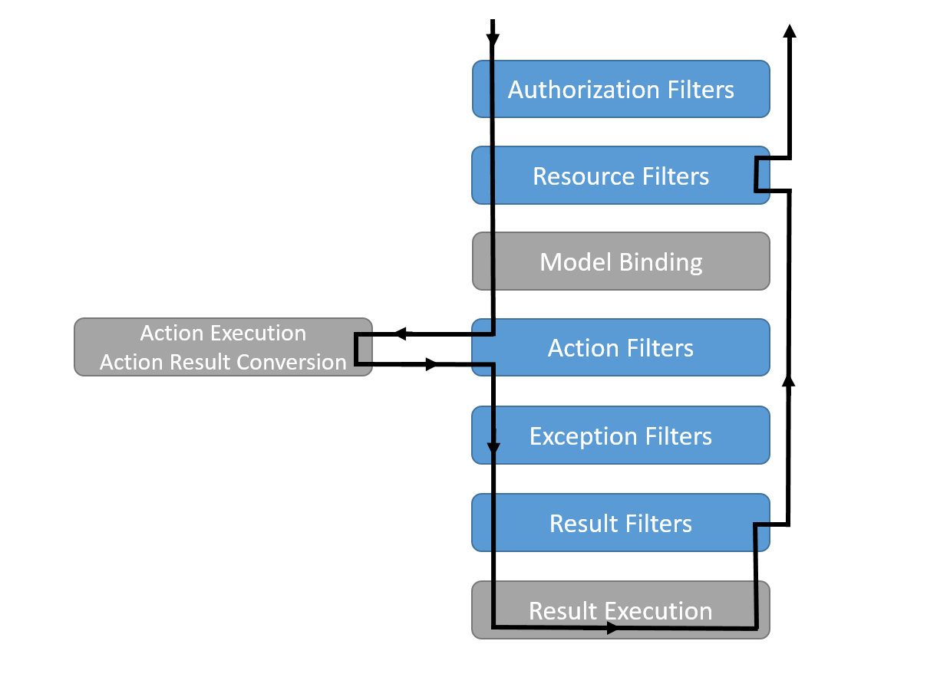
What Are Filters?
Filters in ASP.NET MVC allow you to run code before or after a particular stage in the execution pipeline.
Filters can be configured globally, per-controller, or per-action.
Notes:
MVC filters can cause confusion for students who are familiar with request and response filters in ASP.NET Web Forms applications, which can perform transformation operations of the request and response streams. If you have advanced ASP.NET students in the class, ensure that they are clear about these entirely different kinds of filters.
You will see how to configure authentication and authorization, and how to use the Authorize attribute on controllers and actions, in Module 11.
Question: Which filter type will you use for the following actions?
Intercepting an error
Modifying a result
Authorizing users
Inspecting a returned value
Answer: The following filter types can be used to perform the actions.
Intercepting an error—Exception filters
Modifying a result—Result filters
Authorizing users—Authorizing filters
Inspecting a returned value—Action filters
20486B
04: Developing ASP.NET MVC 4 Controllers

Slide 19
Filter Types
Authorization filters
used to determine whether the current user is authorized for the request being made
Resource filters
the first filter to handle a request after authorization, and the last one to touch the request as it is leaving the filter pipeline
useful to implement caching or otherwise short-circuit the filter pipeline for performance reasons
Action filters
wrap calls to individual action method calls
can manipulate the arguments passed into an action as well as the action result returned from it
Exception filters
used to apply global policies to unhandled exceptions in the MVC app
Result filters
wrap the execution of individual action results
only run when the action method has executed successfully
ideal for logic that must surround view execution or formatter execution

Slide 20
Creating and Using Action Filters
Synchronous Action Filter
using FiltersSample.Helper;
using Microsoft.AspNetCore.Mvc.Filters;
namespace FiltersSample.Filters {
public class SampleActionFilter : IActionFilter {
public void OnActionExecuting(ActionExecutingContext context) {
// do something before the action executes
}
public void OnActionExecuted(ActionExecutedContext context) {
// do something after the action executes
}
}
}
Notes:
Question: What are the advantages of custom action filters?
Answer: Answers will vary. Custom action filters enable you to write code that runs before or after multiple controller actions in a single re-usable class.
20486B
04: Developing ASP.NET MVC 4 Controllers

Slide 21
Creating and Using Action Filters
Asynchronous Action Filter
using System.Threading.Tasks;
using Microsoft.AspNetCore.Mvc.Filters;
namespace FiltersSample.Filters {
public class SampleAsyncActionFilter : IAsyncActionFilter {
public async Task OnActionExecutionAsync(
ActionExecutingContext context, ActionExecutionDelegate next) {
// do something before the action executes
await next();
// do something after the action executes
}
}
}

Slide 22
Filter Attributes
Builtin Base Classes to derive from:
ActionFilterAttribute
ExceptionFilterAttribute
ResultFilterAttribute
FormatFilterAttribute
ServiceFilterAttribute
TypeFilterAttribute

Slide 23
Filter Attributes
using Microsoft.AspNetCore.Mvc.Filters;
namespace FiltersSample.Filters {
public class AddHeaderAttribute : ResultFilterAttribute {
private readonly string _name;
private readonly string _value;
public AddHeaderAttribute(string name, string value) {
_name = name;
_value = value;
}
public override void OnResultExecuting
(ResultExecutingContext context) {
context.HttpContext.Response.Headers.Add(
_name, new string[] { _value });
base.OnResultExecuting(context);
}
}
}

Slide 24
Filter Scopes
Action Scope:
add a particular filter to a particular action as an attribute
Controller Scope:
add a filter to all actions within a controller by applying an attribute at the controller level
Global Scope:
register a filter globally, to be run with every MVC action

Slide 25
Applying Filters
//Controller Scope
[AddHeader("Author", "Steve Smith @ardalis")]
public class SampleController : Controller {
// or Action Scope
// [AddHeader("Author", "Steve Smith @ardalis")]
public IActionResult Index() {
return Content("Examine the headers using developer tools.");
}
}
//Global Scope
public void ConfigureServices(IServiceCollection services) {
services.AddMvc(options => {
options.Filters.Add(typeof(SampleActionFilter)); // by type
options.Filters.Add(new SampleGlobalActionFilter()); // an instance
});
services.AddScoped<AddHeaderFilterWithDi>();
}

Slide 26
Discussion: Action Filter Scenarios
Discuss the following scenarios:
A photo sharing application with discussion amongst friends
Passing correct parameters to the GetImage method
Preventing unauthenticated users from adding comments to a photo
Preventing malicious users from intercepting credentials
Notes:
Lead the class in a discussion of the scenarios. In each case, decide whether filters or custom actions filters are an appropriate solution. Ensure that the students understand the best solution to each scenario, as described below:
You are writing a photo sharing application and you want to enable each user to discuss photos, cameras, lenses, and other photography equipment with other users whom they have marked as their friends. Other users should be prevented from seeing these discussions.
Answer: This is a good example of a scenario in which a custom action filter could work. It is a cross-cutting concern because the same restriction, to friends only, should apply across several model classes. You cannot use the built-in AuthorizeAttribute filter, because friends do not work in the same way as user accounts and group membership. Specifically, users configure their own friends. Group membership is configured by administrators.
You want to ensure that when MVC calls the GetImage action method, the ID in the query string is passed as a parameter.
Answer: This scenario does not require a filter of any kind. You can ensure that the ID value is passed as a parameter by using the default model binder and adding a parameter called ID to the GetImage action method.
You are writing a photo sharing application and you want to prevent unauthenticated users from adding comments to a photo.
Answer: This scenario can be solved by using the built-in AuthorizeAttribute filter. Add this attribute to the Create action (or equivalent) in the CommentController.
You want to prevent malicious users from intercepting the credentials entered by users in the logon form for your web application. You want to ensure that the credentials are encrypted.
Answer: This scenario does not require a filter of any kind. You can encrypt the logon form and the credentials by using the Secure Sockets Layer (SSL) protocol.
SSL will be discussed in Module 12, but it is very likely that some students in the class have already used it because it can be used with any website, and it is not restricted to MVC.
20486B
04: Developing ASP.NET MVC 4 Controllers

Slide 27
Lab: Developing ASP.NET MVC Core Controllers
Exercise 1: Adding an MVC Controller and Writing the Actions Exercise 2: Optional—Writing the Action Filters in a Controller Exercise 3: Using the Photo Controller
Estimated Time: 60 minutes
Notes:
Exercise 1: Adding an MVC Controller and Writing the Actions
In this exercise, you will create the MVC controller that handles photo operations. You will also add the following actions:
Index. This action gets a list of all the Photo objects and passes the list to the Index view for display.
Display. This action takes an ID to find a single Photo object. It passes the Photo to the Display view for display.
Create (GET). This action creates a new Photo object and passes it to the Create view, which displays a form that the visitor can use to upload a photo and describe it.
Create (POST). This action receives a Photo object from the Create view and saves the details to the database.
Delete (GET). This action displays a Photo object and requests confirmation from the user to delete the Photo object.
DeleteConfirmed (POST). This action deletes a Photo object after confirmation.
GetImage: This action returns the photo image from the database as a JPEG file. This method is called by multiple views to display the image.
Exercise 2: Optional—Writing the Action Filters in a Controller
Your development team is new to MVC and is having difficulty in passing the right parameters to controllers and actions. You need to implement a component that displays the controller names, action names, parameter names, and values in the Visual Studio Output window to help with this problem. In this exercise, you will create an action filter for this purpose.
Complete this exercise if time permits.
20486B
04: Developing ASP.NET MVC 4 Controllers
(More notes on the next slide)

Slide 28
Notes:
Exercise 3: Using the Photo Controller
In this exercise, you will:
Create a temporary index and display views by using the scaffold code that is built into the Visual Studio MVC application template.
Use the views to test controllers, actions, and action filters, and run the Photo Sharing application.
Instructor Note: Point out to the students that the views created in this exercise are temporary, and intended only to test the photo controller and associated classes. These views will be removed and replaced with more sophisticated views later in the course.
20486B
04: Developing ASP.NET MVC 4 Controllers

Slide 29
Lab Scenario
You have been asked to add a controller to the photo sharing application that corresponds to the Photo model class that you have created in an earlier module. The controller should include actions that respond when users upload photos, list all photos, display a single photo, and delete photos from the application. You should also add an action that returns the photo as a .jpg file to show on a webpage.
The members of your development team are new to ASP.NET MVC and they find the use of controller actions confusing. Therefore, you need to help them by adding a component that displays action parameters in the Visual Studio Output window whenever an action runs. You will add an action filter to achieve this.
Note: The controllers and views that you have added in Lab 2 were to test your new model classes. They have been removed from the project to create the actual controllers. You will create temporary views to test these controllers at the end of this lab.
Notes:
20486B
04: Developing ASP.NET MVC 4 Controllers

Slide 30
Lab Review
What will happen if you click the Edit or Delete links in the Index view in the Lab? Why did you use the ActionName annotation for the DeleteConfirmed action in the PhotoController class? In the lab, you added two actions with the name, Create. Why is it possible to add these actions without using the ActionName annotation?
Notes:
Question
What will happen if you click the Edit or Delete links in the Index view in the Lab?
Answer
If you click the Edit or Delete links in the Index view in the lab, a 404 error message will appear.
Question
Why did you use the ActionName annotation for the DeleteConfirmed action in the PhotoController class?
Answer
Two methods in the same .NET Framework class cannot have the same name and signature. When you have an action called Delete, you cannot have the method with the same name because the Delete action for the GET verb already exists and has the same ID parameter. To resolve this issue, use a different name to the method, which in this case is DeleteConfirmed, but use the ActionName annotation to ensure it runs when the Delete action is called in an HTTP POST.
Question
In the lab, you added two actions with the name, Create. Why is it possible to add these actions without using the ActionName annotation?
Answer
The two Create methods (one for HTTP GET and one for HTTP POST) have different signatures because the method parameters are different.
20486B
04: Developing ASP.NET MVC 4 Controllers

Slide 31
Module Review and Takeaways
Review Question(s) Best Practice
Notes:
Review Question(s)
Question
You want to ensure that the CreatedDate property of a new Photo object is set to today’s date when the object is created. Should this value be set in the Photo model class constructor method or in the PhotoController Create action method?
Answer
The CreatedDate property should be set in the PhotoController Create action method.
Best Practice: Unless you have a good reason not to, keep to the convention that each controller should be named to match the corresponding model class, with “Controller” appended. For example, for the Photo model class, the controller should be called PhotoController. By maintaining this convention, you create a logically named set of model and controller classes, and can use the default controller factory.
Best Practice: Take great care if you choose to override the built-in AuthorizeAttribute filter because it implements permissions and security for the web application. If you carelessly modify the security infrastructure of the MVC framework, you may introduce vulnerabilities in your application. Instead, use the built-in filter wherever possible.
20486B
04: Developing ASP.NET MVC 4 Controllers

