Slide 1
Module16
Deploying
ASP.NET MVC Core
Web Applications
Notes:
20486B
16: Deploying ASP.NET MVC 4 Web Applications

Slide 2
Module Overview
Publishing to IIS
Publishing to IIS with Web Deploy using Visual Studio
Deploy an ASP​.NET Core web app to Azure using Visual Studio
Publish to a Docker Image
Notes:
20486B
16: Deploying ASP.NET MVC 4 Web Applications

Slide 3
Lesson 1: Publishing to IIS
Supported operating systems
IIS configuration
Install the .NET Core Windows Server Hosting bundle
Application configuration
Deploy the application
Configure the website in IIS
Create a Data Protection Registry Hive
Configuration of sub-application
Configuration of IIS via web.config
Notes:
https://docs.microsoft.com/en-us/aspnet/core/publishing/iis
20486B
16: Deploying ASP.NET MVC 4 Web Applications

Slide 4
Supported Operating Systems
The following operating systems are supported:
Windows 7 and newer
Windows Server 2008 R2 and newer
Notes:
20486B
16: Deploying ASP.NET MVC 4 Web Applications

Slide 5
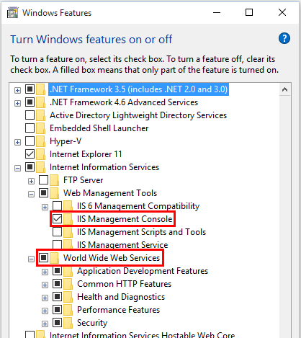
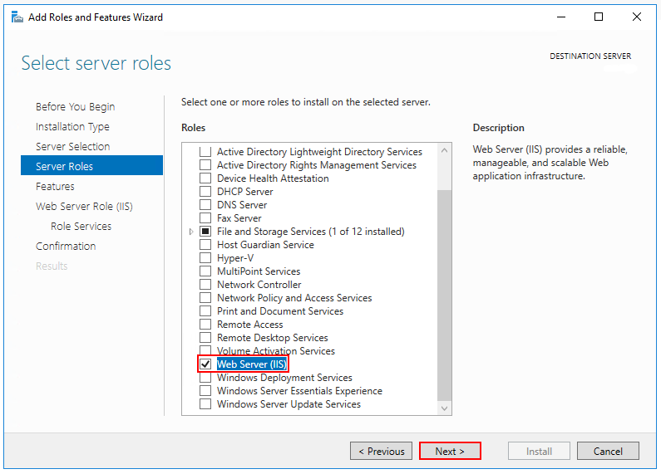
IIS configuration
Enable the Web Server (IIS) server role and establish role services.
Notes:
Windows desktop operating systems
Navigate to Control Panel > Programs > Programs and Features > Turn Windows features on or off (left side of the screen). Open the group for Internet Information Services and Web Management Tools. Check the box for IIS Management Console. Check the box for World Wide Web Services. Accept the default features for World Wide Web Services or customize the IIS features to suit your needs.
IIS Management Console and World Wide Web Services are selected in Windows Features.
Windows Server operating systems
For server operating systems, use the Add Roles and Features wizard via the Manage menu or the link in Server Manager. On the Server Roles step, check the box for Web Server (IIS).
The Web Server IIS role is selected in the Select server roles step.
On the Role services step, select the IIS role services you desire or accept the default role services provided.
The default role services are selected in the Select role services step.
Proceed through the Confirmation step to install the web server role and services. A server/IIS restart is not required after installing the Web Server (IIS) role.
20486B
16: Deploying ASP.NET MVC 4 Web Applications

Slide 6
Install the .NET Core Windows Server Hosting bundle
Install the .NET Core Windows Server Hosting bundle on the server.
The bundle will install
.NET Core Runtime
.NET Core Library
ASP.NET Core Module
The module creates the reverse-proxy between IIS and the Kestrel server
Restart the server or execute from a command prompt
net stop was /y
net start w3svc
Notes:
Question: What is the purpose of configuring the machineKey element in the Web.config file?
Answer: Configuring the machineKey element ensures that the same key is used for encrypting and decrypting content stored in the session state or configuration file.
20486B
16: Deploying ASP.NET MVC 4 Web Applications

Slide 7
Application Configuration (1/3)
Include a dependency on the Microsoft.AspNetCore.Server.IISIntegration Incorporate IIS Integration middleware into the application by adding the .UseIISIntegration() extension method to WebHostBuilder()
var host = new WebHostBuilder()
.UseKestrel()
.UseContentRoot(Directory.GetCurrentDirectory())
.UseIISIntegration()
.UseStartup<Startup>()
.Build();
Notes:
Enabling the IISIntegration components
Include a dependency on the Microsoft.AspNetCore.Server.IISIntegration package in the application dependencies. Incorporate IIS Integration middleware into the application by adding the .UseIISIntegration() extension method to WebHostBuilder().
Copy
C#
var host = new WebHostBuilder()
.UseKestrel()
.UseContentRoot(Directory.GetCurrentDirectory())
.UseIISIntegration()
.UseStartup<Startup>()
.Build();
Note that code calling .UseIISIntegration() does not affect code portability.
Setting IISOptions for the IISIntegration service
To configure IISIntegration service options, include a service configuration for IISOptions in ConfigureServices.
Copy
C#
services.Configure<IISOptions>(options => {
...
});
Option Setting
AutomaticAuthentication If true, the authentication middleware will alter the request user arriving and respond to generic challenges. If false,the authentication middleware will only provide identity and respond to challenges when explicitly indicated by theAuthenticationScheme
ForwardClientCertificate If true and the MS-ASPNETCORE-CLIENTCERT request header is present, the ITLSConnectionFeature will be populated.
ForwardWindowsAuthentication If true, authentication middleware will attempt to authenticate using platform handler windows authentication. If false, authentication middleware won’t be added.
publish-iis tool
The publish-iis tool can be added to any .NET Core application and will configure the ASP.NET Core Module by creating or modifying the web.config file. The tool runs after publishing with the dotnet publish command or publishing with Visual Studio and will configure the processPath and arguments for you. If you're publishing a web.config file by including the file in your project and listing the file in the publishOptions section of project.json, the tool will not modify other IIS settings you have included in the file.
To include the publish-iis tool in your application, add entries to the tools and scripts sections of project.json.
Copy
none
"tools": {
"Microsoft.AspNetCore.Server.IISIntegration.Tools": "1.1.0-preview4-final"
},
"scripts": {
"postpublish": "dotnet publish-iis --publish-folder %publish:OutputPath% --framework %publish:FullTargetFramework%"
}
20486B
16: Deploying ASP.NET MVC 4 Web Applications

Slide 8
Application Configuration (2/3)
To configure IISIntegration service options, include a service configuration for IISOptions in ConfigureServices.
services.Configure<IISOptions>(options => { ... });
Option | Setting
AutomaticAuthentication | If true, the authentication middleware will alter the request user arriving and respond to generic challenges. If false,the authentication middleware will only provide identity and respond to challenges when explicitly indicated by theAuthenticationScheme
ForwardClientCertificate | If true and the MS-ASPNETCORE-CLIENTCERTrequest header is present, the ITLSConnectionFeature will be populated.
ForwardWindowsAuthentication | If true, authentication middleware will attempt to authenticate using platform handler windows authentication. If false, authentication middleware won’t be added.

Slide 9
Application Configuration (3/3)
publish-iis tool
creates or modifies the web.config file
runs after publishing with the dotnet publish command or publishing with Visual Studio
configures processPath and arguments
To include the publish-iis tool, add entries to the tools and scripts sections of project.json
"tools": {
"Microsoft.AspNetCore.Server.IISIntegration.Tools": "1.1.0-preview4-final"
},
"scripts": {
"postpublish": "dotnet publish-iis --publish-folder %publish:OutputPath% --framework %publish:FullTargetFramework%"
}

Slide 10
Deploy the Application
On the target IIS server, create a folder
Within the folder, optionally create a logs folder
Deploy the application to the folder using
MSDeploy (Web Deploy)
Xcopy
Robocopy
PowerShell
Visual Studio web publish script

Slide 11
Configure the website in IIS
In IIS Manager, create a new website
Provide a Site name
Set the Physical path to the application's deployment folder
Provide the Binding configuration
Create the website
Set the application pool to No Managed Code
ASP.NET Core runs in a separate process and manages the runtime

Slide 12
Create a Data Protection Registry Hive
For standalone IIS installations
Use the Data Protection Provision-AutoGenKeys.ps1 PowerShell script for each application pool
Keys will be persisted in the registry
In web farm scenarios
An application can be configured to use a UNC path to store its data protection key ring.
By default, the data protection keys are not encrypted
You can deploy an x509 certificate to each machine to encrypt the key ring

Slide 13
Configuration of sub-applications
Root application web.config file should include the <handlers> section
Applications added to the root application shouldn't include the <handlers> section
<handlers> section in a sub-application's web.config file generates a 500.19 (Internal Server Error) referencing the faulty config file

Slide 14
Configuration of IIS via web.config
IIS configuration is still influenced by the <system.webServer> section of web.config for those IIS features that apply to a reverse proxy configuration

Slide 15
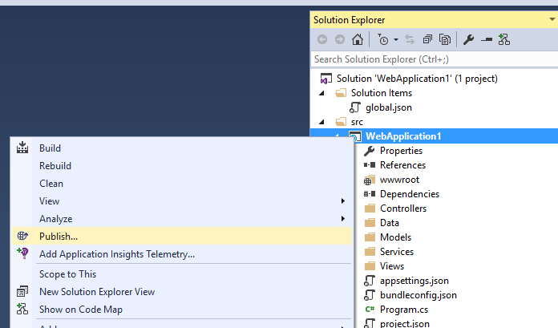
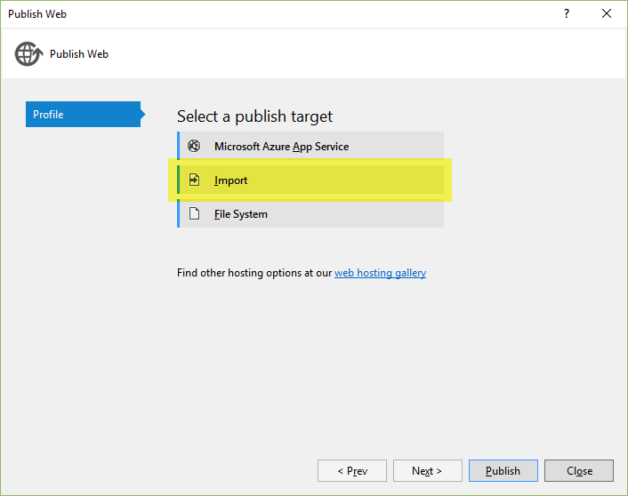
Lesson 2: Publishing to IIS with Web Deploy using Visual Studio
Create a publish profile in Visual Studio
If hosting provider supports publish profile, download and import it into Visual Studio
Notes:
https://docs.microsoft.com/en-us/aspnet/core/publishing/iis-with-msdeploy
20486B
16: Deploying ASP.NET MVC 4 Web Applications

Slide 16
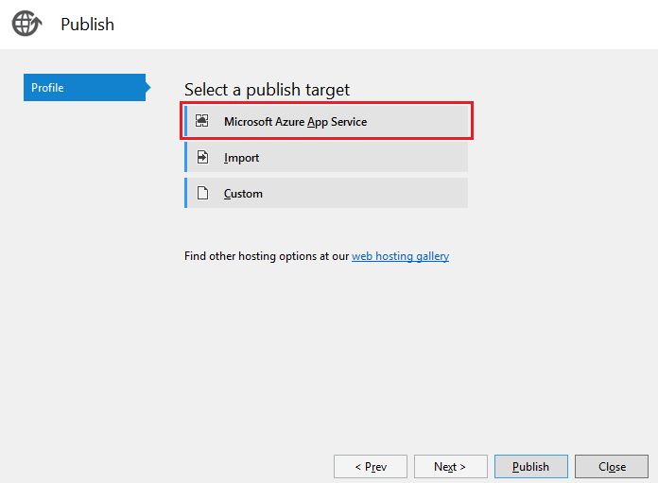
Lesson 3: Deploy an ASP.NET Core web app to Azure using Visual Studio
Right-click on the project in Solution Explorer
select Publish
tap Microsoft Azure App Service
Notes:
https://docs.microsoft.com/en-us/aspnet/core/tutorials/publish-to-azure-webapp-using-vs

Slide 17
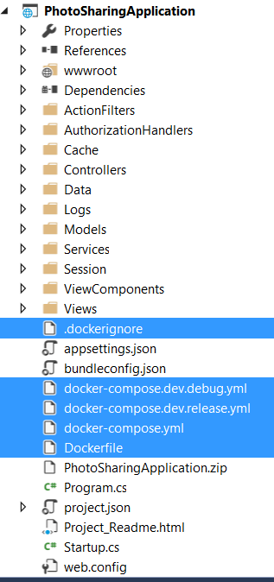
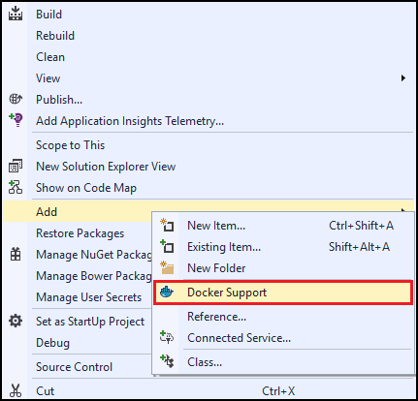

Lesson 4: Publish to a Docker Image
Install Visual Studio Tools for Docker
Add Docker support
Notes:
https://docs.microsoft.com/en-us/azure/vs-azure-tools-docker-hosting-web-apps-in-docker

Slide 18
Demonstration: How to Deploy a Website to Windows Azure
In this demonstration, you will see how to:
Obtain a publish profile for a website from Windows Azure
Use the Publish wizard in Visual Studio to publish a website
Notes:
Preparation Steps
Log on to the virtual machine, 20486B-SEA-DEV11, with the user name, admin, and the password, Pa$$w0rd.
Start File Explorer.
Navigate to Allfiles (D):\Democode\Mod16\OperasWebSite.
Open the OperasWebSite.sln project.
In the Solution Explorer pane, under OperasWebSite\App_Data, delete the aspnetdb.mdf file. Also, delete the aspnetdb_log.ldf file, if present.
Enable the Allow NuGet to download missing packages during build option, by performing the following steps:
On the TOOLS menu of the Microsoft Visual Studio window, click Options.
In the navigation pane of the Options dialog box, click Package Manager.
Under the Package Restore section, select the Allow NuGet to download missing packages during build checkbox, and then click OK.
Note: In Hyper-V Manager, start the MSL-TMG1 virtual machine if it is not already running.
Demonstration Steps
On the taskbar, click the Internet Explorer icon.
In the Address bar of the Internet Explorer window, type http://www.windowsazure.com, and then click the Go to button.
In the upper-right corner of the Windows Azure: Microsoft’s Cloud Platform | Cloud Hosting | Cloud Services page, click PORTAL.
On the Sign in to your Microsoft account page, in the Microsoft account box, type <your username>, in the Password box, type Pa$$w0rd, and then click Sign in.
20486B
16: Deploying ASP.NET MVC 4 Web Applications
(More notes on the next slide)

Slide 19
Notes:
5. In the left pane of the Windows Azure page, click WEB SITES.
6. In the NAME column of the Web Sites – Windows Azure page, click <your username>operas.
7. On the Web Sites – Windows Azure page, click DASHBOARD.
Note: If the quick start page appears, repeat the steps 5 and 6 before proceeding to the next step.
8. In the quick glance section of the Web Sites – Windows Azure page, click the Download publish profile link.
9. In the Navigation bar, click Save, and then click the Close button.
10. On the taskbar, click the Microsoft Visual Studio icon.
11. In the Solution Explorer pane of the OperasWebSite - Microsoft Visual Studio window, right-click OperasWebSite, and then click Publish.
12.On the Profile page of the Publish Web wizard, click Import.
13. In the Import Publish Settings dialog box, click <your username>operas.azurewebsites.net.PublishSettings, and then click Open.
14. On the Connection page of the Publish Web wizard, click Validate Connection.
15. If the Certificate Error dialog box appears, click Accept.
16. On the Connection page, click Next.
17. On the Settings page, click Next.
18. On the Preview page, click Start Preview.
19. On the Preview page, click Publish.
Note: Visual Studio publishes the website. This process can take several minutes. When the publish operation is complete, the website is displayed in the Internet Explorer window.
(More notes on the next slide)
20486B
16: Deploying ASP.NET MVC 4 Web Applications

Slide 20
Notes:
20. If the Certificate Error dialog box appears, click Accept.
21. In the Internet Explorer window, if the Server Error in ‘/’ Application error is displayed, click the Refresh button.
Note: If the Operas I Have Seen page does not appear, you need to re-publish the OperasWebSite project.
22. On the Operas I Have Seen page, click All Operas.
23. In the Navigation bar, if the message Intranet settings are turned off by default. is displayed, click Turn on Intranet settings.
24. If the message Are you sure you want to turn on intranet-level security settings? appears, click Yes.
25. On the Index of Operas page, click the Details link corresponding to Cosi Fan Tutte.
26. On the Opera: Cosi Fan Tutte page, click the Back to List link.
27. On the Index of Operas page, click the Details link corresponding to Nixon in China.
28. In the Internet Explorer window, click the Close button.
29. In the OperasWebSite - Microsoft Visual Studio window, click the Close button.
(More notes on the next slide)
20486B
16: Deploying ASP.NET MVC 4 Web Applications

Slide 21
Lab: Deploying ASP.NET MVC Core Web Applications
Exercise 1: Deploying a Web Application to Windows Azure Exercise 2: Testing the Completed Application
Estimated Time: 45 minutes
Notes:
The starter and solution lab files for this module do not include connection strings for the students' ASP.NET services database in Windows Azure SQL Database. This does not affect the functionality implemented and tested in this lab. However, if students try to log on to the Photo Sharing application to add new photos when testing the site, ASP.NET will throw an exception. To resolve this error, students can copy the Web.config file from their completed Lab 11 starter project to their Lab 16 starter project. Alternatively, they can obtain the connection string from the database properties in the Windows Azure portal, as they did in Lab 11.
Exercise 1: Deploying a Web Application to Windows Azure
In this exercise, you will:
Reconfigure the Photo Sharing application for release deployment.
Configure the Entity Framework initializer class, which fills the database with initial data, and ensure that the build configuration and connection strings are correct.
Create a new web application in Windows Azure and deploy the Photo Sharing application to the new site.
Exercise 2: Testing the Completed Application
You have completed and fully deployed the Photo Sharing web application in Windows Azure. Now, you want to perform some final functionality tests before you confirm the completion of the application to your manager.
Instructor Note: The Photo Sharing application that is deployed in each student's Windows Azure website is accessible from any Internet-connected browser. If time permits, encourage students to test each other’s deployments. They can also access the deployed application from laptops, smart phones, and tablets.
20486B
16: Deploying ASP.NET MVC 4 Web Applications

Slide 22
Lab Scenario
You have completed the development and testing of the photo sharing application. Your managers and senior developers have signed off the project, and have requested you to deploy the application to the Adventure Works Windows Azure account.
Notes:
20486B
16: Deploying ASP.NET MVC 4 Web Applications

Slide 23
Lab Review
Why is it unnecessary to use bin deployment in this lab? In the labs for this course, you used the same Windows Azure SQL Database for both development and production. If you wanted to use separate databases for development and production, but did not want to reconfigure the web application every time you deployed to the development and production web servers, how would you configure the web application?
Notes:
Question
Why is it unnecessary to use bin deployment in this lab?
Answer
It is unnecessary to use bin deployment because all the pre-requisites for the Photo Sharing web application are already in place on Windows Azure servers.
Question
In the labs for this course, you used the same Windows Azure SQL Database for both development and production. If you wanted to use separate databases for development and production, but did not want to reconfigure the web application every time you deployed to the development and production web servers, how would you configure the web application?
Answer
Use separate Web.config variance files for development and production deployments.
20486B
16: Deploying ASP.NET MVC 4 Web Applications

Slide 24
Module Review and Takeaways
Review Question(s)
Notes:
Review Question(s)
Question
You need to create two packages for deployment-for testing and for production environment. This is because of the difference in server name and other environment settings. What should you do?
Answer
You should consider having different Web.config files configured in your project and you need to use the publish feature to create the deployment package in different environment.
20486B
16: Deploying ASP.NET MVC 4 Web Applications

Slide 25



Course Evaluation
Notes:
Remind students to complete the course evaluation.

