Slide 1
Module 4
Developing Pages
Notes:
At this point in the course, students will not have a complete understanding of views and models. Lack of this knowledge might cause confusion because in a complete Model-View-Controller (MVC) application, controllers, views, and models are tightly integrated. Therefore, to ensure that the students understand how to develop controllers, consider including a discussion on views and models as you describe controllers. However, try not to get into the details because views are covered in detail in Module 5, “Developing Views”, and models are covered in Module 6, “Developing Models”.
20486D
04: Developing Controllers

Slide 2
Module Overview
Razor Pages
Razor Page Handlers Configuring Routes
Notes:
The first lesson introduces controllers and actions. After completing the first lesson, the students might not fully understand why a given request is handled by a particular action. The second lesson helps explain the relationship by teaching them about routes and how they map requests to actions. The third lesson introduces action filters. Before proceeding to this lesson, it is important to ensure that the students have a complete understanding of the concepts covered in the first two lessons.
20486D
04: Developing Controllers

Slide 3
Lesson 1: Razor Pages
Responding to User Requests Writing Page Handlers Using Parameters Using ViewBag and ViewData to Pass Information to Pages Demonstration: How to Write Pages and Handlers
Notes:
This lesson is very important. Ensure that students have a complete understanding of controllers and actions and how they handle user requests.
20486D
04: Developing Controllers

Slide 4
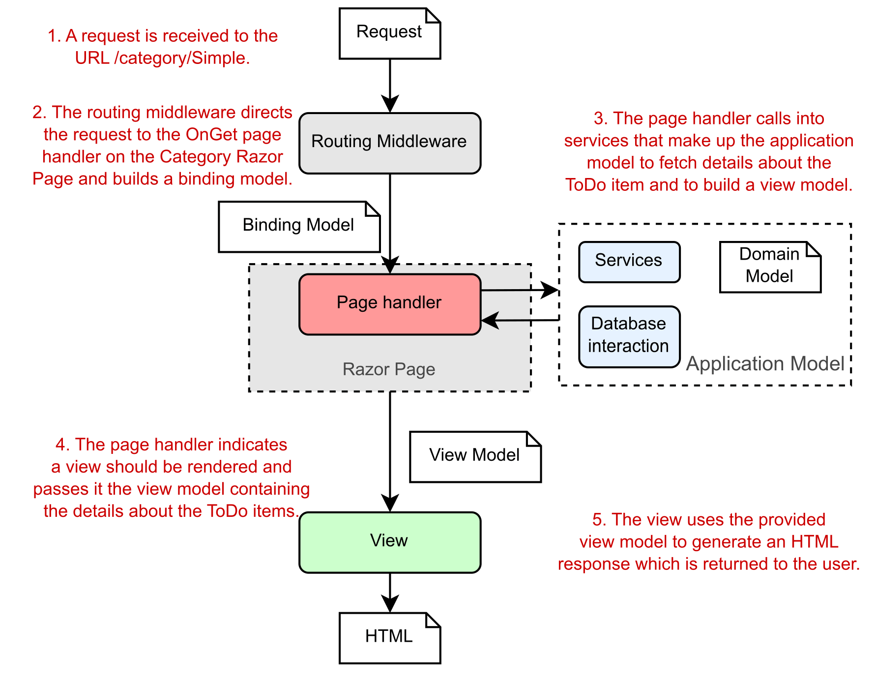
Responding to User Requests
https://andrewlock.net/aspnetcore-in-action-2e-applying-the-mvc-design-pattern-to-razor-pages/
Notes:
https://andrewlock.net/aspnetcore-in-action-2e-applying-the-mvc-design-pattern-to-razor-pages/
20486D
04: Developing Controllers

Slide 5
Razor Pages
Combination of two files
PageModel file: C# file ending in .cshtml.cs Class inheriting from PageModel containing handlers with server side logic
Content Page: Razor file ending with .cshtml. Contains a mixture of client-side and server-side code, which, when processed, results in HTML being sent to the browser
Notes:
https://www.learnrazorpages.com/razor-pages

Slide 6
Razor Page Handlers
Methods automatically executed as a result of a request
Naming convention used to select the appropriate handler method to execute
HTTP verb used for the request prefixed with "On": OnGet(), OnPost(), OnPut() etc.
Optional asynchronous equivalents: OnPostAsync(), OnGetAsync() etc.
Must be public
Can have any return type
Typically void (or Task if asynchronous) or ActionResult.
Notes:
https://www.learnrazorpages.com/razor-pages/handler-methods
20486D
04: Developing Controllers

Slide 7
Razor Pages
//index.cshtml
@page
<h3>@Message</h3>
<form method="post"><button class="btn btn-default">Click to post</button></form>
<p><a href="/" class="btn btn-default">Click to Get</a></p>
//Index.cshtml.cs
public class IndexModel : PageModel {
public string Message { get; set; }
public void OnGet() {
Message = "Get used";
}
public void OnPost() {
Message = "Post used";
}
}

Slide 8
Named Handlers
Specify multiple methods that can be executed for a single verb.
The name of the handler is added to the form's action as a query string parameter
public void OnPost() {
Message = "Form Posted";
}
public void OnPostDelete() {
Message = "Delete handler fired";
}
public void OnPostEdit(int id) {
Message = "Edit handler fired";
}
public void OnPostView(int id) {
Message = "View handler fired";
}
<form method="post">
<button>Submit</button>
<button asp-page-handler="edit" >Edit</button>
<button asp-page-handler=“delete" >Delete</button>
<button asp-page-handler=“view" >View</button>
</form>

Slide 9
Parameters in Handlers Methods
Handlers can accept parameters
public void OnPost (int id) {
Message = $“Post handler fired for {id}";
}
In a POST handler, the parameter name must match a form field name for the incoming value to be automatically bound to the parameter:
<form method="post">
<button>Submit</button>
<input type="hidden" name="id" value="3" />
</form>

Slide 10
Action Result Types
Handlers can return different types of results:
PageResult
ContentResult
NotFoundResult
RedirectToPageResult
BadRequestResult
StatusCodeResult
Notes:
https://www.learnrazorpages.com/razor-pages/action-results
20486D
04: Developing Controllers

Slide 11
Using Parameters
The model binders obtain parameters from a user request and pass them to handlers
There are several ways to retrieve parameters, including:
The Request property
The FormCollection object
Routing
Notes:
The model binders locate parameters in a posted form, routing values, a query string, or posted files. When they find a parameter in the action method that matches the name and type of a parameter from the request, the action method is called and the parameter is passed from the request.
20486D
04: Developing Controllers

Slide 12
Demonstration: How to Write Razor Pages and Handlers
In this demonstration, you will learn how to:
Add a Razor Page to an ASP.NET Web application
Add a handler that creates a model and passes it to a Page
Add another handler that gets a parameter
Notes:
This demonstration shows the students how to write actions and controllers. The application also includes routing and a view. Note that the starter solution for this demo is not based on a vanilla template because it was prepared specifically for this demo. Inform the students that they will learn about routing in Lesson 2 of Module 4, “Configuring Routes”, and views in Module 5, “Developing Views”.
Demonstration Steps
You will find the steps in the section “Demonstration: How to Write Controllers and Actions“ on the following page: https://github.com/MicrosoftLearning/20486D-DevelopingASPNETMVCWebApplications/blob/master/Instructions/20486D_MOD04_DEMO.md#demonstration-how-to-write-controllers-and-actions.
20486D
04: Developing Controllers

Slide 13
Lesson 2: Configuring Routes
The ASP.NET Core Routing Engine Discussion: Why Add Routes? What Is Search Engine Optimization? Configuring Routes by Using Convention-Based Routing Using Routes to Pass Parameters Configuring Routes by Using Attributes Demonstration: How to Add Routes
Notes:
https://www.learnrazorpages.com/razor-pages/routing
20486D
04: Developing Controllers

Slide 14
URL Matching
Virtual path of content page, removing root folder name and file extension.
/Pages/Privacy.cshtml -> yourdomain.com/privacy
/Pages/Error.cshtml -> yourdomain.com/error
/Pages/OneFolder/OnePage.cshtml -> yourdomain.com/OneFolder/OnePage
Index.cshtml is considered the default document.
It has two routes defined
file name without the extension -> yourdomain.com/index
empty string -> yourdomain.com

Slide 15
Passing Parameters to Pages
Supply value as a query string value
www.myblog.com/post?title=my-latest-post
Supply Value as Form Input Field
<input type=“hidden” name=“title” value=“my-latest-post”>
Supply value as Route Data
www.myblog.com/post/my-latest-post

Slide 16
Route Data
Segment in the URL
Plays no part in matching files on disk
Parameter - arbitrary piece of data passed in the URL
More readable
More search engine-friendly

Slide 17
Route Templates
Route Data parameters are defined in a Route Template as part of the @page directive in the .cshtml file.
@page "{title}"
make the parameter optional by adding a ? after it:
@page "{title?}"
provide a default value for the parameter
@page "{title=first post}"

Slide 18
Route Data Constraints
Constrain route parameters values by data type and range
@page "{id:int}"
@page "{id:min(10000)}"
@page "{username:alpha:minlength(5):maxlength(8)}"

Slide 19
Accessing Route Data Values
RouteData.Values property
@RouteData.Values["title"]
Add a parameter to a handler
public void OnGet(string title)

Slide 20
Lab: Developing Pages
Exercise 1: Adding Pages and Handlers to a Web Application Exercise 2: Configuring Routes
Estimated Time: 30 minutes
Notes:
Note that the starter solution for this lab is not based on a vanilla template because it was prepared specifically for this lab. The starter solution already contains models and views that won’t be changed during the lab. Additionally, the starter solution contains images and cascading style sheets (CSS). Models is covered in Module 6, “Developing Models”, Views is covered in Module 5, “Developing Views” and CSS is covered in Module 8, “Using Layouts, CSS and JavaScript in ASP.NET Core MVC”.
You will find the high-level steps on the following page: https://github.com/MicrosoftLearning/20486D-DevelopingASPNETMVCWebApplications/blob/master/Instructions/20486D_MOD04_LAB_MANUAL.md.
You will find the detailed steps on the following page: https://github.com/MicrosoftLearning/20486D-DevelopingASPNETMVCWebApplications/blob/master/Instructions/20486D_MOD04_LAK.md.
Exercise 1: Adding Controllers and Actions to an MVC Application
In this exercise, you will create the MVC controller that handles user operations. You will also add the following actions:
Index. This action displays the Index view.
Display. This action takes an ID to find a single City object. It passes the City object to the Display view.
GetImage. This action returns the photo image from the service as a .jpg file.
The main tasks for this exercise are as follows:
Add controllers to an MVC application
Add actions to a controller
Change actions to get a parameter
Change an action to redirect to another action in another controller
20486D
04: Developing Controllers
(More notes on the next slide)

