Slide 1
Module 9
Integrating Blazor Components in ASP.NET Core
Notes:
This module and Module 9, “Client-Side Development”, cover key client-side technologies that are used in many web applications. These modules cover how the Blazor WebAssembly client-side technology can be used in Microsoft ASP.NET Core applications.
20486D
08: Using Layouts, CSS and JavaScript in ASP.NET Core MVC

Slide 2
Module Overview
Introduction to Blazor Blazor Components
Blazor Integration and Prerendering
Notes:
20486D
08: Using Layouts, CSS and JavaScript in ASP.NET Core MVC

Slide 3
Lesson 1: Introduction to Blazor
What Is Blazor?
Blazor Hosting Models
Notes:
Lesson 1 introduces Layouts. To better understand the material in Lesson 2, “Using CSS and JavaScript”, it is important that the students have a complete understanding of the content of Lesson 1. Therefore, ensure that the students understand the material in the first lesson before moving to the next lesson.
20486D
08: Using Layouts, CSS and JavaScript in ASP.NET Core MVC

Slide 4
What is Blazor?
Feature of ASP.NET
Framework to build interactive web UIs using C# instead of JavaScript
Composed of reusable web UI components implemented using C#, HTML, and CSS
.NET running on WebAssembly
Notes:
When you have multiple pages in your web application and you want to apply a consistent style to the pages, you can use layouts. Using layouts, you can add company logos and menus to multiple pages in your web application.
20486D
08: Using Layouts, CSS and JavaScript in ASP.NET Core MVC

Slide 5
Blazor Hosting Model
Blazor Server
Blazor WebAssembly
Notes:
You can describe the functionality of the RenderBody method and explain its importance in the layout. You can also describe the benefits of using the ViewBag property and describe how to use it to pass information between a layout and view files.
20486D
08: Using Layouts, CSS and JavaScript in ASP.NET Core MVC

Slide 6
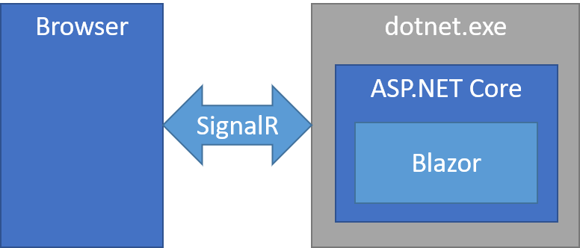
Blazor Server
App executed on the server from within an ASP.NET Core app
UI updates, event handling, and JavaScript calls handled over SignalR connection
Notes:
https://docs.microsoft.com/en-us/aspnet/core/blazor/hosting-models?view=aspnetcore-6.0#blazor-server
20486D
08: Using Layouts, CSS and JavaScript in ASP.NET Core MVC

Slide 7
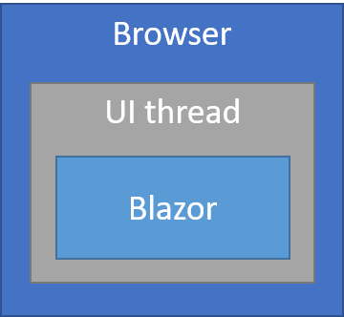
Blazor WebAssembly
App runs client-side in browser on WebAssembly-based .NET runtime
The Blazor app, its dependencies, and.NET runtime downloaded to browser
App executed directly on browser UI thread
UI updates and event handling occur within same process
Standalone: app created for deployment without a backend
Hosted: app is created for deployment with a backend app to serve its files
Notes:
https://docs.microsoft.com/en-us/aspnet/core/blazor/hosting-models?view=aspnetcore-6.0#blazor-webassembly
20486D
08: Using Layouts, CSS and JavaScript in ASP.NET Core MVC

Slide 8
Lesson 2: Blazor Components
Blazor Components Introduction
Names
Markup
Namespaces
Lifecycle
Component Parameters
Event Handling
Data Binding
Forms And Validation
Notes:
https://docs.microsoft.com/en-us/aspnet/core/blazor/components/?view=aspnetcore-6.0
https://docs.microsoft.com/en-us/aspnet/core/blazor/components/lifecycle?view=aspnetcore-6.0
https://docs.microsoft.com/en-us/aspnet/core/blazor/components/data-binding?view=aspnetcore-6.0
https://docs.microsoft.com/en-us/aspnet/core/blazor/forms-validation?view=aspnetcore-6.0

Slide 9
Blazor Components Introduction
Blazor apps are based on components
A component in Blazor is an element of UI, such as a page, dialog, or data entry form
Components are .NET C# classes built into .NET assemblies that:
Define flexible UI rendering logic
Handle user events
Can be nested and reused
Can be shared and distributed as Razor class libraries or NuGet packages
The component class is usually written in the form of a Razor markup page with a .razor file extension
Components in Blazor are formally referred to as Razor components.
Unlike Razor Pages and MVC, which are built around a request/response model, components are used specifically for client-side UI logic and composition
Notes:
https://docs.microsoft.com/en-us/aspnet/core/blazor/components/?view=aspnetcore-6.0
20486D
08: Using Layouts, CSS and JavaScript in ASP.NET Core MVC

Slide 10
Names
A component's name must start with an uppercase character:
ProductDetail.razor is valid
productDetail.razor is invalid
Common Blazor naming conventions use Pascal case (upper camel case)
No spaces
No punctuation
First letter of each word capitalized, including the first word
Notes:
https://docs.microsoft.com/en-us/aspnet/core/blazor/components/?view=aspnetcore-6.0#names
20486D
08: Using Layouts, CSS and JavaScript in ASP.NET Core MVC

Slide 11
Markup
UI defined using Razor syntax
HTML markup and C# rendering logic converted into a component class when compiled
Members of component class defined in one or more @code blocks
Property and field initializers
Parameter values from arguments passed by parent components and route parameters
Methods for user event handling, lifecycle events, and custom component logic
<h1 style="font-style:@headingFontStyle">@headingText</h1>
@code {
private string headingFontStyle = "italic";
private string headingText = "Put on your new Blazor!";
}
Notes:
https://docs.microsoft.com/en-us/aspnet/core/blazor/components/?view=aspnetcore-6.0#markup
20486D
08: Using Layouts, CSS and JavaScript in ASP.NET Core MVC

Slide 12
Namespaces
Derived from the app's root namespace and the component's location (folder) within the app.
If the app's root namespace is BlazorSample and the Counter component resides in the Pages folder:
The Counter component's namespace is BlazorSample.Pages.
The fully qualified type name of the component is BlazorSample.Pages.Counter.
Add an @using directive to the parent component or to the app's _Imports.razor file.
Components can also be referenced using their fully qualified names, which doesn't require an @using directive.
Notes:
https://docs.microsoft.com/en-us/aspnet/core/blazor/components/?view=aspnetcore-6.0#namespaces
20486D
08: Using Layouts, CSS and JavaScript in ASP.NET Core MVC

Slide 13
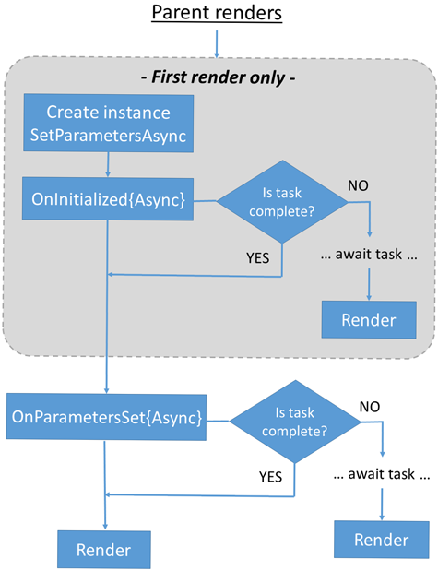
Lifecycle
The Razor component processes Razor component lifecycle events in a set of synchronous and asynchronous lifecycle methods.
The lifecycle methods can be overridden to perform additional operations in components during component initialization and rendering.
Notes:
https://docs.microsoft.com/en-us/aspnet/core/razor-pages/?view=aspnetcore-6.0&tabs=visual-studio#css-isolation

Slide 14
Component Parameters
Component parameters pass data to components and are defined using public C# properties on the component class with the [Parameter] attribute.
<div class="card w-25" style="margin-bottom:15px">
<div class="card-header font-weight-bold">@Title</div>
<div class="card-body" style="font-style:@Body.Style"> @Body.Text </div>
</div>
@code {
[Parameter]
public string Title { get; set; } = "Set By Child";
[Parameter]
public PanelBody Body { get; set; } = new() {
Text = "Set by child.",
Style = "normal"
};
}
Notes:
https://docs.microsoft.com/en-us/aspnet/core/blazor/components/?view=aspnetcore-6.0#component-parameters
20486D
08: Using Layouts, CSS and JavaScript in ASP.NET Core MVC

Slide 15
Event Handling
Specify delegate event handlers in Razor component markup with @on{DOM EVENT}="{DELEGATE}"
The {DOM EVENT} placeholder is a Document Object Model (DOM) event (for example, click)
The {DELEGATE} placeholder is the C# delegate event handler
For event handling
Asynchronous delegate event handlers that return a Task are supported
Delegate event handlers automatically trigger a UI render
Exceptions are logged
<h1>@currentHeading</h1> <button @onclick="UpdateHeading"> Update heading </button>
@code {
private string currentHeading = "Initial heading";
private void UpdateHeading() { currentHeading = $“New Heading"; }
}
Notes:
https://docs.microsoft.com/en-us/aspnet/core/blazor/components/event-handling?view=aspnetcore-6.0
20486D
08: Using Layouts, CSS and JavaScript in ASP.NET Core MVC

Slide 16
Data Binding
Razor components provide data binding features with the @bind Razor directive attribute with a field, property, or Razor expression value
<p> <input @bind="InputValue" /> @InputValue </p>
@code {
private string? InputValue { get; set; }
}
Component parameters permit binding properties of a parent component with @bind-{PROPERTY} where the {PROPERTY} placeholder is the property to bind
Notes:
https://docs.microsoft.com/en-us/aspnet/core/blazor/components/data-binding?view=aspnetcore-6.0

Slide 17
Forms And Validation
A form is defined using the Blazor framework's EditForm component
<EditForm Model="@exampleModel" OnValidSubmit="@HandleValidSubmit">
<DataAnnotationsValidator />
<ValidationSummary />
<InputText id="name" @bind-Value="exampleModel.Name" />
<button type="submit">Submit</button>
</EditForm>
@code {
private ExampleModel exampleModel = new();
private void HandleValidSubmit() {
// Process the valid form
}
}
Notes:
https://docs.microsoft.com/en-us/aspnet/core/blazor/forms-validation?view=aspnetcore-6.0
20486D
08: Using Layouts, CSS and JavaScript in ASP.NET Core MVC

Slide 18
Lesson 3: Component Integration
Introduction
Configuration
Component Tag Helper
Notes:
https://docs.microsoft.com/en-us/aspnet/core/blazor/components/prerendering-and-integration?view=aspnetcore-6.0&pivots=webassembly
20486D
08: Using Layouts, CSS and JavaScript in ASP.NET Core MVC

Slide 19
Introduction
Razor components can be integrated into Razor Pages and MVC apps in a hosted Blazor WebAssembly solution or in a Blazor Server App.
When the page or view is rendered, components can be prerendered at the same time.
Notes:
https://docs.microsoft.com/en-us/aspnet/core/blazor/components/prerendering-and-integration?view=aspnetcore-6.0&pivots=webassembly
20486D
08: Using Layouts, CSS and JavaScript in ASP.NET Core MVC

Slide 20
Configuration (1/2)
Host the Blazor WebAssembly app in an ASP.NET Core app
In the Blazor WebAssembly client application
Delete the wwwroot/index.html and wwwroot.favicon.ico files
Delete the following lines in Program.cs:
builder.RootComponents.Add<App>("#app");
builder.RootComponents.Add<HeadOutlet>("head::after");
Notes:
https://docs.microsoft.com/en-us/aspnet/core/blazor/components/prerendering-and-integration?view=aspnetcore-6.0&pivots=webassembly#solution-configuration
20486D
08: Using Layouts, CSS and JavaScript in ASP.NET Core MVC
(More notes on the next slide)

Slide 21
Configuration (2/2)
In the Hosting ASP.NET Web application Server Side
Add the Package Microsoft.AspNetCore.Components.WebAssembly.Server
Add a Project Reference to the Blazor WebAssembly project.
In program.cs, between app.UseHttpsRedirection(); and app.UseStaticFiles(); add the following:
app.UseBlazorFrameworkFiles();
In the Pages/Shared/_Layout.cshtml file, add the following (where {BLAZOR WEBASSEMBLY NAME} is the name of the Blazor WebAssembly Project):
<base href="~/" />
<link rel="stylesheet" href="~/css/app.css" />
<link rel="stylesheet" href="~/{BLAZOR WEBASSEMBLY NAME}.styles.css" asp-append-version="true" />
Notes:
https://docs.microsoft.com/en-us/aspnet/core/blazor/components/prerendering-and-integration?view=aspnetcore-6.0&pivots=webassembly#solution-configuration
20486D
08: Using Layouts, CSS and JavaScript in ASP.NET Core MVC
(More notes on the next slide)

Slide 22
Component Tag Helper
The Component Tag Helper supports two render modes for rendering a component from a Blazor WebAssembly app in a page or view:
WebAssembly
WebAssemblyPrerendered
To make the component interactive, include the Blazor WebAssembly script
To avoid using the full namespace for the Blazor component with the Component Tag Helper, add an @using directive for the client project's namespace.
@page
@using BlazorHosted.Client.Pages
<component type="typeof(Counter)" render-mode="WebAssemblyPrerendered" />
@section Scripts {
<script src="_framework/blazor.webassembly.js"></script>
}
Notes:
https://docs.microsoft.com/en-us/aspnet/core/blazor/components/prerendering-and-integration?view=aspnetcore-6.0&pivots=webassembly#render-components-in-a-page-or-view-with-the-component-tag-helper
20486D
08: Using Layouts, CSS and JavaScript in ASP.NET Core MVC
(More notes on the next slide)

Slide 23
Module Review and Takeaways
Review Question Best Practices Common Issues and Troubleshooting Tips
Notes:
Review Question
Question
Why do you have sections in a layout?
Answer
A section is a region of content within a layout. It is a placeholder within a layout that allows a view to insert content.
Best Practices
Use npm to add client-side libraries to your application. Avoid installing client-side libraries by using the NuGet packages manager.
When using a CDN to add scripts to your application, create a fallback in case the script is not available on the CDN.
Common Issues and Troubleshooting Tips
Common Issue: You get an error that indicates that a script you want to use is not loaded to your application.
Troubleshooting Tip: Ensure you added the script to the layout or to the correct view. Then check that the script location is correct and that the script URL corresponds to its' location. If you are using CDN check that the CDN is available. Finally, try clearing the cache in the browser.
Note: Ensure that you cover the common issues and the corresponding troubleshooting tips listed in this section. Encourage students to share tips from their own work environments.
20486D
08: Using Layouts, CSS and JavaScript in ASP.NET Core MVC

