Slide 1
Module 9
Client-Side Development
Notes:
This module will cover common client-side tools and technologies that can be used in any web application. At this point, the students should be familiar with the basic client-side development tools covered in Module 8, "Using Layouts, CSS and JavaScript in ASP.NET Core MVC".
20486D
09: Client-Side Development

Slide 2
Module Overview
Applying Styles Using Task Runners Responsive Design
Notes:
In this module, npm will be used to add the client-side packages to the web application. However, there are other techniques that can be used to add the client-side packages. Various techniques to add client-side packages to a web application, including npm, were covered in Module 8, "Using Layouts, CSS and JavaScript in ASP.NET Core MVC".
20486D
09: Client-Side Development

Slide 3
Lesson 1: Applying Styles
Introduction to Bootstrap Bootstrap Components Demonstration: How to Work with Bootstrap Styling Applications with Sass Styling Applications with Less
Notes:
Emphasize the advantages of using Bootstrap, Sass and Less in web applications.
20486D
09: Client-Side Development

Slide 4
Introduction to Bootstrap
What is Boostrap?
Bootstrap is a HTML, CSS and JS framework for building responsive web applications
Allows you to quickly develop the client-side of your web applications
Includes pre-built components and styles
Notes:
Bootstrap is a very popular framework for developing responsive web applications. It is very easy for starters and is extensively used in the industry. This course uses Bootstrap v4.1.3. If you try to use another version of Bootstrap, the syntax might change.
20486D
09: Client-Side Development

Slide 5
Adding Bootstrap to a Web Application
To get started with bootstrap you need to add a few files to your application:
bootstrap.css – Includes all the CSS that Bootstrap needs to work
bootstrap.js – Includes all the JavaScript that Bootstrap needs to work
jQuery – Boostrap is dependant on jQuery and needs it to work
popper.js – This library is responsible for the HTML elements that pop out of the natural flow of the page like tooltips
"dependencies": {
"bootstrap": "4.1.3",
"jquery": "3.3.1",
"popper.js": "1.14.3"
}
Notes:
Bootstrap has few dependencies that are needed to make it work: jQuery and popper.js. After adding those, you need to add bootstrap.css that includes all the CSS that is needed and bootstrap.js that includes all the JavaScript that is needed. After adding these files, you can use Bootstrap in your application.
20486D
09: Client-Side Development

Slide 6
Bootstrap Components
Bootstrap includes a large variety of pre-built components, such as:
Alerts, Buttons, Dropdowns, Nav menus, Navbars, Modal windows and more
To create these components, it is important to follow the right HTML hierarchy that is described inside the Bootstrap documentation and add all needed CSS classes
When a required class is missing or the hierarchy is not right, the elements will not look and behave as expected
Notes:
To help the students understand how Bootstrap works, it is needed to emphasize the importance of following the right HTML hierarchy. If an element is not placed inside the right HTML element or CSS class, the Bootstrap CSS will not match the HTML structure needed for the design to work. Also, some components need JavaScript code to work. If the HTML structure is not as expected, it might cause some exceptions to appear in the console.
20486D
09: Client-Side Development

Slide 7
Bootstrap Components Example
<div class="alert alert-danger">A designed alert message</div>
<button type="button" class="btn btn-secondary">Back</button>
<button type="button" class="btn btn-primary">Next</button>
<ul class="nav">
<li class=“nav-item”>
<a class="nav-link active" href=“/">Home</a>
</li>
<li class=“nav-item”>
<a class="nav-link" href=“/home/about">About</a>
</li>
</ul>
Notes:
This slide showcases some popular Bootstrap components: an alert message, buttons with different colors and a navigation menu.
20486D
09: Client-Side Development

Slide 8
Demonstration: How to Work with Bootstrap
In this demonstration, you will learn how to:
Add Bootstrap to your web application by using npm
Add Bootstrap components to your web application
Notes:
The starter solution already contains a package.json file which includes Bootstrap and its dependencies. It is important not to change the versions written in the package.json file.
Demonstration Steps
You will find the steps in the section “Demonstration: How to Work with Bootstrap“ on the following page: https://github.com/MicrosoftLearning/20486D-DevelopingASPNETMVCWebApplications/blob/master/Instructions/20486D_MOD09_DEMO.md#demonstration-how-to-work-with-bootstrap.
20486D
09: Client-Side Development

Slide 9
Styling Applications with Sass
Sass is a language that is compiled to CSS
Installing Sass by using npm:
npm install -g sass
Compiling Sass file:
sass main.scss main.css
Notes:
20486D
09: Client-Side Development
Sass adds many features to CSS that the students should know from other programming languages such as variables and functions. This makes writing CSS code more natural. Discuss with the students the benefits of using Sass in their applications.

Slide 10
Exploring Sass
$highlights: #00FFFF;
.p {
color: $highlights;
font-size: 16px;
span {
color: darken($highlights, 20%);
em {
text-decoration: underline;
}
}
}
Notes:
This slide shows some of the most popular Sass features – variables, nested styles, and functions.
$highlights is a variable that can be used throughout all the code.
darken is a function that returns a color darken by a certain percentage than the original color.
The CSS output after compilation of Sass code is:
.p {
color: #00FFFF;
font-size: 16px;
}
.p span {
color: #009999;
}
.p span em {
text-decoration: underline;
}
20486D
09: Client-Side Development

Slide 11
Styling Applications with Less
Less is a language that is compiled to CSS
Installing Less by using npm:
npm install -g less
Compiling a Less file:
lessc main.less main.css
Notes:
Discuss with the students regarding the difference and similarity between Less and Sass.
20486D
09: Client-Side Development

Slide 12
Exploring Less
@highlights: #00FFFF;
.p {
color: @highlights;
font-size: 16px;
span {
color: darken(@highlights, 20%);
em {
text-decoration: underline;
}
}
}
Notes:
This slide shows some of the most popular Less features – variables, nested styles, and functions.
@highlights is a variable that can be used throughout all the code.
darken is a function that returns a color darken by a certain percentage than the original color.
The CSS output after compilation of Less code is:
.p {
color: #00FFFF;
font-size: 16px;
}
.p span {
color: #009999;
}
.p span em {
text-decoration: underline;
}
20486D
09: Client-Side Development

Slide 13
Lesson 2: Using Task Runners
Using Grunt Using gulp Demonstration: How to Use gulp to Compile Sass to CSS Bundling and Minification
Notes:
This lesson introduces a very large topic to the students, both gulp and Grunt have many plugins which they can use and only very little of the functionalities will be introduced here. Encourage the students to learn more about these powerful tools, as task runners are a cornerstone of modern web development.
20486D
09: Client-Side Development

Slide 14
Using Grunt
Grunt is a task runner
Used to perform operations such as bundling, minification and compilation
Sections of Grunfile.js:
Project and task configuration information
Loading the grunt plugins and tasks
Custom tasks that are created by the user
Notes:
20486D
09: Client-Side Development
Explain to the students the structure of the Gruntfile.js file.

Slide 15
Grunt Example
module.exports = function(grunt) {
grunt.initConfig({
sass: {
dist: {
files: [{
expand: true,
cwd: 'Styles',
src: ['**/*.scss'],
dest: 'wwwroot/styles',
ext: '.css'
}]
}
}
});
grunt.loadNpmTasks("grunt-sass");
};
Notes:
This slide demonstrates a Gruntfile.js file which can be used to compile Sass files.
20486D
09: Client-Side Development

Slide 16
Using gulp
gulp is a task runner
A gulp task can perform several sequential operations on a single pipeline
Task configuration will be done inside a gulpfile.js file
Notes:
20486D
09: Client-Side Development
Point out that in gulp each task can run several operations in a row. This is as opposed to Grunt in which each task is configured to only do one single thing.

Slide 17
gulp Example
var gulp = require('gulp');
var sass = require('gulp-sass');
var paths = {
webroot: "./wwwroot/"
};
paths.sass = "./Styles/*.scss";
paths.compiledCss = paths.webroot + "styles/";
gulp.task("sass", function() {
return gulp.src(paths.sass)
.pipe(sass().on('error', sass.logError))
.pipe(gulp.dest(paths.compiledCss));
});
Notes:
The code in the slide demonstrates how you can use gulp to compile Sass files into CSS files.
20486D
09: Client-Side Development

Slide 18
Multiple Tasks in gulp
var gulp = require('gulp’);
gulp.task("one", function() {
console.log("one");
});
gulp.task("two", function() {
console.log("two");
});
gulp.task("three", function() {
console.log("three");
});
gulp.task("all", ["one", "two", "three"], function() {
console.log("four");
});
Notes:
20486D
09: Client-Side Development
The code in the slide demonstrates how you can use gulp to run multiple tasks. Mention that gulp tasks run in parallel and not in order. Point out that students should make sure that tasks are run in order by having each task run its dependencies first.

Slide 19
Demonstration: How to Use gulp to Compile Sass to CSS
In this demonstration, you will learn how to:
Configure an ASP.NET Core Web Application to use gulp
Add a Sass file to an ASP.NET Core Web Application
Use gulp to Compile the Sass file to a CSS file
Notes:
To run the end solution of the demo you should install the packages by using npm.
Demonstration Steps
You will find the steps in the section “Demonstration: How to Use gulp to Compile Sass to CSS“ on the following page: https://github.com/MicrosoftLearning/20486D-DevelopingASPNETMVCWebApplications/blob/master/Instructions/20486D_MOD09_DEMO.md#demonstration-how-to-use-gulp-to-compile-sass-to-css.
20486D
09: Client-Side Development

Slide 20
Bundling and Minification
One of the most frequent usages of task runners is to perform bundling and minification
Bundling. Reduces the number of files
Minification. Reduces the size of files
To perform bundling and minification, the following gulp plugins can be added:
gulp-concat. Used for combining multiple files performing a bundling operation
gulp-cssmin. Minifies the CSS files
gulp-uglify. Minifies the JavaScript files
Notes:
20486D
09: Client-Side Development
Mention that bundling and minification help web applications become dynamic and responsive, reducing the potential of a user becoming frustrated by the application for being “slow”.

Slide 21
Bundling and Minification Example
gulp.task("minify-js", function() {
return gulp.src(paths.jsFiles)
.pipe(concat(paths.minifiedJsFileName))
.pipe(uglify())
.pipe(gulp.dest(paths.destinationJsFolder));
});
gulp.task("js-watcher", function() {
gulp.watch(paths.jsFiles, ["minify-js"]);
});
Notes:
Point out that watcher tasks are tasks that are usually run when the project is loaded and continue running until it is closed. The purpose of watcher tasks is to watch for any changes occurring in files and if a change occurs, to run the appropriate task.
20486D
09: Client-Side Development

Slide 22
Lesson 3: Responsive Design
The HTML5 Viewport Attribute CSS Media Queries The Bootstrap Grid System Demonstration: How to Use the Bootstrap Grid System Applying the Flexbox Layout
Notes:
There are many techniques and frameworks that help developers to create a responsive web application. In this lesson, the students will learn some of the most common tools and techniques.
20486D
09: Client-Side Development

Slide 23
The HTML5 Viewport Attribute
The viewport attribute helps render webpages in a virtual window in mobile devices
<meta name="viewport" content="width=device-width,
initial-scale=1, maximum-scale=1">
Notes:
If you want to specify multiple properties in the viewport attribute, you need to separate the properties by using commas.
20486D
09: Client-Side Development
.

Slide 24
CSS Media Queries
Characteristics of media queries:
Media queries are special selectors that begin with @media
You can also apply media queries in the <link> elements
Media queries support properties that allow you to specify the size details of the targeted display area
@media only screen and (max-width: 500px) {
header{
float: none;
}
}
Notes:
The use of media query is part of HTML5 specifications. You should inform students that not all browsers support media queries. Some old versions of browsers, such as Internet Explorer 8 and prior versions of Internet Explorer, do not support media queries.
20486D
09: Client-Side Development

Slide 25
The Bootstrap Grid System
Bootstrap grid is a layout system which includes 12 columns
It uses containers, rows and columns to organize and align the content
<div class="container">
<div class="row">
<div class="col">
<h3>First Column</h3>
</div>
<div class="col">
<h3>Second Column</h3>
</div>
</div>
</div>
Notes:
Mention that it is possible to set the Bootstrap grid system to behave differently based on the device on which the application runs.
20486D
09: Client-Side Development

Slide 26
Demonstration: How to Use the Bootstrap Grid System
In this demonstration, you will learn how to:
Configure an ASP.NET Core web application to use Bootstrap
Use the Bootstrap grid system
Use alignment in the grid
Notes:
To run the end solution of the demo you should first install the packages by using npm.
Demonstration Steps
You will find the steps in the section “Demonstration: How to Use the Bootstrap Grid System“ on the following page:https://github.com/MicrosoftLearning/20486D-DevelopingASPNETMVCWebApplications/blob/master/Instructions/20486D_MOD09_DEMO.md#demonstration-how-to-use-the-bootstrap-grid-system.
20486D
09: Client-Side Development

Slide 27
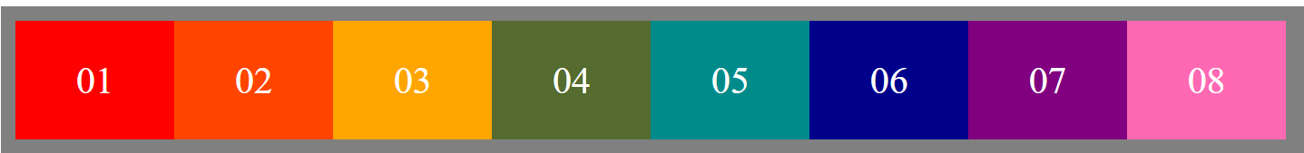
Applying the Flexbox Layout
All modern browsers support Flexbox
It provides an efficient way to layout and align items inside a specific parent container
Using display: flex a parent container can alter its children items width, height and order to fill the available space within it
Each direct child inside the flex container can override the behavior specified by the parent container
Parent container
Child item
Notes:
The Bootstrap grid system which was covered earlier in this lesson is based on CSS flexbox. In order to fully control and understand the Bootstrap grid system, it is important to learn how to use flexbox. Also, in cases that Bootstrap grid cannot be used, flexbox can be used as a solution.
20486D
09: Client-Side Development

Slide 28
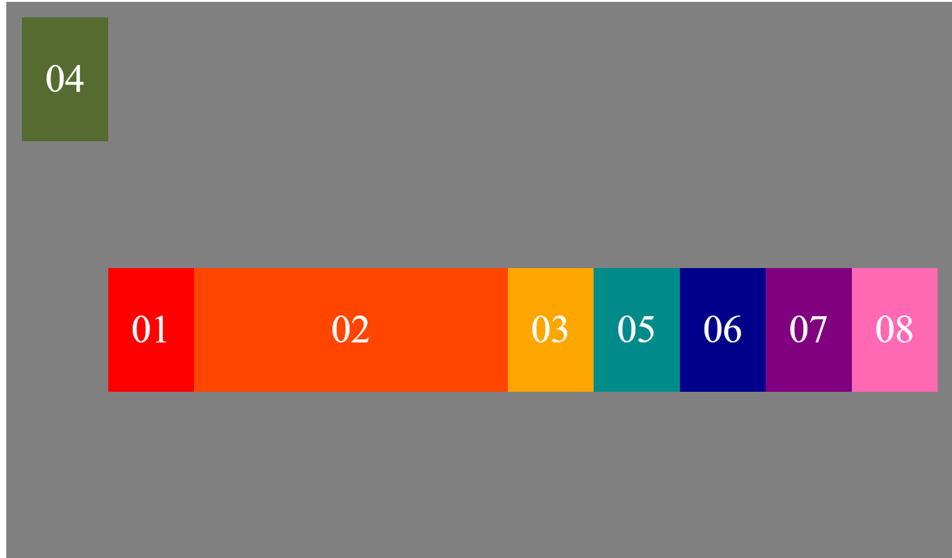
Using Flexbox
.container {
display: flex;
justify-content: center;
align-items: center;
height: 800px;
background-color: gray;
padding: 20px;
}
.box {
width: 100px;
}
.box-4 {
order: -1;
align-self: flex-start;
}
.box-2 {
flex-grow: 2;
}
<div class="container">
<div class="box box-1">01</div>
<div class="box box-2">02</div>
<div class="box box-3">03</div>
<div class="box box-4">04</div>
</div>
Notes:
Use the example in the slide to explain how to use child item properties to lay out the content of the page inside the container.
20486D
09: Client-Side Development

Slide 29
Lab: Client-Side Development
Exercise 1: Using gulp to Run Tasks Exercise 2: Styling Using Sass Exercise 3: Using Bootstrap
Estimated Time: 60 minutes
Notes:
The Starter solution for this lab is not based on a vanilla template because it was prepared specifically for this lab. Briefly go over the code in the starter solution to give the students a better idea of the context in which they are working.
To run the end solution of the lab you should install the packages using npm.
You will find the high-level steps on the following page: https://github.com/MicrosoftLearning/20486D-DevelopingASPNETMVCWebApplications/blob/master/Instructions/20486D_MOD09_LAB_MANUAL.md.
You will find the detailed steps on the following page: https://github.com/MicrosoftLearning/20486D-DevelopingASPNETMVCWebApplications/blob/master/Instructions/20486D_MOD09_LAK.md.
Exercise 1: Using gulp to Run Tasks
In this exercise, you will first install gulp using npm. You will then create a JavaScript file named gulpfile.js. After that, you will write tasks in the gulpfile.js file to bundle and minify JavaScript files. Finally, you will write a watcher task to track for any changes occurring in files which are located in the Scripts folder.
The main tasks for this exercise are as follows:
Use npm to install gulp.
Write a task to copy a JavaScript file.
Run the task.
Write a task to minify a JavaScript file.
Write a task to bundle and minify all JavaScript files in a folder.
Add a watcher task.
Run the tasks.
20486D
09: Client-Side Development
(More notes on the next slide)

Slide 30
Notes:
Exercise 2: Styling by Using Sass
In this exercise, you will first create a Sass file named main.scss and fill its content. After that, you will create a gulp task to compile the Sass file to a CSS file. Then you will create a gulp watcher task so compilation of the Sass file to CSS file will be done automatically when the Sass file is changed.
The main tasks for this exercise are as follows:
Add a new Sass file to the project.
Add gulp tasks to handle Sass files.
Run the tasks.
Exercise 3: Using Bootstrap
In this exercise, you will first update the min-vendor:js task that bundles and minifies JavaScript files to include the JavaScript files of Bootstrap. After that, you will add a task to handle the CSS files of Bootstrap. You will then run the tasks to create the vendor.min.css file and to update the vendor.min.js file. After that, you will style the layout using Bootstrap. Finally, you will create a view to buy an ice cream and style it by using Bootstrap.
The main tasks for this exercise are as follows:
Update gulpfile.js to handle Bootstrap.
Run the tasks.
Style the application by using Bootstrap.
Run the application.
20486D
09: Client-Side Development

Slide 31
Lab Scenario
You have been asked to create a web-based ice cream application for your organization's customers. The application should have a page showing all kinds of ice creams in stock, and a purchase page which will allow customers to purchase ice cream. To style the application, you decided to use Bootstrap and Sass. You have decided to use gulp to compile, minify and bundle files.
Notes:
20486D
09: Client-Side Development

Slide 32
Lab Review
A developer in your team added a function to the payment-calc.js file which is located in the Scripts folder. He was surprised to see the script.min.js file was automatically updated. Can you explain to him why the script.min.js file was automatically updated? A member of your team was told the application is styled by using Bootstrap. However, when she looked at the layout of the application, she didn’t see any link to Bootstrap. Can you explain to her how the application is linked to Bootstrap?
Notes:
Question
A developer in your team added a function to the payment-calc.js file which is located in the Scripts folder. He was surprised to see the script.min.js file was automatically updated. Can you explain to him why the script.min.js file was automatically updated?
Answer
In the gulpfile.js file, there is a watcher task named js-watcher. This task watches for changes in the JavaScript files which are located in the Scripts folder and updates the script.min.js file when one of them is changed.
Question
A member of your team was told the application is styled by using Bootstrap. However, when she looked at the layout of the application, she didn’t see any link to Bootstrap. Can you explain to her how the application is linked to Bootstrap?
Answer
In the first step, the Bootstrap package was installed by using npm. The files are located in the node_modules folder. Then gulp was used to bundle and minify the JavaScript and CSS files. As a result, the files vendor.min.js and vendor.min.css were created. Finally links to these files were added from the layout of the application.
20486D
09: Client-Side Development

Slide 33
Module Review and Takeaways
Review Questions Best Practices Common Issues and Troubleshooting Tips
Notes:
Review Questions
Question
What are the differences and similarities between Sass and Less?
Answer
Both Sass and Less are powerful CSS preprocessors that share some features but have many unique ones. They both are CSS extensions that make designing websites easier and more efficient. Sass is based on Ruby and requires a Ruby install, while Less was originally written in Ruby but ported to JavaScript and does not require a Ruby install.
There are some significant changes in terms of syntax between Sass and Less. For example, variables in Sass are defined by using the $ sign and in Less by using the @ sign. There are also similarities between the two, for example, the nesting CSS rules work the same in both Sass and Less.
Question
What tools and techniques would you use to adapt your web application for mobile and tablet devices?
Answer
There are many tools and techniques available for developers today to create responsive websites that are compatible for multiple devices. Some of the techniques you can use are:
Using the viewport attribute.
Use media queries.
Use flexbox.
Use grid systems like Bootstrap grid.
And more.
20486D
09: Client-Side Development
(More notes on the next slide)

Slide 34
Notes:
Best Practices
Use Sass or Less to add features to CSS, such as variables, nested rules, functions, inheritance, importing styles and operators which improve the maintainability of large and complex applications.
Use task runners not only to compress or compile files, but to add a variety of additional behaviors such as code quality tools and client-side unit testing.
Use the viewport attribute to customize your web application’s display based on specifications of the user’s web browser.
Common Issues and Troubleshooting Tips
Common Issue: The Bootstrap component does not look as it supposed to.
Troubleshooting Tip: Make sure that you add all the necessary HTML elements and CSS classes in the right order and hierarchy. Check that the Bootstrap CSS file is present and that all the other dependencies are loaded (such as popper.js). Also check that you are using the correct version of Bootstrap – each version expects slightly different HTML structure and CSS classes.
Common Issue: Properties included in the flexbox module are not working.
Troubleshooting Tip: Make sure that you applied "display:flex" on the parent container and that you are applying the properties on the parent container or its direct children only.
Note: Ensure that you cover the common issues and the corresponding troubleshooting tips listed in this section. Encourage students to share tips from their own work environments.
20486D
09: Client-Side Development

