Slide 1
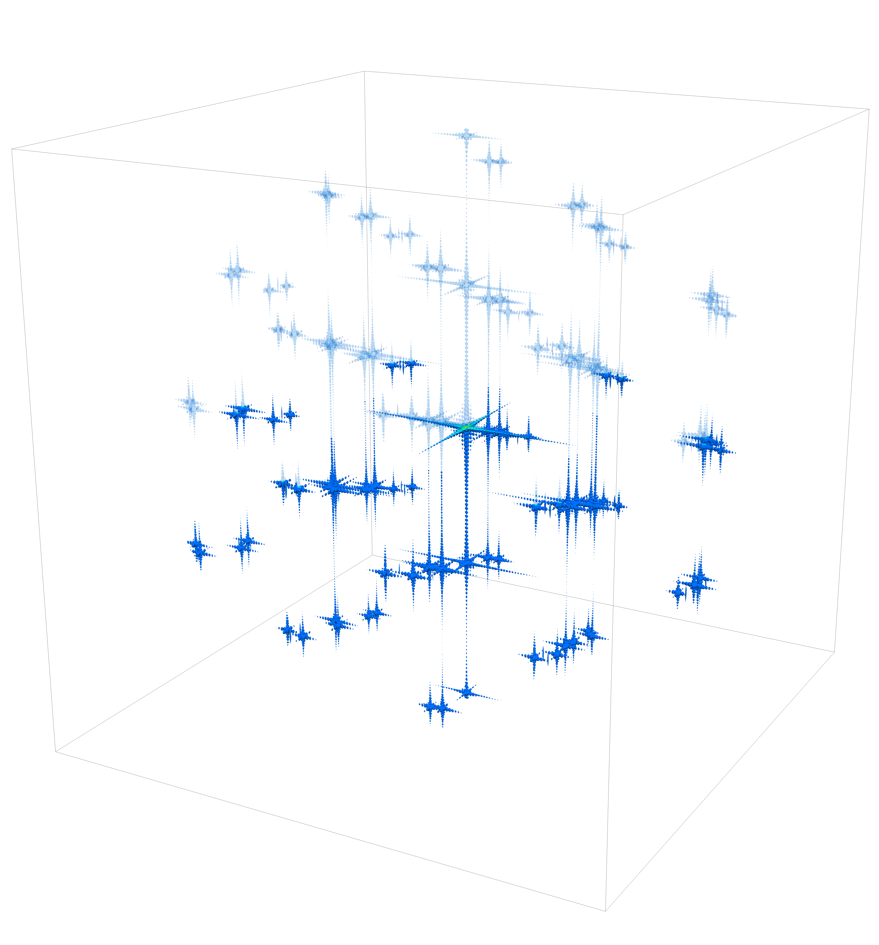




[010] Zone Axis
Intersection of Ewald Sphere
$$dR_{Ewald}$$
$$k$$
$$l$$
$$h$$

