Slide 1
Informed Real Estate Investment
Scott Locke
Project 2
2021/07/23

Slide 2
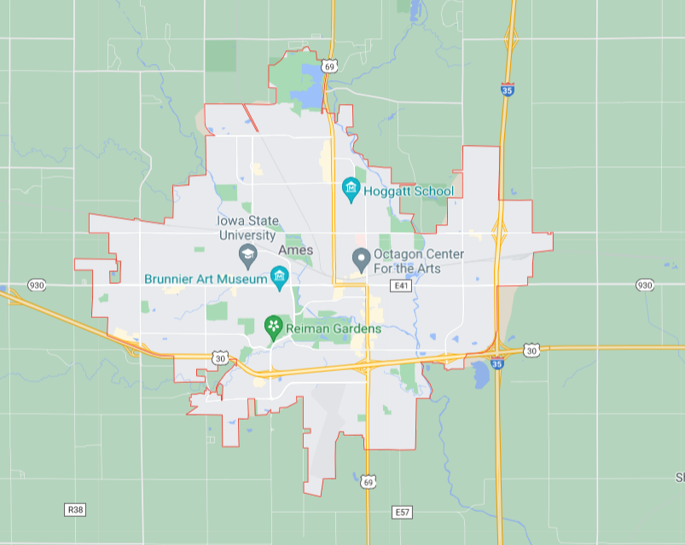
Predicting Worthwhile Investments
Look to provide a model to find undervalued properties for investment/flipping and assess what factors drive price
  How well do we predict typical prices?
  What features dictate the price the most?
Use Ames, IA as a testbed
  With success, expand to elsewhere in the Midwest and US as a whole

Slide 3
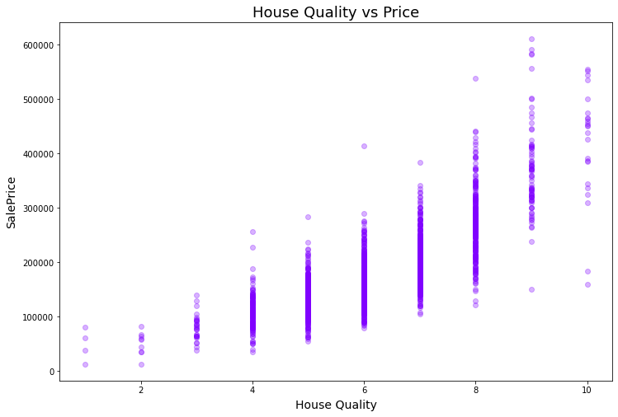
Building a Model
Built based on qualitative and quantitative assessment of the houses
  Bring quantity to quality
Minimize how much we guess wrong
  Less big loss (and big gains) for consistency
Fill in gaps for missing info
Factor | Amount
Starting Predictive Qualities | 80
Total Predictive Qualities Searched | 1856
Number of Fit Parameters | 40

Slide 4
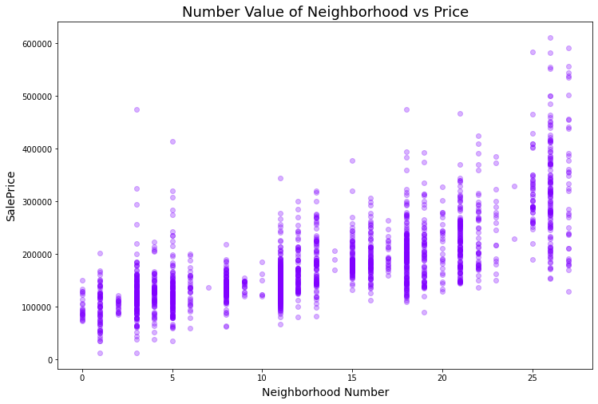
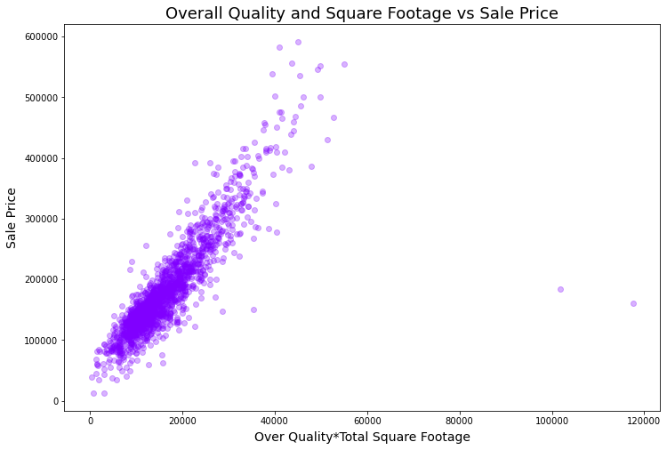
“New” Features
Northridge Heights
Some are to make common qualities:
  Total house sq ft
  Total number of bathrooms
Quantify what typically isn’t quantified
  Ex. Neighborhoods
How the quantities potentially interact
  Ex. House size * Quality Grade
Old town

Slide 5
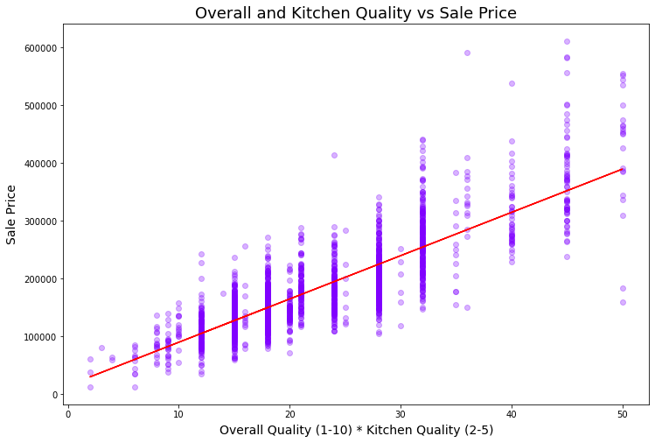
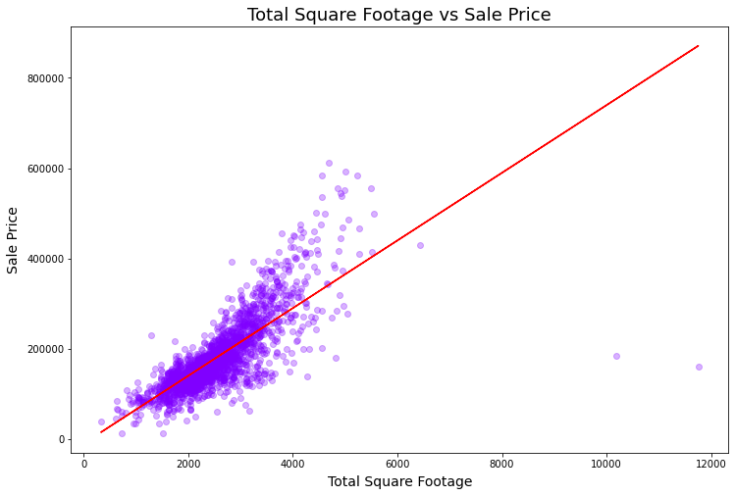
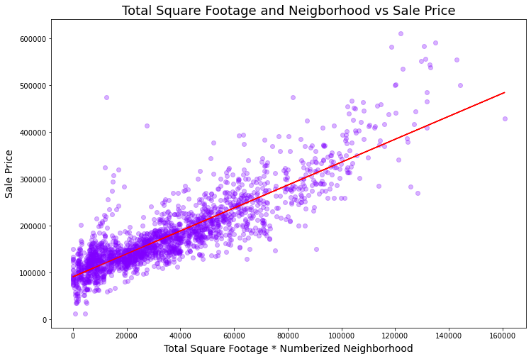
Major Factors
The obvious:
  Lot area, house square footage, overall quality, neighborhood…
The less obvious:
  Kitchen quality, how factors interact with each other
Most influential are interaction terms

Slide 6
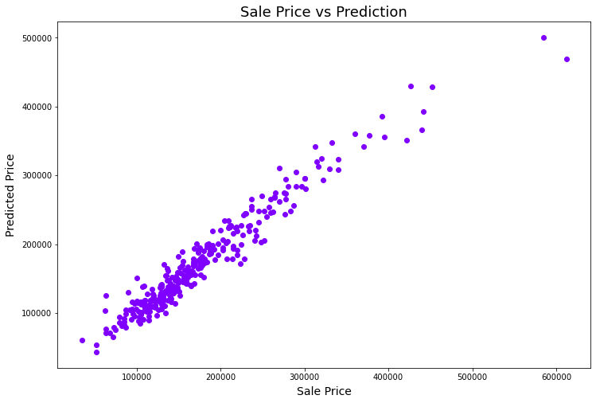
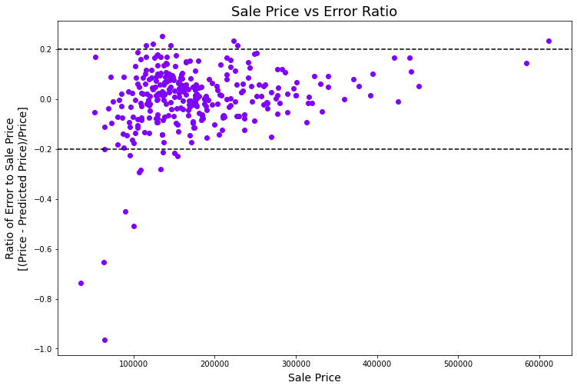
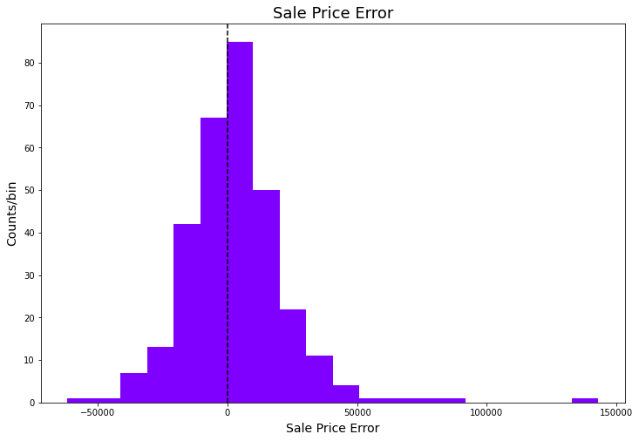
Quality of Model
Metric | Value
R² | 93.8%
RMSE | $20,300
Mean Absolute Error | $14,100
Vast majority of sales predicted within 20%
Explain 93.8% of variation in test data
Root mean square error ~$20k
  On average guess price within $14.1k

Slide 7
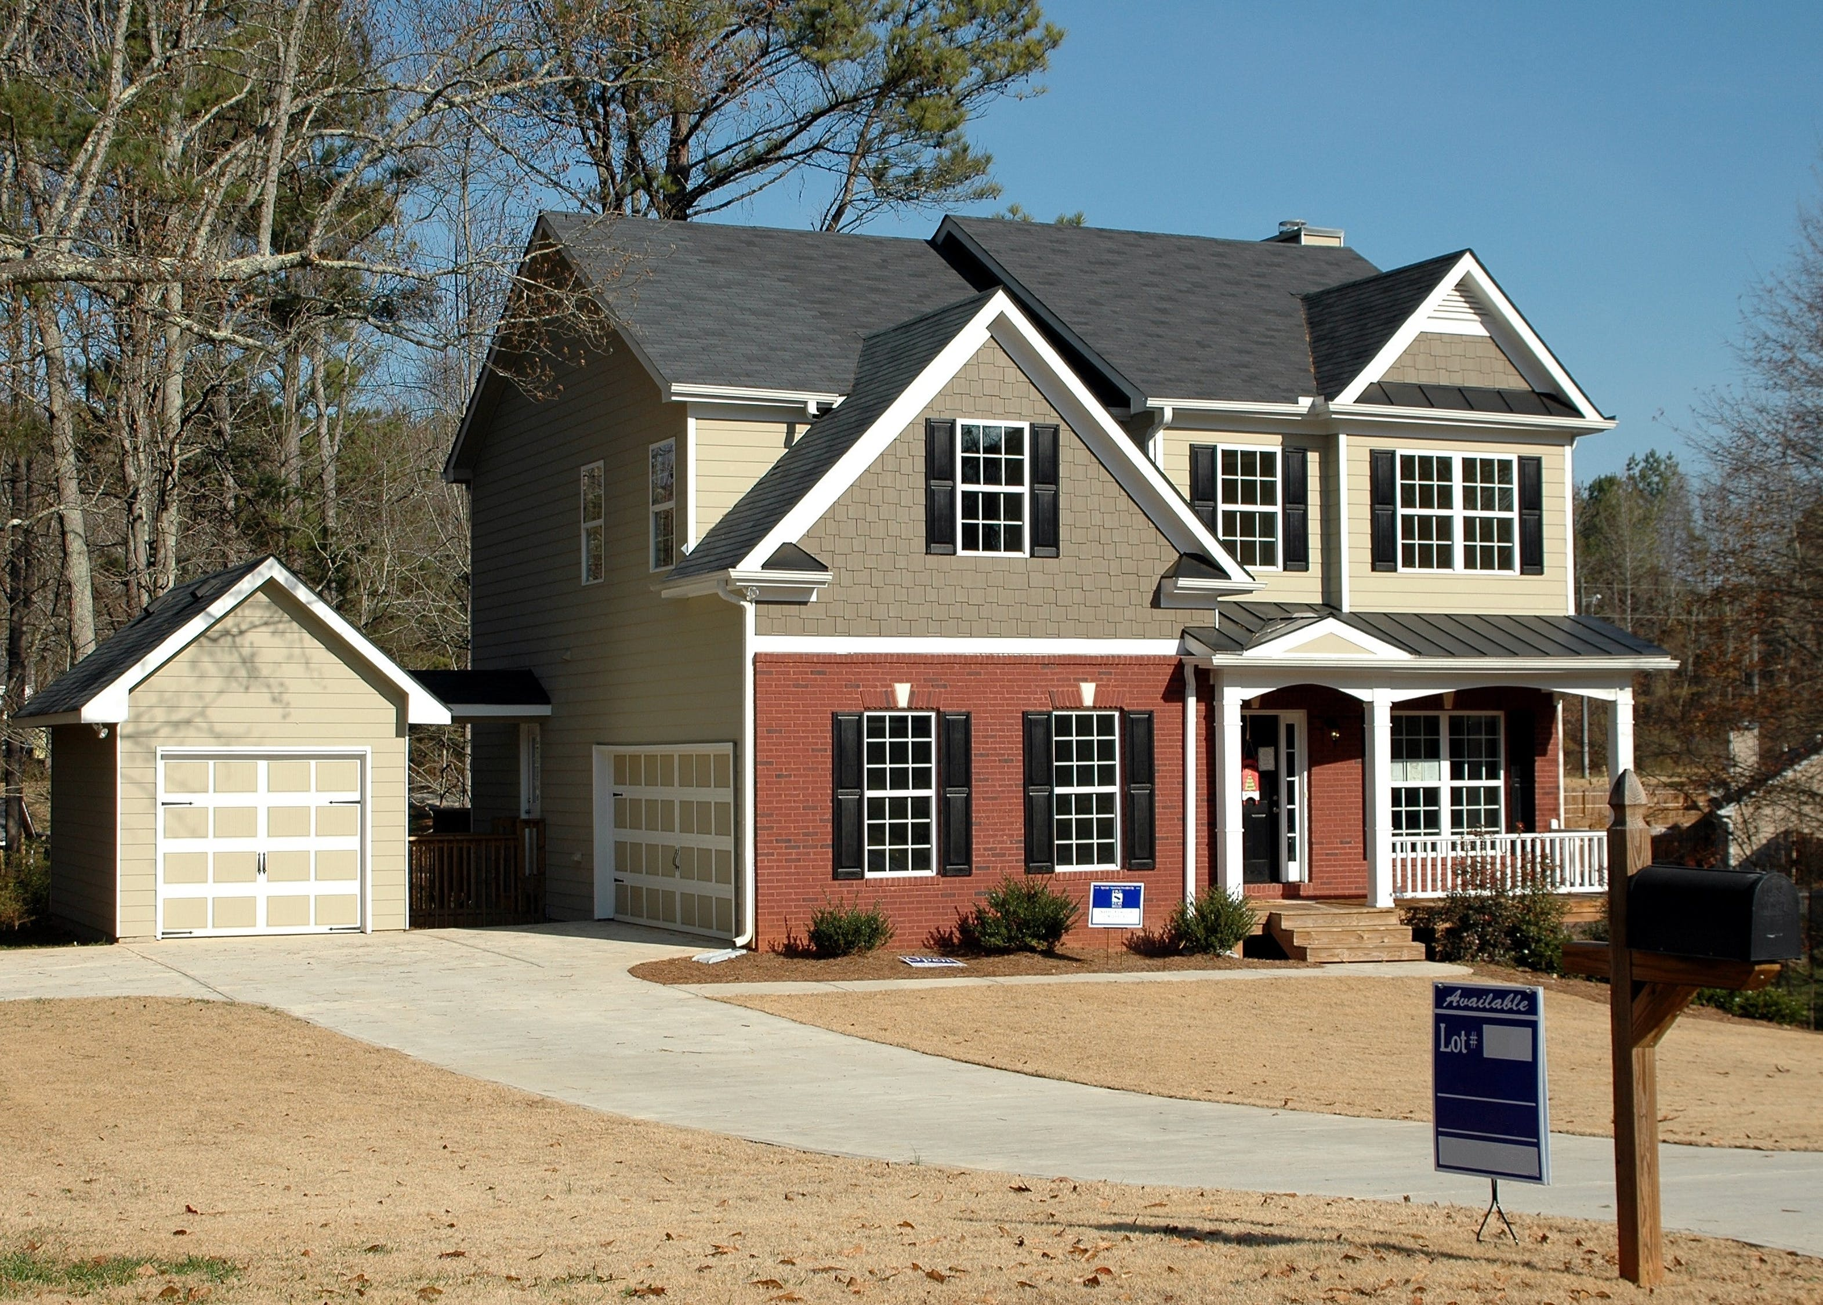
Outcomes
Focus on the big picture
  Location, size, kitchen, and how everything come together
With our model, you can make informed investment decisions
  Find not only value, but potential
  More insights than shown here
Caveat Emptor
  This is to be used as a guide, and a little of your own due diligence is needed
Source

