Slide 1
Exploring Humor with NLP
Scott Locke
DSI 628 Deckard
Project 3

Slide 2
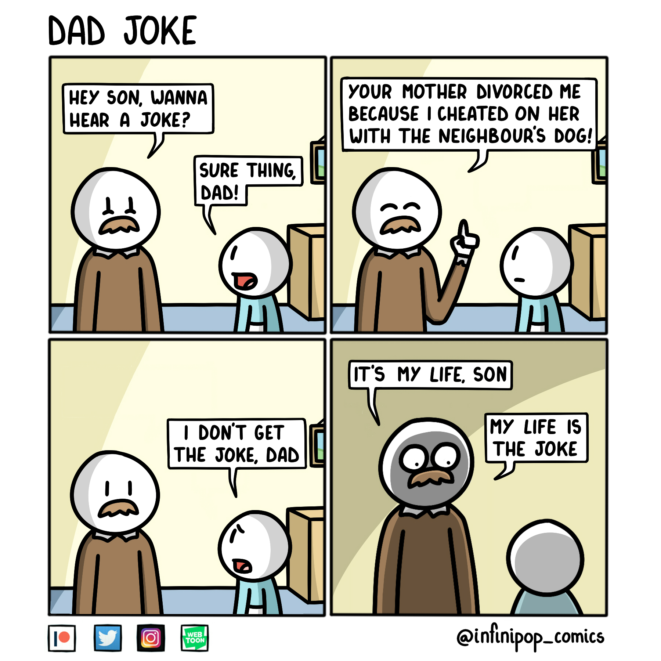
Exploring Forms of Humor with Jokes
Apple has been trying to make Siri more immersive, and humor is one of the most difficult things for AI to be able to recreate.
Want to take the first step in trying to decern the type of joke being told
Can use proper identification of type of humor to decide an appropriate response

Slide 3
General Process
Reddit/PushShift
Data Cleaning
Feature Eng.
Use Reddit as source for “dad jokes” and “anti-jokes”
~6k most recent somewhat unique, non-removed posts from each subreddit
r/dadJokes:
June 22nd – July 30th 2021
r/AntiJokes:
March 23rd 2020 – July 30th 2021
CountVector
vs TFIDF
Model 1/Token 1
…
Model N/Token M
Results

Slide 4
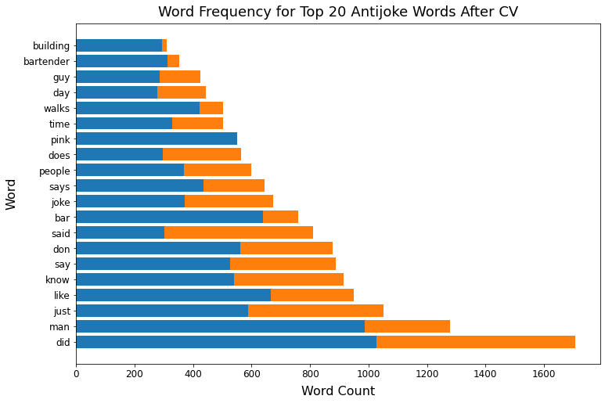
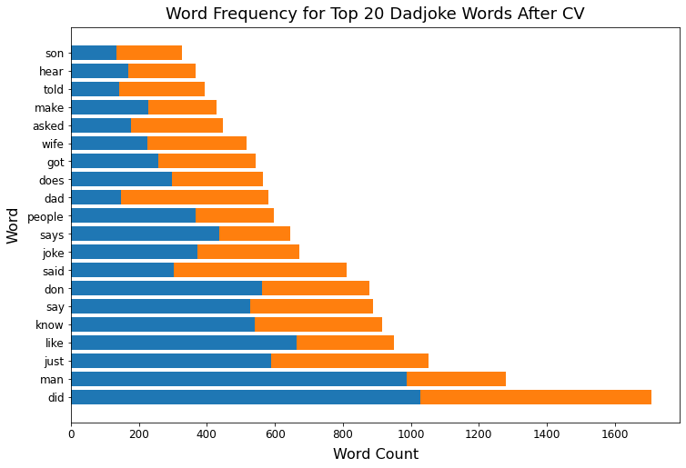
Data Cleaning, EDA
2 antijokes have >100 uses of the word pink
Use only:
Post Title
Self Text (Body)
Remove duplicates
Based on self text
Custom stop words
Force removal of obvious indicators
Attempt to make a few features
Word count, post length, sentiment, certain indicators
Remove
Keep
Remove

Slide 5
Modeling Method
Count Vectorizer
Tf-idf
×
No Tokenizing
Stemming
Lemmatizing
×
Naïve Bayes
Logistic Regression
Decision Tree
Count Vectorizer
Lasso
Ridge

Slide 6
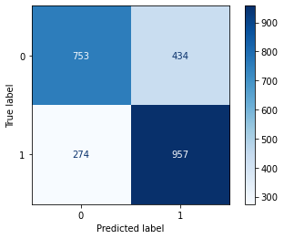
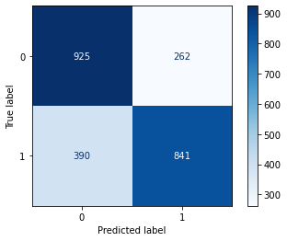
Modeling Method
CountVectorizer
Anti
Count Vectorizer
Tf-idf
×
Dad
No Tokenizing
Stemming
Lemmatizing
×
Tf-idf
Anti
Naïve Bayes
Logistic Regression
Decision Tree
Count Vectorizer
Dad
Lasso
Ridge

Slide 7
Modeling Method
CountVectorizer
Anti
Count Vectorizer
Tf-idf
Remove After Round 3
×
Dad
No Tokenizing
Stemming
Lemmatizing
×
Tf-idf
Anti
Naïve Bayes
Logistic Regression
Decision Tree
Count Vectorizer
Dad
Lasso
Ridge

Slide 8
Modeling Method
CountVectorizer
Anti
Count Vectorizer
Tf-idf
×
Dad
No Tokenizing
Stemming
Lemmatizing
×
Tf-idf
Anti
Naïve Bayes
Logistic Regression
Decision Tree
Random Forest
Attempt added features here
Dad
Lasso
Ridge

Slide 9
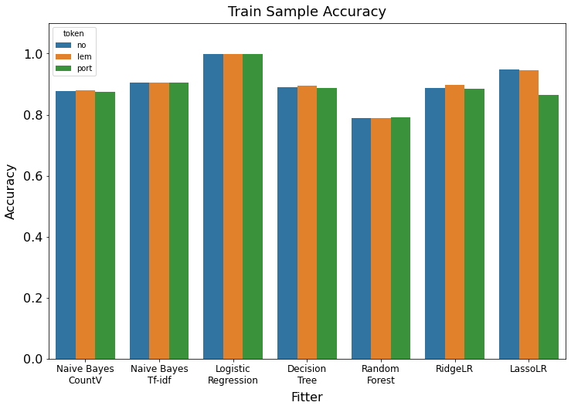
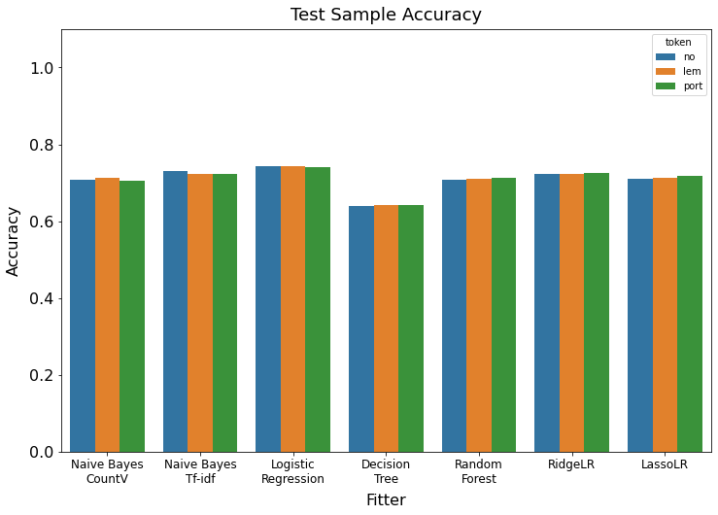
Modeling Results
~74%

Slide 10
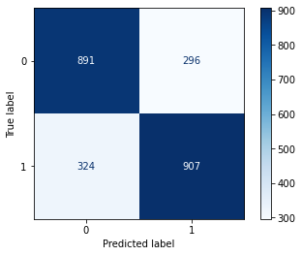
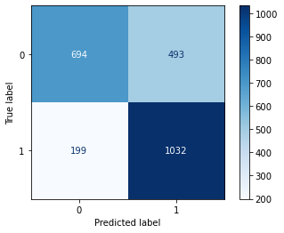
Modeling Results (cont’d)
Take all with similar overall accuracy
Highest Accuracy
Highest Specificity
Highest Recall
No stem/lem, LogReg
No stem/lem, Naïve Bayes
Porter Stem, Random Forest
Acc = 74.4%
Acc = 73.0%, Spec = 77.9%
Acc = 71.4%, Recall = 83.8%
Anti
Anti
Anti
Dad
Dad
Dad

Slide 11
Conclusion
Somewhat successfully can classify jokes, with limitations on how close different categories are
Accuracy in detecting type of joke similar amongst most groups (71-74%)
Depending on how we wish to mold Siri’s “personality” dictates which of these models to choose from
If you want to error on the side of dad jokes and puns, Stemmed Random Forest is best
If you want to maximize just being right, no word alteration and Logistic Regression

Slide 12
'A man walks down a pink sidewalk and up the pink walkway to the pink door of a pink bed and breakfast. He presses the pink doorbell and peers through a small gap in the pink curtains as a woman in a pink dress, pink hat and pink high heels walks down the pink hallway towards him. She opens the pink door and greets him with a big smile from behind her pink lipstick laden lips. "Welcome to The Pink House good sir! Follow me, I will show you to your room." The man follows the pink maiden down the pink hallway past various pink paintings, pink tables set atop plush pink carpeting and covered in pink flowers and pink knickknacks. They walk up 3 flights of pink stairs, down a long pink hallway past 4 pink doors before arriving at his pink room. He shuffles through the pink door and sets his suitcase on a small pink bench at the foot of his fluffy pink bed. The bed covered in a plethora of frilly pink pillows. He walks over to the pink window and pulls apart the pink curtains so he could look out into the perfectly pruned pink garden. Pink petunias and pink roses fill the yard around a beautiful pink fountain with flowing pink water. "Have a wonderful pink evening! Breakfast is at 9am sharp." said the pink innkeeper as she closes the pink door behind her. A second man walks down a pink sidewalk and up the pink walkway to the pink door of a pink bed and breakfast. He presses the pink doorbell and peers through a small gap in the pink curtains as a woman in a pink dress, pink hat and pink high heels walks down the pink hallway towards him. She opens the pink door and greets him with a big smile from behind her pink lipstick laden lips. "Welcome to The Pink House good sir! Follow me, I will show you to your room." The man follows the pink maiden down the pink hallway past various pink paintings, pink tables set atop plush pink carpeting and covered in pink flowers and pink knickknacks. They walk up 3 flights of pink stairs, down a long pink hallway past 3 pink doors before arriving at his pink room. He walks through his pink doorway and tosses his backpack onto his fluffy pink bed. 2 frilly pink pillows fall off of the pink bed and onto the pink stained hardwood floor. He surveys the pink room and walks over to a large pink chair set in the pink corner. He plops himself down on the pink chair and puts his feet up on the pink ottoman in front of him. "Have a wonderful pink evening! Breakfast is at 9am sharp." said the pink innkeeper as she closes the pink door behind her. A young woman walks down a pink sidewalk and up the pink walkway to the pink door of a pink bed and breakfast. She presses the pink doorbell and peers through a small gap in the pink curtains as a woman in a pink dress, pink hat and pink high heels walks down the pink hallway towards her. She opens the pink door and greets her with a big smile from behind her pink lipstick laden lips. "Welcome to The Pink House madam! Follow me, I will show you to your room." The woman follows the pink maiden down the pink hallway past various pink paintings, pink tables set atop plush pink carpeting and covered in pink flowers and pink knickknacks. They walk up 3 flights of pink stairs, down a long pink hallway past 2 pink doors before arriving at her pink room. She runs into the pink room and catapults herself onto her fluffy pink bed. Her head is buried by frilly pink pillows. She kicks her own pink shoes off and they land on the pink throw rug next to her pink bed. "Have a wonderful pink evening! Breakfast is at 9am sharp." said the pink innkeeper as she closes the pink door behind her. A very old woman slowly walks down a pink sidewalk and up the pink walkway to the pink door of a pink bed and breakfast. She presses the pink doorbell and peers through a small gap in the pink curtains as a woman in a pink dress, pink hat and pink high heels walks down the pink hallway towards him. She opens the pink door and greets her with a big smile from behind her pink lipstick laden lips. "Welcome to The Pink House madam! Follow me, I will show you to your room." The woman follows the pink maiden down the pink hallway past various pink paintings, pink tables set atop plush pink carpeting and covered in pink flowers and pink knickknacks. They walk up 3 flights of pink stairs, down a long pink hallway past 1 pink door before arriving at her pink room. The old woman pushes past the pink innkeeper and heads directly to her pretty pink bathroom. She admires the pink sink, pink shower curtains, ornate pink Venetian mirror and pink commode before slamming the pink bathroom door. "Have a wonderful pink evening! Breakfast is at 9am sharp." said the pink innkeeper as she closes the pink door behind her. An old man with a cane walks down a pink sidewalk and up the pink walkway to the pink door of a pink bed and breakfast. He presses the pink doorbell with his cane. He notices a small pink crack under the pink doorbell. Sticking out of the pink crack was the corner of a tiny pink envelope. He plucked the pink envelope from the pink crack and looked it over. It was no bigger than a postage stamp and was sealed with a tiny pink wax seal. He couldnt decipher the markings on the pink seal as his eyes were not what they used to be. He hears rattling from behind the pink door and quickly shoves the tiny envelope into his coat pocket. A woman dressed all in pink opens the pink door and greets him with a big smile from behind her pink lipstick laden lips. "Welcome to The Pink House good sir! Follow me, I will show you to your room." The man follows the pink maiden down the pink hallway past various pink paintings, pink tables set atop plush pink carpeting and covered in pink flowers and pink knickknacks. They walk up 3 flights of pink stairs, down a long pink hallway before arriving at his pink room. He walks into the pink room and hangs his cane on the pink coat rack before sitting on the edge of his fluffy pink bed. His hand searches his pocket for the envelope he had discovered as he stares at a pink framed portrait of a pink bunny in a pink tuxedo playing a pink pipe organ. "Have a wonderful pink evening! Breakfast is at 9am sharp." said the pink innkeeper as she closes the pink door behind her. Morning comes. 8:55am. The first man closes the pink door to his room and walks down the long pink hallway. He passes 4 pink doors on his way to the pink staircase. He walks down 3 flights of pink stairs and down another pink hallway past various pink paintings, pink tables set atop plush pink carpeting and covered with pink flowers and pink knickknacks. He heads into a beautiful pink dining room complete with pink place settings, pink table cloth and even a pink crystal chandelier. The pink innkeeper greets him with a smile from behind her pink lipstick laden lips as she pours him a pink glass full of pink champagne. "Good pink morning!" she said. "In addition the the pink buffet to your left, we have your choice of pink corn flakes or pink frosted flakes. Which would you prefer?" The man chooses the pink frosted flakes. The pink innkeeper goes into the pink kitchen, picks up a pink bowl and fills it with pink frosted flakes. She then pours the perfect amount of pink milk into the bowl and delivers it to the man along with a pink spoon. He makes himself a pink plate of pink bacon and pink eggs from the pink buffet and sits down in his pink chair to enjoy his meal. 8.56am. The second man closes the pink door to his room and walks down the long pink hallway. He passes 3 pink doors on his way to the pink staircase. He walks down 3 flights of pink stairs and down another pink hallway past various pink paintings, pink tables set atop plush pink carpeting and covered with pink flowers and pink knickknacks. He notices a pink balerina figurine has been knocked over onto the pink carpeting so he picks it up and returns it to it\'s home on the ornate pink sidetable. He heads into a beautiful pink dining room complete with pink place settings, pink table cloth and even a pink crystal chandelier. The pink innkeeper greets him with a smile from behind her pink lipstick laden lips as she pours him a pink glass full of pink champagne. "Good pink morning!" she said. "In addition the the pink buffet to your left, we have your choice of pink corn flakes or pink frosted flakes. Which would you prefer?" The second man chooses the pink corn flakes. The pink innkeeper goes into the pink kitchen, picks up a pink bowl and fills it with pink corn flakes. She then pours the perfect amount of pink milk into the bowl and delivers it to the second man along with a pink spoon. He makes himself a pink plate of pink sausage and pink eggs from the pink buffet and sits down in his pink chair to enjoy his meal. 8:57am. The young woman closes the pink door to her room and walks down the long pink hallway. She passes 2 pink doors on her way to the pink staircase. She walks down 3 flights of pink stairs and down another pink hallway past various pink paintings, pink tables set atop plush pink carpeting and covered with pink flowers and pink knickknacks. She notices a pink balerina figurine is facing in the opposite direction than the other pink knickknacks on the ornate pink table so she turns it 180° to the left. She heads into a beautiful pink dining room complete with pink place settings, pink table cloth and even a pink crystal chandelier. The pink innkeeper greets her with a smile from behind her pink lipstick laden lips as she pours her a pink glass full of pink champagne. "Good pink morning!" she said. "In addition the the pink buffet to your left, we have your choice of pink corn flakes or pink frosted flakes. Which would you prefer?" The young woman chooses the pink frosted flakes. The pink innkeeper goes into the pink kitchen, picks up a pink bowl and fills it with pink frosted flakes. She then pours the perfect amount of pink milk into the bowl and delivers it to the young woman along with a pink spoon. She makes herself a pink plate full of pink pastries and pink berries from the pink buffet and sits down in her pink chair to enjoy her meal. 8:58am. The old woman closes the pink door to her room and walks down the long pink hallway. She passes 1 pink door on her way to the pink staircase. She walks down 3 flights of pink stairs and down another pink hallway past various pink paintings, pink tables set atop plush pink carpeting and covered with pink flowers and pink knickknacks. She stops to admire a pink birdcage on a pink stand. In it is 4 pink singbirds chirping in the pink glow of the morning sun streaming through the pink lace curtains. The smell of bacon fills her pink nose and her stomach grumbles with anticipation. She heads into a beautiful pink dining room complete with pink place settings, pink table cloth and even a pink crystal chandelier. The pink innkeeper greets her with a smile from behind her pink lipstick laden lips as she pours her a pink glass full of pink champagne. "Good pink morning!" she said. "In addition the the pink buffet to your left, we have your choice of pink corn flakes or pink frosted flakes. Which would you prefer?" The old woman chooses the pink frosted flakes. The pink innkeeper goes into the pink kitchen, picks up a pink bowl and fills it with pink frosted flakes. She then pours the perfect amount of pink milk into the bowl and delivers it to the old woman along with a pink spoon. She makes herself a pink plate full of pink bacon and pink French toast the pink buffet and sits down in her pink chair to enjoy her meal. 9:01am. The old man is late. He is sitting on the edge of his bed staring at the tiny pink envelope he had found the previous day. He was unsure if he should open it. He had almost done it twice already but felt guilty for taking it from the pink crack under the pink doorbell. He notices he is late so he puts the still sealed envelope back into his coat pocket, grabs his cane from the pink coat rack and heads for the pink door. The old man closes the pink door to his room and walks down the long pink hallway. He passes a pink cat licking his pink paws on his way to the pink staircase. He walks down 3 flights of pink stairs and down another pink hallway past various pink paintings, pink tables set atop plush pink carpeting and covered with pink flowers and pink knickknacks. He heads into a beautiful pink dining room complete with pink place settings, pink table cloth and even a pink crystal chandelier. The pink innkeeper greets him with a smile from behind her pink lipstick laden lips as she pours him a pink glass full of pink champagne. "Good pink morning!" she said. "In addition the the pink buffet to your left, we have your choice of pink corn flakes or pink frosted flakes. Which would you prefer?" The old man chooses the pink frosted flakes. The pink innkeeper goes into the pink kitchen, picks up a pink bowl and fills it with pink frosted flakes. She then pours the perfect amount of pink milk into the bowl and delivers it to the old man along with a pink spoon. He isn\'t very hungry so he skips the pink buffet and just eats his pink frosted flakes while still contemplating what to do with the envelope. The guests all finish their pink meals and make their way back to their pink rooms to pack their belongings. They all walk together out of the pink dining room past the various pink paintings, pink tables set atop plush pink carpeting covered with pink flowers and pink knickknacks. They walk up 3 flights of pink stairs and down the long pink hallway each stopping at their pink doors before entering their pink rooms. After packing they all head back downstairs to check out. Back down the long pink hallway, down 3 flights of pink stairs, down another pink hallway past various pink paintings and pink tables set atop plush pink carpeting covered with pink flowers and pink knickknacks. The pink innkeeper thanks all of them for staying at her pink B&amp;B and hands each of them a small pink gift bag full of pink toiletries and some homemade pink salt water taffy. The old man is last to leave. As he walks out onto the pink porch and the pink door closes behind him, he reaches into his pocket one more time and pulls out that tiny pink envelope. He turns it over in his hand wondering what secrets it holds. He thinks back over his long life. Images of loves lost and missed opportunities flood his brain. He pulls a small pocket knife that he has carried since he was a boy. It has an inlaid bone handle and his initials engraved on one side. His father had given it to him before going of to die in the war. The knife opens with a soft click and he slowly peels back the wax seal with the razor sharp blade. Finally, he sees what is in the envelope. The moral of this story... \n4 out of 5 people prefer frosted flakes over corn flakes.'

