Slide 1
A Genetic Algorithm for Scheduling of Data-Parallel Tasks
Yang Liu, Lin Meng, Hiroyuki Tomiyama
Ritsumeikan University
Notes:
Thanks for introduction, today I going to talk about genetic algorithm for scheduling of data-parallel tasks.
I am name is liu yang, form ritsumeikan university.

Slide 2
Background
Due to the rapid spread of multi-cores, task scheduling became more important than ever.
Genetic algorithms (GAs) are often used for scheduling. However, no study considers both task and data parallelism.
Considering both task and data parallelism is a efficient way to fully utilize multicores.
Notes:
At the beginning, I want give a brief Background of this filed.

Slide 3
Related Work
Genetic algorithms for task scheduling problem
F. Omara, M. Arafa (JPDC) 2010
Two algorithms are proposed for scheduling which mixed GA and heuristic.
Task Scheduling in Multiprocessor System Using Genetic Algorithm
S. Gupta, G. Agarwal, V. Kumar (ICMLC), 2010
A GA for heterogeneous system.
The main distinction between them is the chromosomal representation.
No GAs consider both task and data parallelism.
The existing chromosomes not appropriate for scheduling with data-parallel tasks.
Notes:
There are many works for task scheduling based on genetic algorithm.
For example, omara proposed Two algorithms which mixed GA and heuristic.
Gupta also proposed a genetic algorithm for heterogeneous system.
The main distinction between them is the chromosomal representation. As I mentioned before. There are no GAs considering both task and data parallelism.
And existing chromosomes not very appropriate for scheduling with data-parallel tasks.
……

Slide 4
Problem Definition
An application can be modeled as a task graph.
S
Task 5
Degree of data parallelism: 3
Execution time: 20
1
( 3,30)
2
( 1,10 )
3
( 1,10 )
4
( 1,40 )
5
( 3,20)
E
Given: Task graph, total cores numbers
Objective : minimize the overall scheduling length
Notes:
At the first, I want give the definition of scheduling problem with data-parallel tasks.
An application can be modeled as a task graph.
There is a very sample task graph.
As we can see, a task graph including 2 dummy tasks, the Start task and the End task.
Each normal task associated with 2 number, the first one indicate the degree of data parallelism, which means how many cores must be used, when this task is running.
The second is the execution time of this task.
The scheduling problem can be defined as： giving a task graph and total cores number, try to find the minimal overall scheduling length.

Slide 5
Genetic Algorithm Fundamentals
Initialization
Randomly generating chromosomes
Fitness Function
Evaluating chromosomes
Selection
Choosing chromosomes from population
Crossover
Producing new chromosomes
Mutation
Randomly changing chromosomes
Notes:
In this page, I want talk some basic ideal of genetic algorithm.
Genetic algorithm is inspired by natural selection.
At first, the Initialization try to generate a set of chromosomes, chromosome is a string containing the key information for a problem,
Next step, the Fitness Function evaluate those chromosomes, and find out which one is better.
Just as the natural selection, the better one have high probability be selected to produce the next generation.
next generation may mutate by chance.
Our following discussion will first give the definition of our chromosome.
And introduce our algorithm according to this chart step by step.

Slide 6
Chromosomal representation
We propose a novel chromosomal representation.
The ordering of task execution
Without mapping information
S
Example:
1 | 2 | 5 | 3 | 4
1
2
( 3,30)
( 1,10 )
3
( 1,10 )
4
( 1,40 )
5
( 3,20)
Means task 1 is scheduled first.
Next is task 2.
And so on…
E
Note: Due to the flow dependency, not all random chromosomes are valid.
Notes:
The chromosomal representation often be considered as the most important part for the genetic algorithm.
The conventional chromosome for scheduling problem usual consist of 2 part. The part of scheduling information, indicated the order of task execution,
Next part is mapping information, which means those tasks are mapped on which core.
Our chromosome is a sample string, which indicate the ordering of task execution, without mapping information,
There is a sample chromosome, according to this chromosome, the task 1 is scheduled first, next is task 2, task 5, and so on…
We must note that, due to the flow dependency, not all random chromosomes are valid.
For example, the task 3, depending on task 1, which means task 3 can not be scheduled before task 1, so if we put 3 at the first, this chromosome is invalid one.

Slide 7
Initialization
Initialization
Try to randomly generate valid chromosomes.
Select the task according to the ID order.
Insert this task into the position P of the chromosome.
position P : A random number between MIN and MAX
MIN: The task’s ID
MAX: The execution order of last parent task + 1
Assume that: A task with a larger ID is not a parent for tasks with smaller ID. If the task graph does not satisfy this assumption, we need to reorder the tasks before the initialization.
Fitness Function
Selection
Crossover
Mutation
Notes:
The first step is initialization
We show the detail algorithm at here.
Our algorithm select the task by ID order.
and insert this task into the position P of the chromosome.
The P is a random number between MIN and MAX, the MIN is the task’s ID, and the MAX is the execution order of the last parent.
Here, we assume that A task with a larger ID is not a parent for tasks with smaller ID. If the task graph does not satisfy this assumption, we need to reorder the tasks before the initialization.

Slide 8
Fitness Function
Our fitness function is used to decode a chromo-some and assign it a fitness value as following:
Initialization
Fitness Function
Ti = the first gene in the chromosome.
Remove Ti from the chromosome.
Calculate start time of Ti as follows:
a = MAX(finished time of Ti’s parents).
b = Earliest time at which an enough number of cores for executing Ti become free.
Start time of Ti = MAX(a, b).
Finish time of Ti = start time of Ti + execution time of Ti.
Assign the cores which were selected at step 2.2 to Ti.
Update the occupied time of the cores.
Go back to step 1 until the chromosome is empty.
Fitness value = MAX(finish times of all tasks).
Selection
Crossover
T1の実行順の計算：
T1の親はないので
1~1の整数を選択
Mutation
The above algorithm schedules tasks as early as possible
in the order specified by the chromosome.
Notes:
Next is fitness function.
Our fitness function is used to decode a chromosome and compute the fitness value:
the detail of the fitness function is show at here.
Sample speaking, our algorithm schedules tasks as early as possible in the execution order specified by the chromosome.

Slide 9
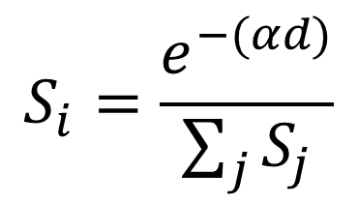
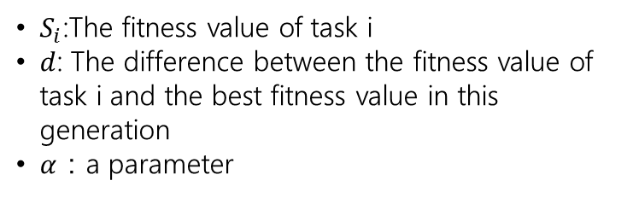
Selection
Initialization
We use the roulette wheel to select chromosome.
Fitness Function
$$S_{i}=\frac{e^{−(αd)}}{\sum_{j}{S_{j}}}$$
Selection
$S_{i}$:The fitness value of task i
$d$: The difference between the fitness value of task i and the best fitness value in this generation
$α$：a parameter
Crossover
Mutation
The good chromosomes have a larger segment.
The chromosome with a bad fitness values also has the opportunity to be selected.
Notes:
Next step is selection,
Our algorithm use the roulette wheel.
The chromosomes with a better fitness value have a larger segment.
Means that the good chromosomes have a higher opportunity to be selected.
But our algorithm also ensure that even the chromosome with a bad fitness values also has the opportunity to be selected.

Slide 10
Crossover
Initialization
The child chromosome is produced from two selected chromosomes.
Fitness Function
Random cut-point
Chrom A
1 | 2 | 5 | 3 | 4
Selection
Chrom B
4 | 1 | 5 | 2 | 3
Crossover
Child
1 | 2 | 4 | 5 | 3
Mutation
Our algorithm guarantees that the child is valid.
Notes:
Crossover produces the child form two selected chromosomes.
There is an example of crossover.
We divide the chromosome A by a random cut-point.
The tasks in first part is copied to child, and remove those tasks in chromosome B
The rest part of B is moved to child.
Our crossover algorithms also guarantees that if A and B, are valid, the child chromosome is also valid.

Slide 11
Mutation
Initialization
Mutation produce new chromosome by randomly changing one or more genes.
Fitness Function
Example:
Try to change Task 5:
1 | 2 | 5 | 3 | 4
Selection
All Possible mutations:
1 | 2 | 5 | 3 | 4
Crossover
S
1 | 2 | 3 | 5 | 4
1
( 3,30)
2
( 1,10 )
1 | 2 | 3 | 4 | 5
Mutation
3
( 1,10 )
4
( 1,40 )
5
( 3,20)
E
Mutation guarantees that the new chromosome is valid.
Notes:
Final step, The mutation produce new chromosome by randomly changing one or more genes.
Here is a example, in this chromosome, we try to change the execution order of task 5
According to this task graph, task 5 must be scheduled after task 2.
There are all possible mutations.
As we can see, our mutation also ensure that the new chromosome is valid.

Slide 12
Parallelization of the Algorithm
Our algorithm is inherently parallel.
We can speedup it by OpenMP.
Initialization
(multi-thread)
Calculate fitness values
(multi-thread)
Genetic operators
(multi-thread)
Calculate the
selection factor
(single thread)
Check stopping criteria
(single thread)
…
…
…
Notes:
The genetic algorithm usually require an long execution time because a large number of chromosomes must be generated and evaluated.
Fortunately, Our algorithm is inherently parallel. Most operations can be run independently.
We implemented our algorithm, and used OpenMP to speed up it.

Slide 13
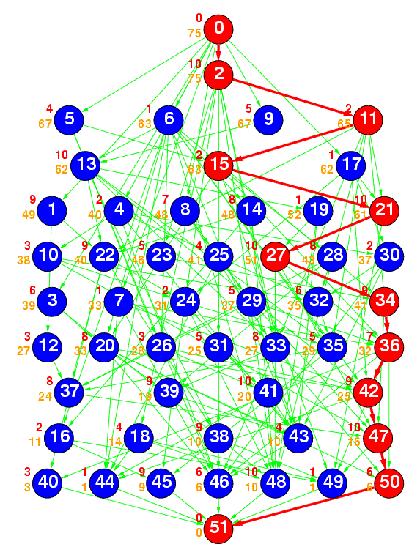
Experiments
Benchmark
Standard Task Graph (STG) Set
http://www.kasahara.elec.waseda.ac.jp/schedule
20 task graphs with 50 tasks
The number of cores: 4, 8
Compared methods
PCS algorithm (IJNC 2014)
Dual-mode algorithm (IJES 2017)
B&B (SASIMI 2016)
The parameter of proposed GA
50 iterations
16384 population
Mutation rate 5%
Notes:
To evaluate the proposed algorithm, We use Standard T Graph Set which developed at Waseda University.
Standard Task Graph Set* (STG) is a kind of benchmark for evaluate scheduling algorithms.
We choose 20 graphs with 50 tasks
The total number of cores was changed from 4 to 8.
And the experimental result asks are compared with 2 heuristic algorithm the PCS and Dual-mode algorithm .
And one exacting branch-and-bound algorithm

Slide 14
50 Tasks on 4 cores
Notes:
Because the B&B is exacting algorithm, it guarantees yield optimal results.
In the graph we normalize all scheduling results to the B&B. we can find for 50 tasks on 4 cores system. our algorithm can a very good results very close to the optimal one.

Slide 15
50 Tasks on 8 cores
Notes:
for 50 tasks on 8 cores system. our algorithm also find shorter scheduling results than PCS or Dual-mode.

Slide 16
Runtimes
 | 4 cores (sec) | 8 cores (sec)
B&B (SASIMA 2016) | 0.89 – 43,200 (suspended) | 0.93 – 43,200 (suspended)
PCS (IJNC 2014) | < 0.01 | < 0.01
Dual-mode (IJES 2017) | < 0.01 | < 0.01
GA (this work) | 3.81 – 4.37 | 4.21 – 4.84
Parallelized GA (this work) | 0.48 – 0.65 | 0.52 – 0.68
Notes:
The runtime of B&B significantly depends on the task graph. In some cases, optimal 269 solutions were found within a second, but in some other cases, the branch-and-bound algorithm did 270 not finish within 12 hours. The PCS and dual-mode algorithms are very fast, at the cost of the 271 degraded quality of results as seen in Figures 7 and 8. Our single-threaded implementation of the 272 genetic algorithm found near-optimal solutions within 5 seconds, and the parallelized 273 implementation achieved approximately 7 times speed-up

Slide 17
Conclusions & Future
Conclusions
We proposed a GA for the task scheduling problem with both task and data parallelism.
We proposed a new chromosome representation and corresponding genetic operators.
We also proposed a parallelization method for our GA.
Future
we plan to extend our GA for scheduling problem with inter-task communication.

Slide 18
Questions?

