Slide 1

Doctoral Dissertation Defense Scheduling Algorithms for Data Parallel Tasks on Multicore Architectures
Presented by: LIU Yang
Supervisor: TOMIYAMA Hiroyuki
Notes:
Thanks for introduction.
Good afternoon
Today I’m going to talk about my work scheduling algorithms for data parallel tasks on multicore architectures.

Slide 2
Presentation Outline
Background
Related Works
The Problem Definition
List Scheduling Algorithms
Dual-mode Algorithm
Genetic Algorithm
Branch-and-Bound Algorithm
Conclusions
Notes:
Here is the outline of my presentation.
At first I’m go int
After ·the

Slide 3
Presentation Outline
Background
Related Works
The Problem Definition
List Scheduling Algorithms
Dual-mode Algorithm
Genetic Algorithm
Branch-and-Bound Algorithm
Conclusions
Notes:
In the first, I’d like to give a brief background about our research.

Slide 4
Background
Due to the rapid spread of multicores, task scheduling became more important than ever.
Considering both task and data parallelism is a efficient way to fully utilize multicores.
Have few works on task scheduling problem considering both task and data parallelism.
Notes:
As every one know, Due to the rapid spread of multicores, task scheduling became more important than ever.
And many works show than considering both task and data parallelism is a efficient way to fully utilize multicores.
However, we found only a few works on task scheduling problem considering both task and data parallelism simultaneously.
This is the reason I chose this research topic.

Slide 5
Presentation Outline
Background
Related Works
The Problem Definition
List Scheduling Algorithms
Dual-mode Algorithm
Genetic Algorithm
Branch-and-Bound Algorithm
Conclusions
Notes:
Next I will talk about some related works on our topic

Slide 6
Related Works
Scheduling is a NP hard problem, The exact algorithms may take very long time.
A large number of heuristics and meta-heuristics aim to find near-optimal results.
Have few works considering both data and task parallelisms.
Heuristic Algorithms
Meta-Heuristic Algorithms
Exact Algorithms
List Scheduling
H. Kasahara, TC, 1984
N. Vydyanathan, TPDS, 2009
G. Sinevriotis, ISCAS, 2002
Cluster Based
Duplication Based
Genetic Algorithm
L. Wang, JPDC, 1997
Y. Xu, JIS, 2014
Ant Colony Optimization
F. Ferrandi, TCAD, 2010
Branch-and-Bound Algorithm
O. Sinnen, PDCAT, 2008
Integer Linear Programming
H. Yang, ISOCC, 2008
Problem: The degree of data parallelism in tasks is flexible, this
assumption may not be practical in some systems
Our Assumption: The degree of data parallelism in tasks is fixed
Notes:
There are many works on this topic
We roughly divided them into Heuristics, Meta-Heuristics and Exact Algorithms.
Exact algorithms always find the optimal solution. However, Scheduling is a NP hard problem, to find optimal solution may take very long time.
So, A large number of works on heuristics and meta-heuristics aim to find near-optimal results.
For example, list scheduling is a important family of heuristics scheduling algorithm.
This method is easy to implement and generally find a results in very short time.
meta-heuristics are some frameworks that provide a set of guidelines to explore solution space, usually can find better results, but take longer time to execution,
The most important representatives are Genetic Algorithm。
But among them， Only few works considering both data and task parallelisms, which is a efficient way to fully utilize multicores.
a list scheduling based algorithm proposed by Vydyanathan and Integer linear programming based algorithm proposed by Yang
The common assumption of The two algorithms is The degree of data parallelism in tasks is flexible
Which not be practical in some systems, Our works study to schedule data-parallel task with fixed degree of data parallelism

Slide 7
Presentation Outline
Background
Related Works
The Problem Definition
List Scheduling Algorithms
Dual-mode Algorithm
Genetic Algorithm
Branch-and-Bound Algorithm
Conclusions
Notes:
In the next slide, I’ll give the problem definition of task scheduling.

Slide 8
The Problem Definition
7
An application is modeled as a task graph.
S
Task 5
Degree of data parallelism: 3
Execution time: 30
1
( 4,10)
2
( 3,20 )
3
( 1,10 )
4
( 1,40 )
5
( 3,30)
E
Given: Task graph, total cores numbers
Objective : minimize the overall schedule length
Notes:
In task scheduling study. An application can be modeled as a task graph.
There is a very sample task graph.
As we can see, a task graph including 2 dummy tasks, the Start task and the End task.
Each normal task associated with 2 number, the first one indicate the degree of data parallelism, which means how many cores must be used, when this task is running.
The second is the execution time of this task.
The scheduling problem can be defined as： giving a task graph and total cores number, try to find the minimal overall scheduling length.

Slide 9
Presentation Outline
Background
Related Works
The Problem Definition
List Scheduling Algorithms
Dual-mode Algorithm
Genetic Algorithm
Branch-and-Bound Algorithm
Conclusions
Notes:
next, I’d like to present 4 kind of algorithms to solve this problem.
The first one, is based on list scheduling.

Slide 10
List Scheduling Algorithms
The basic idea of list scheduling algorithms:
Make a list, and let it contain all executable task.
According to certain priority rule, select a task from the list and assign it to free cores.
Repeatedly executes step 1 and 2, until all tasks are scheduled.
The key of list scheduling algorithms is:
How to define an appropriate priority rule.
Notes:
List Scheduling are very popular methods for scheduling problem,
The basic idea of list scheduling algorithms is:
Make a list, update the list and let it contain all executable task.
According to certain priority rule, select a task from the list and assign it to free cores.
Repeatedly executes step 1 and 2, until all the tasks are scheduled
The most important point here is How to define the appropriate priority.

Slide 11
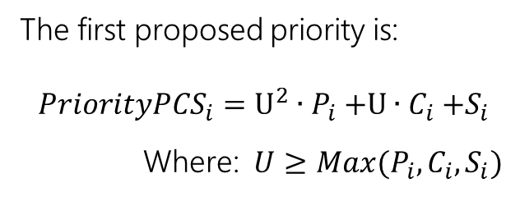
The Proposed Priorities (1)
The proposed priorities are based on following factors:
The first proposed priority is:
$${PriorityPCS}_{i}=U^{2}{∙P}_{i}+U{∙C}_{i}+S_{i}$$
Where: $U≥Max(P_{i},C_{i},S_{i})$
P: The degree of data parallelism
C: The length of critical path
S: The number of immediate successors
Task ID | P | C | S | PriorityPCS*
Task 1 | 4 | 20 | 1 | 15601
Task 2 | 3 | 60 | 2 | 14402
Task 3 | 1 | 10 | 0 | 4200
Task 4 | 1 | 40 | 0 | 6000
Task 5 | 3 | 30 | 0 | 12600
S
1
(4,10,20,1)
2
(3,20,60,2)
3
(1,10,10,0)
4
(1,40,40,0)
5
(3,30,30,0)
E
*Let the U equal to 60 at here
Notes:
Our proposed priorities are based on following factors:
The first one is The degree of data parallelism
The second one is The length of critical path, denote the longest path from a task to the end point.
The third one is The number of immediate successors, determined by how many children this task have.
The first proposed priority is calculated by this formula:
This priority generally considering the 3 three factor by the order of P C S
So we named it as PriorityPCS.

Slide 12
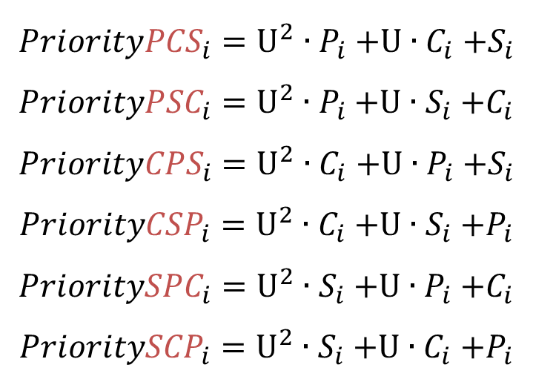
The Proposed Priorities (2)
In the similar manner, we can define six algorithms:
$${PriorityPCS}_{i}=U^{2}{∙P}_{i}+U{∙C}_{i}+S_{i}$$
$${PriorityPSC}_{i}=U^{2}{∙P}_{i}+U{∙S}_{i}+C_{i}$$
$${PriorityCPS}_{i}=U^{2}{∙C}_{i}+U{∙P}_{i}+S_{i}$$
$${PriorityCSP}_{i}=U^{2}{∙C}_{i}+U{∙S}_{i}+P_{i}$$
$${PrioritySPC}_{i}=U^{2}{∙S}_{i}+U{∙P}_{i}+C_{i}$$
$${PrioritySCP}_{i}=U^{2}{∙S}_{i}+U{∙C}_{i}+P_{i}$$
All of the six algorithms are based on list scheduling
Notes:
, we also can define six different algorithms in the similar way, They use the there factor by different order.
All of the six algorithms are based on list scheduling,

Slide 13
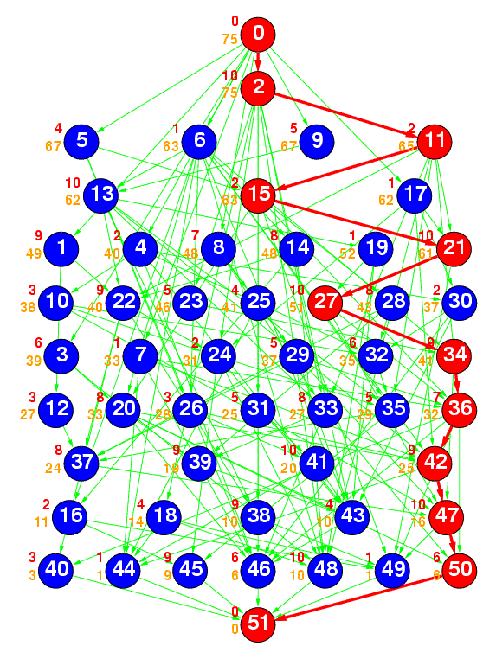
Experiments
Benchmark
Standard Task Graph (STG) Set
http://www.kasahara.elec.waseda.ac.jp/schedule
20 sets of 50 tasks
20 sets of 100 tasks
The number of cores: 2, 4, 8, 16
Compared methods
PCS,CPS, CSP, SCP, PSC, SPC.
Xeon processors 2.00Hz with 8GB
Notes:
To evaluate the proposed algorithm, We use Standard Task Graph Set which developed at Waseda University.
We choose 20 graphs with 50 tasks
Because the time limit we only show the results of first 20 task graphs. in most cases the other 20 graphs get similar results
The total number of cores is 4
And the results are compared with 2 heuristic algorithm the PCS and Dual-mode algorithm .

Slide 14
Experiments
Normalized schedule length
Averages of normalized schedule lengths for task graphs with 50 tasks

Slide 15
Presentation Outline
Background
Related Works
The Problem Definition
List Scheduling Algorithms
Dual-mode Algorithm
Genetic Algorithm
Branch-and-Bound Algorithm
Conclusions
Notes:
The next proposed algorithm is Dual-mode Algorithm

Slide 16
Dual-mode Algorithm
The experimental results show that the PCS algorithm finds good results on average.
Actually, pure list scheduling technique is easy to fall into the local optimality.
We aim to improve the quality of results by using two types of priorities. Our new algorithm switches the two different priorities during the scheduling process.
Notes:
The previous experimental results show that the PCS algorithm finds good results on average.
However, we also notes that using pure list scheduling technique is easy to fall into the local optimal solutions.
In the next few slide I’d like to introduce a new algorithms which aim to improve the quality of results by using two types of priorities.
The our new algorithm switches the two different priorities during the scheduling process, thus, we call it as dual0mode algorithm

Slide 17
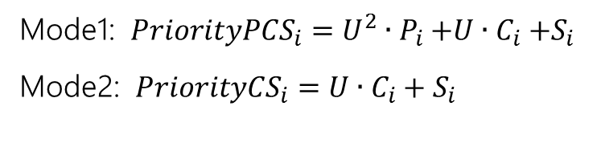
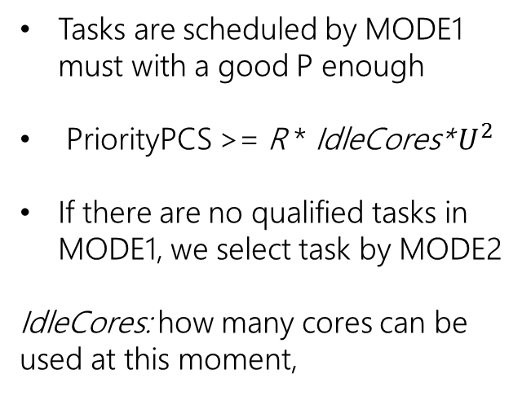
The Proposed Priorities
S
Mode1: ${PriorityPCS}_{i}=U^{2}{∙P}_{i}+U{∙C}_{i}+S_{i}$
Mode2: ${PriorityCS}_{i}=U∙C_{i}+S_{i}$
1
(4,10,20,1)
2
(3,20,60,2)
3
(1,10,10,0)
4
(1,40,40,0)
5
(3,30,30,0)
E
Tasks are scheduled by MODE1 must with a good P enough
PriorityPCS >= R * IdleCores* $U^{2}$
If there are no qualified tasks in MODE1, we select task by MODE2
IdleCores: how many cores can be used at this moment,
Task ID | PriorityPCS
Task 1 | 15601
Task 2 | 14402
Task 3 | 4200
Task 4 | 6000
Task 5 | 12600
Task ID | PriorityCS
Task 1 | 1201
Task 2 | 3002
Task 3 | 600
Task 4 | 2400
Task 5 | 1800
*Let the U equal to 60 at here
Notes:
Different form pure list scheduling, our new algorithm determine the order of schedule process by one types of MODE
One is using the PriorityPCS which we just introduced.
The first MODE tend to schedule tasks which with a good enough $PCS Priority$ value,
And here the parameter is used by control the threshold at here.
If there are no qualified tasks in MODE1, we select task by MODE2
The mode use $PriorityCS$, which consider the critical path more than PriorityPCS .

Slide 18
Experiments
Benchmark
Standard Task Graph (STG) Set
http://www.kasahara.elec.waseda.ac.jp/schedule
20 sets of 50 tasks
20 sets of 100 tasks
The number of cores: 2, 4, 8, 16
Compared methods
PCS algorithm
Dual-mode algorithm (Proposed algorithm)
Xeon processors 2.00Hz with 8GB

Slide 19
Experiments
Normalized schedule length
Averages of normalized schedule lengths for task graphs with 50 tasks
Notes:
This figure show the scheduling results for task graphs with 50 tasks . To understand easy,
We make the results obtained by PCS is normalized to 1, if the result under than 1, means this algorithm better than PCS.
We can found in all situation, The Dual-mode algorithm get better scheduling result than PCS.
Especially, when the multicore processor has more cores.

Slide 20
Presentation Outline
Background
Related Works
The Problem Definition
List Scheduling Algorithms
Dual-mode Algorithm
Genetic Algorithm
Branch-and-Bound Algorithm
Conclusions
Notes:
In the next, we going to introduce to solve scheduling algorithm by genetic algorithm.

Slide 21
Genetic Algorithm
Initialization
Randomly generating chromosomes
Fitness Function
Evaluating chromosomes
Selection
Choosing chromosomes from population
Crossover
Producing new chromosomes
Mutation
Randomly changing chromosomes
Notes:
In first, I want talk some basic ideal of genetic algorithm.
Genetic algorithm is inspired by natural selection.
At beginning, use Initialization function to generate a set of chromosomes, chromosome is a string containing the key information for a problem,
Next step, the Fitness Function evaluate those chromosomes, and find out which one is better.
Just as the natural selection, the better one have high probability be selected to produce the next generation.
next generation may mutate by chance.
How to define the chromosome often be considered as the most important part for the genetic algorithm.

Slide 22
Chromosomal representation
We propose a novel chromosomal representation.
The ordering of task execution
Without mapping information
S
1
( 4,10)
2
( 3,20 )
Example:
1 | 2 | 3 | 5 | 4
3
( 1,10 )
4
( 1,40 )
5
( 3,30)
Time = 0 | 10 | 20 | 30 | 40 | 50 | 60 | 70 | 80
Core 0 | T1 | T2 | T2 | T4 | T4 | T4 | T4
Core 1 | T1 | T2 | T2 | T5 | T5 | T5
Core 2 | T1 | T2 | T2 | T5 | T5 | T5
Core 3 | T1 | T3 |  | T5 | T5 | T5
E
Fitness Value: 70
Note: Due to the flow dependency, not all random chromosomes are valid.
Notes:
Our proposed chromosome is a sample string, which only contain the scheduling information,
There is a sample chromosome, according to this one, the task 1 is scheduled first, next is task 2, task 5, and so on…
According to this chromosome, we can schedule this task graph as this figure.
For each chromosome, a single Fitness Value can be calculated.
We must note that, due to the flow dependency, not all random chromosomes are valid.
For example, the task 3, depending on task 1, which means task 3 can not be scheduled before task 1.

Slide 23
Corresponding Genetic Operators
Initialization
We use the roulette wheel to select chromosomes.
The good chromosomes have a larger segment.
Fitness Function
Selection
Chrom A
1 | 2 | 5 | 3 | 4
Produce child from two selected chromosomes.
Chrom B
4 | 1 | 5 | 2 | 3
Crossover
Child
1 | 2 | 4 | 5 | 3
Mutation
1 | 2 | 4 | 5 | 3
Produce new chromosome by randomly changing one or more genes.
Move task 4 to new position
1 | 2 | 5 | 4 | 3
Notes:
After we initial a set of chromosomes and calculate the fitness value for each one.
We use 3 genetic operators to create the next generations.
First we choose some chromosomes by roulette wheel algorithm, as the name indicated, The good chromosomes have a larger segment, so, when spin the roulette good chromosome will be selected by higher probability.
Next, we swap some information of the selected chromosomes, our crossover algorithm also guarantee that if the …..
Finally, the produced new chromosome will change some gene by chance,

Slide 24
Parallelization of the Algorithm
Our algorithm is inherently parallel.
We speedup it by OpenMP.
Initialization
(multi-thread)
Calculate fitness values
(multi-thread)
Genetic operators
(multi-thread)
Calculate the
selection factor
(single thread)
Check stopping criteria
(single thread)
…
…
…
Notes:
The genetic algorithm usually require an long execution time because a large number of chromosomes must be generated and evaluated.
Fortunately, Our algorithm is inherently parallel. Most operations can be run independently.
We implemented our algorithm, and used OpenMP to speed up it.

Slide 25
Experiments
Benchmark
Standard Task Graph (STG) Set
http://www.kasahara.elec.waseda.ac.jp/schedule
20 sets of 50 tasks
20 sets of 100 tasks
The number of cores: 2, 4, 8, 16
Compared methods
PCS algorithm
Dual-mode algorithm
Genetic Algorithm (Proposed algorithm)
The parameter of proposed GA
50 iterations
16384 population
Mutation rate 5%
Notes:
To evaluate the proposed algorithm, We use Standard Task Graph Set which developed at Waseda University.
We choose 20 graphs with 50 tasks
The total number of cores is 4
And the results are compared with 2 heuristic algorithm the PCS and Dual-mode algorithm .

Slide 26
Experiments
Averages of normalized schedule lengths for task graphs with 50 tasks
Notes:
In the graph we normalize all scheduling results to the PCS. we can find for 50 tasks on 4 cores system. our algorithm can find much good results than PCS or Dual-mode

Slide 27
Runtimes
 | 50 tasks (sec) | 100 tasks (sec)
PCS | < 0.01 | < 0.01
Dual-mode | < 0.01 | < 0.01
GA | 3.81 – 4.37 | 4.21 – 4.84
Parallelized GA | 0.48 – 0.65 | 0.52 – 0.68
Notes:
We also find, the runtime of B&B is very depending on the task graph. But generally it is very time-consuming·
The PCS and dual-mode algorithms are very fast, but cannot find good enough results.
GA can find good enough results, The runtime is also Less than 1 second。

Slide 28
Presentation Outline
Background
Related Works
The Problem Definition
List Scheduling Algorithms
Dual-mode Algorithm
Genetic Algorithm
Branch-and-Bound Algorithm
Conclusions
Notes:
In above we have been introduced 3 algorithms aim to find the near-optimal results.
because the optimal schedules are still unknown, we need find a way to make sure the optimal results, then, to evaluate the above 3 algorithms in a better way,
Next I’d like to present a exact algorithm based on Branch-and-Bound Algorithm.

Slide 29
Branching tree
S
Scheduling problem belongs to strong NP-hard.
Need to enumerates all possible solutions.
1
( 4,10)
2
( 3,20 )
3
( 1,10 )
4
( 1,40 )
5
( 3,30)
E
T S
T 1
T 3
T 2
T 2
T 5
T 4
T 1
T 2
T 5
T 4
T 5
T E
T E
T 4
T 5
T 3
T 4
T 5
T 4
T 5
T 3
T 4
T 3
T 5
T E
T 4
T E
T 5
T E
T 3
T E
T 4
T E
T 3
T E
T 4
T 5
T E
T 5
T 4
T E
T 4
T 3
T 5
T E
T 5
T 3
T E
T 5
T 3
T 4
T E
T 4
T 3
T E
T 3
T 5
T 1
T E
T 3
T 3
T E
T 1
T 3
T 5
T 5
T E
T 1
T 3
T 4
T E
T 4
T 3
T E
T 5
T 1
T 3
T E
Notes:
As a mentioned in beginning.
Scheduling problem belongs to strong NP-hard
Thus, we need to enumerates all possible solutions to find the optimal results.
For ease to search we make a branching-tree, at here each path from the root to the bottom, denote a schedule for a task graph,

Slide 30
Branch and bound algorithms
Our work explores the branching-tree by depth-first search.
The time complexity of DFS algorithm is O(n!).
The branch-and-bound (B&B) algorithms are employed to prune non-optimal solution spaces.
(1) Related Pattern Rule
(2) Exclusive Task Branch Rule
(3) Reducing Meaningless Idle Time
(4) Lower Bound Rule
Notes:
Our work explores the branching-tree by depth-first search.
Actually, searching this tree extremely difficult, the algorithm is factorial of n, here, n is the number of tasks.
Therefore, we proposed 4 branch-and-bound algorithms to prune non-optimal solution space.
Because of the time limit, we show 2 of them in the few slides.

Slide 31
(1) Related Pattern Rule
The branch under (b) can be pruned, because the branch of (b) is a subset of (a)’s.
(a)
Time = 0 | 10 | 20 | 30 | 40
Core 0 | T1 | T2 | T2
Core 1 | T1 | T2 | T2
Core 2 | T1 | T2 | T2
Core 3 | T1
{T3}
{T3, T4, T5}
S
(b)
Time = 0 | 10 | 20 | 30 | 40
Core 0 | T2 | T2 | T1
Core 1 | T2 | T2 | T1
Core 2 | T2 | T2 | T1
Core 3 |  |  | T1
1
( 4,10)
2
( 3,20 )
3
( 1,10 )
4
( 1,40 )
5
( 3,30)
E
{T3, T4, T5}
Notes:
The first B&B rule is called Related Pattern Rule,
Considering 2 partial schedules which consist of the same tasks T1 and T2, but in a different order.
Let us see the first partial schedule A, because T3 depended on T1, so, the T3 can be scheduled at here.
On the other hand, in partial schedule B, we only can schedule T3 at here.
But we notes that a also can do

Slide 32
(3) Reducing Meaningless Idle Time
Assume that T1 and T2 have been executed. T3, T4 and T5 can be scheduled in next step.
Time = 0 | 10 | 20 | 30 | 40
Core 0 | T1 | T2 | T2
Core 1 | T1 | T2 | T2 | T5 | T5 | T5
Core 2 | T1 | T2 | T2 | T5 | T5 | T5
Core 3 | T1 | idle |  | T5 | T5 | T5
Time = 0 | 10 | 20 | 30 | 40
Core 0 | T1 | T2 | T2
Core 1 | T1 | T2 | T2
Core 2 | T1 | T2 | T2
Core 3 | T1 | idle |  | T4 | T4 | T4 | T4
Schedule T3 is obviously better than schedule T4 or T5.
S
Time = 0 | 10 | 20 | 30 | 40
Core 0 | T1 | T2 | T2
Core 1 | T1 | T2 | T2
Core 2 | T1 | T2 | T2
Core 3 | T1 | T3
1
( 4,10)
2
( 3,20 )
3
( 1,10 )
4
( 1,40 )
5
( 3,30)
E
{T4, T5}
Notes:
Next B&B rules is called: Reducing Meaningless Idle Time
To illustrate it, let us consider T1 and T2 have been executed, the T3, T4, and T5 can be scheduled in next step.
we can see to schedule T3 is obviously better than schedule T4 or T5. because after T3 be scheduled we also can assign task T4 or T5 at the some position.
So the two branch can be pruned.

Slide 33
Experiments
Benchmark
Standard Task Graph (STG) Set
http://www.kasahara.elec.waseda.ac.jp/schedule
20 sets of 50 tasks
20 sets of 100 tasks
The number of cores: 2, 4, 8, 16
Compared methods
PCS algorithm
Dual-mode algorithm
Genetic Algorithm
B&B (Proposed algorithm)
The runtime of B&B are limited to 12 hours

Slide 34
Experiments
B&B found optimal schedules within 12 hours for task sets with 50 tasks in 73 test cases out of 80.
Normalized schedule length
Averages of normalized schedule lengths for task graphs with 50 tasks

Slide 35
Runtimes
 | 50 tasks (sec) | 100 tasks (sec)
PCS | < 0.01 | < 0.01
Dual-mode | < 0.01 | < 0.01
GA | 3.81 – 4.37 | 4.21 – 4.84
Parallelized GA | 0.48 – 0.65 | 0.52 – 0.68
B&B | 0.89 – 43,200 (suspended) | 0.93 – 43,200 (suspended)

Slide 36
Presentation Outline
Background
Related Works
The Problem Definition
List Scheduling Algorithms
Dual-mode Algorithm
Genetic Algorithm
Branch-and-Bound Algorithm
Conclusions

Slide 37
Conclusions
we present a series of different scheduling algorithms for data-parallel tasks.
Aim to suit a diverse range of applications and environments.
 | Quality of results | Runtimes
PCS | △ | ◎
Dual-mode | △＋ | ◎
GA | 〇 | 〇
B&B | ◎ | △

Slide 38
Future works
There are several works we plan to conduct in the future:
Considering the cost of the communication.
Using CUDA to speed up our genetic algorithm further.
Comparing our genetic algorithm with other meta-heuristics.

Slide 39
Achievements (1)
Journal Publications
Y. Liu, L. Meng, I. Taniguchi and H. Tomiyama, "Novel List Scheduling Strategies for Data Parallelism Task Graphs," International Journal on Networking and Computing, vol. 4, no. 2, pp. 279-290, July 2014.
Yining Xu, Yang Liu, Junya Kaida, Ittetsu Taniguchi, and Hiroyuki Tomiyama, "Static Mapping of Multiple Parallel Applications on Non-Hierarchical Manycore Embedded Systems," IEICE Transactions on Fundamentals of Electronics, Communications and Computer Sciences, vol. E99-A, no. 7, pp. 1417-1419, July 2016.
Y. Liu, L. Meng, I. Taniguchi, and H. Tomiyama, "A Dual-Mode Scheduling Approach for Task Graphs with Data Parallelism," International Journal of Embedded Systems, Inderscience Publishers, vol. 9, no. 2, pp. 147-156, April 2017.
Y. Liu, L. Meng, I. Taniguchi, and H. Tomiyama, "A Branch-and-Bound Approach to Scheduling of Data-Parallel Tasks on Multicore Architectures," Accepted for publication in International Journal of Embedded Systems, Inderscience Publishers.

Slide 40
Achievements (2)
International Conference Publications
Y. Liu, I. Taniguchi, H. Tomiyama, and L. Meng, "List Scheduling Strategies for Task Graphs with Data Parallelism," In Proc. of International Symposium on Computing and Networking (CANDAR), pp. 168-172, Matsuyama, Dec. 2013.
Y. Liu, L. Meng, I. Taniguchi, and H. Tomiyama, "A Dual-Mode Scheduling Algorithm for Task Graphs with Data Parallelism," In Proc. of Asia Pacific Conference on Circuits and Systems (APCCAS), pp. 371-374, Ishigaki, Japan, November 2014.
Yining Xu, Junya Kaida, Yang Liu, Ittetsu Taniguchi, Hiroyuki Tomiyama, "Static Task Mapping for Non-Hierarchical Manycore SoCs," In Proc. of International Technical Conference on Circuits/Systems, Computers and Communications (ITC-CSCC), pp. 519-521, Seoul, Korea, June-July 2015.

Slide 41
Achievements (3)
Domestic Workshops and Meetings
Yang Liu, Ittetsu Taniguchi, Hiroyuki Tomiyama and Lin Meng, "List Scheduling Algorithms for Task Graphs with Data Parallelism," 電子情報通信学会VLD/DC/情報処理学会SLDM研究会, 鹿児島, 2013年11月.
Yang Liu, Ittetsu Taniguchi, Hiroyuki Tomiyama and Lin Meng, "List Scheduling Strategies for Task Graphs with Data Parallelism," 第14回留日中国人研究成果報告会論文集, pp. 265-268, 大阪, 2013年11月.
Yang Liu, Lin Meng, Ittetsu Taniguchi and Hiroyuki Tomiyama, "A Dual-Mode Scheduling Strategy for Task Graphs with Data Parallelism," 電子情報通信学会VLD/CPSY/RECONF/情報処理学会SLDM研究会, 横浜, 2015年1月.
Yang Liu, Yining Xu, Lin Meng, Ittetsu Taniguchi and Hiroyuki Tomiyama, "A Fast and Exact Algorithm for Scheduling of Data-Parallel Tasks," 電子情報通信学会総合大会, 草津, 2015年3月.

