Slide 1
A Genetic Algorithm for Scheduling of Data-Parallel Tasks on Multicore Architectures
YANG LIU
Tomiyama-Lab
Ritsumeikan Univ.

Slide 2
Background
Due to the rapid spread of multi-cores, Task scheduling became more important than ever.
Consider both task and data parallelism is a efficient way to fully utilize multicores
Although Genetic algorithm (GA) are often used for scheduling, no study consider both task and data parallelism.
Notes:
At the beginning, I want give a brief talk about the background of this filed.
As everyone knows, due to the rapid spread of multi-cores, today, even our phone or XXX have more than 8 cores, The task scheduling also became more and more important, because it is a tool try to fully utilize the performance of such many cores.
Many studies have proven that consider both task and data parallelism is a efficient way to fully utilize the multicores. At here, the task parallelism means
Although Genetic algorithm (GA) are often used for scheduling, to the best of my knowledge, few studies consider both task and data parallelism.
I think there is a lot of works can do at here.

Slide 3
Related Work
Genetic algorithms for task scheduling problem
F. Omara, M. Arafa (JPDC) 2010
Proposed two algorithms which mixed GA and heuristic.
Task Scheduling in Multiprocessor System Using Genetic Algorithm
S. Gupta, G. Agarwal, V. Kumar (ICMLC), 2010
A GA for heterogeneous system.
The main distinction between them has been the chromosomal representation.
No GA consider both task and data parallelism.
The exacting chromosomal not appropriate for scheduling with data-Parallel tasks
Notes:
There are some Related Work
……

Slide 4
Problem Definition
An application is modeled as an acyclic directed graph (DAG), so called a Task graph.
Task 5
Execution time: 20
Degree of data parallelism: 3
Task
S
1
( 3,30)
2
( 1,10 )
 | t=0 | 10 | 20
Core 0 |  | T5 | T5
Core 1 |  | T5 | T5
Core 2 |  | T5 | T5
Core 3
3
( 1,10 )
4
( 1,40 )
5
( 3,20)
E
Flow dependence
Degree of data
parallelism
Execution time
Given: Task graph, total cores numbers
Objective : minimize the overall schedule length

Slide 5
Genetic Algorithm Fundamentals
Initialization
Randomly generated chromosomes
Fitness Function
Evaluate chromosomes
Selection
Chose chromosomes form population
Crossover
Produce new chromosomes
Mutation
Randomly alter chromosomes

Slide 6
Proposed chromosomal representation
propose a novel chromosomal representation
The ordering of task execution
Without mapping information
S
1
( 3,30)
2
( 1,10 )
Example:
1 | 2 | 5 | 3 | 4
3
( 1,10 )
4
( 1,40 )
5
( 3,20)
Means task 1 is scheduled first.
Next is task 2.
And so on…
E
Note: Due to the task dependency, Not all random chromosomes are valid.

Slide 7
Initialization
Initialization
Try to randomly generated valid chromosomes
Our strategy:
Select tasks by ID order, determine the upper and lower limits of execution order.
Upper limits: the ID
lower limits: The execution order of last parent tasks was executed.
Randomly decided within range.
# A assumes that a task with a larger ID is not a parent for tasks with smaller ID. If the task graph does not satisfy this assumption, we need to reorder the tasks before the initialization.
Fitness Function
Selection
Crossover
T1の実行順の計算：
T1の親はないので
1~1の整数を選択
Mutation

Slide 8
Fitness Function
Initialization
Our fitness function is used to decode a chromosome
and assign it a fitness value as following algorithm:
Fitness Function
Ti = the first gene in the chromosome.
Remove Ti from the chromosome.
Calculate start time of Ti as follows:
a = MAX(finished time of Ti’s parents).
b = Earliest time at which an enough number of cores for executing Ti become free.
Start time of Ti = MAX(a, b).
Finish time of Ti = start time of Ti + execution time of Ti.
Assign the cores which were selected at step 2.2 to Ti.
Update the occupied time of the cores.
Go back to step 1 until the chromosome is empty.
Fitness value = MAX(finish times of all tasks).
Selection
Crossover
T1の実行順の計算：
T1の親はないので
1~1の整数を選択
Mutation
The above algorithm schedules tasks as early as possible
in the order specified by the chromosome.

Slide 9
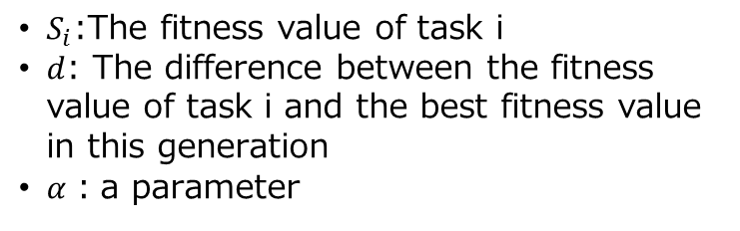
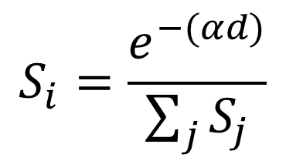
Selection
Initialization
We uses the roulette wheel to select chromosome.
Fitness Function
$$S_{i}=\frac{e^{−(αd)}}{\sum_{j}{S_{j}}}$$
Selection
$S_{i}$:The fitness value of task i
$d$: The difference between the fitness value of task i and the best fitness value in this generation
$α$：a parameter
Crossover
Mutation
The good chromosomes have a larger segment.
Every chromosome has the opportunity to be selected even with a bad fitness values.

Slide 10
Crossover
Initialization
produce the child chromosome from two selected chromosomes.
Fitness Function
Randomly selected cutting points
Chrom A
1 | 2 | 5 | 3 | 4
Selection
Chrom B
4 | 1 | 5 | 2 | 3
Crossover
Child
1 | 2 | 4 | 5 | 3
Mutation
Our algorithm guarantees that the child is valid.

Slide 11
Mutation
Initialization
Produce new chromosome by randomly changing one or more genes.
Fitness Function
Example:
Try to change Task5:
1 | 2 | 5 | 3 | 4
Selection
All Possible mutations:
1 | 2 | 5 | 3 | 4
Crossover
1 | 2 | 3 | 5 | 4
S
1
( 3,30)
2
( 1,10 )
1 | 2 | 3 | 4 | 5
Mutation
3
( 1,10 )
4
( 1,40 )
5
( 3,20)
E
Mutation guarantees that the new chromosome is valid.

Slide 12
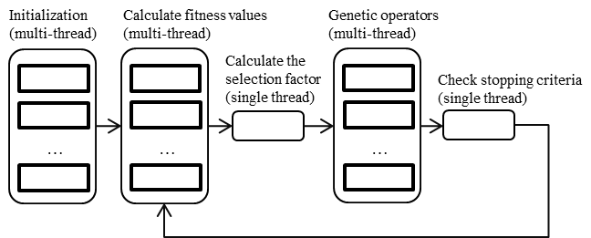
Parallelization of the Algorithm
Our algorithm is inherently parallel.
Can speedup by OpenMP.

Slide 13
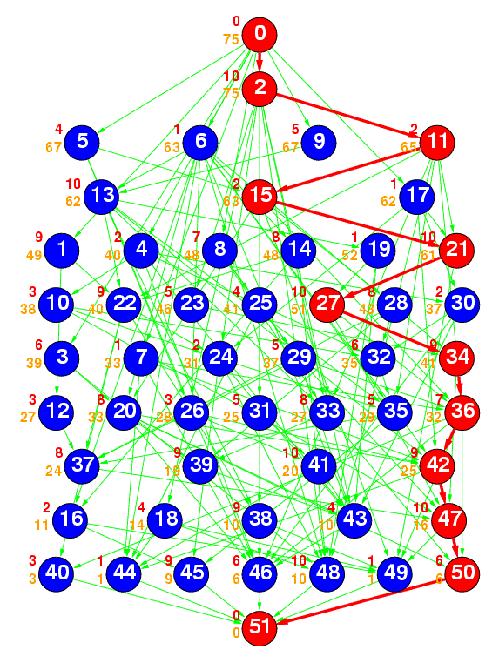
Experiments
Benchmark
Standard T Graph (STG) Set
http://www.kasahara.elec.waseda.ac.jp/schedule
20 task graphs with 50 tasks
20 task graphs with 100 tasks
The number of cores: 4
Compared methods
PCS algorithm (IJNC 2014)
Dual-mode algorithm (APCCAS 2014)
B&B (SASIMI 2016)
The parameter of proposed GA
50 iterations
16384 population
Mutation rate 5%
Notes:
To evaluate the proposed algorithm, We use Standard T Graph Set which developed at Waseda University.
Standard T Graph Set* (STG) is a kind of benchmark for evaluate scheduling algorithms.
We choose 20 graphs with 50 tasks, and more 20 graphs with 100 tasks.
The total number of cores was changed from 2 to 32.
And the experimental resultasks are compared with PCS algorithm.

Slide 14
50 Tasks on 4 cores

Slide 15
100 Tasks on 4 cores

Slide 16
Execution time
 | 4 cores | 8 cores
B&B [19] | 0.89 – 43,200 (suspended) | 0.93 – 43,200 (suspended)
PCS [17] | < 0.01 | < 0.01
Dual-mode [18] | < 0.01 | < 0.01
GA (this work) | 3.81 – 4.37 | 4.21 – 4.84
Parallelized GA (this work) | 0.48 – 0.65 | 0.52 – 0.68

Slide 17
Conclusions & Future
Conclusions
We proposed a GA for the task scheduling problem with both task and data parallelism
we proposed a new chromosome representation and corresponding genetic operators
We also proposed a parallelization method for the genetic algorithm.
Future
we plan to extend our GA for scheduling problem with inter-task communication

Slide 18
Questions?

Slide 19
Background
Motivation
Due to the rapid spread of many-cores, Task scheduling became more important than ever.
Consider both task and data parallelism is a efficient way to fully utilize multicores
Although Genetic algorithm (GA) are often used for scheduling, few studies consider both task and data parallelism.
Challenging
This is a NP-hard problem
Aim to find a novel a representation for the chromosome of task scheduling to reduce the search space and improve the computing speed.

