Slide 1
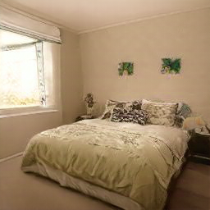
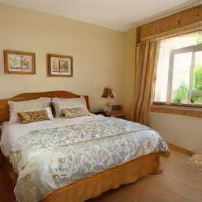
+
Be ready to see and
remember an image
Memorize the image
Hold the image
in memory!
The image on the left will change
based on your mouse position.
Find the memorized image by
click within the circle

Slide 2
+
Be ready to see and
remember an image
Memorize the image
Hold the image
in memory!
The image on the left will
change based on your mouse position. Find the memorized
image by click within the circle

Slide 3


+
Be ready to see and
remember an image
Memorize the image
Hold the image
in memory!
The image on the left will
change based on your mouse position. Find the memorized
image by click within the circle

Slide 4

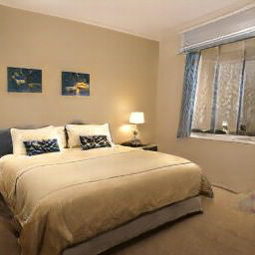
+
Be ready to see and
remember an image
Memorize the image
Hold the image
in memory!
The image on the left will change
based on your mouse position.
Find the memorized image by
click within the circle

