Slide 2
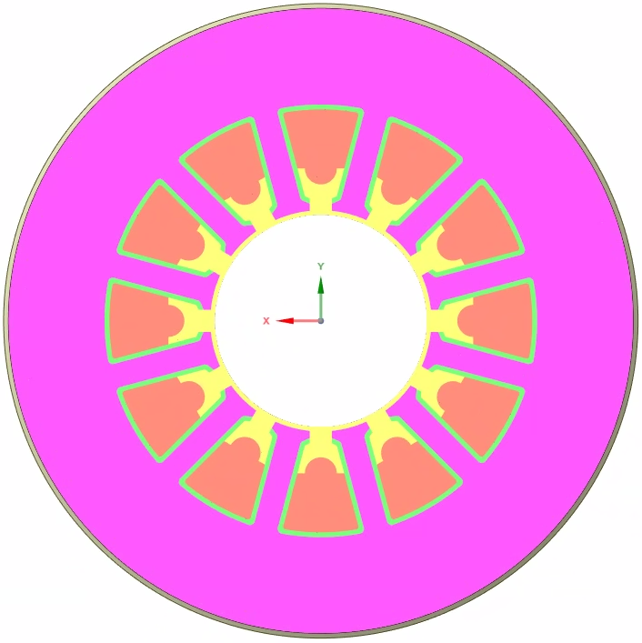
Motor Parts
Inputs
2D Pic
Materials
Ambient T
Power losses
stator
insulation
winding
potting
Outputs
T@each part

