Slide 1
WAR in java
Eston P Penwell
Drew Davis

Slide 2


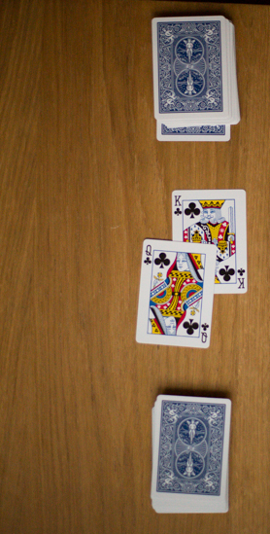
Elevator pitch
The war game is a great idea for the reason of its universal concept. Almost everyone knows how to play, and it is fundamentally a fun and simply game to play. Furthermore, It would be a great way to demonstrate the number system to children to provide them a helpful tool to see which number is bigger in a deck of cards.

Slide 3
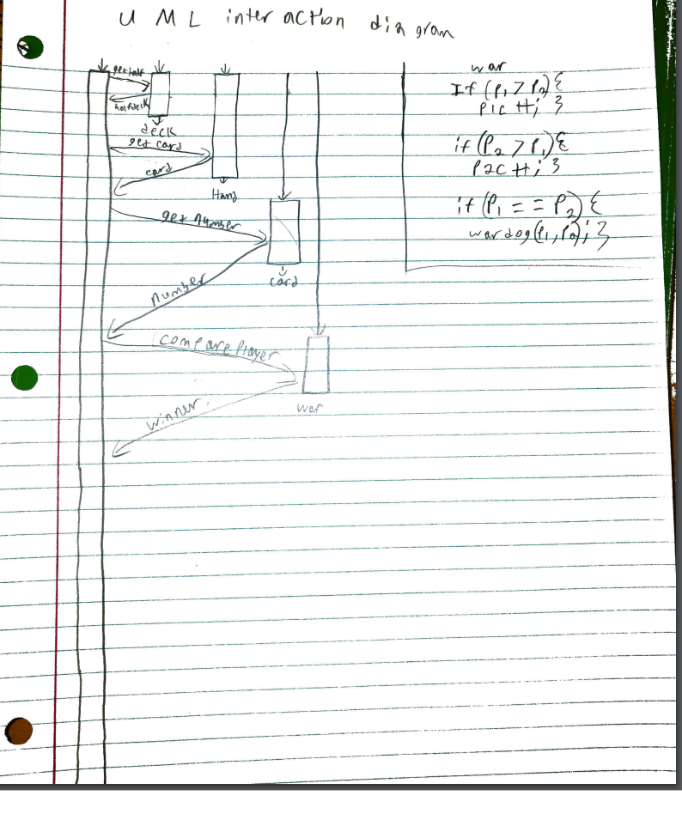
UML

Slide 4
war Deck
This implements the war program
We created another class to handle this sequence of events
This class displays three cards while also declaring war
After which it checks them to see who won and displays the winner of the war
Furthering said players points

Slide 5
Score system
We decided to introduce a score method instead of creating a new deck
Based on creating a class variable
The class variable increases when someone wins
When a certain score is reached the game sequence ends and the winner is announced
Special instances like war create a special scenario

Slide 6
Thank you

