Slide 1
AIR CREW TRAINING
160th Special Operations Regiment

Slide 2
Contents
Objectives
Hierarchy
Radios
Ground Support Ops
Parachuting
Gunnery
Combat Search and Rescue (CSAR)
Combat Air Support (CAS)
Co-Pilot Navigation

Slide 3
Objectives
To know Airborne hierarchy
To know mission server join tasks
Show demonstrated ability/understanding on how to;
operate TFAR radio systems
operate a parachute accurately
perform vehicle ground support ops
perform Blackhawk fire missions
call in a Combat Air Support (CAS) strike on a target
navigate and direct a pilot to a reference point acting as a co-pilot
Learn
SOPs
Practice
Parachuting
Pass
TFAR
CAS calls
Ground Ops
Navigation
Gunnery

Slide 4
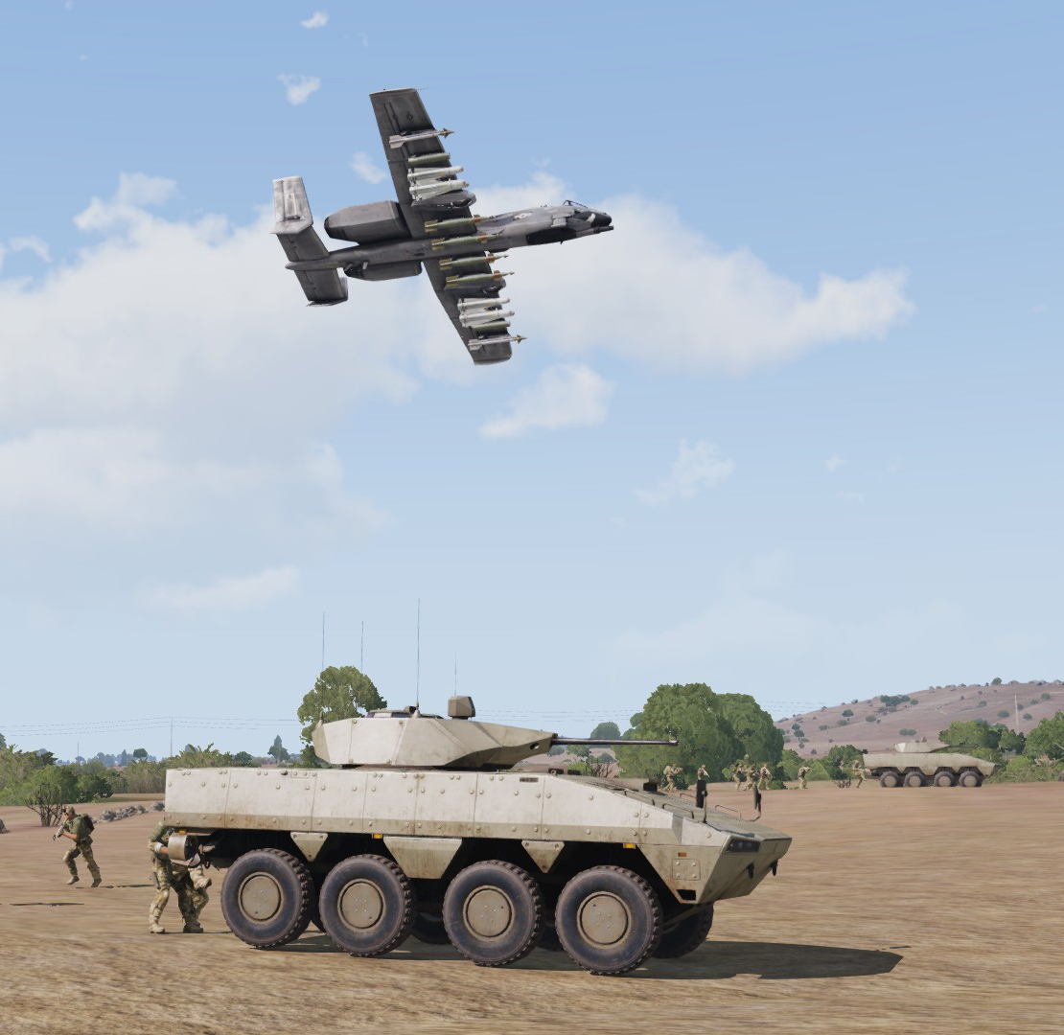
hierarchy

Slide 5
hierarchy
Jupiter
Delegates positions usually based on rank on Wed missions
Eagle
Pegasus
Angle
Medivac
Flight Crew
CAS missions
Liaises with ground for fire missions
Issues directives /initial tasks
CAS missions
Liaises with ground for fire missions
Combat SAR missions
Troop transport (insertions / extractions / relocations)
Usually not in direct combat situations
Supply drop missions
Co-pilots (Second in command in the aircraft)
Monitor loading and unloading of personnel and cargo (If there is no crew chief)
Gunners/Crew chief (Third in command in the aircraft)
Monitor loading and unloading of personnel and cargo
Airborne Para Jumper “PJ1” (Forth in command in the aircraft)
Monitor loading and unloading of personnel and cargo (If there is no crew chief)
Manage wounded
Liaise with the crew chief for supplies
Supports all 160th units as required
Combat Search and Rescue (CAS)
Troop transport (reinforcements only, usually)

Slide 6
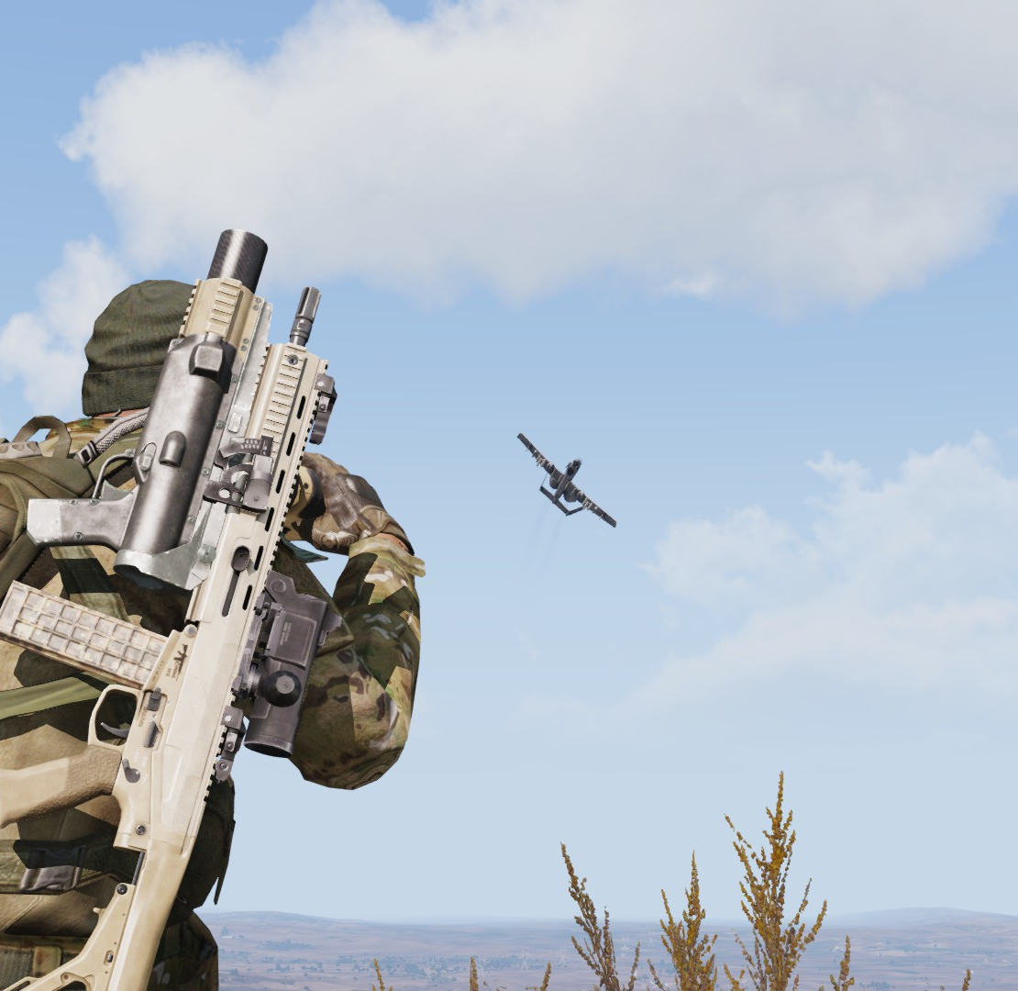
Radios

Slide 7
radios
Long wave and short wave setup as per 10th Aviation Regiment SOPs.
Accessing equipment
Alt + P for Long wave
Ctrl + P for Short wave
Volume adjustments
Important freqs should be able to drown out less important freqs
Left and right headset channel selections
Alt + ← → for Long wave left or right ear selection
Ctrl + ← → for Short wave left or right ear selection
Additional channel selection
7LW for “Havoc” CAS missions
5LW for air and Jupiter chatter
5SW for air short wave chatter

Slide 8
radios
Reference your callouts (Are you using the recipients vantage point or yours?)
Target indication
Needs to be 3 dimensional
Bearing/clock direction, distance (approximate if not known) and height (high/low/ same level)
Compass bearings
Clock codes
Always reference from the receivers point of view, not yours (unless you are both in the same aircraft)
“Enemy helo 12 o’clock level 600 meters” directly in front at the same level
“Enemy tanks 3 o’clock low 100 meters” to your right, low and close

Slide 9
Ground support ops

Slide 10
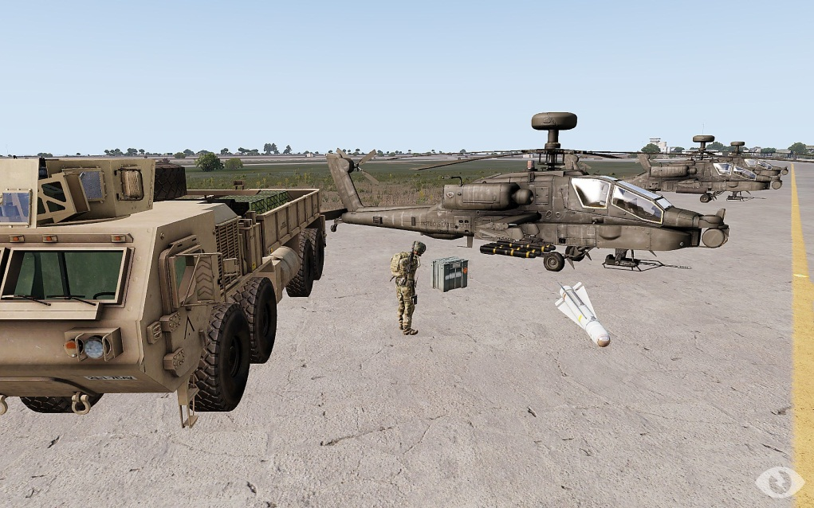
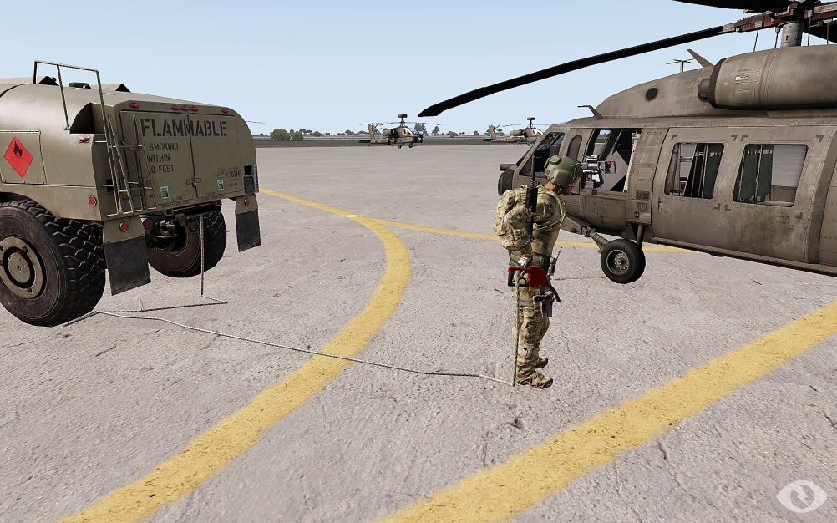
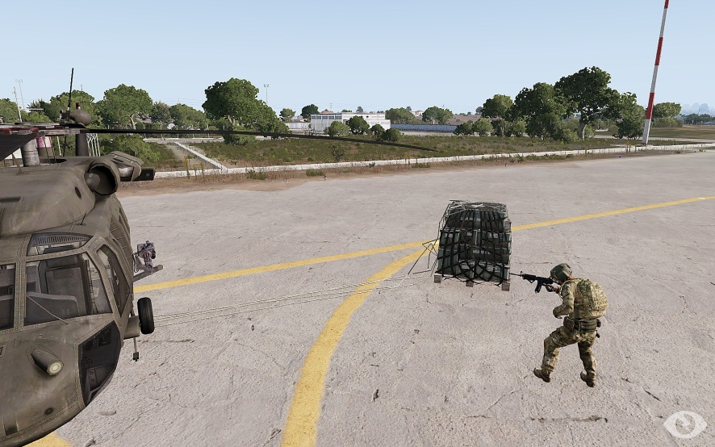
Ground support ops
Repairs
ACE interaction
Must have a toolkit backpack
Full repair only available near a repair truck
Rearming
ACE interaction
Must be near ammo truck
Caution hitting others !!
Refuelling
ACE interaction
Limited hose length
Back up truck for best results
Caution hitting moving heli rotors !!
Sling Loading
Mouse scroll user action
Don’t climb on attached objects !!

Slide 11
parachuting

Slide 12
parachuting
If choosing to do a manual jump, MAKE SURE YOU HAVE A CHUTE !!
If performing a script based jump, chute is supplied automatically
Caution landing on slopes (ARMA bug)
Caution trees (they hurt!)
Hostile LZ’s should be avoided (Think high velocity piñata!)
Chute open height (Based on having the ability to see your altitude):
110m is safe
90m is safe minimum flight time
-80m possible injury on landing
-70m expect death on impact
When controlling a steerable chute be sure to confirm controller joystick, mouse or keyboard.

Slide 13
Gunnery

Slide 14
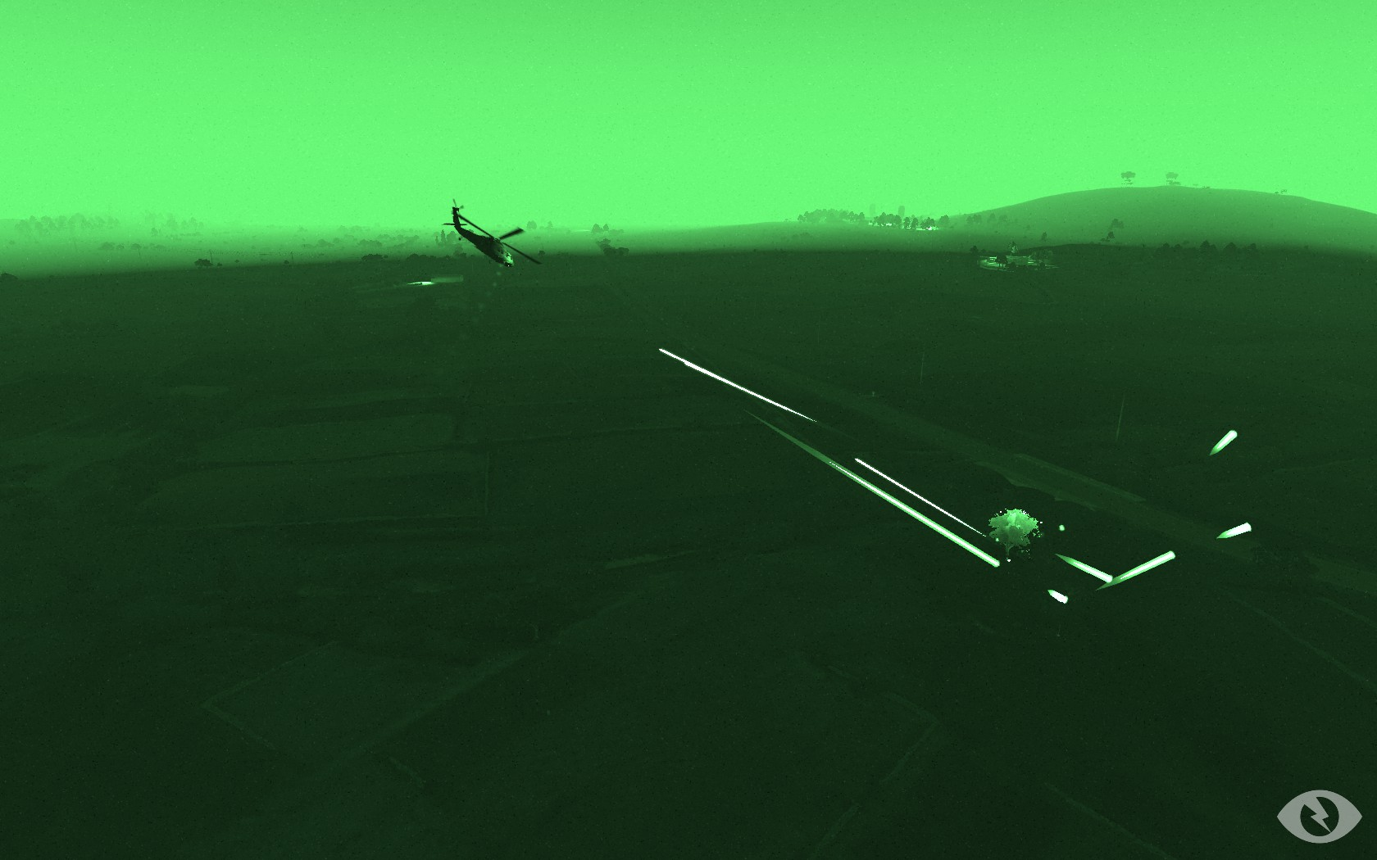
Gunnery
PID, PID, PID
Aim high
Don’t shoot towards Blufor !!
Ricochets can happen up to 45°

Slide 15
Combat Search and Rescue

Slide 16
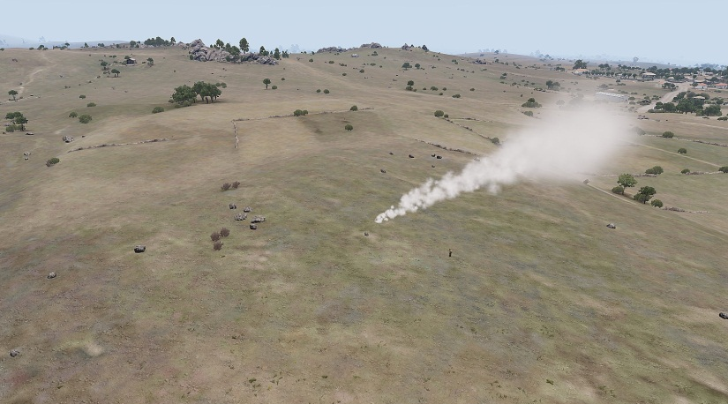
Combat search and rescue
Use your surroundings to navigate, be sure to note the big (easy) features such as:
Hills
Coastline
Roads
Towns/ man-made objects
Use MAP/GPS or “9 line” numbers XXXXXX
When using grid refs remember to read from the TOP first then LEFT
Ref BIT notes for more information
When calling in your position don’t forget to note features
“Next to building with red roof”
Note possible entry directions if area is hostile to maximise cover

Slide 17
Combat air support

Slide 18
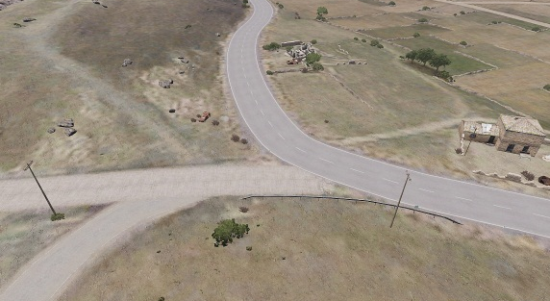
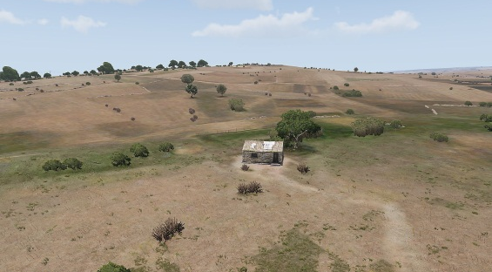
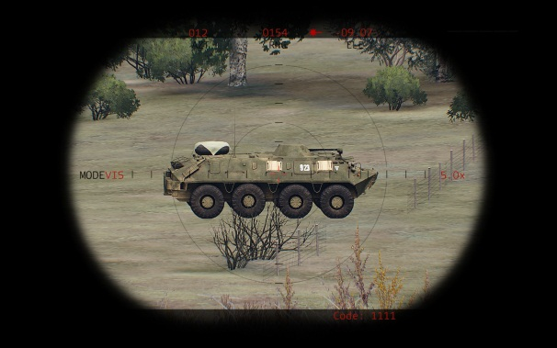
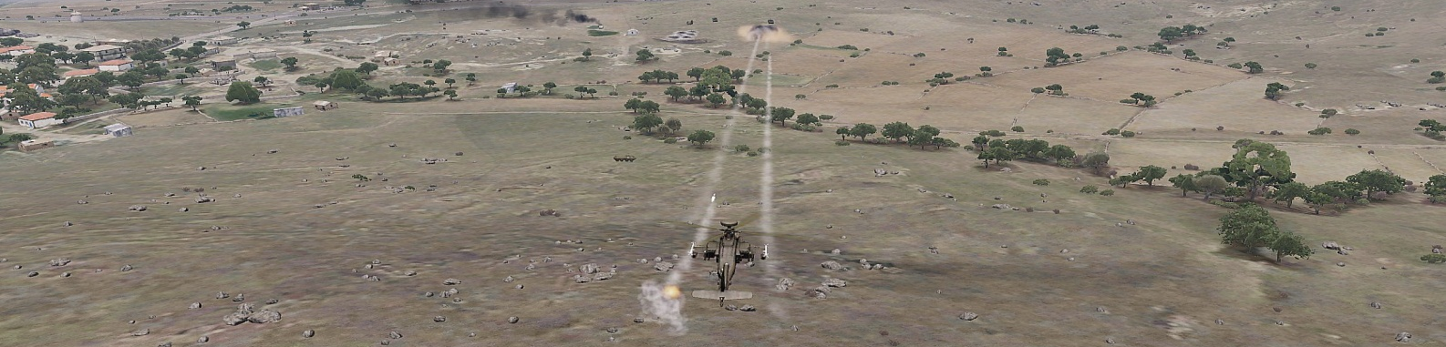
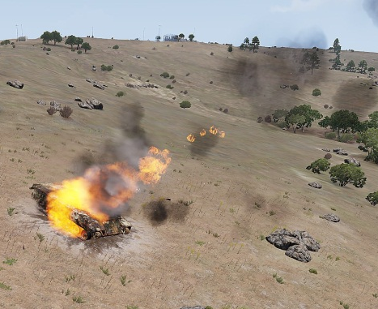
Combat air support
Use your surrounding features to ID the map grid position; use easy features like:
Roads
Hills
Buildings etc.
When using a Laser Designator, simple precautions must be taken:
Make sure the pointer is on the target that is visible from above.
Inform the asset of which direction to approach the laser.
(The asset needs to come over your shoulder and be facing the same direction as you)
Make sure to turn off the Laser after the strike is complete or it may still continue to be visible from the asset

Slide 19
Co-Pilot Navigation

Slide 20
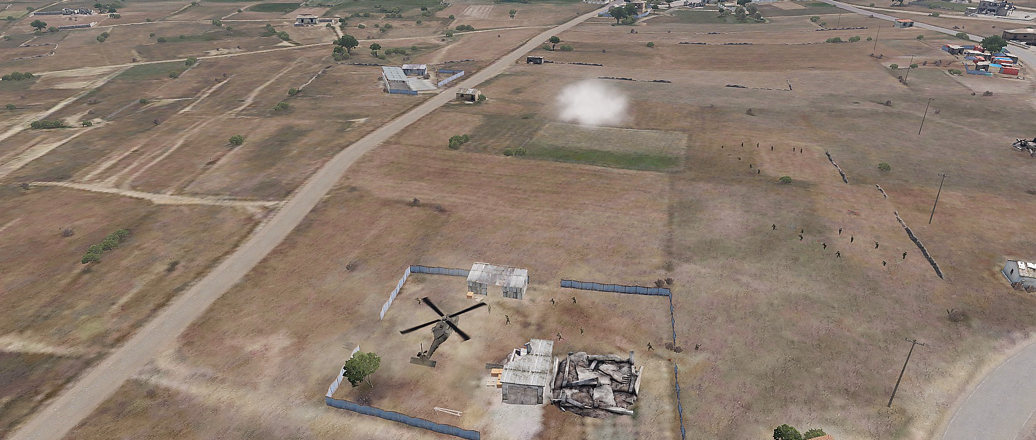
Co-Pilot Navigation
When navigating for a pilot, simple clear commands are crucial.
Easy to absorb information can be in the form of:
“Clock code” styled directions using the front of the chopper as a reference
Compass bearings
Visual (easy) features e.g. “The red house on your left”
When directing to an LZ, consider the surrounding area.

Slide 21
Objectives
To know Airborne hierarchy
To know mission server join tasks
Show demonstrated ability/understanding on how to;
operate TFAR radio systems
operate a parachute accurately
perform vehicle ground support ops
perform Blackhawk fire missions
call in a Combat Air Support (CAS) strike on a target
navigate and direct a pilot to a reference point acting as a co-pilot
Learn
SOPs
Practice
Parachuting
Pass
TFAR
CAS calls
Ground Ops
Navigation
Gunnery

