Slide 1
Requiem Registry Design
By Samantha Cook, Lucas Gamboa, Bricen Hicks

Slide 2
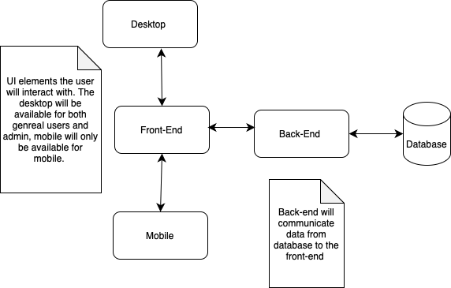
Block Diagram

Slide 3
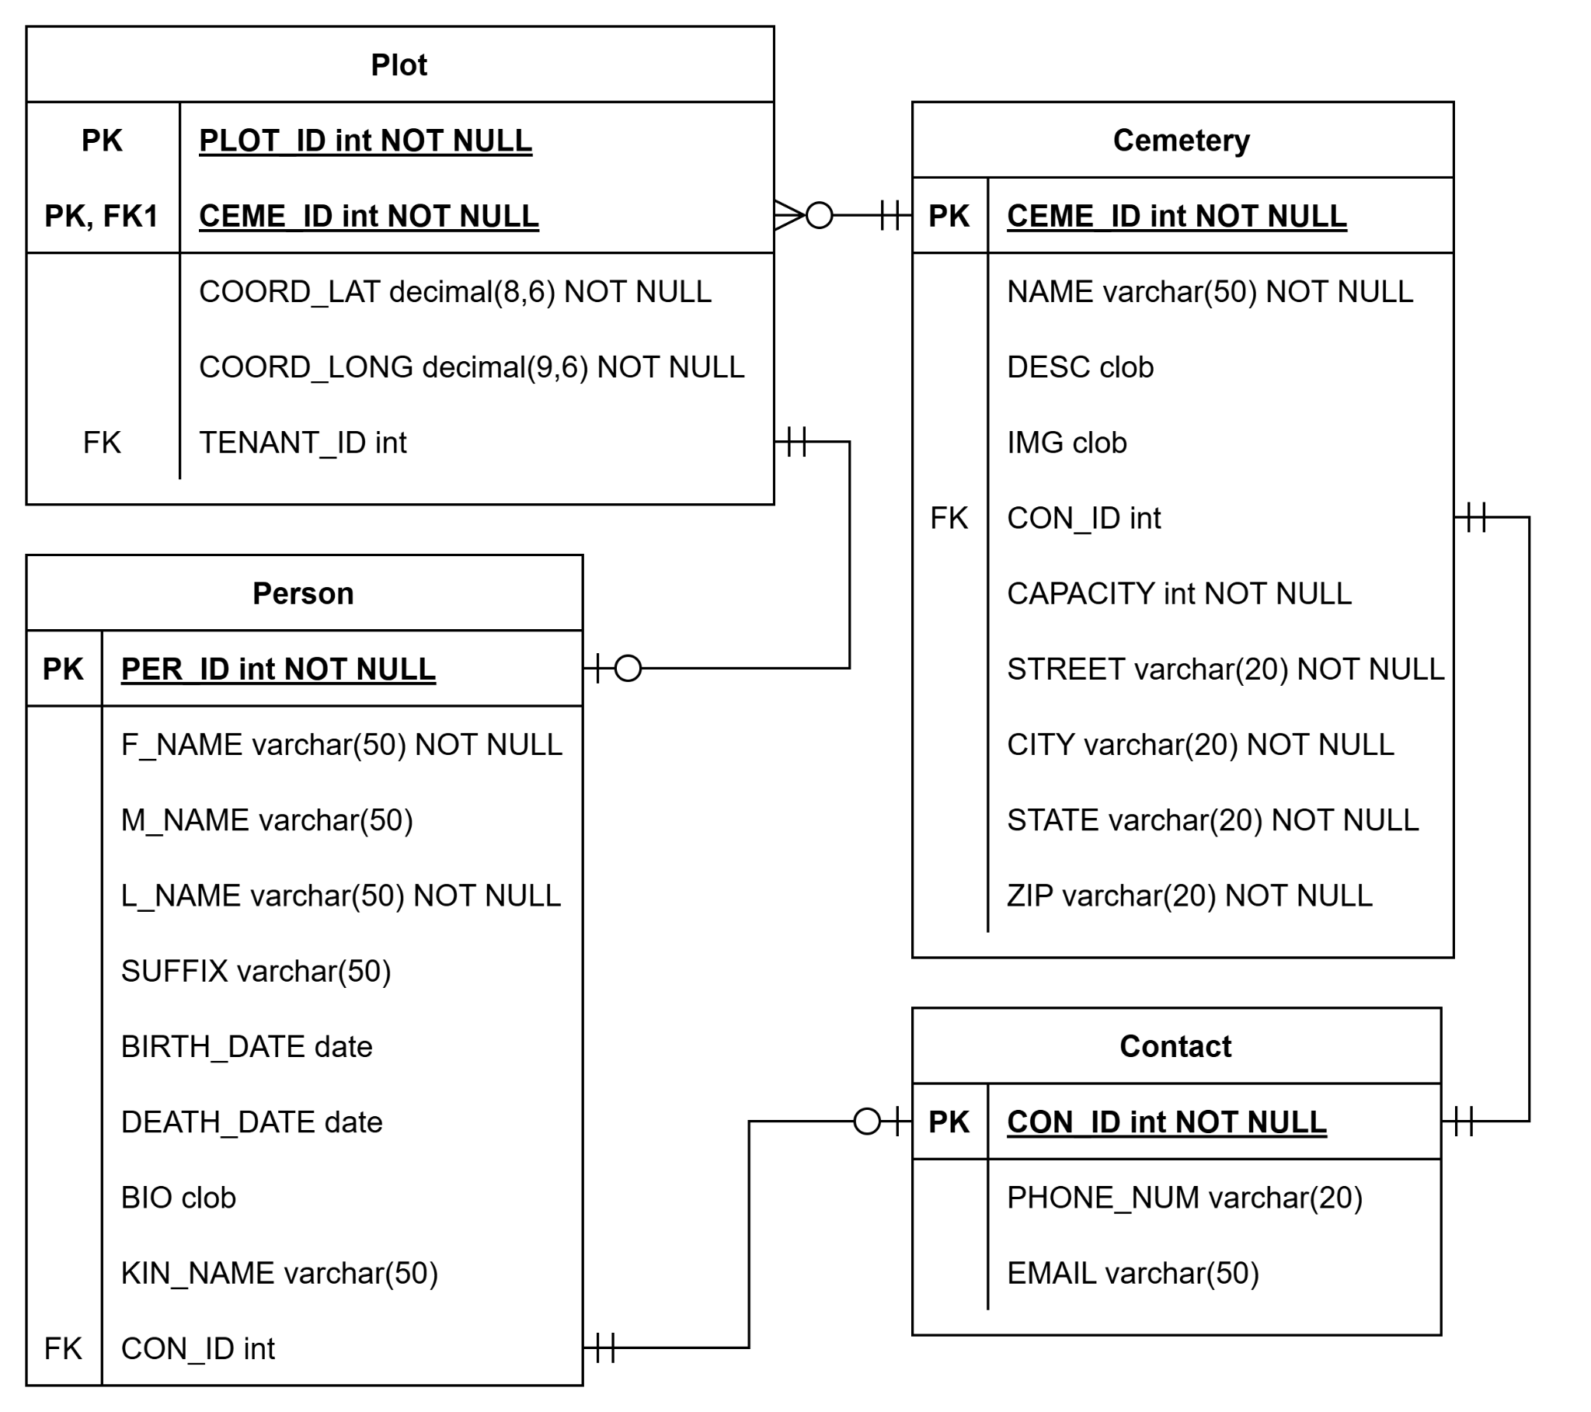
ER Diagram
Four tables
Cemetery
Name, capacity, and address required
Plot
Composite Key
Coordinates included
Person
Stores personal information
Contact
Two methods of contact
Shared by two tables
Images and lengthy text stored as CLOBs
Notes:
This ER diagram here shows what information our database will store. Note that the diagram as a total of 4 tables, these are: Cemetery, Plot, Person, and Contact.
The cemetery is about one the most important tables, as it is an anchor for the plots. With that in mind, attributes such as the name, capacity and addressed must be provided upon creation of an instance.
Next is the Plot table, which each instance being identified by both the plot’s number and the cemetery it belongs to. Since our plots are made by placing them in the map page, their coordinates are immediately known and can be filled in upon creation. Lastly, the plot can have the ID of its tenant, which refers to a person.
The Person table is where we’ll store a person’s full name and their date of birth and death. It can also store the person’s biography, the name of their next of kin, as well as this kin’s contact information, which will be held in it’s own table.
Lastly, the Contact table is used to hold

Slide 4
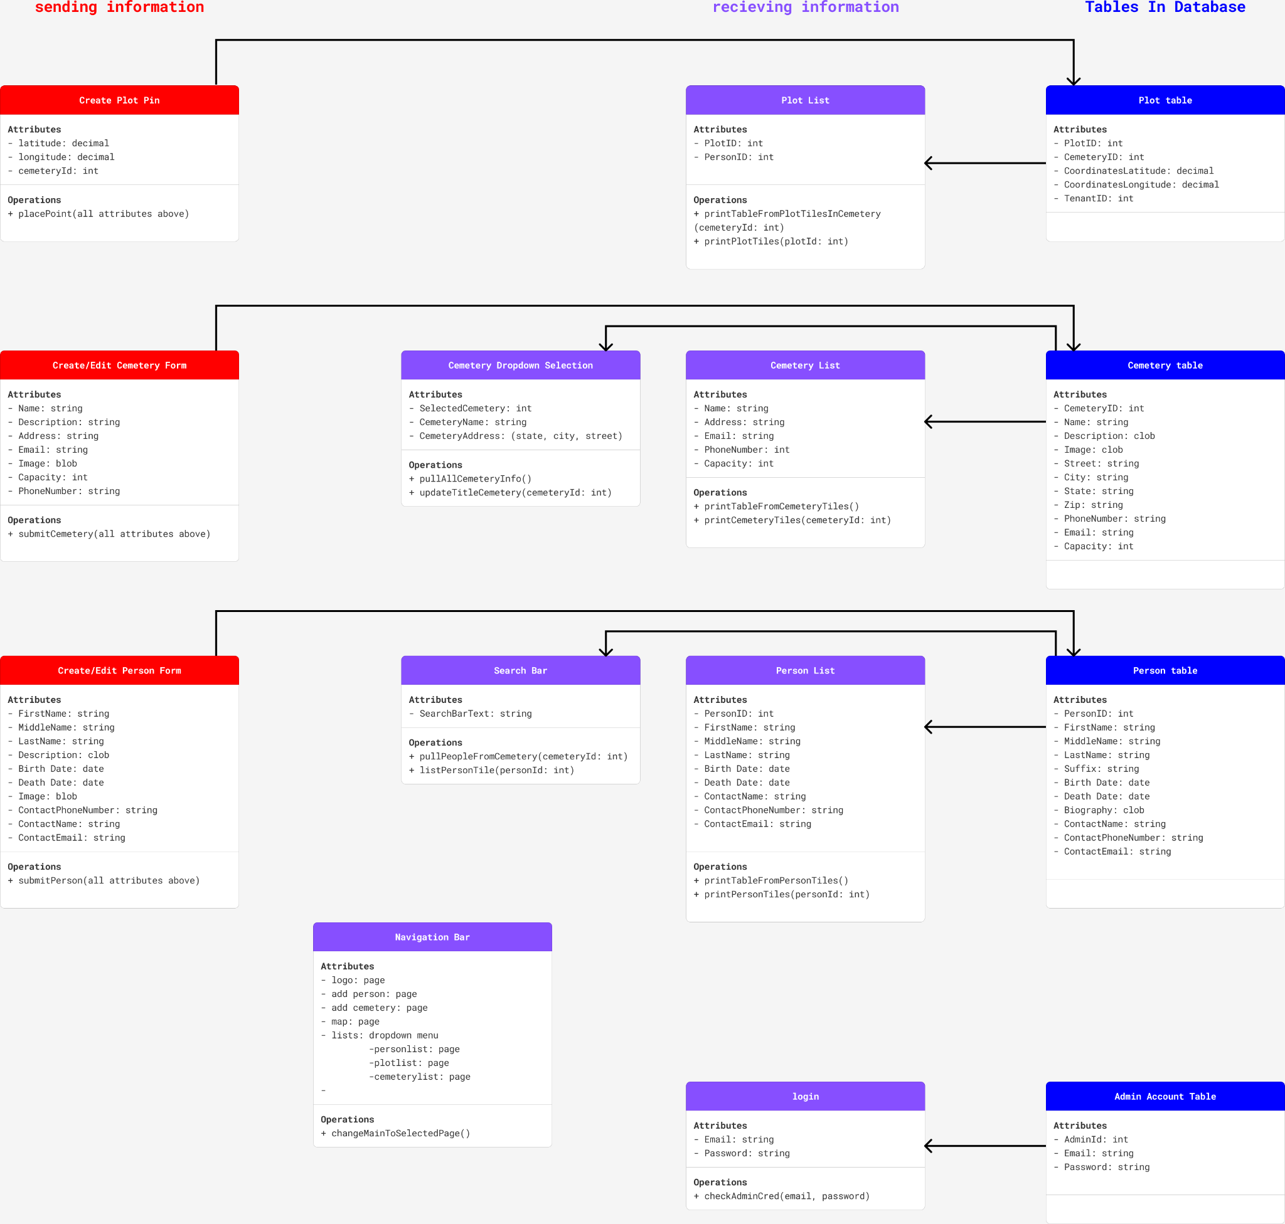
Component Diagram

Slide 5
Component Diagram cont.

Slide 6
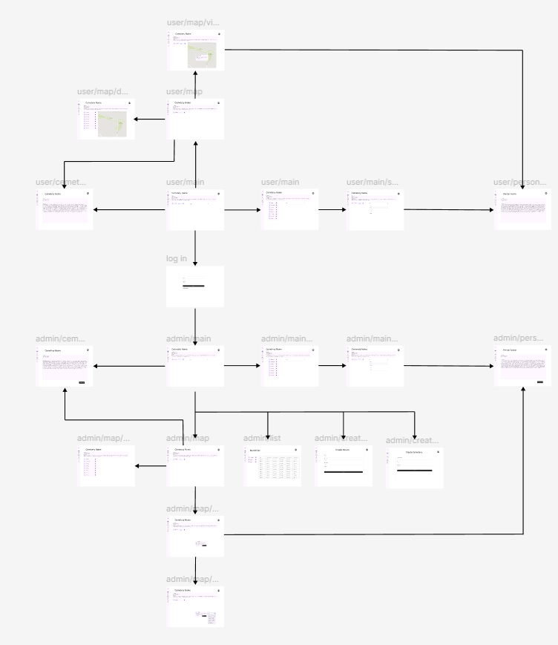
Storyboard UI
User
Login
Admin

Slide 7
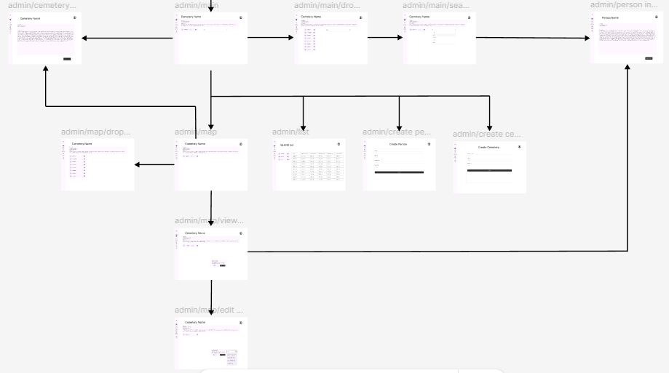
Admin side of StoryBoard UI
Cemetery info
Search Bar
NavBar - (map, lists, create cemetery & people)
Cemetery info/edit
Pick Cem.
Person info/edit
Edit plot link

Slide 8
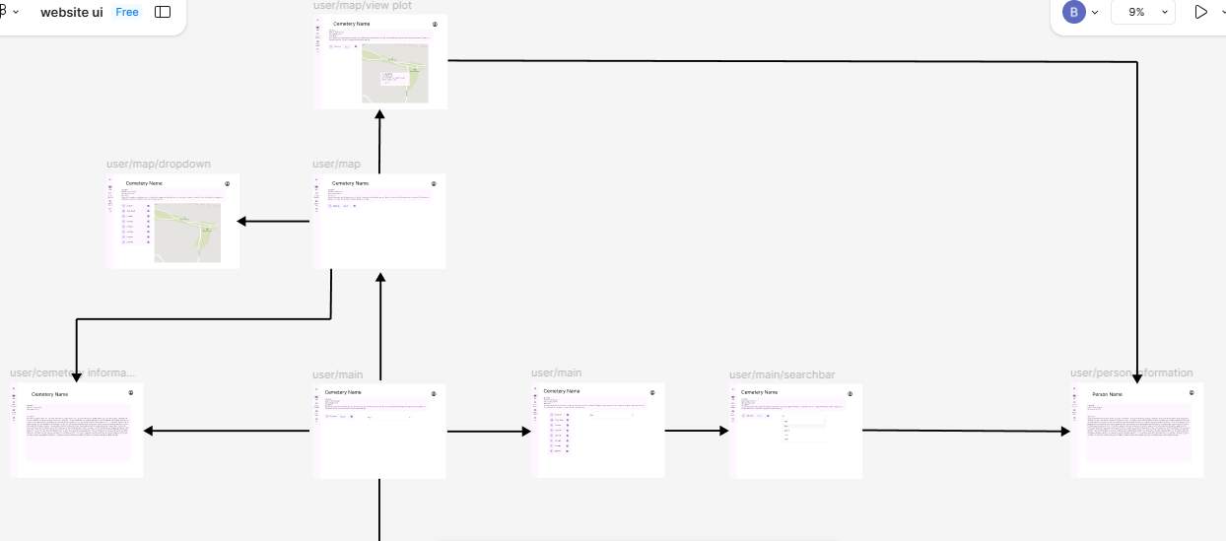
User side of Storyboard UI
Picking cemetery
Person info through plot link
Navbar - (map)
Person info through search
Cemetery info

Slide 9

Logo
Clicking on Logo in website will reroute to the Homepage of website.
This works for both General Users and Admin Users.

Slide 10
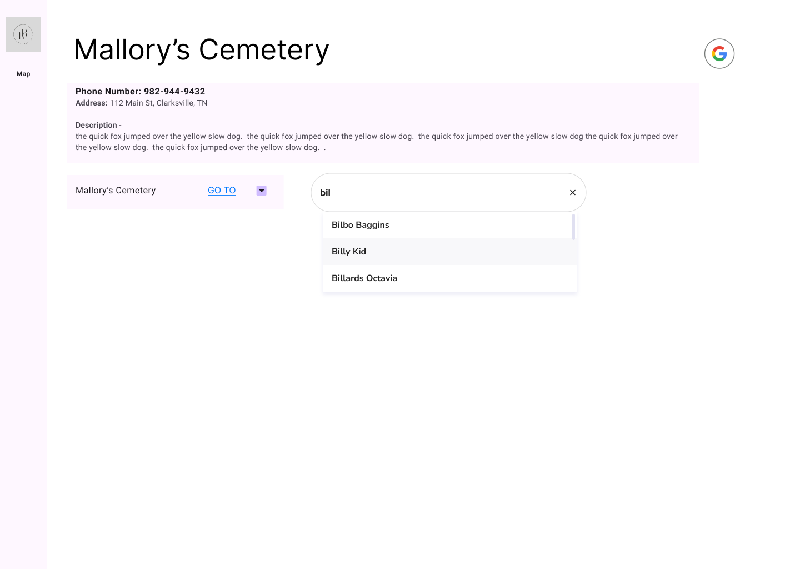
Home Page UI General User
Cemetery Information
Cemetery Dropdown Menu
Button redirects to Cemetery Page
Person Search Bar
Redirects to Person Page
Notes:
This is the first page people will see when visiting the website. It has the information of the current selected cemetery, this includes the address, a description, and its contact info if available. This page also has a dropdown Menu to change the current cemetery, I’ll talk more about that later, what I want to focus on now is that GO TO button on the dropdown menu. Clicking that will redirect the user to Cemetery’s page (Next Slide).
Going back to the home page, the next feature this page has is the search bar, which is used to find people who are buried in this Cemetery. It’ll provide suggestions when users type into it, and if they hit enter with a valid name or they click on one of the suggested names, they’ll get redirected to that person’s page. (Move 2 slides forward).

Slide 11
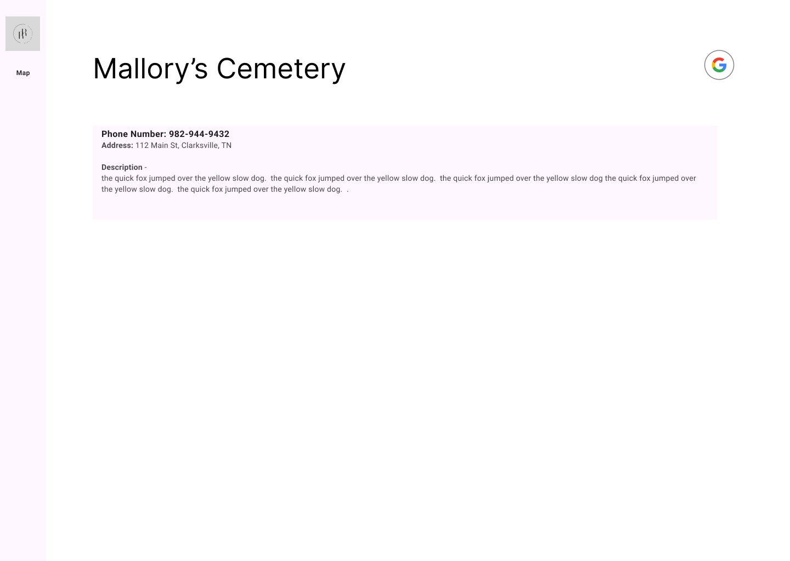
Cemetery Page General User
Room for longer descriptions
Notes:
This is pretty much a strip down home page where there's more room for the Cemetery’s description or an image if provided. (Go back a slide).

Slide 12
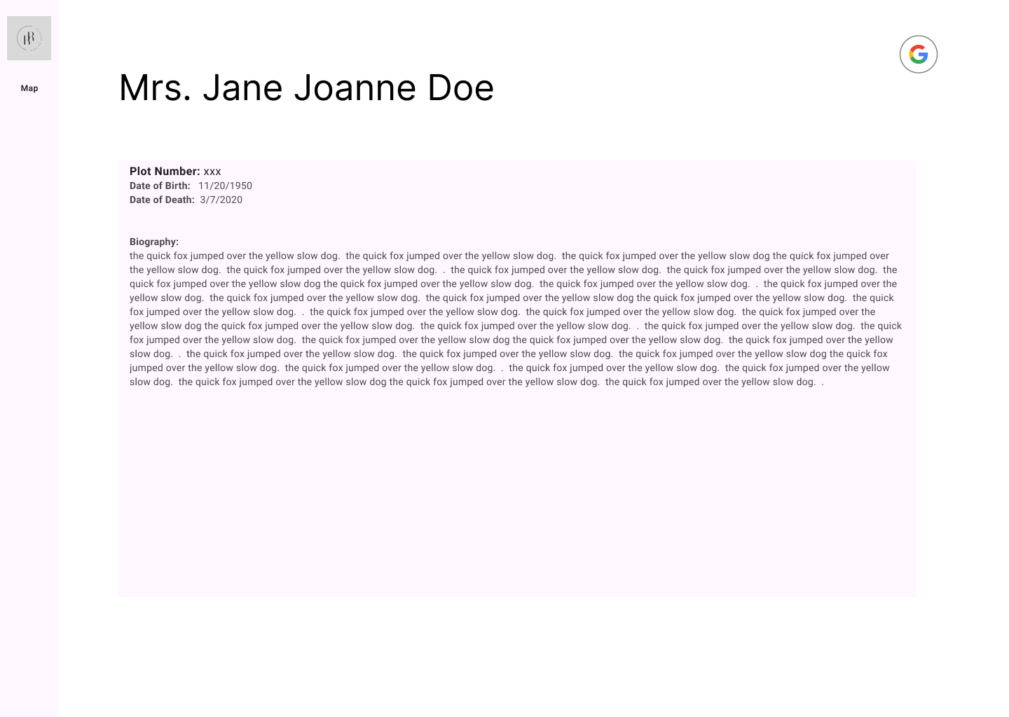
Person Page General User
Presents Person’s Information
Navigation Bar
Logo Button
Map Button
Notes:
This page is where a Person’s information is shown, this includes their full name, the date of their birth and death, their biography, and the number of the plot they were buried in. This isn’t the only way to get to this page or others, notice the navigation bar on the left hand side, it has two buttons. The first one at the top is the logo button, which as Sam mentioned is used to go back to the home page, but below that is Map button, which can take the users to the Map Page. (Next slide)

Slide 13
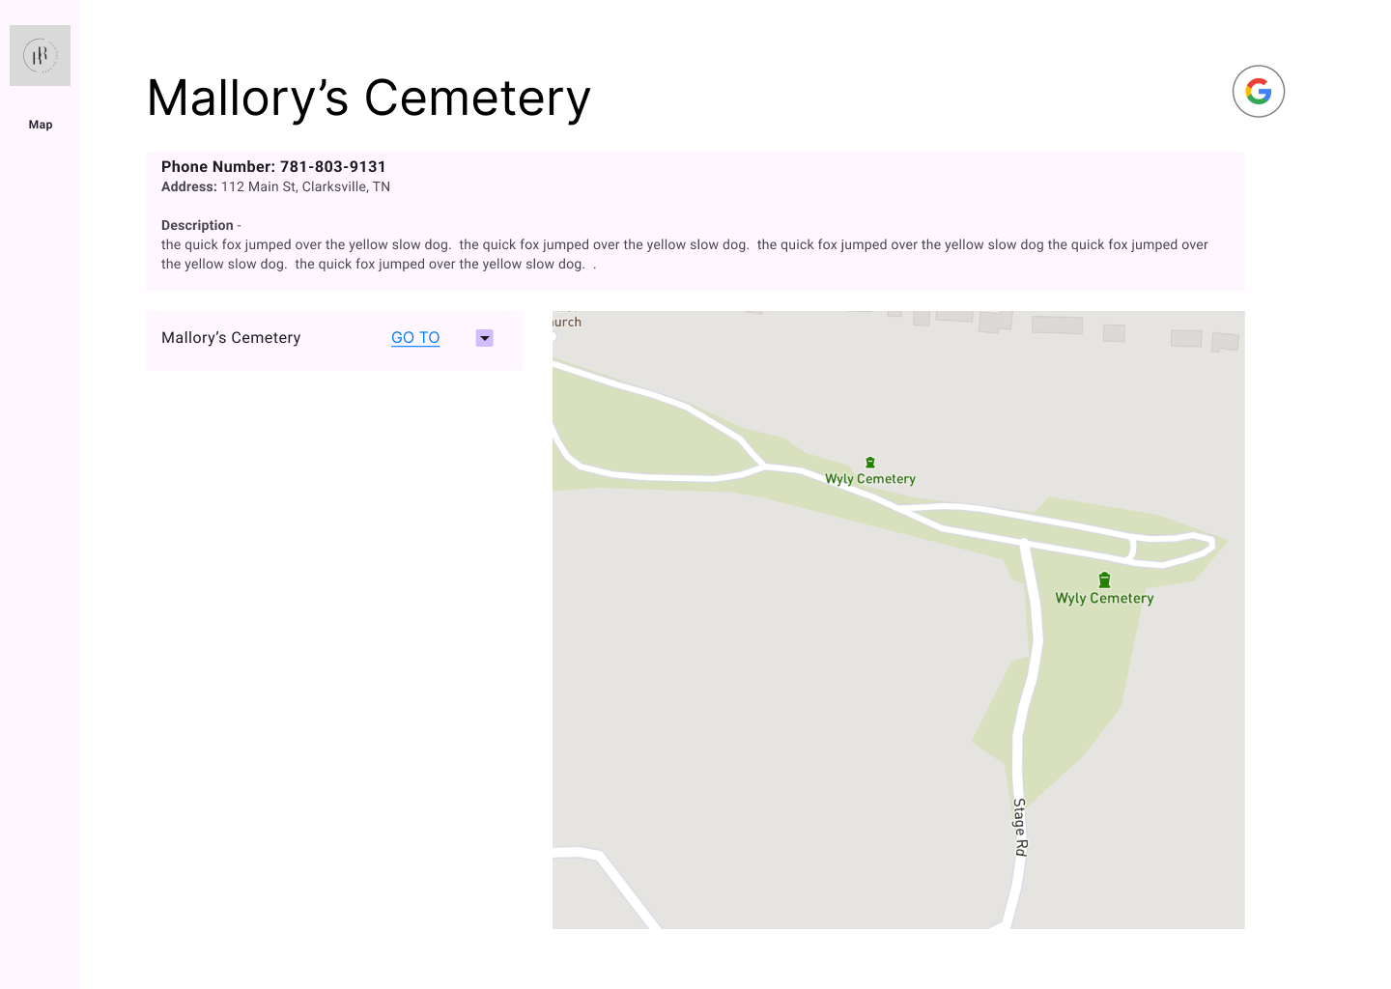
Map Page
General User
View Cemetery from the Sky
Locate Occupied Plots
Notes:
The map page gives users a view of the selected cemetery from above, with this, they can find Occupied plots in the cemetery. (Next Slide)

Slide 14
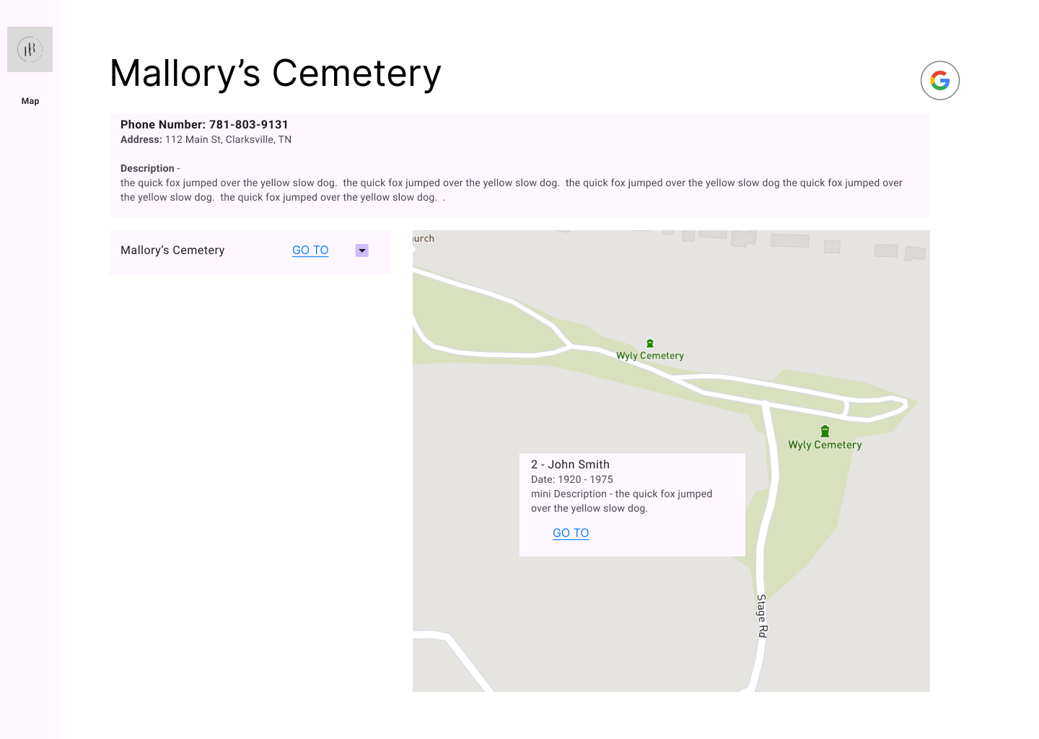
Map Page General User View Plot
Mini Popup with Person’s Info
Go To Button for Person’s Page
Notes:
Upon clicking one of these plots, a miniature popup will appear to display information about the plot’s tenant, which also include a GO TO button to redirect users to that person’s page. Plots that are visible on the map will be limited to those belonging to the currently selected Cemetery. To change that, the Cemetery Drop down menu is used (Next Slide).

Slide 15
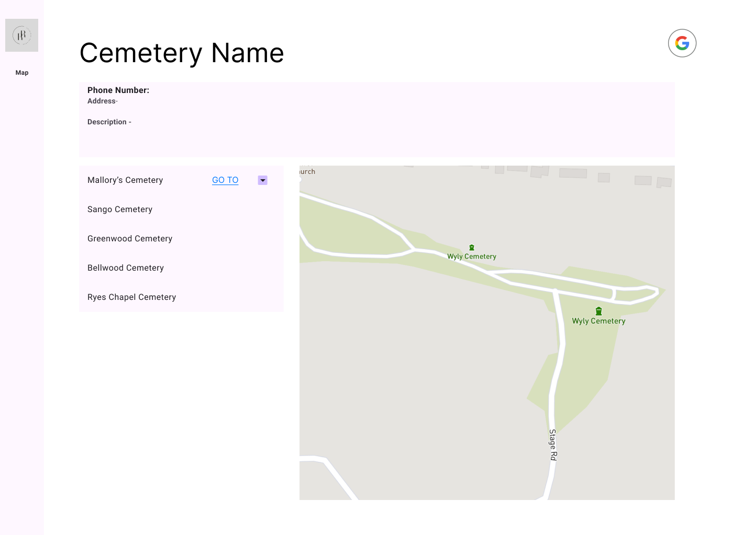
Map Page General User Dropdown
Cemetery Dropdown Menu
Used to Switch Cemeteries
Updates Cemetery Info
Login Button
Notes:
Clicking on it expands the menu into a list of the cemeteries in RR’s database. Selecting one of these will update the cemetery’s information, including what plots and people can be found in the Map page or the Home page’s search bar. By now, you’ve likely noticed the google icon in the top right corner of the screen, this is the login button for our admins, which I’ll let Sam explain now. (Next slide)

Slide 16
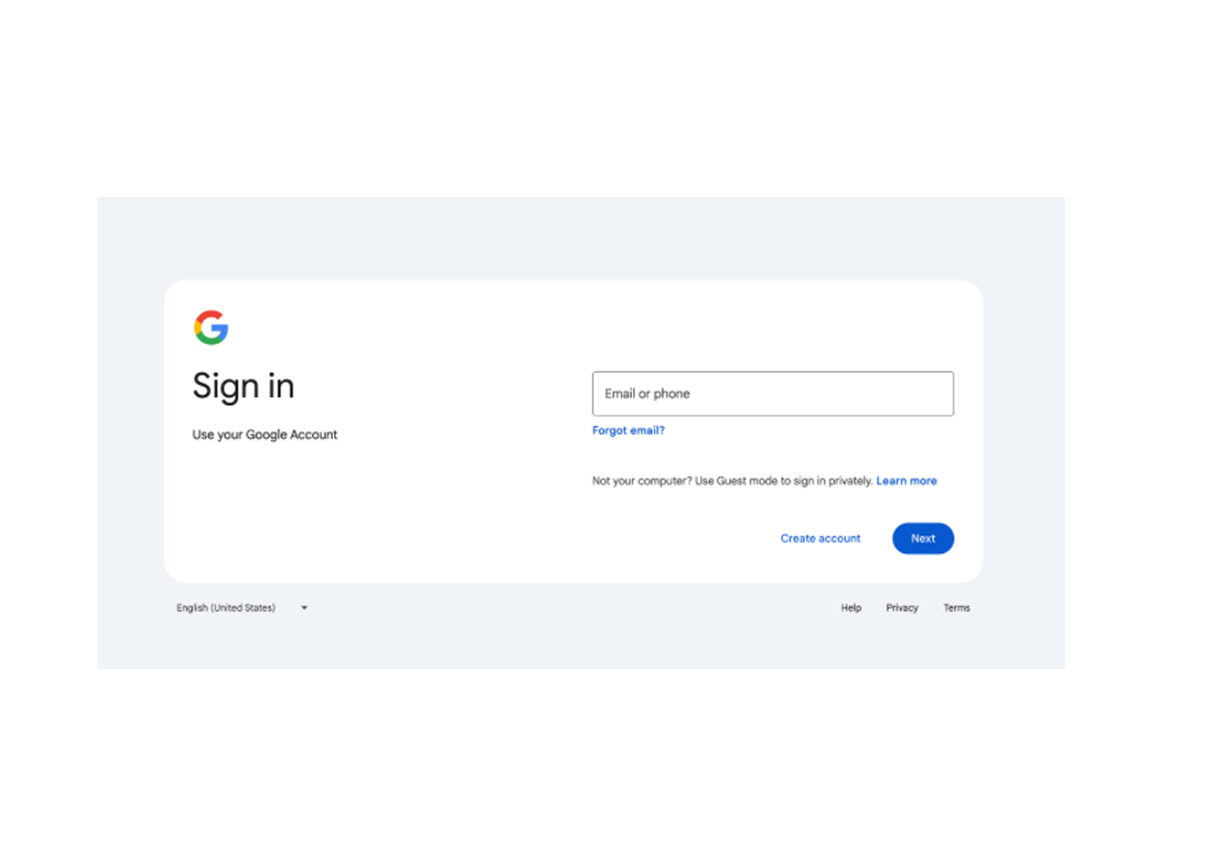
Google Sign-In
Sign-in process through Google API.
Users will be rerouted to this page to verify admin credentials.

Slide 17
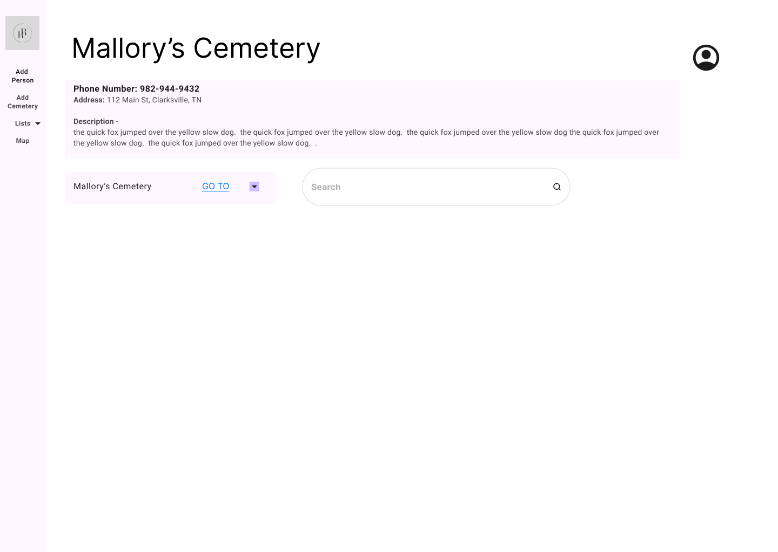
Home Page UI - Admin
Pressing the logo reroutes to this screen.
The previous Google logo is now profile image.
This is where Admin can click to log out.

Slide 18
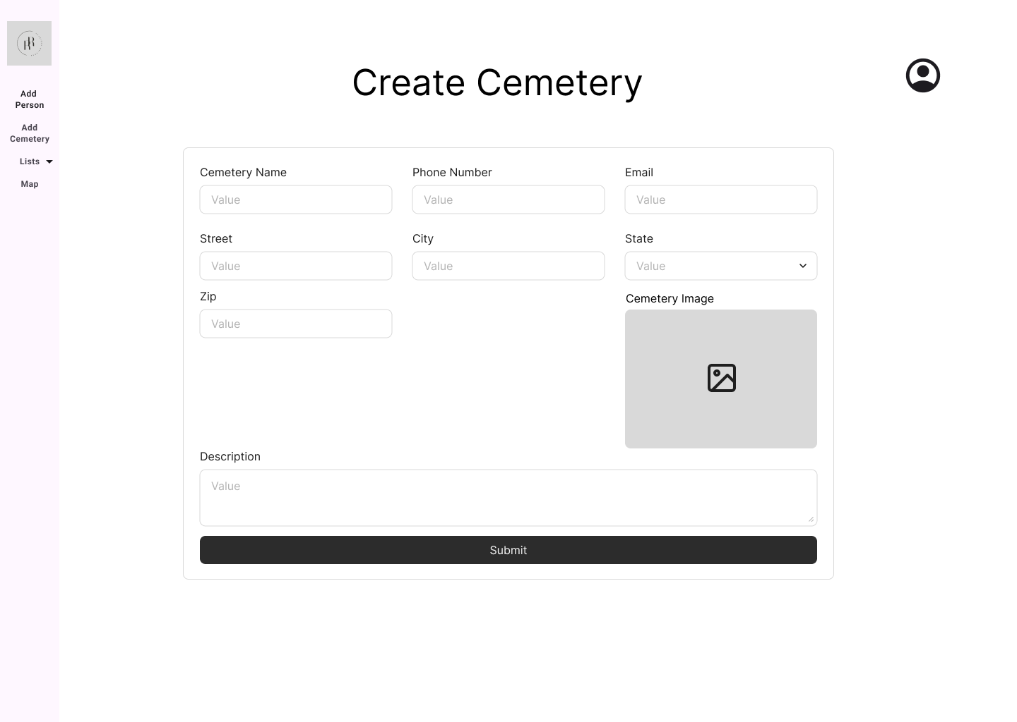
Add Cemetery

Slide 19
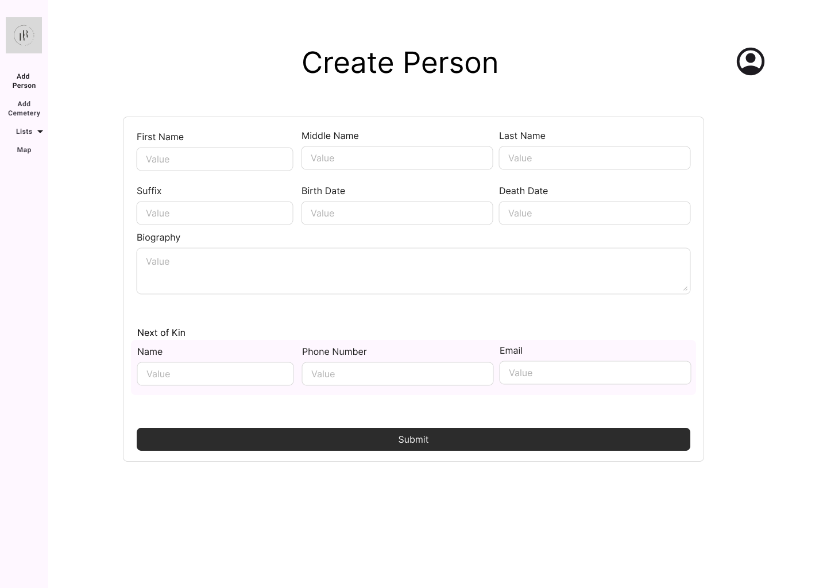
Add Person

Slide 20
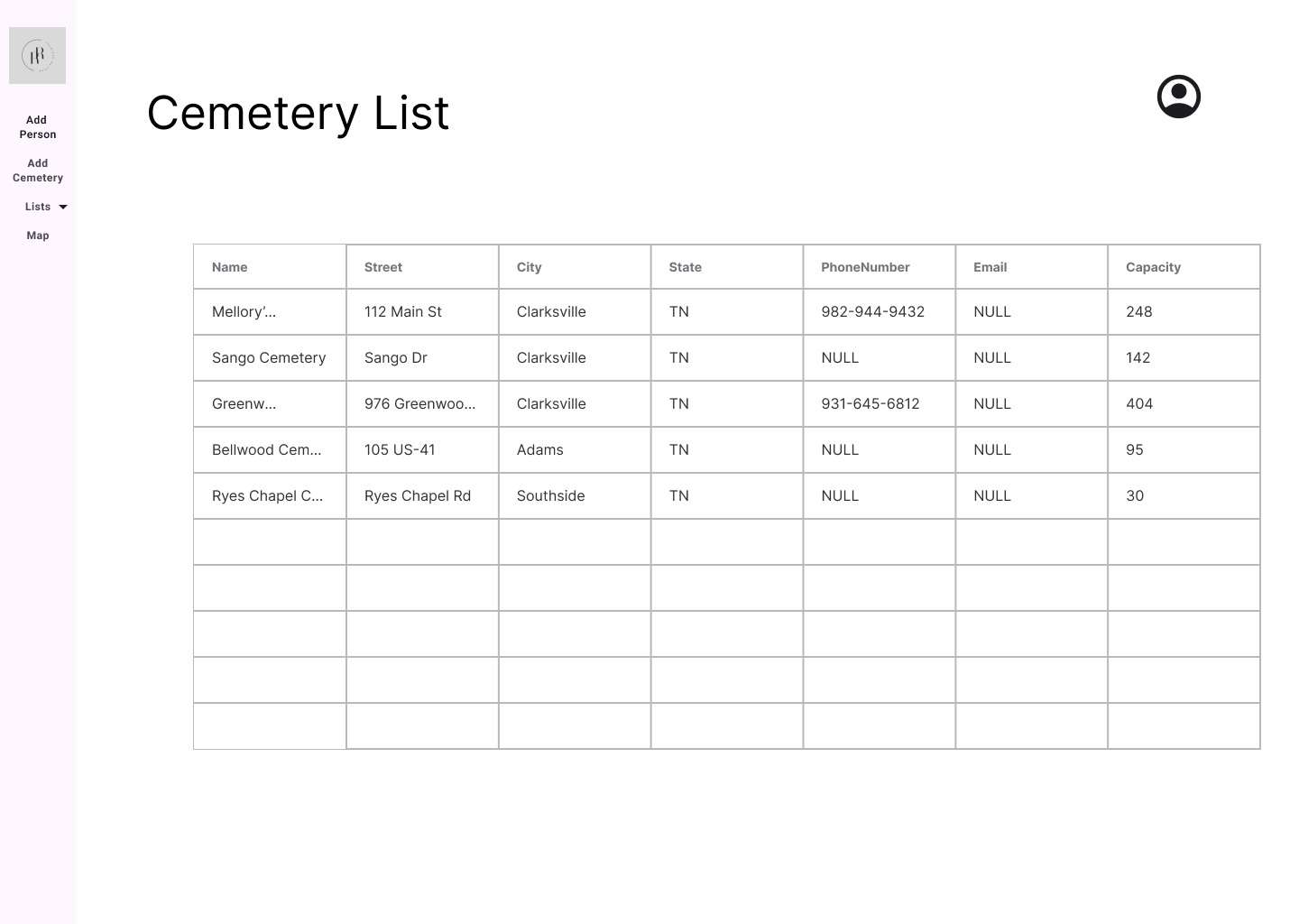
Person, Plot, Cemetery List
Pictured here is only the Cemetery List
The Person and Plot list will look just the same, only with different information.

Slide 21
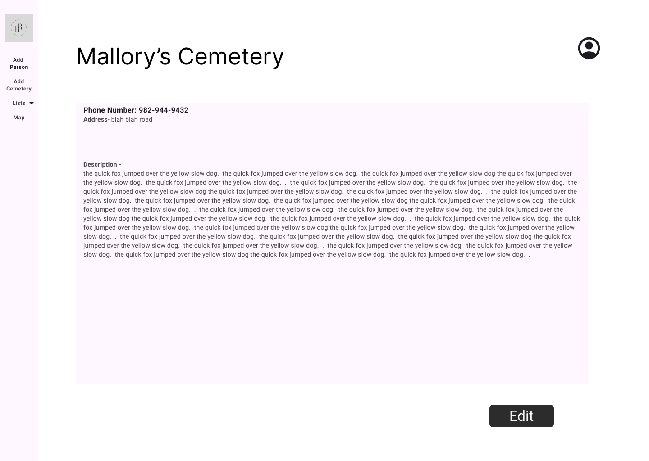
Edit Cemetery Page
Similar to Cemetery Page (for Users) - seen in previous slide
Now there is an edit button as well.

Slide 22
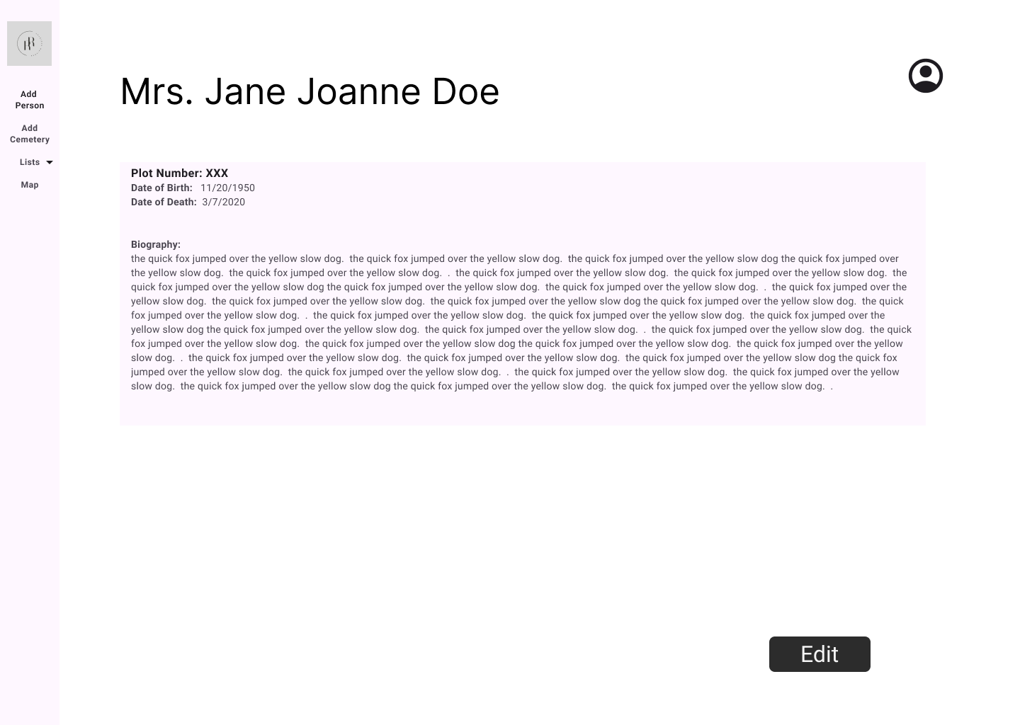
Edit Person Page
Similar to Person Page (for Users) - seen in previous slide
Now there is an edit button as well.

Slide 23
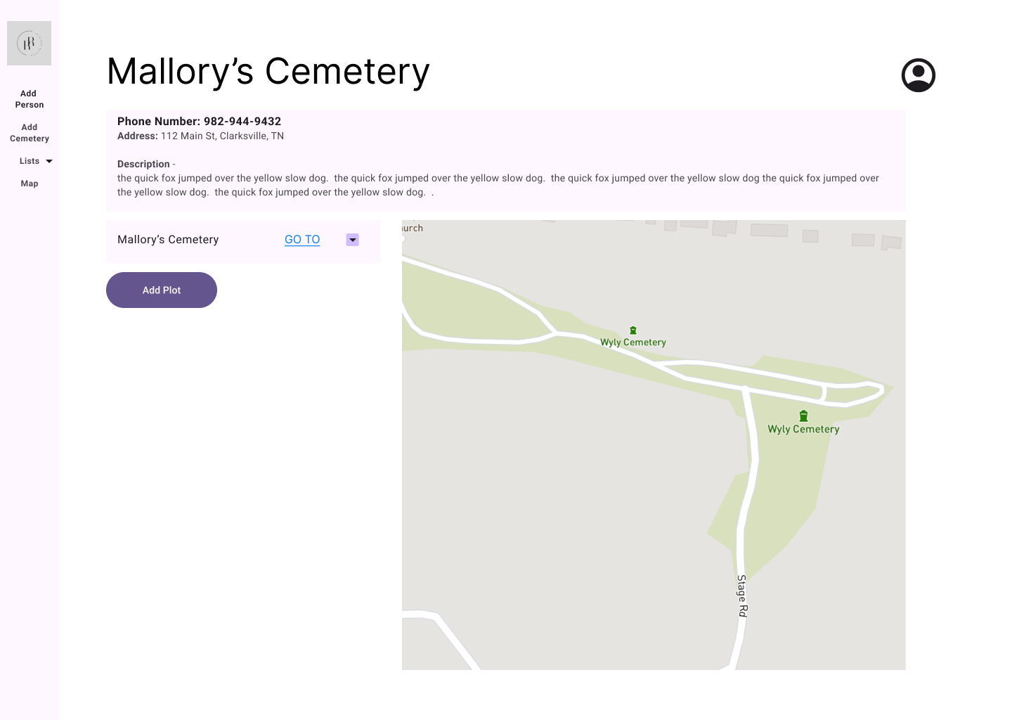
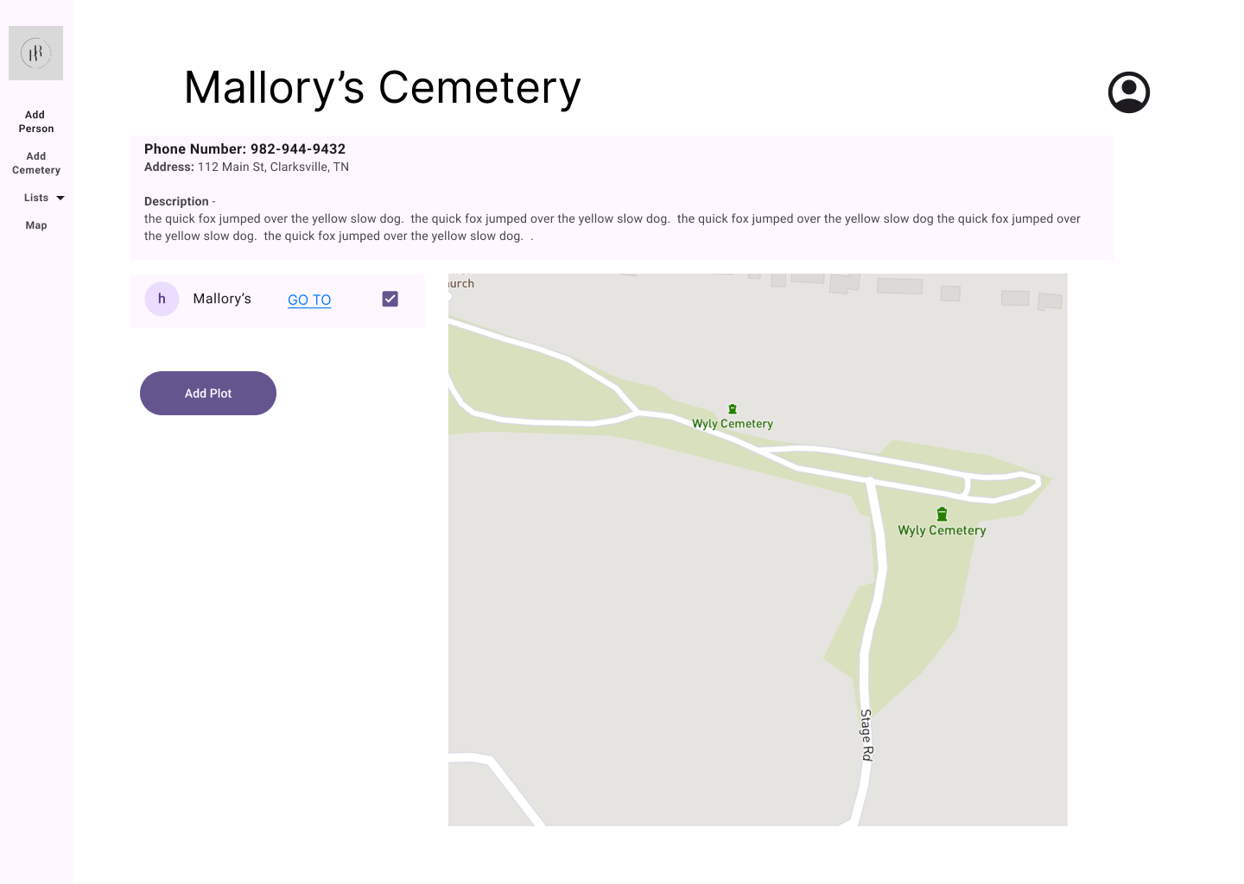
Map Page - Admin

Slide 24
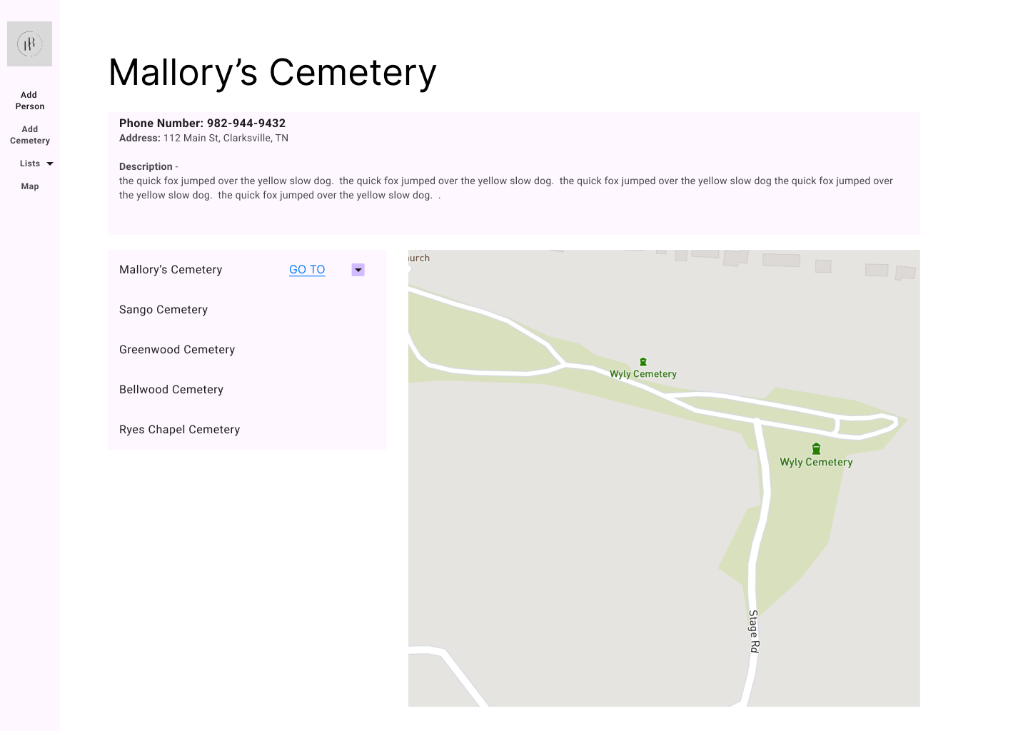
Map Page - Admin - Dropdown

Slide 25
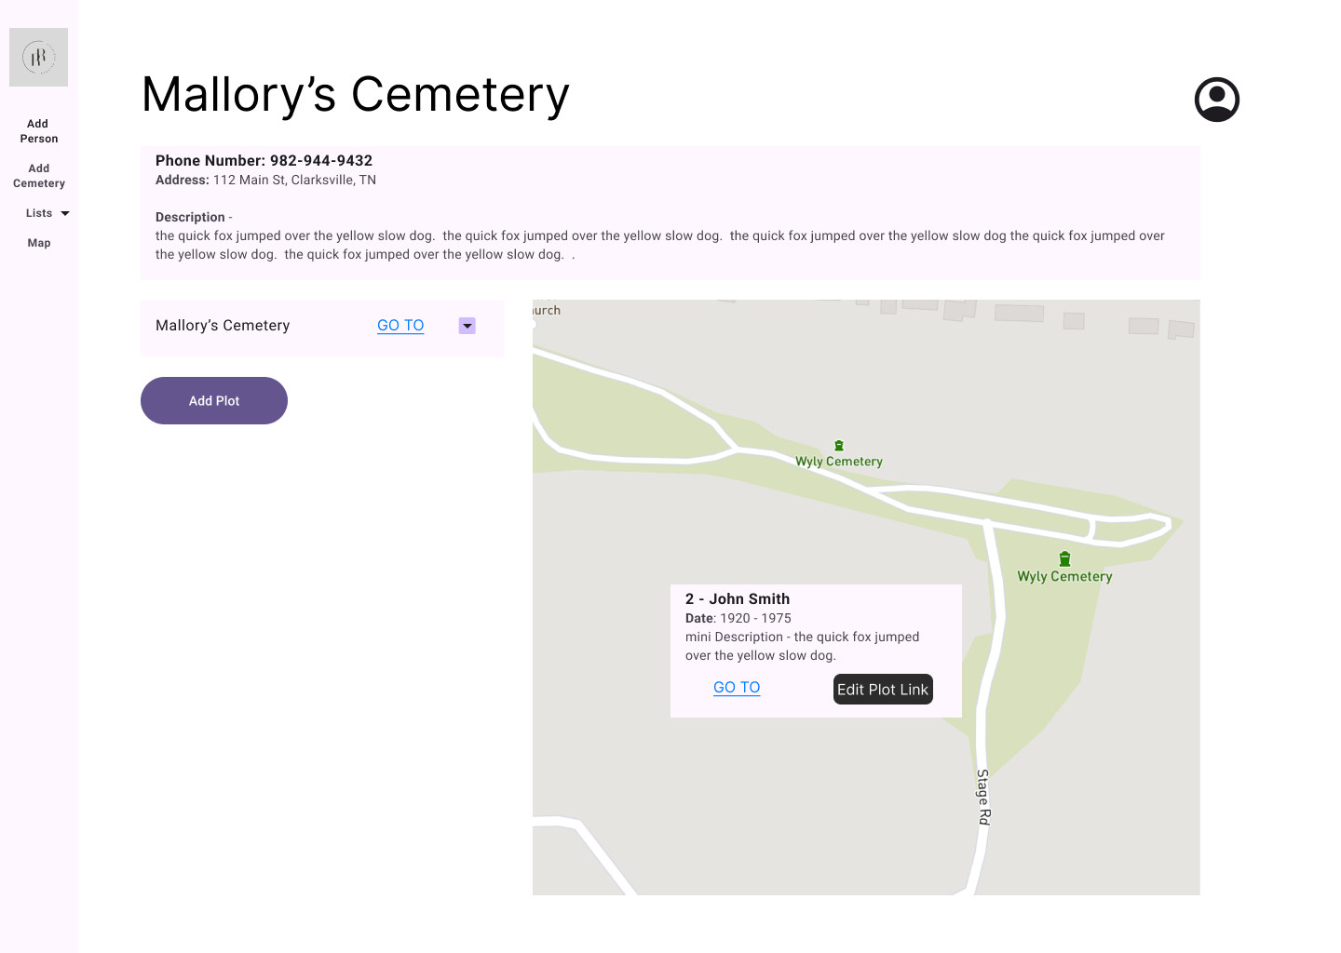
Map Page - Admin - View Plot

Slide 26
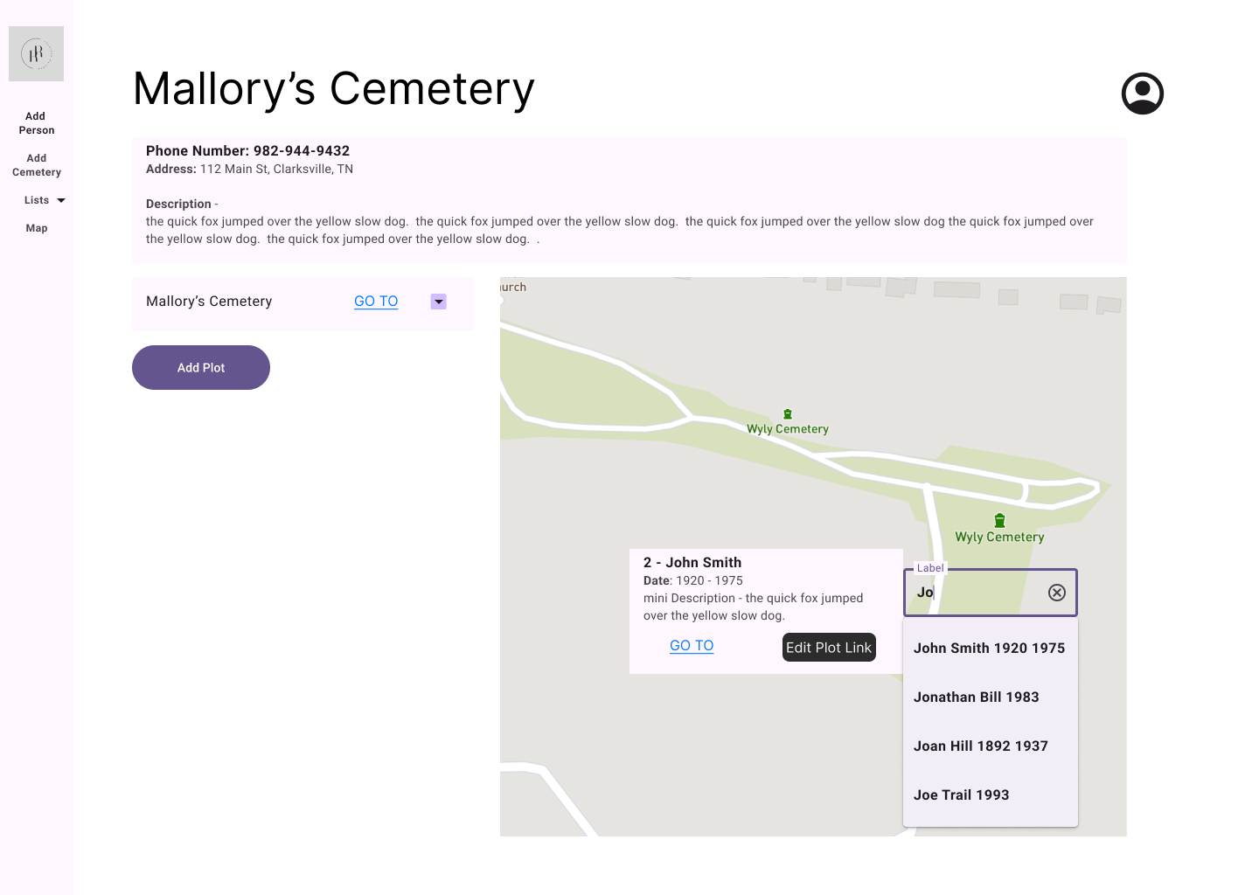
Map Page - Admin - Edit Link

Slide 27
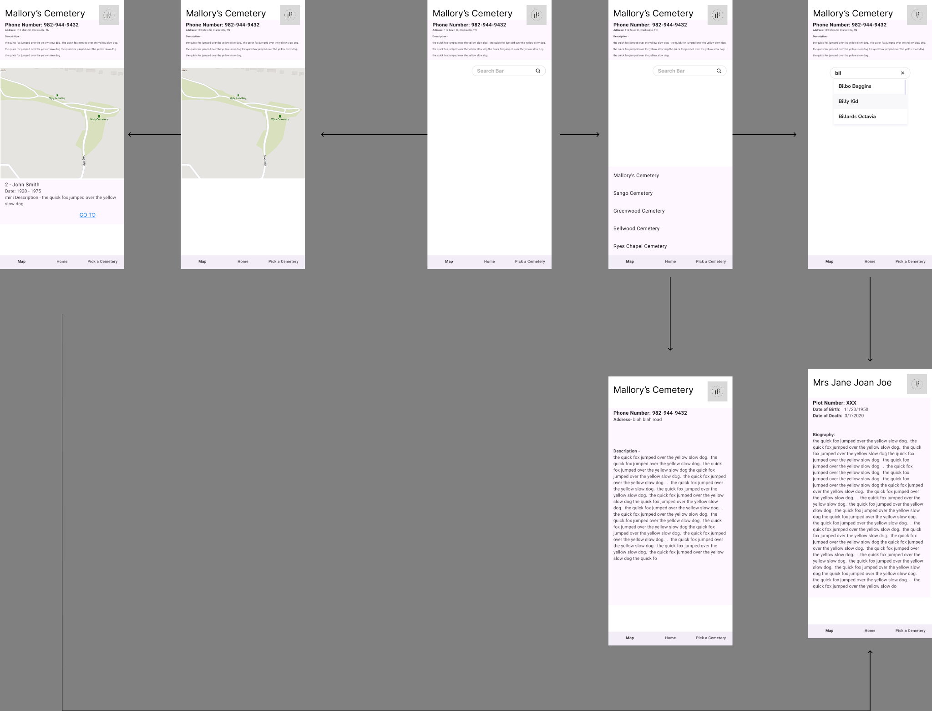
Mobile

Slide 28
Thank You!
Any Questions?

