Slide 1


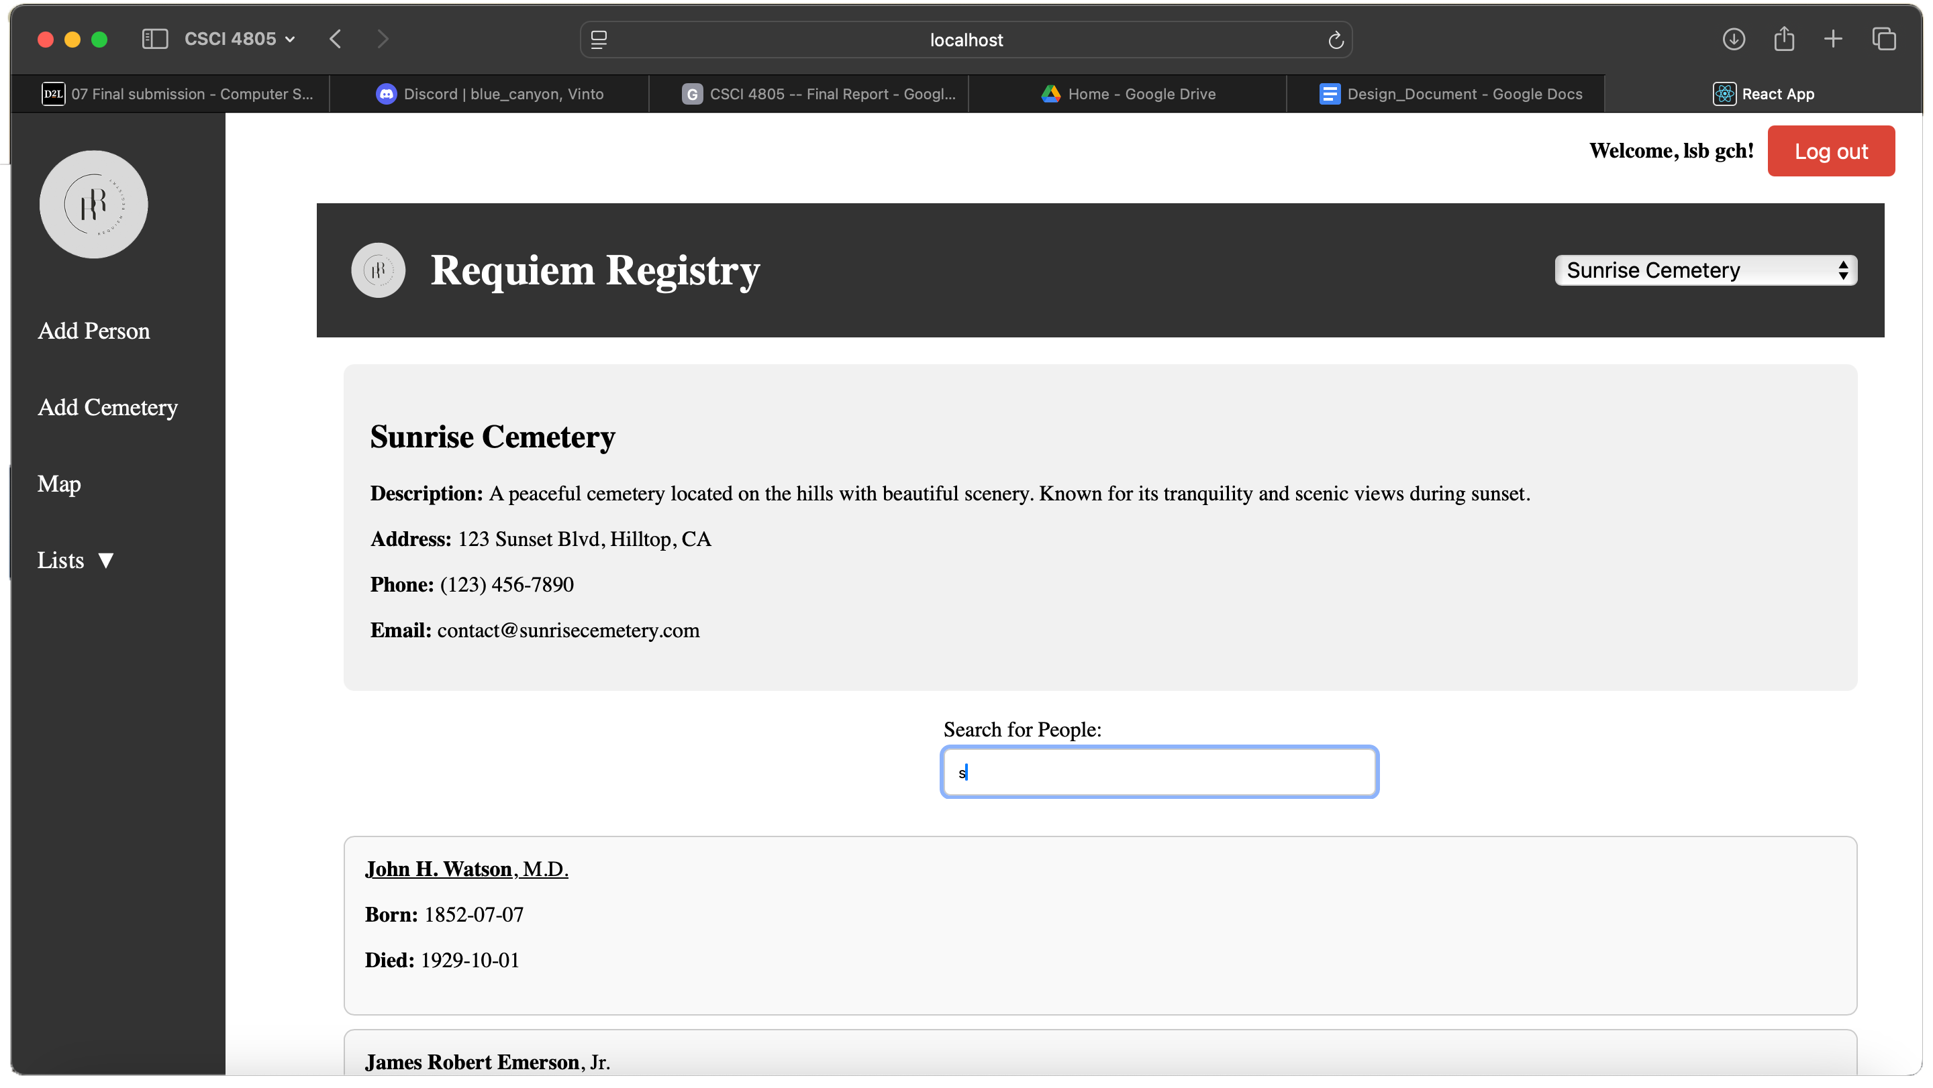
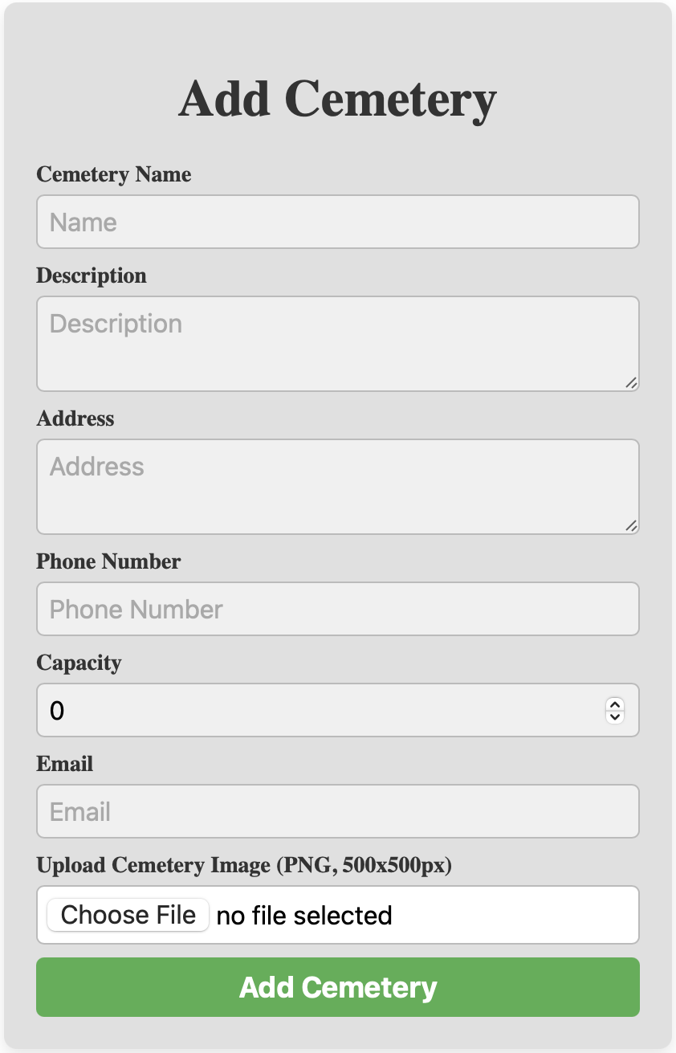
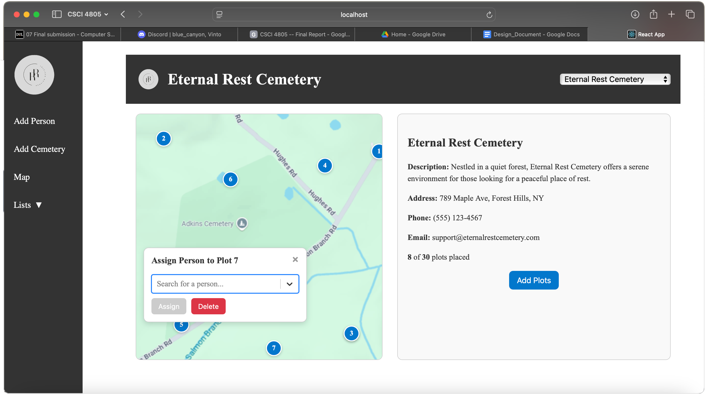
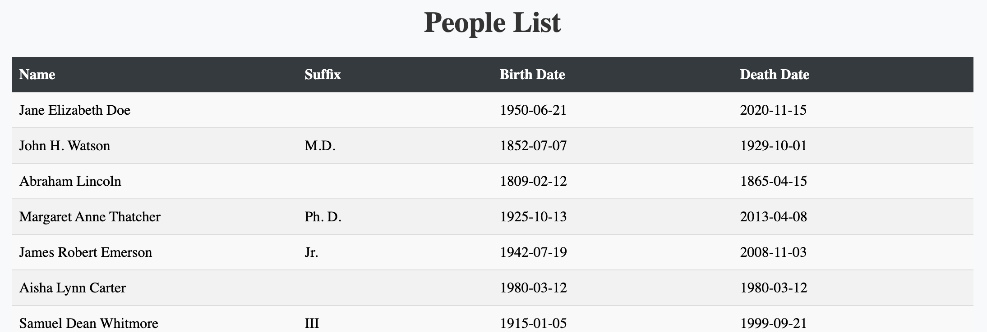
Requiem Registry
Bricen Hicks, Lucas Gamboa, Samantha Cook
Dept. Of Computer Science and Information Technology
Abstract
Technology
Requiem Registry is a web-accessible database that aids small churches with managing cemeteries. The website is designed to help small cemeteries which might not have much personnel or funding. It is a simple solution to help organizations manage their records and minimize errors. The website includes a search feature, lists of information, and a map view. The site also has a public front where people can search for plots and the locations of people buried in that cemetery. The website is divided into two sections: one for admin and one for the public. For data security, admins must log in, but the public is not required to provide login credentials to view records. Admins can manage information about cemeteries, plots, and people who are interred. Search features allow admins and the public to search in individual cemeteries and across multiple cemeteries.
Requiem Registry’s website is built using React, HTML, and CSS to design the user interface. The language for the website’s database is PostgreSQL, which is hosted via Supabase. The website is deployed and hosted on the internet via Vercel hosting services. It utilizes Google Authentication API to provide a secure sign-in for administrative users. Updates and maintenance are performed with the use of a repository on GitHub to allow collaboration among developers and provide easy version control management.
Figure 1: The homepage of Requiem Registry with admin privileges enabled. The entries below the search bar are suggested matches for the current input.
Problem Statement
Imagine you want to find a loved one's grave, and you know it is in a small cemetery in a rural area; where do you begin to find their grave? Most small cemeteries in rural areas have little to no management or proper records to help point you in the right direction. Requiem Registry aims to solve this problem for the public and provide a better-streamlined management system for cemeteries.
Figure 4: Adding cemeteries is handled by filling in a form, which is used to insert an entry into the database.
Features
The website’s homepage has a search bar to find people by name; its scope can include all cemeteries in the database or just one by selecting it from a dropdown menu. Once found, the location of their plot can be shown on the map page; other plots in the cemetery’s map are also visible from here. These pages gain additional functions when accessed by an admin. This includes adding new people and cemeteries, creating new plots and linking people to them on the map page, viewing lists of these entries, and editing or removing them on demand. These features are protected with a login system to ensure that only verified admins can access them.
Figure 2: Admins can add plots to a cemetery with the map page; its coordinates are taken from the mouse's position on the map and saved to the new plot. People can also be linked to plots from here.
References
Supabase - https://supabase.com/
React - https://react.dev/
Vercel - https://vercel.com/
GitHub - https://github.com/
Acknowledgements
We want to thank Dr. Karen Meisch Dean of CoSTEM, and Dr. Leong Lee Department Chair of Computer Science and Information Technology.
Figure 3: A list of all people in the database is accessible to the admins for easy look-up.

