Slide 1




Developing a Corporate Marketing Strategy:
0101ExVeacluuetisve Summary
02₀₂Si_{V}tu_{is}a_{io}ti_{n}on Analysis
03 Planning
a proven approach and premium tool-kit
03 Situation
04 Administration
04 Objectives
05 Measurement
₀₆05 _{B}S_{u}t_{d}r_{g}a_{e}te_{t}gy
Follow this simple, step-by-step, methodology to develop a corporate marketing strategy that supports your company’s values and vision.
06 Budget & Measurement
© 2012 Demand Metric Research Corporation. All Rights Reserved.

Slide 2







What is the purpose of this methodology?
To help you develop a Corporate Marketing Strategy that:
Corporate Marketing Strategy
» Is aligned with corporate values and vision
» Provides the foundation for product planning and marketing
Product A Marketing Plan
Product B Marketing Plan
» Drives the Marketing Communications process and plan
Marketing Communications Plan
© 2012 Demand Metric Research Corporation. All Rights Reserved.

Slide 3

How to use this consulting methodology:
This methodology consists of six stages, each with a description, steps and action items.
Action items include using our premium tools & templates. Our intention with this methodology is to help you:
Identify the foundation of any marketing strategy: your corporate values and vision.
Analyze and assess your current situation: competitiveness, products, industry, and other forces.
Plan using the classic marketing mix, craft a strategy to drive your firm’s success in its chosen markets.
© 2012 Demand Metric Research Corporation. All Rights Reserved.

Slide 4
What is a Marketing Strategy?
Marketing strategies are often called marketing plans or marketing communications plans. Demand Metric believes the marketing strategy is separate and unique. The marketing strategy should ideally flow from corporate strategy and is heavily influenced by corporate values and vision.
To use a metaphor, the corporate strategy is a book with the marketing strategy as one of the most prominent chapters.
Other chapters in the book might be:
Operations strategy ✓ Human Resources strategy
Finance strategy ✓ Development strategy
© 2012 Demand Metric Research Corporation. All Rights Reserved.

Slide 5


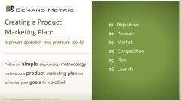
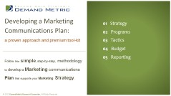


Scope of the Marketing Strategy
This methodology helps you develop a corporate marketing strategy, aligned with corporate strategy and vision, to guide your marketing efforts toward a specific set of outcomes. Your marketing strategy, then lets you craft specific, detailed plans in these areas that will put your strategy into action.
Demand Metric has separate methodologies to help you create:
Product Marketing Plans Marketing Communications Plan
Download
Download
© 2012 Demand Metric Research Corporation. All Rights Reserved.

Slide 6
Outputs from this Planning Process:
Stage 01 – Core Values Worksheet
Stage 02 – Vision Statement Worksheet, Business Alignment and Core Competencies Stage 03 – SWOT Analysis, Brand Assessment, PEST Analysis, Competitor Analysis Stage 04 – Marketing Objectives Scorecard
Stage 05 – Market Requirements, Product Marketing Plans, Product Development Plans,
Marketing Communications Plan
Stage 06 – Consolidated Budget, Marketing Strategy Dashboard
© 2012 Demand Metric Research Corporation. All Rights Reserved.

Slide 7
Values
Vision
Situation
Objectives
Strategy
Budget & Measurement
Values
STAGE 01 – CORPORATE VALUES
The place to begin any strategic planning process is with corporate values. Every firm has a set of core values that are usu ally
put in place when a company is founded. Often, these values are well-articulated, documented and fully-integrated into the
firm’s culture. Even if a firm’s values aren’t documented, they exist and will require identification as part of this process.
During this stage, you’ll examine your core values to understand how they should influence the development of your marketing strategy.
© 2012 Demand Metric Research Corporation. All Rights Reserved.

Slide 8
Values
Vision
Situation
Objectives
Strategy
Budget & Measurement
Values
STEP 1 – Review “Core Values” Case Study
A firm’s core values should exert the strongest influence on its culture and how it manages its brand.
Zappos provides an excellent example of a company that integrates its core values with its operations and marketing strategy.
Those values are:
Deliver WOW through service
Embrace and drive change
Create fun and a little weirdness
Be adventurous, creative and open-minded
Pursue growth and learning
Build open and honest relationships through communication
Build a positive team and family spirit
Do more with less
Be passionate and determined
Be humble
© 2012 Demand Metric Research Corporation. All Rights Reserved.

Slide 9

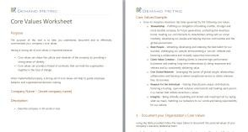

Values
Vision
Situation
Objectives
Strategy
Budget & Measurement
Values
STEP 2 – Examine Your Core Values
Action Item – use the Core Values Worksheet to identify each of your firm’s core values. Determine how they can and should influence marketing strategy development to ensure your strategy is in alignment with core values.
Having a strong set of Core Values is important because:
Core values can shape the culture and character of the company by providing a strong sense of identity.
Core values can provide a thread of continuity that can hold the organization together in the face of change.
Download
© 2012 Demand Metric Research Corporation. All Rights Reserved.

Slide 10
Values
Vision
Situation
Objectives
Strategy
Budget & Measurement
Vision
STAGE 02 – VISION
A firm’s vision is shaped by its core values and ideally is articulated and embodied by its leader. All functions within the firm are optimized for achieving the vision. The vision represents a preferred future destination, and the strategy you develop is the map to help get you there.
Some fundamental truths about vision:
A firm’s leader owns and casts the vision.
Vision is not just a set of words, but the actions that support it.
Without a meaningful, well-articulated vision, a firm cannot achieve its greatest success.
© 2012 Demand Metric Research Corporation. All Rights Reserved.

Slide 11
Values
Vision
Situation
Objectives
Strategy
Budget & Measurement
Vision
STEP 1 – What Business are we in?
How is your firm is positioned? For example, when asked what business Harley Davidson is in, most
people respond, “motorcycles”. A Harley Davidson executive, however, gave this answer:
“What we sell is the ability for a 43-year-old accountant to dress in black leather, ride through small towns and have people be afraid of him.”
Resist the temptation of providing the “easy” answer to this question. Focus on the answer that positions your company uniquely based on its core competencies (Step 4 of this Stage) and reveals the value your firm provides to its customers.
© 2012 Demand Metric Research Corporation. All Rights Reserved.

Slide 12

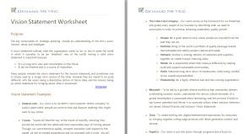

Values
Vision
Situation
Objectives
Strategy
Budget & Measurement
Vision
STEP 2 – Marketing Implications of the Vision
Action Item – use the Vision Statement Worksheet to summarize your company’s vision. Consider the
vision to understand its implications on marketing strategy.
To complete this step, determine how to answer the following questions
in light of your vision:
What business are you in?
What markets does our vision direct us to serve?
What opportunities exist within these markets that we are
uniquely qualified to exploit?
Download
For example, Zappos CEO Tony Hsieh speaks about his vision for service quality excellence when he says “customer service shouldn’t just be a department, it should be the whole company.”
© 2012 Demand Metric Research Corporation. All Rights Reserved.

Slide 13
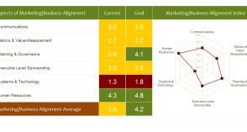


Values
Vision
Situation
Objectives
Strategy
Budget & Measurement
Vision
STEP 3 – Marketing Alignment with Business
Action Item – Use the Marketing Business Alignment Tool to assess the marketing organization’s alignment with the business. Focus on improving alignment between marketing and the business in the areas indicated of the assessment.
Firms that have culturally embraced their vision typically have great
business unit alignment. What this assessment will tell you:
If alignment between marketing and the business is effective, the
culture will facilitate the success of your marketing strategy.
If marketing and the business are misaligned, cultural barriers will impair marketing’s ability to execute a marketing strategy, no matter how brilliant it is.
Download
© 2012 Demand Metric Research Corporation. All Rights Reserved.

Slide 14

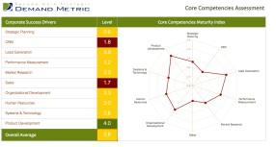

Values
Vision
Situation
Objectives
Strategy
Budget & Measurement
Vision
STEP 4 – Identify Core Competencies
Action Item – Use the Core Competencies Assessment to identify your firm’s core competencies.
Core values shape your firm’s vision. Pursuit of the vision creates core competencies.
This assessment will have you review and rate your firm’s competencies in the areas of:
Strategic Planning & Governance
Customer Relationship Management
Demand Generation
Performance Measurement
Market Intelligence & Research
Sales
Organizational Development
Human Resources
Systems & Technology
Product Development
Download
© 2012 Demand Metric Research Corporation. All Rights Reserved.

Slide 15
Values
Vision
Situation
Objectives
Strategy
Budget & Measurements
Situation
STAGE 03 – ASSESS CURRENT SITUATION
This stage is diagnostic and involves detailed research and analysis, during which you will consider:
Your company
Your brand
Your customers
Your industry
Your competitors
© 2012 Demand Metric Research Corporation. All Rights Reserved.

Slide 16
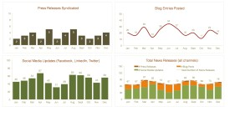

Values
Vision
Situation
Objectives
Strategy
Budget & Measurements
Situation
STEP 1 – Current Company Status
Action Item – Use our Business Strategy Metrics Dashboard to develop, track and analyze key performance metrics for your firm.
Choose metrics that have meaning for your company, not just
the marketing function.
Some examples are:
Revenue
Growth rate
Profit/loss
Download
Cost per sale
Revenue per employee
Headcount
Review enough data to determine trends for each metric. Which trends does your marketing strategy need to help or exploit?
© 2012 Demand Metric Research Corporation. All Rights Reserved.

Slide 17
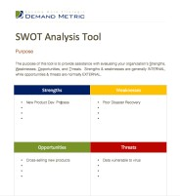


Values
Vision
Situation
Objectives
Strategy
Budget & Measurements
Situation
STEP 2 – Company Strengths & Weaknesses
Action Item – Use the SWOT Analysis Template to assess your firm’s internal strengths, weaknesses,
opportunities and threats.
Download
An effective SWOT analysis has the following characteristics:
It is honest
It is broad in focus
It considers multiple time horizons
It is built on perceptions from several individuals or groups in the firm
Additional Resource – The GAP Analysis Tool will lead you through a deeper, functional assessment.
© 2012 Demand Metric Research Corporation. All Rights Reserved.

Slide 18
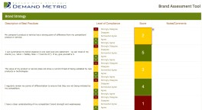


Values
Vision
Situation
Objectives
Strategy
Budget & Measurements
Situation
STEP 3 – Current Brand Status
Action Item – use the Brand Assessment Tool to perform an in-depth analysis of your brand. Conduct this
assessment regardless of whether or not Brand Equity is a strength based on your SWOT analysis.
This assessment will help in a later stage of this methodology by:
Ensuring there is a brand plan that integrates with your marketing strategy.
Download
Leveraging your brand effectively throughout the firm.
© 2012 Demand Metric Research Corporation. All Rights Reserved.

Slide 19
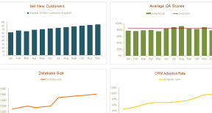

Values
Vision
Situation
Objectives
Strategy
Budget & Measurements
Situation
STEP 4 – Current Customer Status
Action Item – Even if you do not use a CRM system to manage customer relationships, use the CRM
Program Metrics Dashboard to develop, track and analyze key customer metrics.
Here are some customer metrics you may wish to include in your dashboard/assessment:
Total customer accounts
New accounts
Key accounts
Retention
Revenue or profit per customer
Download
© 2012 Demand Metric Research Corporation. All Rights Reserved.

Slide 20
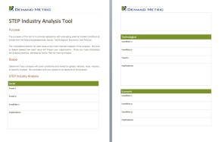


Values
Vision
Situation
Objectives
Strategy
Budget & Measurements
Situation
STEP 5 – Current Industry Status
Action Item – Use the STEP Industry Analysis Tool (also referred to as PEST) to analyze your industry
from political, economic, social and technological perspectives.
The STEP analysis considers the following:
How well prepared are you for the forces of change affecting
your industry?
Which strategies and tactics should you avoid because they
are destined to fail for reasons beyond your control?
Download
The scope of the SWOT analysis completed in Step 2 is your business.
© 2012 Demand Metric Research Corporation. All Rights Reserved.

Slide 21

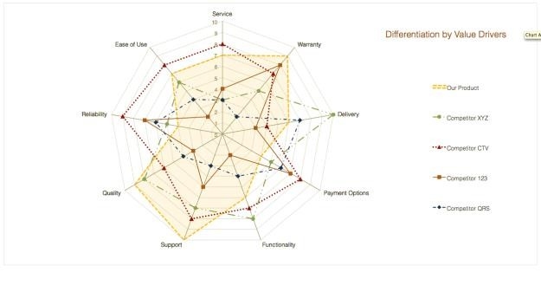
Values
Vision
Situation
Objectives
Strategy
Budget & Measurements
Situation
STEP 6 – Current Competitive Situation
Action Item – Use the Competitor Analysis Template to assess the competitive playing field in your
industry.
This tool looks at your competitive playing field at the corporate level.
We recommend deferring the product analysis to the Product Marketing Plan process.
However, if you need to conduct an assessment of competitive
products immediately, use the Competitive Analysis Tool.
Download
© 2012 Demand Metric Research Corporation. All Rights Reserved.

Slide 22
Values
Vision
Situation
Objectives
Strategy
Budget & Measurement
Objectives
STAGE 04 – OBJECTIVES
To this point, you’ve done in-depth research and analysis in preparation for setting objectives and developing your Marketing Strategy. In this Stage, you’ll determine what you want to accomplish – your objectives. In the next Stage, you’ll determine how to accomplish these objectives. You’ll use the insights you’ve gained from the first three Stages of this methodology to guide your efforts. In this Stage, you will deal with two sets of objectives:
Business Objectives
Marketing Objectives
The two will, of course, ideally align.
© 2012 Demand Metric Research Corporation. All Rights Reserved.

Slide 23

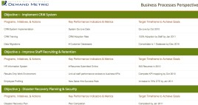
Values
Vision
Situation
Objectives
Strategy
Budget & Measurement
Objectives
STEP 1 – Business Objectives
Action Item – Ensure your understanding of your firm’s business objectives. If your firm’s business objectives are unknown or undocumented, use the Balanced Scorecard Strategy Map to identify and document them.
In some cases, business objectives and marketing objectives are one and the same.
Typically, marketing objectives are a subset of business objectives, contain more detail and are more refined. Examples of common business objectives are:
Maximize profit
Grow market share
Increase shareholder value
Download
© 2012 Demand Metric Research Corporation. All Rights Reserved.

Slide 24

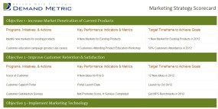

Values
Vision
Situation
Objectives
Strategy
Budget & Measurement
Objectives
STEP 2 – Marketing Objectives
Action Item – Determine what you want to accomplish with the Marketing Strategy you are developing.
Use the Marketing Strategy Scorecard to document these objectives.
Examples of how business objectives can drive marketing objectives are provided below:
Business Objective | Marketing Objective
Maximize profits | Increase market penetration of current products in current markets
 | Improve customer retention
Grow market share | Develop new markets for existing products
Download
© 2012 Demand Metric Research Corporation. All Rights Reserved.

Slide 25
Values
Vision
Situation
Objectives
Strategy
Budget & Measurement
Strategy
STAGE 05 – CREATE/REFINE STRATEGY
In this Stage, you will articulate coherent actions that achieve your objectives – your strategy – in each of the
following areas:
Markets
Products
Communications
Infrastructure
© 2012 Demand Metric Research Corporation. All Rights Reserved.

Slide 26
Values
Vision
Situation
Objectives
Strategy
Budget & Measurement
Strategy
STEP 1 – Markets and Products
Action Item – Based on the assessment of your situation completed in Stage 3, and your objectives from Stage 4, determine which markets to pursue and with which products.
Consider the risk for each of these strategies:
Current
Market Penetration | Product Development
Market Development | Product Diversification
Market penetration:
Product development:
Market development:
Product diversification: highest risk
lowest risk moderate risk moderate risk
Markets
New
Current
New
Products
© 2012 Demand Metric Research Corporation. All Rights Reserved.

Slide 27

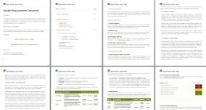
Values
Vision
Situation
Objectives
Strategy
Budget & Measurement
Strategy
STEP 2 – Market Plan
Action Item – Use the Market Requirements Document to analyze opportunity in your chosen market(s).
Regardless of which approach from Step 1 you choose, you will need to develop a plan for that market. For current markets, consider:
What is your market share?
Who is the market leader?
Download
For new markets, consider:
How accessible are these new markets?
What size is the market potential?
Do these markets know you have solutions that can solve problems they are having?
© 2012 Demand Metric Research Corporation. All Rights Reserved.

Slide 28

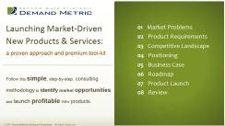
Values
Vision
Situation
Objectives
Strategy
Budget & Measurement
Strategy
STEP 3 – Products
Put a product strategy in place to support the choice you made in Step 1 of this Stage.
If your strategy calls for developing new products, use the Product Development Strategy methodology to develop market-driven solutions.
If your strategy calls for using current products,
use the Product Marketing Plan methodology to develop a marketing plan for them.
Download
Download
© 2012 Demand Metric Research Corporation. All Rights Reserved.

Slide 29

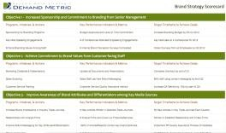
Values
Vision
Situation
Objectives
Strategy
Budget & Measurement
Strategy
STEP 4 –Brand Strategy
Action Item – Use the Brand Strategy Scorecard to document your branding objectives, initiatives, measures, and targets
Review the results of the Brand Assessment you completed in Step 3. Include in your Marketing Strategy a plan to
implement the recommendations from this assessment.
The Brand Assessment recommendations fall into these categories:
Brand Strategy
Brand Alignment
Brand Communication
Brand Execution
Download
© 2012 Demand Metric Research Corporation. All Rights Reserved.

Slide 30
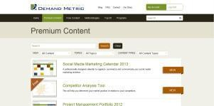

Values
Vision
Situation
Objectives
Strategy
Budget & Measurement
Strategy
STEP 5 – Partnerships & Alliances
Action Item – Visit the Partnerships & Channels section of our website for a full set of tools and resources to help evaluate, measure and manage your partnerships and partnering strategy.
Determine if you have the right set of partnerships and alliances in place to support your strategy. Ask yourself the following questions:
What are the goals of your partnering strategy?
How effective are your current partnerships and how do you measure this?
What gaps exist in your current line-up of partners?
What can your partners do that you cannot?
© 2012 Demand Metric Research Corporation. All Rights Reserved.

Slide 31
Values
Vision
Situation
Objectives
Strategy
Budget & Measurement
Strategy
STEP 6 – Communications
Develop a Marketing Communications Plan to support this strategy and the Product Marketing plans you
created in Step 3 of this Stage.
Your Marketing Communications Plan will provide detail on:
What needs communicating
Who needs to receive the communication (Internal and External audiences)
Which communications channels to use
When the communications need to occur
© 2012 Demand Metric Research Corporation. All Rights Reserved.

Slide 32
Values
Vision
Situation
Objectives
Strategy
Budget & Measurement
Strategy
STEP 6 (cont.) – Communications
In the classic 4 P’s of Marketing – Product, Price, Place and Promotion – the Marketing Communications Plan is primarily concerned with Promotion.
The Marketing Communications Plan is often quite detailed and includes all communications through all channels such as:
Events
Public Relations
Advertising
Social Media
Web and Online
Others
Download
Helpful hint – Use the MarCom Plan Methodology to help you outline your communications strategy.
© 2012 Demand Metric Research Corporation. All Rights Reserved.

Slide 33
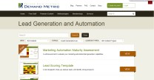
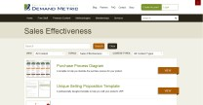
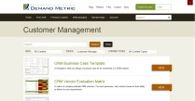
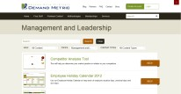




Values
Vision
Situation
Objectives
Strategy
Budget & Measurement
Strategy
STEP 7 – Infrastructure
Action Item – Identify the infrastructure requirements to support this marketing strategy.
These requirements often fall into one of the following areas (click links to see related resources):
Technology
Processes
People
Examples: CRM or Marketing Automation systems
Examples: Sales or Lead nurturing processes
Examples: Staffing, performance reviews, hiring, job descriptions or leadership development
© 2012 Demand Metric Research Corporation. All Rights Reserved.

Slide 34
Budget & Measurement
Values
Vision
Situation
Objective
Strategy
Budget & Measurement
STAGE 06 – BUDGET & MEASUREMENT
With the major elements of your Marketing Strategy in place as a result of Stages 1-5, you will finish this process by considering the budget and how you will measure your strategy’s results.
In this Stage, you will:
Make sure you have a consolidated, comprehensive view of the budget required to support this strategy
Ensure that the right metrics and tracking mechanisms are in place
© 2012 Demand Metric Research Corporation. All Rights Reserved.

Slide 35

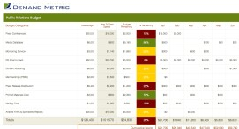

Budget & Measurement
Values
Vision
Situation
Objective
Strategy
Budget & Measurement
STEP 1 – Consolidate Your Budget
Action Item – The Product Marketing Plans (Stage 5, Step 3) and the Marketing Communications Plan
(Stage 5, Step 6) both include budgets to support them. Use our Marketing Budget Template to consolidate individual budgets into one master budget.
Your marketing strategy budget will include:
Product Marketing Plan budget(s)
Marketing Communications Plan budget
Marketing Strategy budget items not included in the above, such as
Infrastructure (Stage 5, Step 7)
Download
© 2012 Demand Metric Research Corporation. All Rights Reserved.

Slide 36

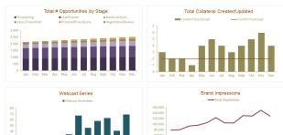
Budget & Measurement
Values
Vision
Situation
Objective
Strategy
Budget & Measurement
STEP 2 – Fine Tune your Dashboard
Action Item – Review the Balanced Scorecard Strategy Map from Stage 4, Step 1 and the Marketing
Strategy Scorecard from Stage 4, Step 2. Make any necessary changes to your Balanced Scorecard Strategy Map to include the appropriate elements of this Marketing Strategy. Finally, use the Key Marketing Metrics Dashboard to define, track & report on key metrics.
Carefully review the metrics and systems for capturing them:
Ensure that the measurement systems are in place to
track progress toward these objectives
Download
Consider other measurements you should add to ensure
your strategy is effective
© 2012 Demand Metric Research Corporation. All Rights Reserved.

Slide 37
A Final Word on Strategy
“However beautiful the strategy, you should occasionally look at the results.”
Sir Winston Churchill
© 2012 Demand Metric Research Corporation. All Rights Reserved.

Slide 38
Conclusion
At the end of any business process, it’s always a good idea to review it and identify areas for improvement.
Demand Metric has the tools and expertise to help you build an effective Marketing Strategy Plan
» Create or audit your marketing strategy plans
» Assist with using any of the tools referenced in this methodology
» Provide hands-on marketing assistance to accelerate achieving your marketing department’s goals.
To learn more, simply contact Demand Metric: info@demandmetric.com
© 2012 Demand Metric Research Corporation. All Rights Reserved.

