Slide 1
F1tenth Architecture (IAP and IDL)
Samir Gupta

Slide 2
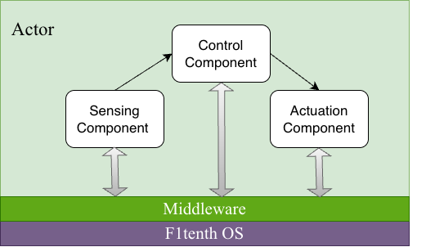
F1tenth Information Architecture Platform

Slide 3
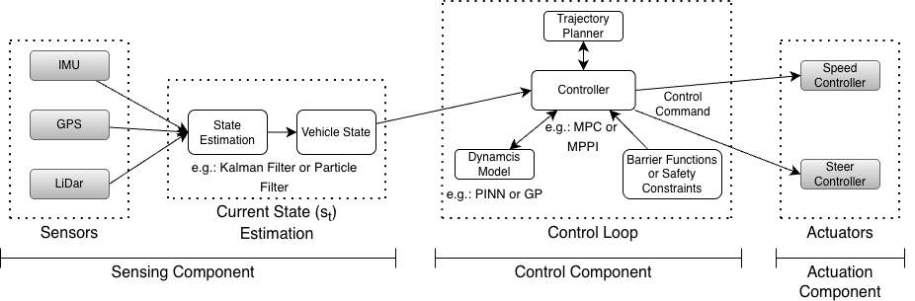
F1tenth Components
The proposed architecture follows the principles of an Information Architecture Platform combined with an Interface Definition Language (IDL). The functionality can be decomposed into modular components that interact through well-defined interfaces.

Slide 4
F1tenth Message Types and Mapping
Interface Name | Message Type (Structures in the next slide) | Data Type | Producer → Consumer
Sensor Data | SensorMsg | Struct (float32) | Sensors → State Estimator (EKF/UKF)
Vehicle State | VehicleStateMsg | Struct (float32) | State Estimator → Controller Dynamics model → Controller
Control Command | ControlCmdMsg | Struct (float32) | Controller → Actuator
Waypoints | WaypointsMsg | Static array | Trajectory Planner → Controller
Parameters | ParamMsg | Static

Slide 5
F1tenth Message Structure Definitions
struct Header {
Time time;
string frame_id; // IMU or Lidar
};
struct StateSensorData {
Header header; //for timestamp
// IMU data
float v_mps; // forward speed
float steering_rad; // steering angle
float yaw_rate; // from IMU gyro
float ax; // acceleration x and y
float ay; // m/s^2
// GPS data
float lat_deg;
float lon_deg;
float heading_deg; // heading
};
struct LidarScanData {
Header header; // for the timestamp
uint n_beams;
float angle_min_rad;
float angle_max_rad;
float angle_increment_rad;
float range_min_m;
float range_max_m;
float ranges[1080];
};
struct SensorData {
StateSensorData state; // GPS + IMU + odom
LidarScanData lidar; // lidar scan
};
struct ControlCmdMsg {
float acceleration;
float steering_vel;
};
struct VehicleStateMsg {
float x;
float y;
float psi;
float v;
float beta;
float omega;
};
struct WaypointsMsg {
float x[];
float y[];
};

Slide 6
F1tenth Frequency and Trigger Type
Component | Trigger Type | Frequency
Sensors (IMU – VESC Mk VI) | Time-triggered | 800 Hz
Sensors (LiDAR– Hokuyo 10LX) | Time-triggered | 40 Hz
State Estimator (EKF/UKF) | Time-triggered | 100 Hz
Controller (MPC / MPPI) | Time-triggered | 25 Hz
Dynamics Model (NN/GP) | Event-triggered | Every control update
Safety Monitor (CBF) | Event-triggered | Every control update
Actuation | Time-triggered | 100 Hz

Slide 7
F1tenth WCET Expectations and what will run where?
Component | WCET (Expected) | What will run where?
Sensor | < 1ms | IMU – VESC Mk VI and LiDAR – Hokuyo 10LX
State Estimation (EKF / UKF) | < 1ms | Jetson Orin Nano
Dynamics Model (NN / GP) | < 1ms | Jetson Orin Nano
Controller (MPC / MPPI) | < 25ms | Jetson Orin Nano
Safety Check (CBF) | < 1ms | Jetson Orin Nano
Actuation Command | < 1ms | Jetson Orin Nano → VESC Mk VI

