Slide 1
Blockchain-enabled Middleware for Distributed Embedded Devices with a Transactive Microgrid Application
Aron Laszka
Abhishek Dubey
Doug Schmidt Michael Walker
In collaboration with Gabor Karsai

Slide 2
Outline
Towards distributed energy networks
What computation platforms & services are required to realize these systems?
Middleware for decentralized computing
Can it manage both physical & financial transactions?
Proposed implementation of a blockchain-enabled middleware platform & its application in distributed energy networks

Slide 3
Outline
Towards distributed energy networks
What computation platforms & services are required to realize these systems?
Middleware for decentralized computing
Can it manage both physical & financial transactions?
Proposed implementation of a blockchain-enabled middleware platform & its application in distributed energy networks

Slide 4
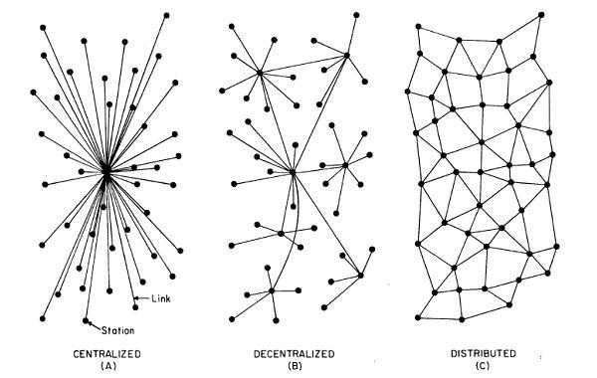
The Evolution of Energy Networks
Traditional networks with transmission system operators, distribution system operators & radial distribution systems to communities

Slide 5
The Evolution of Energy Networks
Network of distribution feeders with some microgrids with tightly integrated distributed energy resources

Slide 6
The Evolution of Energy Networks
Traditional networks with transmission system operators, distribution system operators & radial distribution systems to communities
Network of distribution feeders with some microgrids with tightly integrated distributed energy resources
Network of transactive microgrids with limited role of distribution system operators

Slide 7
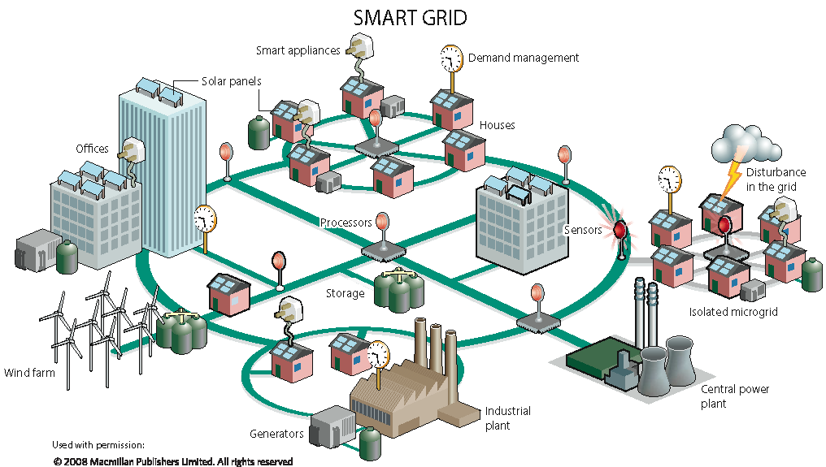
Decentralization in Electrical Networks
Decentralized analysis, computation & control is necessary for enabling the next generation of smart electrical networks
Advantages of decentralization
Improved cyber & physical reliability by removing single point of failures
Faster decision making by avoiding network penalties due to round-trip to the cloud
Improved scalability
Better integration with hierarchical control systems

Slide 8
Towards Distributed Energy Networks
Energy distribution networks can be made self-sustaining by allowing them to
Exchange energy from nearby microgrids
Balance storage & production to maintain a stable load demand to the DSO. [Transactive Energy]
Support Islanding operations [if the conditions require it]

Slide 9
Outline
Towards distributed energy networks
What computation platforms & services are required to realize these systems?
Middleware for decentralized computing
Can it manage both physical & financial transactions?
Proposed implementation of a blockchain-enabled middleware platform & its application in distributed energy networks

Slide 10
Middleware for Decentralized Computing
Programming, developing & managing decentralized & distributed networks is hard
A number of services that are orthogonal to the application logic are required
Time synchronization
Messaging middleware
Consensus & coordination mechanisms
Fault-tolerant & scalable real-time market implementation
Tamper-proof auditable transaction records
Discovery & deployment Mechanisms
Fault-detection & recovery mechanisms
Distributed security mechanisms

Slide 11
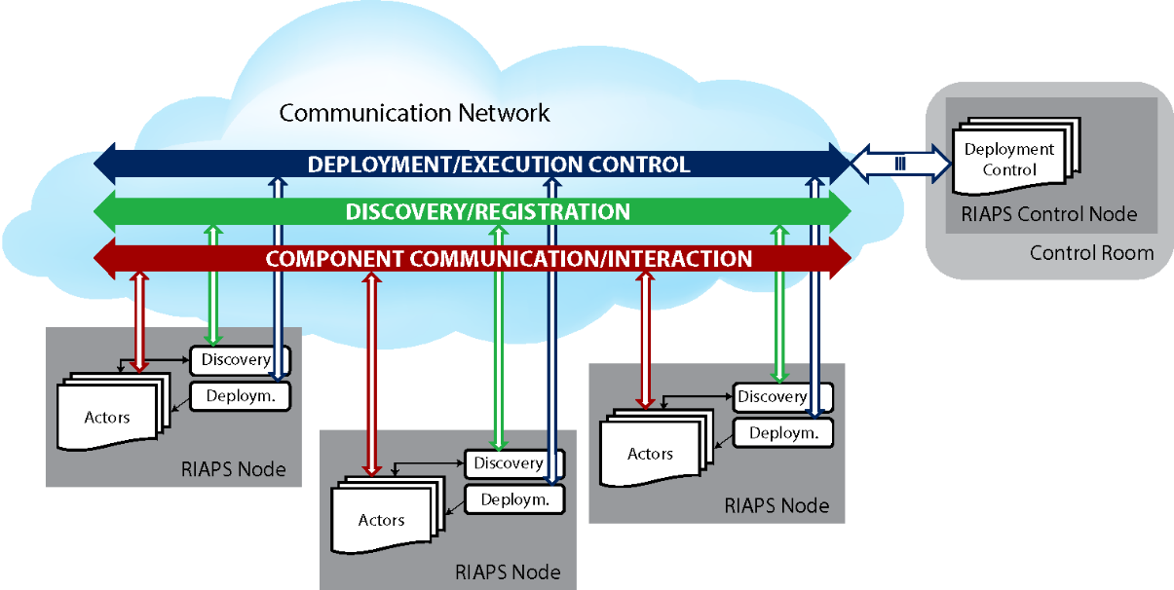
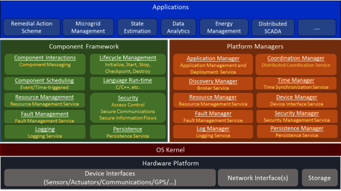
Middleware for Decentralized Computing
Funded by ARPA-E under Award #: DE-AR0000666, PI: Gabor Karsai
Goal: Create an open source software platform to run Smart Grid applications & demonstrate it through selected applications
This software platform defines:
Programming model (for distributed real-time software)
Services
Time synchronization
Messaging middleware
Consensus & coordination mechanisms
Discovery & deployment mechanisms
Fault-detection & recovery mechanisms
Distributed security mechanisms
Development toolkit (for building & deploying apps)
Uniqueness:
Focus on distributed applications not only on networking
Focus on resilience – fault recovery
Focus on security – maintain confidentiality, integrity, availability

Slide 12
Outline
Towards distributed energy networks
What computation platforms & services are required to realize these systems?
Middleware for decentralized computing
Can it manage both physical & financial transactions?
Proposed implementation of a blockchain-enabled middleware platform & its application in distributed energy networks

Slide 13
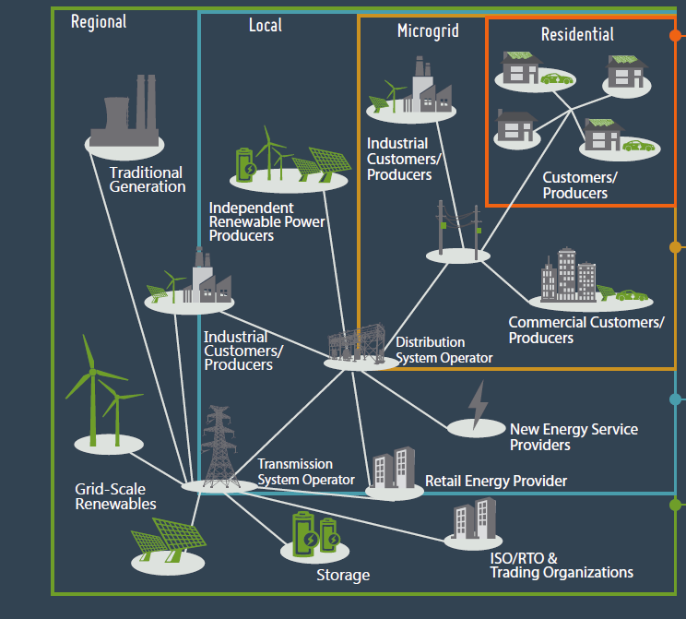
What’s Missing?
We need to explore the interactions between what happens when we operate at the boundary of the interaction of power management in a community & the financial trades in the microgrid
Can we ensure that the system is resilient and stable under those conditions. Towards, that:
Can we provide the full traceability for the transactions
Can we ensure that a prosumer cannot sell more power than it generates
Can we ensure a prosumer cannot execute pure financial transactions i.e., all transactions should require transfer of energy
Source: www.gridwiseac.org/pdfs/te_infographics_061014_pnnl_sa_103395.pdf

Slide 14
Outline
Towards distributed energy networks
What computation platforms & services are required to realize these systems?
Middleware for decentralized computing
Can it manage both physical & financial transactions?
Proposed implementation of a blockchain-enabled middleware platform & its application in distributed energy networks

Slide 15
Middleware for Transactive Energy
New services:
Distributed Ledger
Trading Platform
Controller
stores transactions that specify energy trades, record energy production & consumption, & change regulatory policies for the microgrid
by serving as a database for bids, enables prosumers to find trade partners without communicating with all potential partners
stabilizes load within the microgrid & controls it based on the load in the rest of the grid

Slide 16
Distributed Architecture
RIAPS nodes implement these services:
Controller
Trading Platform
Distributed Ledger

Slide 17
Transactive Energy System
measured / forecasted grid load
DSO
measured / forecasted microgrid load
price policy
Distributed ledger
Distributed ledger
buy/sell energy
in advance
record actual net consumption
current & future
energy prices
Smart meter
Prosumer
(trading and
control algorithm)
energy production / consumption / storage
measure
control

Slide 18
Transactive Energy Algorithms
Forecasted grid load
Control signal
(for microgrid load)
desired load
Price policy
DSO price
for consumption
Forecasted microgrid load
DSO price
for production
grid & microgrid load
control signal
price policy
control algorithm
pricing algorithm

Slide 19
Energy Trading
Time is divided into fixed-length intervals based on how often the DSO control signal may change
default length in our implementation is 4 sec (can be changed for each deployment)
Financial Transaction
prosumer buys/sells energy from/to another prosumer or the DSO
buy/sell in advance: DSO may set rules and regulations on timing
Energy Transaction
tamper-proof smart meter of the prosumer records actual energy production or consumption

Slide 20
Energy Trading
Time is divided into fixed-length intervals based on how often the DSO control signal may change
default interval in our implementation is 4s (can be changed for each deployment)
Financial Transaction
prosumer buys/sells energy from/to another prosumer or the DSO
buy/sell in advance: DSO may set rules and regulations on timing
Energy Transaction
tamper-proof smart meter of the prosumer records actual energy production or consumption

Slide 21



Ledger Service
Ledger: list of transactions specifying energy trades, recording energy production & consumption, and regulating the microgrid
secure from tampering & revisions
Transactions are signed & submitted by nodes
Distributed ledger for reliability & security
implemented by one or many ledger nodes
ledger nodes must reach consensus on which transactions are recorded in the ledger

Slide 22
Ledger Service
Ledger: list of transactions specifying energy trades, recording energy production & consumption, and regulating the microgrid
secure from tampering & revisions
Transactions are signed & submitted by nodes
Distributed ledger for reliability & security
implemented by one or many ledger nodes
ledger nodes must reach consensus on which transactions are recorded in the ledger
We are planning to use this because of its modular structure

Slide 23
Consensus Service
Ledger nodes must reach consensus on which transactions are valid & recorded on the ledger
Consensus algorithm
must be secure & reliable
must happen in a matter of seconds (due to the timing constraints of electricity control)
approaches:
Blockchain with proof-of-work system
Blockchain with proof-of-stake system
Practical Byzantine Fault Tolerance (PBFT)
popular, but it is computationally expensive & has unpredictable timing

Slide 24

Protection Invariant
Without protection, a malfunctioning or malicious prosumer node may destabilize the grid thru energy trades
e.g., promising to generate an enormous amount of energy but failing to deliver
Ledger nodes must validate transactions & reject potentially dangerous ones
Safety validation
every prosumer node has a maximum net consumption & maximum net production value
in every time interval, the net energy bought/ sold by the prosumer in advance must not exceed the maximum
transactions that would violate this rule are rejected

Slide 25
Regulatory Transactions
Enable regulating the microgrid
must be signed & submitted by the DSO node
Essential regulatory transactions
Price Policy
changes energy prices for the microgrid
can be used to influence demand & supply
Certificate Revocation
prohibits accepting transactions from certain nodes
can be used to remove nodes that have been compromised or left the system

Slide 26
Concluding Remarks
Energy evolution: from centralized to decentralized & distributed energy systems
transactive energy systems can maintain the reliability & security of the power system
RIAPS: open-source software platform for running distributed Smart Grid applications
Extending RIAPS for transactive energy use case
distributed ledger with consensus service
trading platform for fast & scalable energy trading
controller for adjusting microgrid load through prices
Implementation idea: RIAPS (additional services) + Hyperledger

Slide 27
Thank you for your attention!
Questions?

