Slide 1



Evaluating the Performance of Pub/Sub Platforms for Tactical Information Management
Jeff Parsons
j.parsons@vanderbilt.edu
Ming Xiong
xiongm@isis.vanderbilt.edu
Dr. Douglas C. Schmidt
d.schmidt@vanderbilt.edu
James Edmondson
jedmondson@gmail.com
Hieu Nguyen hieu.t.nguyen@vanderbilt.edu
Olabode Ajiboye
olabode.ajiboye@vanderbilt.edu
July 11, 2006
Research Sponsored by AFRL/IF, NSF, & Vanderbilt University

Slide 2





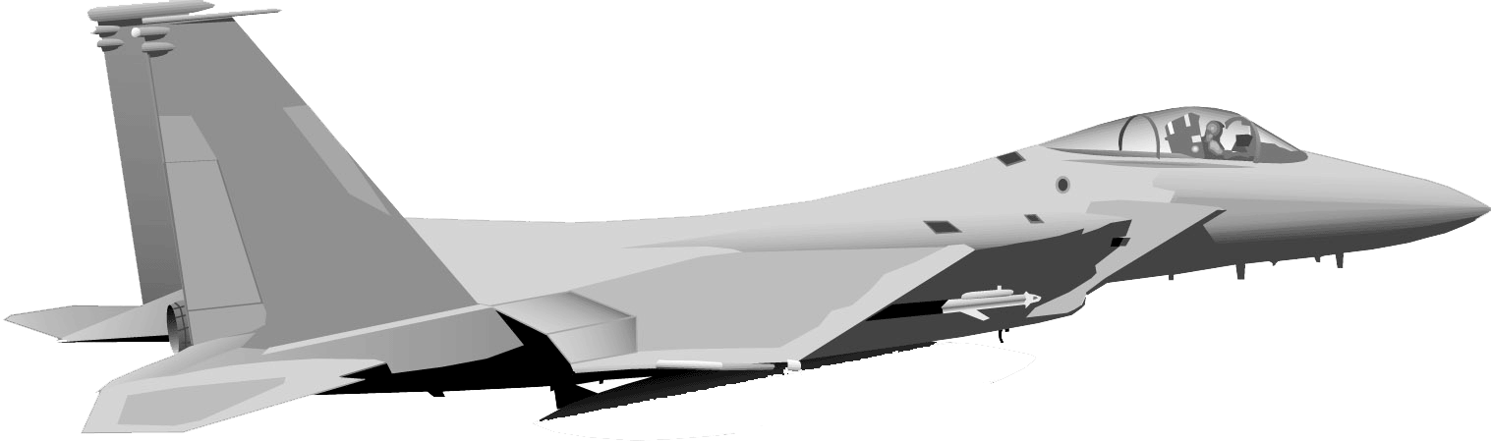
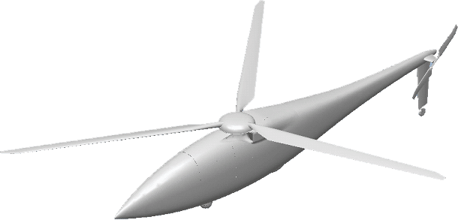





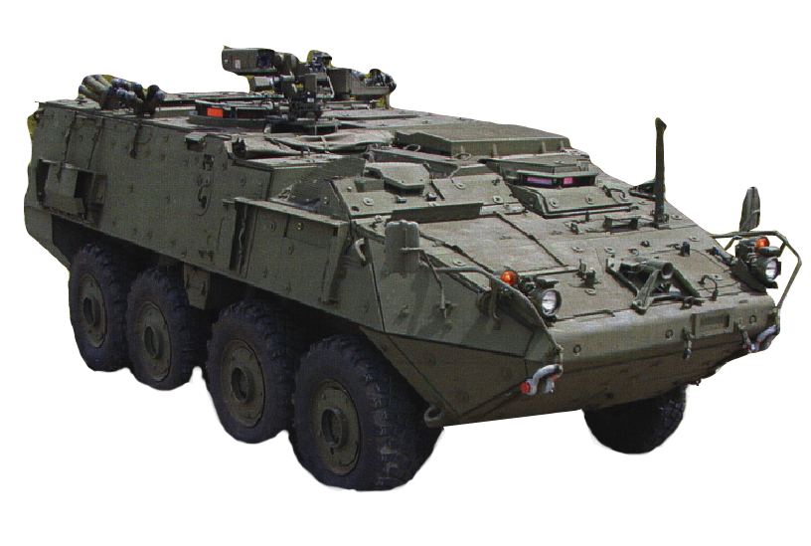
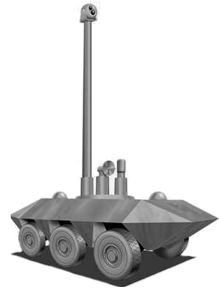







Demands on Tactical Information Systems
Key problem space challenges
  Large-scale, network-centric, dynamic, systems of systems
  Simultaneous QoS demands with insufficient resources
    e.g., wireless with intermittent connectivity
  Highly diverse & complex problem domains
Key solution space challenges
  Enormous accidental & inherent complexities
  Continuous technology evolution refresh, & change
  Highly heterogeneous platform, language, & tool environments
Utility “Curve”
Desired
Utility
Curve
Utility
“Working
Range”
“Broken”
“Works”
Utility
Resources
Resources
“Harder” Requirements
“Softer” Requirements

Slide 3
Promising Approach:
The OMG Data Distribution Service (DDS)
Application
write
read
Application
‘Global’ Data Store
write
Application
write
write
Application
read
read
Application
Workload &
Replicas
Connections &
priority bands
CPU & memory
Network latency
& bandwidth
Provides flexibility, power & modular structure by decoupling:
Location – anonymous pub/sub
Redundancy – any number of readers & writers
Time – async, disconnected, time-sensitive, scalable, & reliable data distribution at multiple layers
Platform – same as CORBA middleware

Slide 4
Overview of the Data Distribution Service (DDS)
A highly efficient OMG pub/sub standard
  fewer layers, less overhead
  RTPS over UDP will recognize QoS
Topic
R
Data Writer R
Data Reader R
Publisher
Subscriber
RT Info to Cockpit & Track Processing
DDS Pub/Sub
Using Proposed
Real-Time Publish Subscribe (RTPS) Protocol
Tactical
Network & RTOS

Slide 5
Overview of the Data Distribution Service (DDS)
A highly efficient OMG pub/sub standard
  fewer layers, less overhead
  RTPS over UDP will recognize QoS
DDS provides meta-events for
detecting dynamic changes
Topic
R
NEW TOPIC
Data Writer R
Data Reader R
NEW
SUBSCRIBER
Publisher
Subscriber
NEW
PUBLISHER

Slide 6
Overview of the Data Distribution Service (DDS)
A highly efficient OMG pub/sub standard
  Fewer layers, less overhead
  RTPS over UDP will recognize QoS
DDS provides meta-events for
detecting dynamic changes
DDS provides policies for
specifying many QoS
requirements of tactical
information management
systems, e.g.,
  Establish contracts that
  precisely specify a wide
  variety of QoS
  policies at multiple system
  layers
HISTORY
Topic
R
RESOURCE LIMITS
Data Writer R
S1
Data Reader R
S2
S3
S4
S5
Publisher
S6
Subscriber
S7
LATENCY
X
S7
S7
S6
S5
S4
S3
S2
S1
COHERENCY
RELIABILITY

Slide 7
Overview of DDS Implementation Architectures
Decentralized Architecture
  embedded threads to handle communication, reliability, QoS etc
node
Network
node

Slide 8
Overview of DDS Implementation Architectures
Decentralized Architecture
  embedded threads to handle communication, reliability, QoS etc
Federated Architecture
  a separate daemon
  process to handle communication, reliability, QoS, etc.
node
Network
node
node
node
daemon
Network
daemon

Slide 9
Overview of DDS Implementation Architectures
Decentralized Architecture
  embedded threads to handle communication, reliability, QoS etc
Federated Architecture
  a separate daemon
  process to handle communication, reliability, QoS, etc.
Centralized Architecture
  one single daemon
  process for domain
node
Network
node
node
node
daemon
Network
daemon
node
node
daemon
node
Network

Slide 10

DDS1 (Decentralized Architecture)
Participant
Participant
comm/
aux threads
Network
comm/
aux threads
User process
User process
Node (computer)
Node (computer)
Pros: Self-contained communication end-points, needs no extra daemons
Cons: User process more complex, e.g., must handle config details (efficient discovery, multicast)

Slide 11
DDS2 (Federated Architecture)
Participant
Participant
aux threads
aux threads
User process
User process
comm threads
Network
comm threads
Daemon process
Daemon process
Node (computer)
Node (computer)
Pros: Less complexity in user process & potentially more scalable to large # of subscribers
Cons: Additional configuration/failure point; overhead of inter-process communication

Slide 12
DDS3 (Centralized Architecture)
Participant
Participant
data
comm threads
comm threads
Network
User process
User process
control
control
Node (computer)
Node (computer)
Aux + comm
threads
Daemon process
Node (computer)
Pros: Easy daemon setup
Cons: Single point of failure; scalability problems

Slide 13
Architectural Features Comparison Table
QoS | Description | DDS1 | DDS2 | DDS3
Notification Mechanism | Blocking or Non-blocking data receiving | Listener-Based/ Wait-Based | Listener-Based/ Wait-Based | Listener-Based
Transport | Controls whether to use network multicast/broadcast/unicast addresses when sending data samples to DataSenders | Unicast/ Multicast | Broadcast / Multicast | Unicast + transport framework
Higher-level DDS Protocol | On-the-wire communication model | RTPS Like protocol | RTPS Like protocol | N/A
Lower-level Transport | Underlying communication transport | Shared Memory/ UDPv4 | Shared Memory/ UDPv4 | Simple TCP/ Simple UDP
Notes:
Inter-node protocols refers to the higher-level communication model used by DDS to provide pub/sub data distribution service, & intra-node protocols refers to the underlying standard industry protocol that the communication model is running over

Slide 14
QoS Policies Comparison Table (partial)
QoS | Description | DDS1 | DDS2 | DDS3
DURABILITY | Controls how long published samples are stored by the middleware for late-joining data readers | VOLATILE TRANSIENT-LOCAL | VOLATILE TRANSIENT-LOCAL TRANSIENT PERSISTENT | VOLATILE TRANSIENT_LOCAL
HISTORY | Sets number of samples that DDS will store locally for data writers & data readers | KEEP_LAST KEEP_ALL | KEEP_LAST KEEP_ALL | KEEP_LAST KEEP_ALL
RELIABILITY | Whether data published by a data writer will be reliably delivered by DDS to matching data readers | BEST_EFFORT RELIABLE | BEST_EFFORT RELIABLE | BEST_EFFORT(UDP) RELIABLE(TCP)
RESOURCE_LIMITS | Controls memory resources that DDS allocates & uses for data writer or data reader | initial_instance(extension) initial_samples(extension) max_instances max_samples max_samples_per_instance | max_instances max_samples max_samples_per_instance | max_instances max_samples max_samples_per_instance

Slide 15
Evaluation Focus
Compare performance of C++ implementations of DDS to:
  Other pub/sub middleware
    CORBA Notification Service
    SOAP
    Java Messaging Service
DDS? JMS? SOAP?
Notification Service?
Application
Application

Slide 16
Evaluation Focus
Compare performance of C++ implementations of DDS to:
  Other pub/sub middleware
    CORBA Notification Service
    SOAP
    Java Messaging Service
  Each other
DDS? JMS? SOAP?
Notification Service?
Application
Application
DDS1? DDS2?
DDS3?
Application
Application

Slide 17

Evaluation Focus
Compare performance of C++ implementations of DDS to:
  Other pub/sub middleware
    CORBA Notification Service
    SOAP
    Java Messaging Service
  Each other
Compare DDS portability & configuration details
DDS? JMS? SOAP?
Notification Service?
Application
Application
DDS1? DDS2?
DDS3?
Application
Application
DDS1
?
?
DDS
DDS2
Application
?
DDS3

Slide 18
Evaluation Focus
Compare performance of C++ implementations of DDS to:
  Other pub/sub middleware
    CORBA Notification Service
    SOAP
    Java Messaging Service
  Each other
Compare DDS portability & configuration details
Compare performance of subscriber notification mechanisms
  Listener vs. wait-set
DDS? JMS? SOAP?
Notification Service?
Application
Application
DDS1? DDS2?
DDS3?
Application
Application
DDS1
?
?
DDS
DDS2
Application
?
DDS3
Subscriber
Wait-set
?
DDS
Listener
?

Slide 19
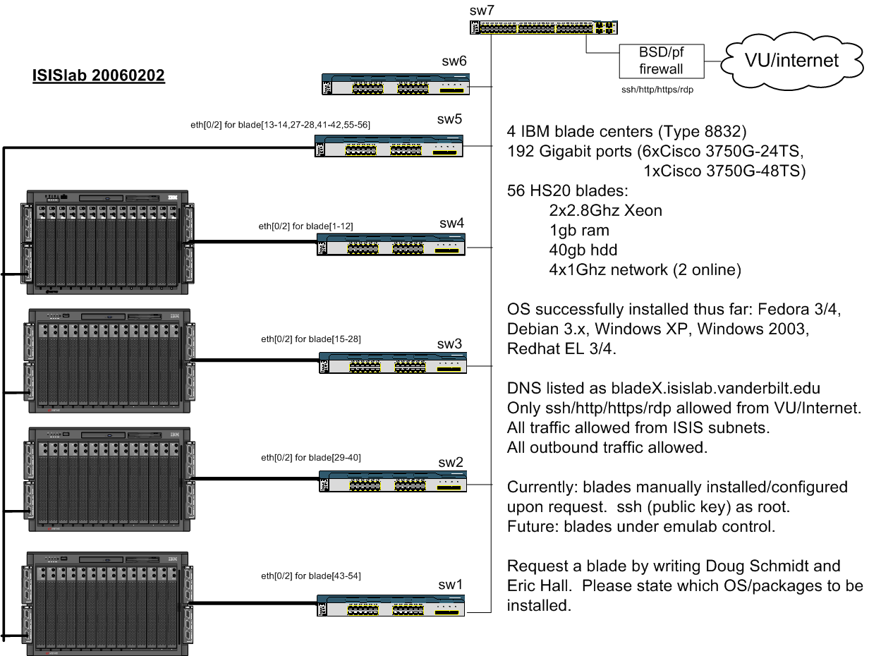
Overview of ISISlab Testbed
Platform configuration for experiments
OS: Linux version 2.6.14-1.1637_FC4smp
Compiler: g++ (GCC) 3.2.3 20030502
CPU: Intel(R) Xeon(TM) CPU 2.80GHz w/ 1GB ram
DDS: Latest C++ versions from 3 vendors
wiki.isis.vanderbilt.edu/support/isislab.htm has more information on ISISlab

Slide 20
Benchmarking Challenges
Challenge – Measuring latency & throughput accurately without depending on synchronized clocks
Solution
  Latency – Add ack message, use publisher clock to time round trip
  Throughput – Remove sample when read, use subscriber clock only

Slide 21
Benchmarking Challenges
Challenge – Measuring latency & throughput accurately without depending on synchronized clocks
Solution
  Latency – Add ack message, use publisher clock to time round trip
  Throughput – Remove sample when read, use subscriber clock only
Challenge – Managing many tests, payload sizes, nodes, executables
Solution – Automate tests with scripts & config files

Slide 22
Benchmarking Challenges
Challenge – Measuring latency & throughput accurately without depending on synchronized clocks
Solution
  Latency – Add ack message, use publisher clock to time round trip
  Throughput – Remove sample when read, use subscriber clock only
Challenge – Managing many tests, payload sizes, nodes, executables
Solution – Automate tests with scripts & config files
Challenge – Calculating with an exact # of samples in spite of packet loss
Solution – Have publisher ‘oversend’, use counter on subscriber

Slide 23
Benchmarking Challenges
Challenge – Measuring latency & throughput accurately without depending on synchronized clocks
Solution
  Latency – Add ack message, use publisher clock to time round trip
  Throughput – Remove sample when read, use subscriber clock only
Challenge – Managing many tests, payload sizes, nodes, executables
Solution – Automate tests with scripts & config files
Challenge – Calculating with an exact # of samples in spite of packet loss
Solution – Have publisher ‘oversend’, use counter on subscriber
Challenge – Ensuring benchmarks are made over ‘steady state’
Solution – Send ‘primer’ samples before ‘stats’ samples in each run
  Bounds on # of primer & stats samples
    Lower bound – further increase doesn’t change results
    Upper bound – run of all payload sizes takes too long to finish

Slide 24
DDS vs Other Pub/Sub Architectures
// Complex Sequence Type
struct Inner {
string info;
long index;
};
typedef sequence<Inner> InnerSeq;
struct Outer {
long length;
InnerSeq nested_member;
};
typedef sequence<Outer> ComplexSeq;
100 primer samples
10,000 stats samples
Measured avg. round-trip latency & jitter
Process 1
Blade 0
Process 2
Blade 0
Tested seq. of byte &
seq. of complex type
Ack message of 4 bytes
Seq. lengths in powers of 2 (4 – 16384)
X & Y axes of all graphs in presentation use log scale for readability
Notes:
Modify this slide once we change the number of stats samples & primer samples to be the same in all tests

Slide 25
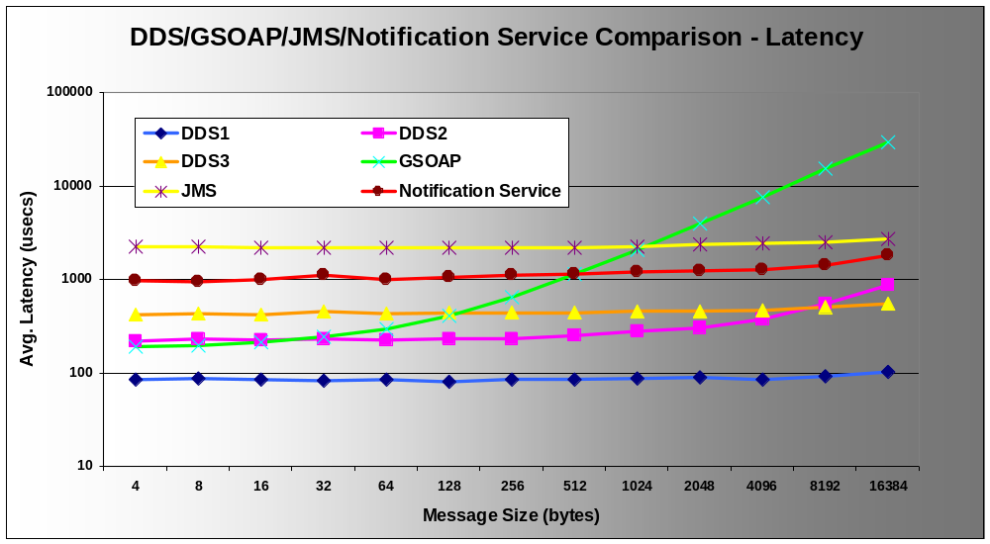
Latency – Simple Data Type
Message Length (samples)

Slide 26
Latency – Simple Data Type
With conventional pub/sub mechanisms the delay before the application learns critical information is very high!
In contrast, DDS latency is low across the board
Message Length (samples)

Slide 27
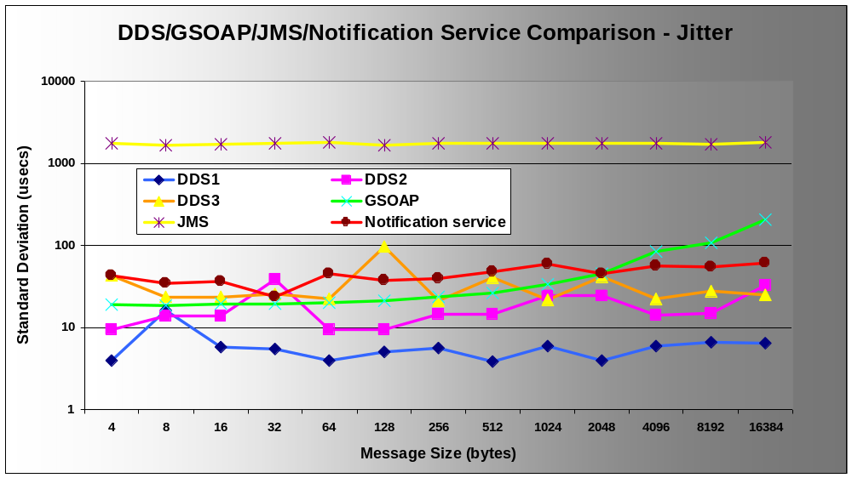
Jitter – Simple Data Type
Message Length (samples)

Slide 28
Jitter – Simple Data Type
Conventional pub/sub mechanisms exhibit extremely high jitter, which makes them unsuitable for tactical systems
In contrast, DDS jitter is low across the board
Message Length (samples)

Slide 29
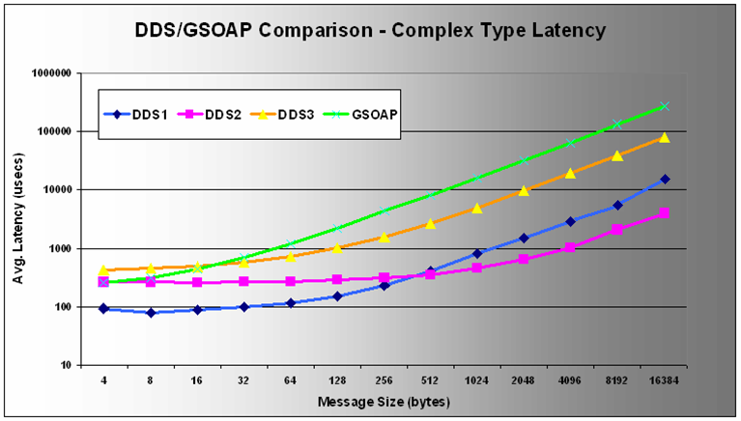
Latency – Complex Data Type
Message Length (samples)

Slide 30
Latency – Complex Data Type
While latency with complex types is less flat for all, DDS still scales better than Web Services by a factor of 2 or more
Some DDS implementations optimized for smaller data sizes
Message Length (samples)

Slide 31
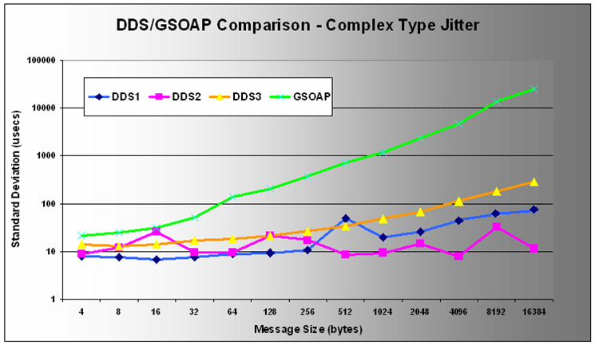
Jitter – Complex Data Type
Message Length (samples)

Slide 32
Jitter – Complex Data Type
Measuring jitter with complex data types brings out even more clearly the difference between DDS & Web Serivices
Better performance can be achieved by optimizing for certain data sizes
Message Length (samples)
Notes:
Jeff, please add “callout balloons” to emphasize the key “take home” points for each slide.

Slide 33
Scaling Up DDS Subscribers
The past 8 slides showed latency/jitter results for 1-to-1 tests
We now show throughput results for 1-to-N tests
4, 8, & 12 subscribers each on different blades
Publisher oversends to ensure sufficient received samples
Blade N
Blade …
Blade 0
Blade 2
Blade 1
Byte sequences
100 primer samples
10,000 stats samples
Seq. lengths in powers of 2 (4 – 16384)
All following graphs plot median + “box-n-whiskers” (50%ile-min-max)

Slide 34
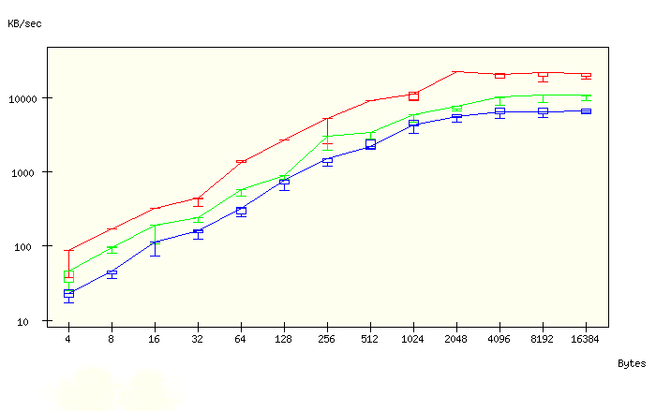
Scaling Up Subscribers – DDS1 Unicast
Performance increases linearly for smaller payloads
Performance levels off for larger payloads
subscriber uses listener
no daemon (app spawns thread)
KEEP_LAST (depth = 1)
4 Subscribers
8 Subscribers
12 Subscribers

Slide 35
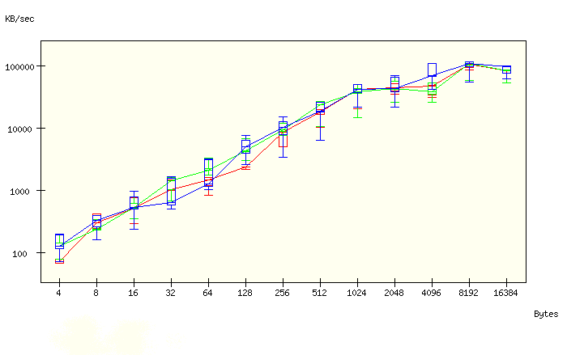
Scaling Up Subscribers – DDS1 Multicast
Performance increases more irregularly with # of subscribers
Performance levels off less than for unicast
subscriber uses listener
no daemon (library per node)
KEEP_LAST (depth = 1)
4 Subscribers
8 Subscribers
12 Subscribers

Slide 36
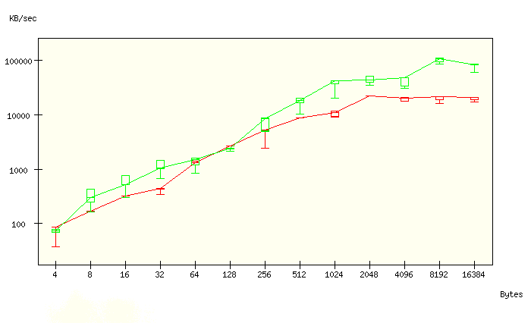
Scaling Up Subscribers – DDS1 1 to 4
Throughput greater for multicast over almost all payloads
Performance levels off less for multicast
subscriber uses listener
no daemon (app spawns thread)
KEEP_LAST (depth = 1)
Unicast
Multicast

Slide 37
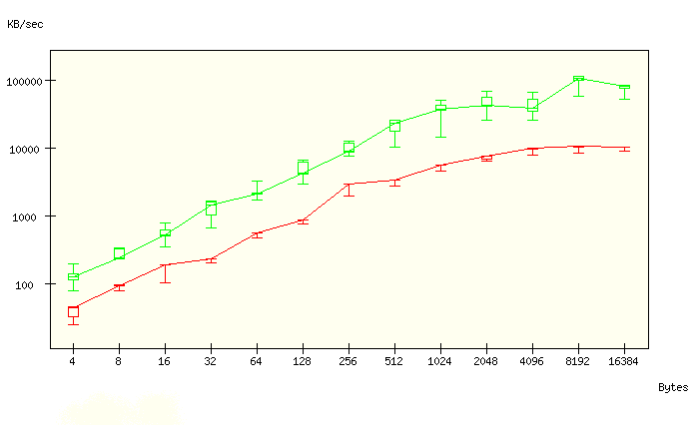
Scaling Up Subscribers – DDS1 1 to 8
Greater difference than for 4 subscribers
Performance levels off less for multicast
subscriber uses listener
no daemon (app spawns thread)
KEEP_LAST (depth = 1)
Unicast
Multicast

Slide 38
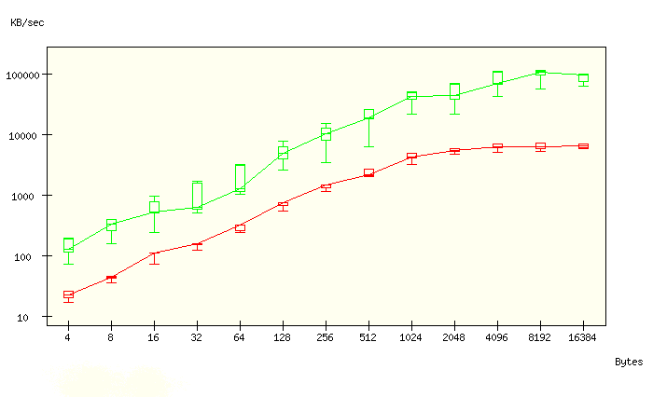
Scaling Up Subscribers – DDS1 1 to 12
Greater difference than for 4 or 8 subscribers
Difference most pronounced with large payloads
subscriber uses listener
no daemon (app spawns thread)
KEEP_LAST (depth = 1)
Unicast
Multicast

Slide 39
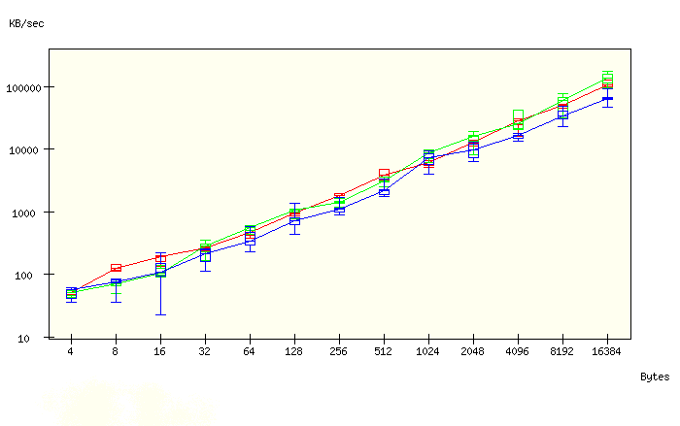
Scaling Up Subscribers – DDS2 Broadcast
Less throughput reduction with subscriber scaling than with DDS1
Performance continues to increase for larger payloads
subscriber uses listener
daemon per network interface
KEEP_LAST (depth = 1)
4 Subscribers
8 Subscribers
12 Subscribers

Slide 40
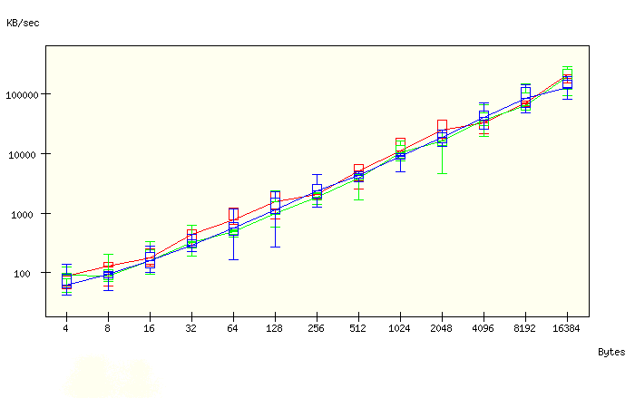
Scaling Up Subscribers – DDS2 Multicast
Lines are slightly closer than for DDS2 broadcast
subscriber uses listener
daemon per network interface
KEEP_LAST (depth = 1)
4 Subscribers
8 Subscribers
12 Subscribers

Slide 41
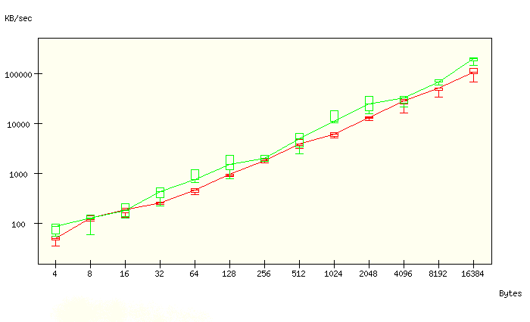
Scaling Up Subscribers – DDS2 1 to 4
Multicast performs better for all payload sizes
subscriber uses listener
daemon per network interface
KEEP_LAST (depth = 1)
Broadcast
Multicast

Slide 42
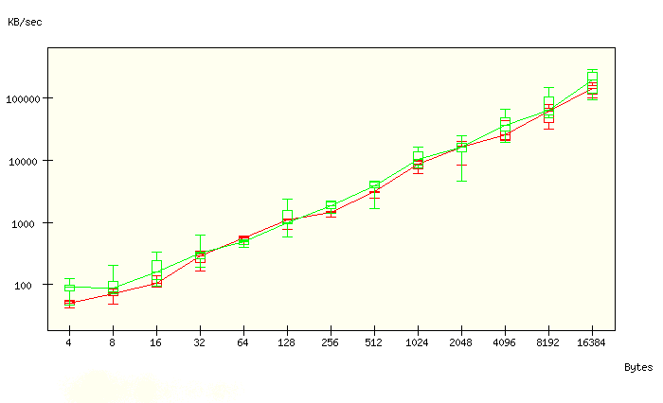
Scaling Up Subscribers – DDS2 1 to 8
Performance gap slightly less than with 4 subscribers
subscriber uses listener
daemon per network interface
KEEP_LAST (depth = 1)
Broadcast
Multicast

Slide 43
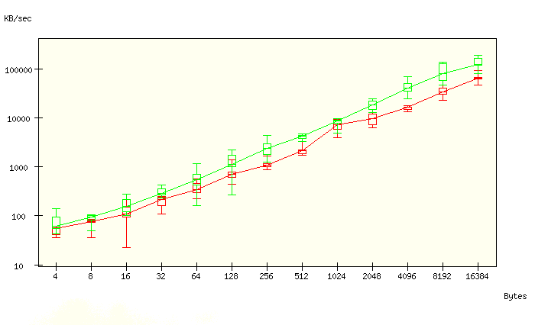
Scaling Up Subscribers – DDS2 1 to 12
Broadcast/multicast difference greatest for 12 subscribers
subscriber uses listener
daemon per network interface
KEEP_LAST (depth = 1)
Broadcast
Multicast

Slide 44
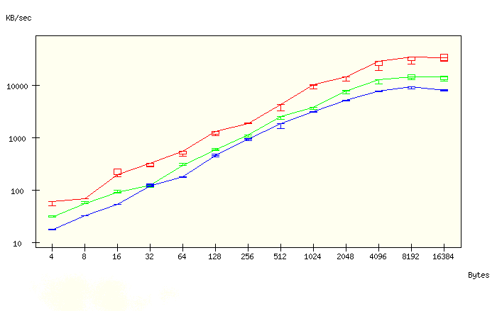
Scaling Up Subscribers – DDS3 Unicast
Throughput decreases dramatically with 8 subscribers, less with 12
Performance levels off for larger payloads
subscriber uses listener
centralized daemon
KEEP_ALL
4 Subscribers
8 Subscribers
12 Subscribers

Slide 45
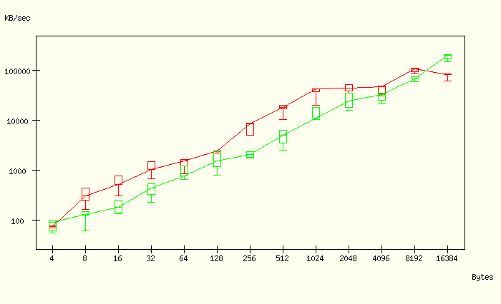
Impl Comparison: 4 Subscribers Multicast
DDS1 faster for all but the very smallest & largest payloads
Multicast not supported by DDS3
subscriber uses listener
KEEP_LAST (depth = 1)
DDS1
DDS2

Slide 46
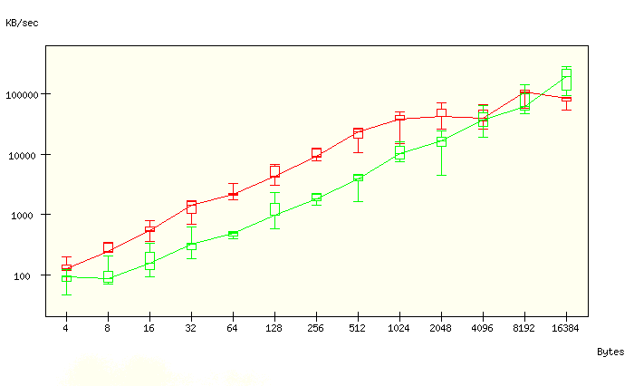
Impl Comparison: 8 Subscribers Multicast
Slightly more performance difference for 8 subscribers
Multicast not supported by DDS3
subscriber uses listener
KEEP_LAST (depth = 1)
DDS1
DDS2

Slide 47
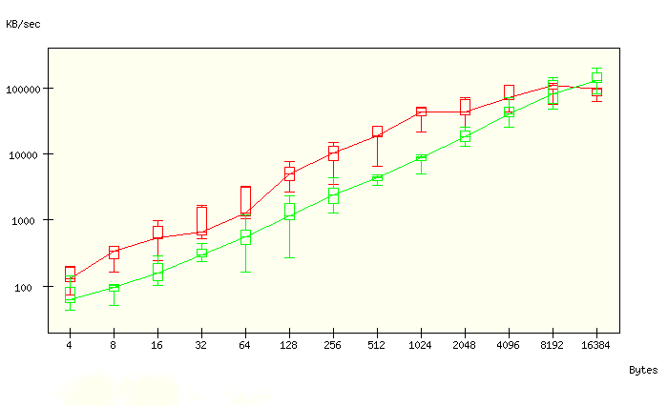
Impl Comparison: 12 Subscribers Multicast
Slightly less separation in performance with 12 subscribers
Multicast not supported by DDS3
subscriber uses listener
KEEP_LAST (depth = 1)
DDS1
DDS2

Slide 48
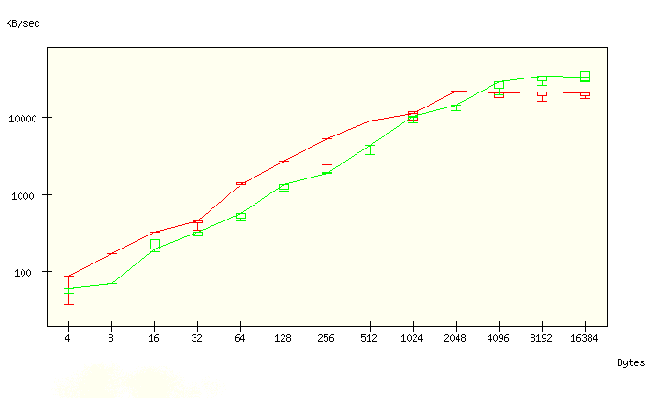
Impl Comparison: 4 Subscribers Unicast
DDS1 significantly faster except for largest payloads
Unicast not supported by DDS2
subscriber uses listener
KEEP_ALL
DDS1
DDS3

Slide 49
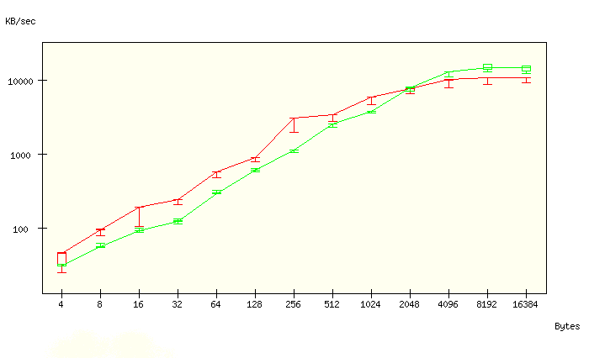
Impl Comparison: 8 Subscribers Unicast
Performance differences slightly less than with 4 subscribers
Unicast not supported by DDS2
subscriber uses listener
KEEP_ALL
DDS1
DDS3

Slide 50
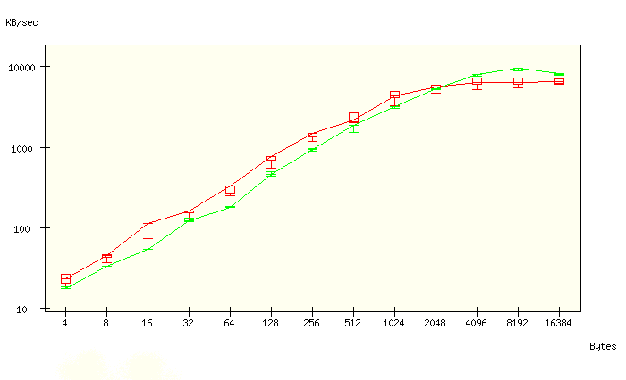
Impl Comparison: 8 Subscribers Unicast
Performance differences slightly less than with 8 subscribers
Unicast not supported by DDS2
subscriber uses listener
KEEP_ALL
DDS1
DDS3

Slide 51
Overview of DDS Listener vs. Waitset
Subscriber Application
Subscriber Application
Waitset
Condition
Data Reader
Data Reader
Condition
Condition
Listener
wait()
on_data_available()
take_w_condition()
DDS
DDS
Key characteristics
No application blocking
DDS thread executes application code
Key characteristics
Application locking
Application has full control over priority, etc.

Slide 52
Comparing Listener vs Waitset Throughput
4 subscribers on different blades
Publisher oversends to ensure sufficient received samples
Blade 4
Blade 3
Blade 0
Blade 2
Blade 1
Seq. lengths in powers of 2 (4 – 16384)
100 primer samples
10,000 stats samples
Byte sequences
Notes:
Ultimate we should make the # of samples the same for all tests

Slide 53
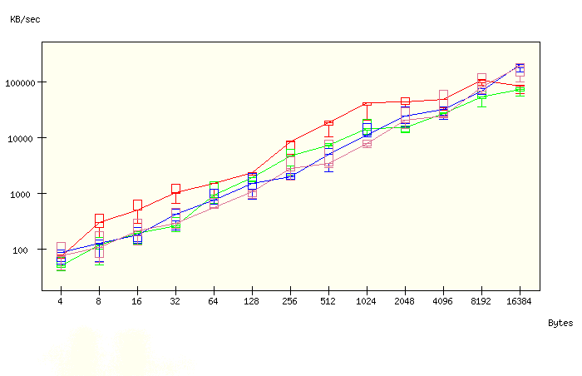
Impl Comparison: Listener vs. Waitset
DDS1 – listener outperforms waitset & DDS2 (except for large payloads)
No consistent difference between DDS2 listener & waitset
multicast
4 subscribers
KEEP_LAST (depth = 1)
DDS1 Listener
DDS1 Waitset
DDS2 Listener
DDS2 Waitset

Slide 54

DDS Application Challenges
Scaling up number of subscribers
  Data type registration race condition (DDS3)
  Setting proprietary ‘participant index’ QoS (DDS1)
DDS
data type A
data type A
data type A

Slide 55
DDS Application Challenges
Scaling up number of subscribers
  Data type registration race condition (DDS3)
  Setting proprietary ‘participant index’ QoS (DDS1)
Getting a sufficient transport buffer size
DDS
data type A
data type A
data type A
Publisher
Subscriber
DDS
X
Transport

Slide 56
DDS Application Challenges
Scaling up number of subscribers
  Data type registration race condition (DDS3)
  Setting proprietary ‘participant index’ QoS (DDS1)
Getting a sufficient transport buffer size
QoS policy interaction
  HISTORY vs RESOURCE LIMITS
    KEEP_ALL => DEPTH = <INFINITE>
      no compatibility check with RESOURCE LIMITS
    KEEP_LAST => DEPTH = n
      can be incompatible with RESOURCE LIMITS value
DDS
data type A
data type A
data type A
Publisher
Subscriber
DDS
X
Transport
DDS
X
Subscriber
Subscriber
KEEP_ALL
KEEP_LAST = 10
MAX_SAMPLES = 5
MAX_SAMPLES = 5

Slide 57
Portability Challenges
 | DDS1 | DDS2 | DDS3
DomainParticipantFactory | compliant | compliant | proprietary function
Register Data Types | static method | member method | member method
Spec Operations | extra argument (newer spec) | compliant | compliant
Key Declaration | //@key | single #pragma | pair of #pragma
Required App. IDs | publisher & subscriber | none | publisher
Required App. Transport Config | code-based | none | file-based or code-based
Notes:
Jeff, I think it would be good to have some callout balloons here to show what the code looked like..

Slide 58
Portability Challenges
 | DDS1 | DDS2 | DDS3
DomainParticipantFactory | compliant | compliant | proprietary function
Register Data Types | static method | member method | member method
Spec Operations | extra argument (newer spec) | compliant | compliant
Key Declaration | //@key | single #pragma | pair of #pragma
Required App. IDs | publisher & subscriber | none | publisher
Required App. Transport Config | code-based | none | file-based or code-based
DomainParticipantFactory::get_instance();
TheParticipantFactoryWithArgs(argc, argv);

Slide 59
Portability Challenges
 | DDS1 | DDS2 | DDS3
DomainParticipantFactory | compliant | compliant | proprietary function
Register Data Types | static method | member method | member method
Spec Operations | extra argument (newer spec) | compliant | compliant
Key Declaration | //@key | single #pragma | pair of #pragma
Required App. IDs | publisher & subscriber | none | publisher
Required App. Transport Config | code-based | none | file-based or code-based
DataType::register_type(participant, name);
DataType identifier;
identifier.register_type(participant, name);

Slide 60
Portability Challenges
 | DDS1 | DDS2 | DDS3
DomainParticipantFactory | compliant | compliant | proprietary function
Register Data Types | static method | member method | member method
Spec Operations | extra argument (newer spec) | compliant | compliant
Key Declaration | //@key | single #pragma | pair of #pragma
Required App. IDs | publisher & subscriber | none | publisher
Required App. Transport Config | code-based | none | file-based or code-based
create_publisher(QoS_list,
listener);
create_publisher(QoS_list,
listener,
DDS_StatusKind);

Slide 61
Portability Challenges
 | DDS1 | DDS2 | DDS3
DomainParticipantFactory | compliant | compliant | proprietary function
Register Data Types | static method | member method | member method
Spec Operations | extra argument (newer spec) | compliant | compliant
Key Declaration | //@key | single #pragma | pair of #pragma
Required App. IDs | publisher & subscriber | none | publisher
Required App. Transport Config | code-based | none | file-based or code-based
#pragma keylist Info id
struct Info {
long id; //@key
string msg;
};
#pragma DCPS_DATA_TYPE “Info”
#pragma DCPS_DATA_KEY “id”

Slide 62
Lessons Learned - Pros
Performance of DDS is significantly faster than other pub/sub architectures
  Even the slowest was 2x faster than other pub/sub services
DDS scales better to larger payloads, especially for simple data types

Slide 63
Lessons Learned - Pros
Performance of DDS is significantly faster than other pub/sub architectures
  Even the slowest was 2x faster than other pub/sub services
DDS scales better to larger payloads, especially for simple data types
DDS implementations are optimized for different use cases & design spaces
  e.g., smaller/larger payloads & smaller/larger # of subscribers

Slide 64
Lessons Learned - Cons
Can’t yet make “apples-to-apples” DDS test parameters comparison for all impls
  No common transport protocol
    DDS1 uses RTPS on top of UDP (RTPS support planned this winter for DDS2)
    DDS3 uses raw TCP or UDP
  Unicast/Broadcast/Multicast
  Centralized/Federated/Decentralized Architectures
DDS applications not yet portable “out-of-the-box”
  New, rapidly evolving spec
  Vendors use proprietary techniques to fill gaps, optimize
  Clearly a need for portability wrapper facades, a la ACE or IONA’s POA utils
Lots of tuning & tweaking of policies & options are required to optimize performance
Broadcast can be a two-edged sword (router overload!)
Impl | unicast | multicast | broadcast
DDS1 | Yes (default) | Yes | No
DDS2 | No | Yes | Yes (default)
DDS3 | Yes (default) | No | No

Slide 65
Future Work - Pub/Sub Metrics
Tailor benchmarks to explore key classes of tactical applications
  e.g., command & control, targeting, route planning
Devise generators that can emulate various workloads & use cases
Include wider range of QoS & configuration, e.g.:
  Durability
  Reliable vs best effort
  Interaction of durability, reliability and history depth
  Map to classes of tactical applications
Measure migrating processing to source
Measure discovery time for various entities
  e.g., subscribers, publishers, & topics
Find scenarios that distinguish performance of QoS policies & features, e.g.:
  Listener vs waitset
  Collocated applications
  Very large # of subscribers & payload sizes

Slide 66
Future Work - Benchmarking Framework
Larger, more complex automated tests
  More nodes
  More publishers, subscribers per test, per node
  Variety of data sizes, types
  Multiple topics per test
  Dynamic tests
    Late-joining subscribers
    Changing QoS values
Alternate throughput measurement strategies
  Fixed # of samples – measure elapsed time
  Fixed time window – measure # of samples
  Controlled publish rate
Generic testing framework
  Common test code
  Wrapper facades to factor out portability issues
Include other pub/sub platforms
  WS Notification
  ICE pub/sub
  Java impls of DDS
DDS benchmarking framework is open-source & available on request

Slide 67

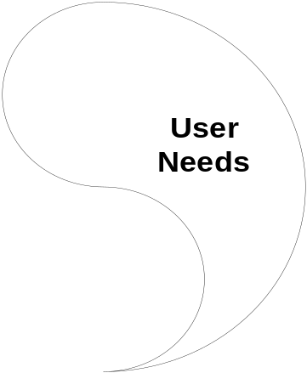

Concluding Remarks
Next-generation QoS-enabled information management for tactical applications requires innovations & advances in tools & platforms
Emerging COTS standards address some, but not all, hard issues!
These benchmarks are a snapshot of an ongoing process
Keep track of our benchmarking work at www.dre.vanderbilt.edu/DDS
Latest version of these slides at
DDS_RTWS06.pdf in the above directory
R&D
Thanks to Object Computing Inc (OCI), PrismTechnologies (PrismTech), & Real-time Innovations (RTI) for providing their DDS implementations & for helping with the benchmarking process

