Slide 1
Understanding the Requirements and Capabilities of Publish/Subscribe Middleware for Industrial IoT Applications
Scott Eisele Shweta Khare Aniruddha Gokhale Doug Schmidt Abhishek Dubey

Slide 2
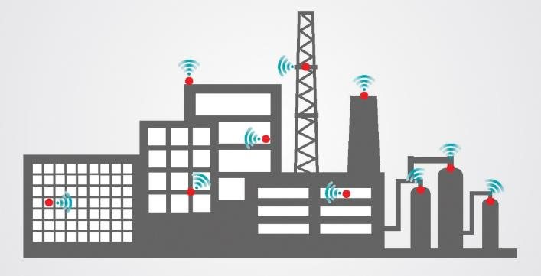

Smart Industrial Internet of Things
Continuous Monitoring, Prognosis and optimization across smart factories
Continuous Monitoring, Prognosis and optimization across the cluster of wind mills

Slide 3
Smart Industrial Internet of Things
Continuous Monitoring, Prognosis and optimization across smart factories
Continuous Monitoring, Prognosis and optimization across the cluster of wind mills
Requires movement of data at large volume and velocity to computation nodes for analytics.
Results have to be disseminated back to the data generation nodes for actuation.

Slide 4
Communication Middleware
Communication middleware is key for this movement of data.
It provides necessary separation of concerns between communication patterns and computation patterns.
It is necessary for building robust, portable and modular IoT applications.
There are essentially four separate communication patters
Synchronous publish/subscribe
Asynchronous publish/subscribe
Synchronous request/reply
Asynchronous request/reply
The publish subscribe pattern supports decoupling publishers from subscribers and is being investigated in this work.

Slide 5
Publish/Subscribe Middleware
There are essentially two different versions of these middleware
Brokerless – The publishers and subscribers find each other using a set of decentralized/distributed services
Brokered Matching – A broker is responsible for matching publishers and subscribers. But the communication is handled directly between publishers and subscribers.
Brokered Communication – Brokers are responsible for actual data movement between publishers and subscribers. The advantage of this mechanism is that it allows data movement through heterogenous networks, e.g. MQTT. However, broker often becomes a bottleneck.
We are interested in a specific implementation of publish subscribe middleware categories
Those implementing an OMG standard called Data Distribution Services.

Slide 6
The OMG Data Distribution Service (DDS) standard
Application
write
read
Application
‘Global’ Data Store
write
Application
write
write
Application
read
read
Application
Workload &
Replicas
Connections &
priority bands
CPU & memory
Network latency
& bandwidth
Provides flexibility, power & modular structure by decoupling:
Location – anonymous pub/sub
Redundancy – any number of readers & writers
Time – async, disconnected, time-sensitive, scalable, & reliable data distribution at multiple layers
Platform – It is platform independent and is supported on a number of operating systems and hardware architectures.

Slide 7
Overview of DDS Implementation Architectures
Decentralized Architecture
embedded threads to handle communication, reliability, QoS etc.
Example: RTI DDS
Federated Architecture
a separate daemon process to handle communication, reliability, QoS, etc.
Example OpenSplice
Centralized Architecture
one single daemon process for domain
Example Open DDS
node
Network
node
node
node
daemon
Network
daemon
node
node
daemon
node
Network

Slide 8
Overview of DDS Implementation Architectures
Decentralized Architecture
embedded threads to handle communication, reliability, QoS etc
Example: RTI DDS
Federated Architecture
a separate daemon process to handle communication, reliability, QoS, etc.
Example OpenSplice
Centralized Architecture
one single daemon process for domain
Example Open DDS
node
Network
node
node
node
daemon
Network
daemon
node
node
daemon
node
Network
We are evaluating RTS DDS and Checking its performance.
RTI DDS implements a brokerless matching mechanism called RTPS protocol

Slide 9
RTPS Protocol – Real-Time Publish Subscribe
Defined by Object Management Group
Completely decentralized architecture with dynamic discovery service that automatically establishes communication between matching peers
Rich Quality of Service (QoS) characteristics for control over every aspect of data distribution, such as data availability, resource usage, reliability, and timing
Interoperable data sharing, platform-independent extensible data modeling, encoding, and representation
Recent extensions for RPC, security, resource-constrained devices, web integration, and OPC UA integration

Slide 10
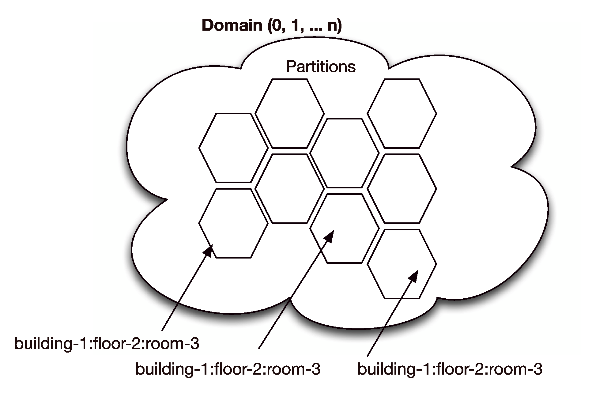
RTPS Protocol – Real-Time Publish Subscribe
https://www.omg.org/spec/DDSI-RTPS/
Designed to be able to run over multicast and connectionless best-effort transports such as UDP/IP
Plug-and-play connectivity so that new applications and services are automatically discovered, and applications can join and leave the network at any time without the need for reconfiguration.
That is the publisher and subscribers discover each other dynamically.
Discovery can be controlled using
Domains – completely separate DDS Network Domains
Partitions – A domain can have several partitions. The messages do not cross partition boundary.
(source: RTI)

Slide 11
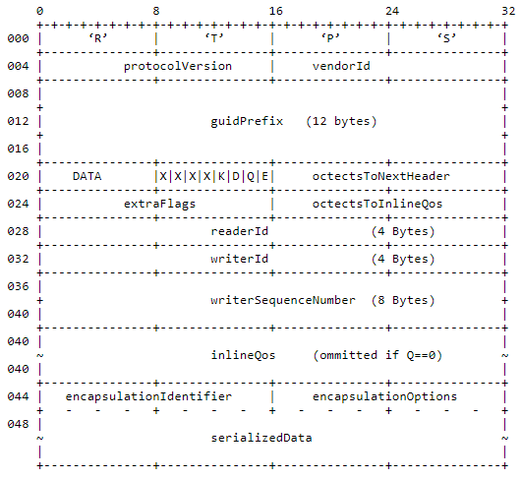
RTPS Minimum Overhead
DDS-RTPS protocol the "minimal" overhead to send application data on the wire is 48 bytes
Time stamp adds another 12 bytes
If the topic has keys then key value adds another 16 bytes overhead
Source: RTI

Slide 12
Evaluation Questions
Evaluate the latency and throughput for packets sent using RTI DDS on arm architecture for various payload sides
Arm architecture has been chosen as it is a common embedded system target.

Slide 13
Evaluation Environment

Slide 14
Systems and software used
Version of DDS | Connext DDS Professional (RTI)
Version of qperf | 0.4.10
Version of ZeroMQ | 17.1.2
Scale of system | 28 devices
Target device hardware | Beaglebone
Network topology | Star
Data rate | Varying (increasing in powers)
Network bandwidth | < 100Mbps
Latency | Publisher clock for round trip timings

Slide 15
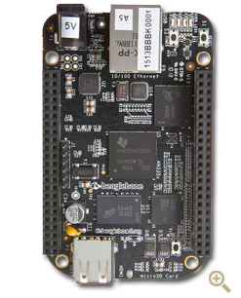
Test Node- Beaglebone Black
512MB DDR3 RAM
4GB 8-bit eMMC on-board flash storage
3D graphics accelerator
NEON floating-point accelerator
2x PRU 32-bit microcontrollers
32 GB class 10 SD Card
32-bit Ubuntu 18.04 operating systems
10/100 ethernet
Source: https://beagleboard.org/black

Slide 16
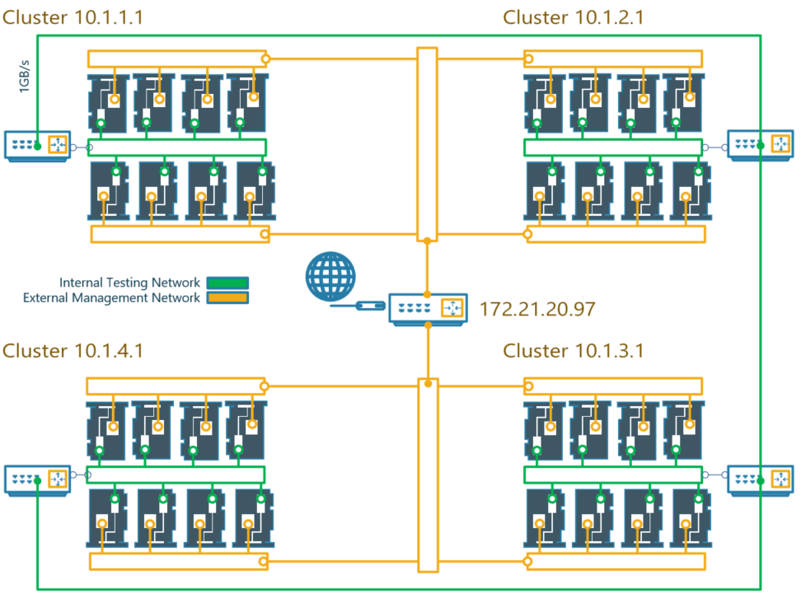
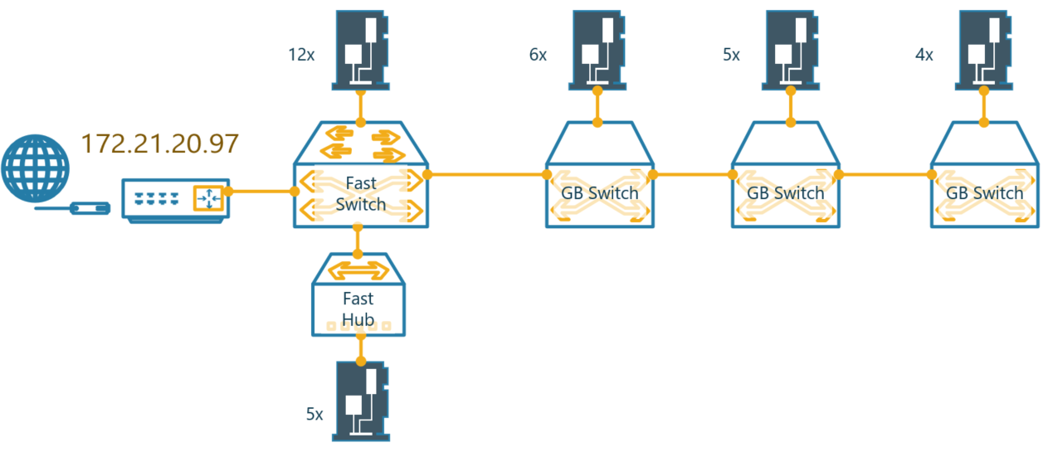
Network Testbed
27 Beaglebones
Separate control and data plane
The network uses microtik routerboard with
Five 1gpbs ports
Five 100mbps ports
2.4 Ghz Arm processor
802.11bgn wireless AP
Network topology of Data Plane
Network topology of Control Plane
Notes:
The Beaglebones are connected to two independent networks, the Data plane and the Control plance.
In the Data plane there are 4 router each with its own subnet and with 8 bbbs connected to it. The 4 routers are daisy chained together and if a bbb tries to communicate with a bbb in another subnet the message is forwarded.
The control plan is such that all the devices receive an ip address from a single router. The physical topology was determined by the hardware we had available.
For the experiments presented we used the control plane because it was easier to use, and we weren’t concerned with what the topology was, just the performance with a given topology.

Slide 17
Establishing the Baseline of the Network
To establish the base line we used qperf
It is a c library that uses raw sockets to measure the bandwidth and latency between two nodes. It can be configured to use TCP/IP as well as RDMA transports.
On one of the nodes, qperf is typically run with no arguments designating it the server node.
One may then run qperf on a client node to obtain measurements such as bandwidth, latency and cpu utilization.

Slide 18
Experiment 1
Measure the latency and throughput between two nodes while varying the message size from 64 to 32768 bytes, doubling for each sample. The CPU utilization on the local and remote nodes was also measured.
The 1-N qperf test is a succession of 1-1 qperf tests run in sequence as qperf has only one publisher and it will need to send out all messages in sequence. Therefore, to establish the baseline 1-1 test is the best option.
Peer1
$ qperf
Peer2
$ qperf -uu -oo m:64:32K:*2 -v peer1 tcp_bw tcp_lat

Slide 19
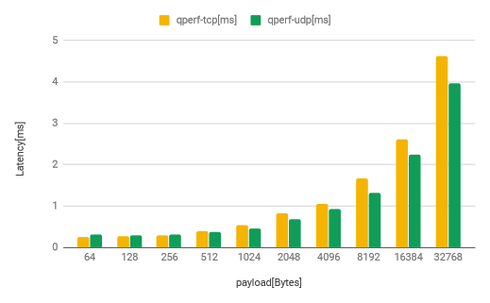
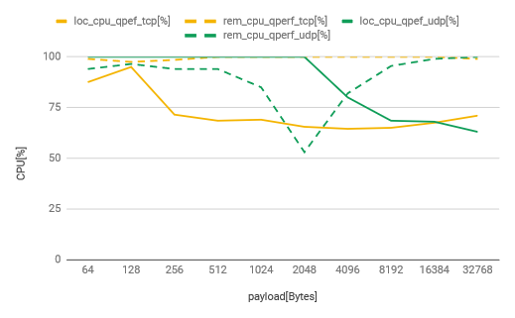
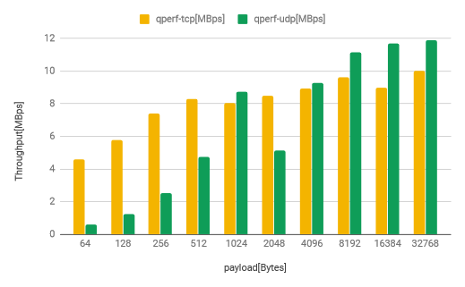
Bandwidth and Latency
TCP: communication (yellow) the subscriber (dashed) cpu is at or near 100 percent utilization, indicating the subscriber cpu or it’s I/O is the communication bottleneck for tcp.
The tcp publisher on the other hand starts at high utilization but decreases as the message size increases. This is because tcp waits for packet to be acknowledged before sending the next packet, so, since the subscriber cannot handle more load the publisher must slow down and thus has lower utilization.
UDP: communication (green) in we note that initially the publisher (solid) cpu is at 100% utilization, until messages of size 2048 bytes when it drops, as does the subscriber (dashed) cpu and the throughput (green).
This indicates that the network becomes congested at around 2048 bytes and packets are being dropped, since the publisher pushes packets as fast as possible without waiting for the subscriber to catch up
Notes:
for tcp communication (yellow) the subscriber (dashed) cpu is at or near 100 percent utilization, indicating the subscriber cpu or it’s I/O is the communication bottleneck for tcp. The tcp publisher on the other hand starts at high utilization but decreases as the message size increases. This is because tcp waits for packet to be acknowledged before sending the next packet, so, since the subscriber cannot handle more load the publisher must slow down and thus has lower utilization. After messages of 256 bytes the publisher cpu remain approximately flat, which makes sense as the amount of work being done or throughput is also approximately flat
the udp communication (green) in we note that initially the publisher (solid) cpu is at 100% utilization, until messages of size 2048 bytes when it drops, as does the subscriber (dashed) cpu and the throughput (green). This indicates that the network becomes congested at around 2048 bytes and packets are being dropped, since the publisher pushes packets as fast as possible without waiting for the subscriber to catch up. As the message size continues
to increase the udp publisher is slowed down by the larger message size, and happens to approach the same utilization as the tcp publisher, reducing the congestion and allowing the packets to get through and be processed by the udp subscriber whose cpu utilization approaches that of the tcp subscriber.
This indicates that for messages from 64 - 1024 bytes the publisher cpu or its I/O is the bottleneck, then from 2048 - 16384 bytes the network is the bottleneck, and at 32768 bytes the subscriber or its I/O is the bottleneck

Slide 20
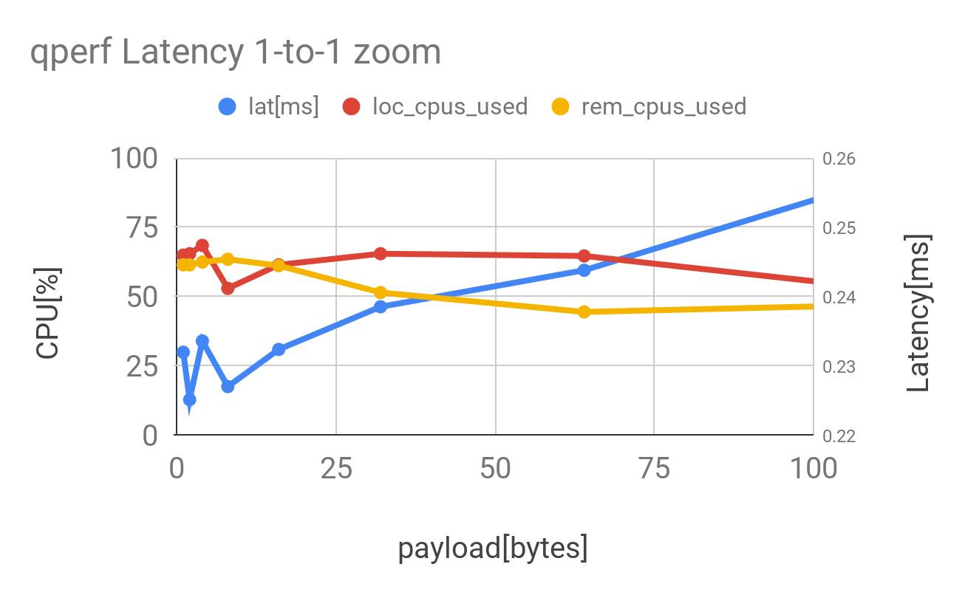
Network Latency
The latency of the network stack, rather than the message size can be estimated by examining the latency of small messages. The data points in the blue circle indicate a latency of about 0.23ms due to the network.
We assume that at low CPU utilizations the latency is primarily due to network.

Slide 21
Experiment 2
The previous test established the range of latency and throughput. To establish the baseline distribution across the network we chose a small message size and did the tests across all pairs.
Measure the latency and bandwidth between all node pairs in the network with a message size of 64 bytes.
Peer1
$ qperf
Peer2
$ qperf -uu -m 64 -v peer1 tcp_bw tcp_lat

Slide 22
Maximum Sustained Bandwidth and Latency histogram – across all pairs
Max | 5202.688
Min | 1617.856
avg | 4446.661
KB per second
max_total | 792.707
min_total | 203.707
avg_total | 415.8146
microseconds

Slide 23
Note about network baselines
Across 27^2 measurements across all pairs
The average bandwidth is 4446.661 KBps
The average latency is 415 microseconds or .415ms
The latency due to the network, rather than message size is about 0.23ms.
Since this information is collected via qperf, and introduces very little overhead on top of the TCP/UDP, it will have much better performance than DDS.

Slide 24
DDS Tests – RTI Perf Test

Slide 25
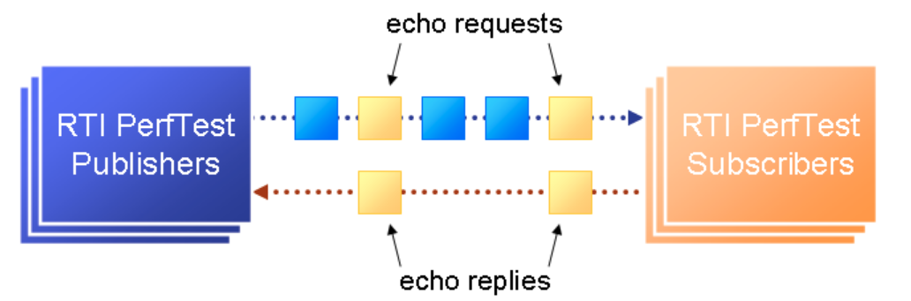
Background: RTI DDS PerfTest
Perftest command-line tool is highly configurable. We used the following parameters to customize test execution:
-dataLen <bytes>: specifies payload size of messages sent by the publisher to the subscriber.
-executionTime <seconds>: specifies how long should a test run (We allow a test to run for 5 mins)
-latencyTest: specifies that the test is a latency test. In a latency test, the publisher only sends latency pings to the subscriber to measure the baseline latency.
-bestEffort: specifies that the test should use BEST_EFFORT qos settings over the default RELIABLE qos settings.
-batchSize 0: specifies that batching is disabled to get baseline throughput.
There are two types of test: throughput test and latency test.

Slide 26
Background: RTI DDS PerfTest
In Throughput Test:
Publisher sends data samples of a specified size (dataLen) to the subscriber at a configurable rate of publication (spin/sleep)
latencyCount, i.e., the number of samples after which a latency request is sent by the publisher is set to the default value of 10,000 messages.
At the end of the test, subscriber reports the observed throughput.
In Latency Test:
Publisher only sends latency requests to the Subscriber.
Subscriber responds to the latency request with a latency reply
Publisher reports the average latency at the end of the test.

Slide 27
Background: RTI DDS PerfTest
The process that is writing the data, the publisher, is trying to write as fast as it can. But it will have to wait when there is
Network saturation
CPU/Memory saturation
Socket buffer size saturation -If the socket buffer’s become full the write system call (one that puts data into the socket) will become blocking.
Or, the process is context switched out by other processes.
The publish loop
While true:
produce data
write data to socket
end while
The subscribe loop
While wait for data:
read data
end while
Due to different waits in the loop the CPU utilization in the results will never reach 100%

Slide 28
DDS pub/sub configuration (27 subscriber and 1 publisher)
Reliable
Peer1-27
$ ./perftest_cpp -pub -cpu -noPrintIntervals -nic eth0 -transport UDPv4 -dataLen <payload size> -batchSize 0 -numSubscribers 1 -executionTime 300 -pidMultiPubTest 0
Peer28
$ ./perftest_cpp -sub -cpu -noPrintIntervals -nic eth0 -transport UDPv4 -numPublishers 1 -sidMultiSubTest <sid>
Best Effort
Peer1-27
$ ./perftest_cpp -pub -cpu -noPrintIntervals -nic eth0 -transport UDPv4 -dataLen <payload size> -batchSize 0 -numSubscribers 1 -executionTime 300 -pidMultiPubTest 0
- bestEffort
Peer28
$ ./perftest_cpp -sub -cpu -noPrintIntervals -nic eth0 -transport UDPv4 -numPublishers 1 -sidMultiSubTest <sid> -bestEffort

Slide 29
1 publisher and 1 subscriber

Slide 30
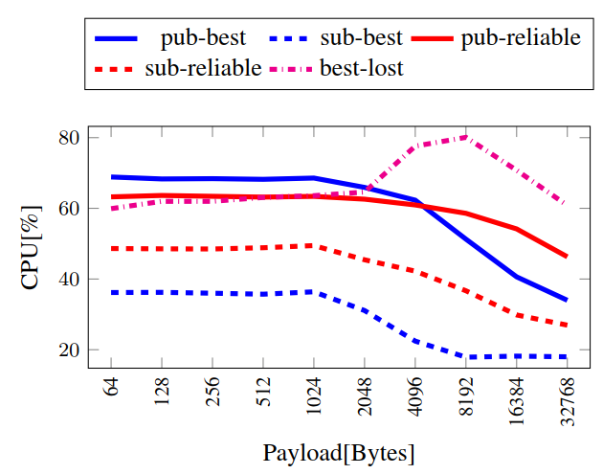
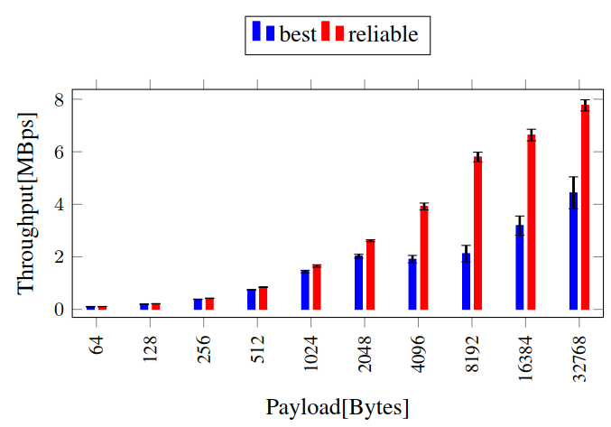
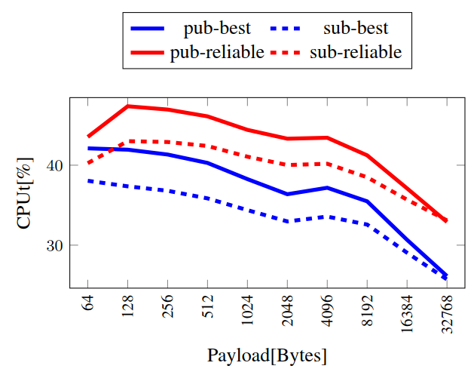
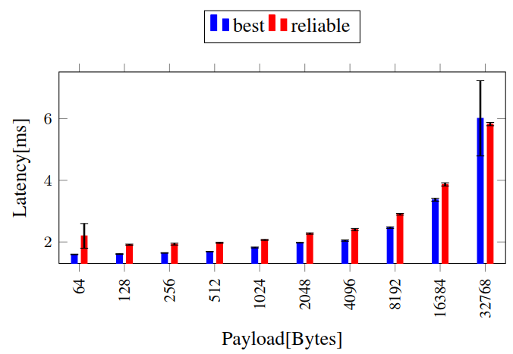
Bandwidth and Latency – DDS: 1 publisher and 1 subscriber
Throughput Test
Latency Test
Notes:
Recall throughput is reported by the subscriber and will not count dropped packets.
The CPU utilization drops as the packet size increases due to additional wait in the sending process. Recall the bottleneck slide (27).
At low message size best effort(UDP) and reliable(TCP) have similar performance. However as the message size increases best effort lags behind. This is due network
congestion and packet loss when using best effort (pink, right plot) where the percent of lost messages (lost_best[%]) increases for messages larger than 2048 bytes,
and recovers when the UDP publisher is forced to slow down with larger messages. Reliable communication does not have this problem as it uses TCP protocol and and waits for acknowledgement from the subscriber before sending the next message. The bottleneck for DDS is not clear as the CPU utilization is rather low, however based on the packet loss behavior the network is the bottleneck for 4096 - 16384 byte messages. Also recall that the CPU will never reach 100% due to different waits in the pub/sub loops.

Slide 31
Bandwidth and Latency – DDS: 1 publisher and 1 subscriber
Throughput Test
At low message size best effort(UDP) and reliable(TCP) have similar performance. However as the message size increases best effort lags behind.
This is due to network congestion and packet loss when using best effort (pink, right plot) where the percent of lost messages (lost_best[%]) increases for messages larger than 2048 bytes and recovers when the UDP publisher is forced to slow down with larger messages.
Reliable communication does not have this problem as it uses TCP protocol and and waits for acknowledgement from the subscriber before sending the next message.
CPU Utilization will never reach 100% due to waits in the publish subscribe loops
Latency Test

Slide 32
Bandwidth and Latency – DDS: 1 publisher and 1 subscriber
Throughput Test
The latency in this test is counted only for packets that were successfully received by the subscriber.
Latency grows with message size as expected, with best effort latency being slightly lower except for the message size of 32768 B, this is likely just noise however.
Latency Test

Slide 33
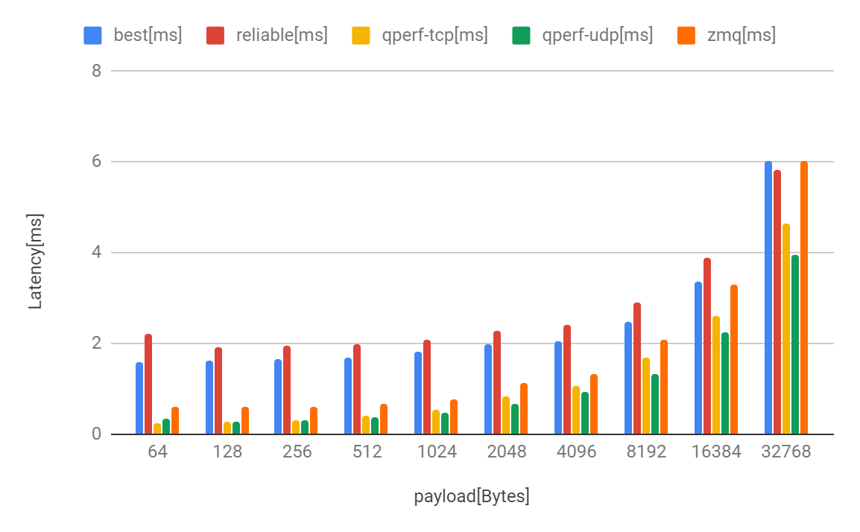
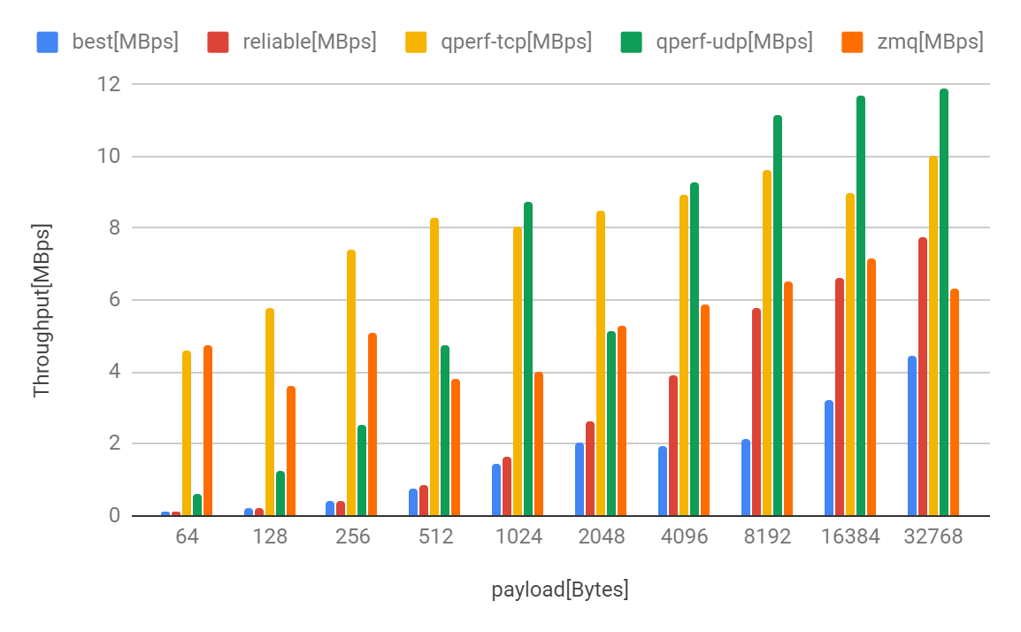
Performance Comparison We did additional tests with zero MQ as well
Notes:
qperf predictably had the best performance, since it is the lowest level protocol. ZeroMQ had performance comparable to qperf for messages up to 256 bytes. For messages up to 16384 bytes ZeroMQ had better performance than DDS, but at the largest size tested, DDS had the advantage using reliable communication. DDS performed relatively poorly for small messages. As a disclaimer the ZeroMQ CPU utilization was not an output of the tool used.

Slide 34
qperf predictably had the best performance, since it is the lowest level protocol.
ZeroMQ had performance comparable to qperf for messages up to 256 bytes.
For messages up to 16384 bytes ZeroMQ had better performance than DDS, but at larger sizes tested, DDS had the advantage using reliable communication.
DDS performed relatively poorly for small messages. As a disclaimer the ZeroMQ CPU utilization was not an output of the tool used.
Notes:
qperf predictably had the best performance, since it is the lowest level protocol. ZeroMQ had performance comparable to qperf for messages up to 256 bytes. For messages up to 16384 bytes ZeroMQ had better performance than DDS, but at the largest size tested, DDS had the advantage using reliable communication. DDS performed relatively poorly for small messages. As a disclaimer the ZeroMQ CPU utilization was not an output of the tool used.

Slide 35
1 publisher and 27 subscribers
The publisher is using unicast transmission to send the data to all the subscribers with a round-robin schedule.

Slide 36
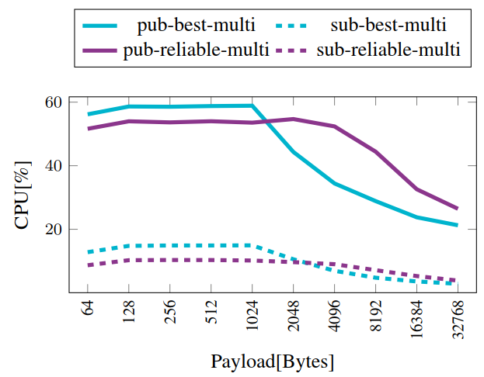
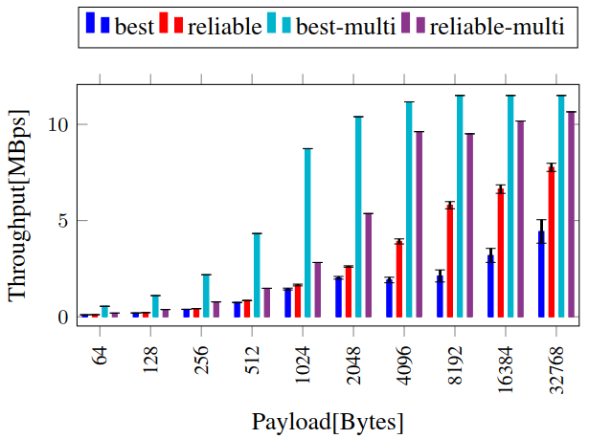
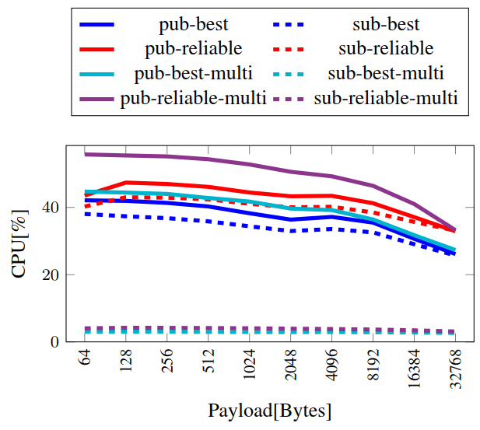
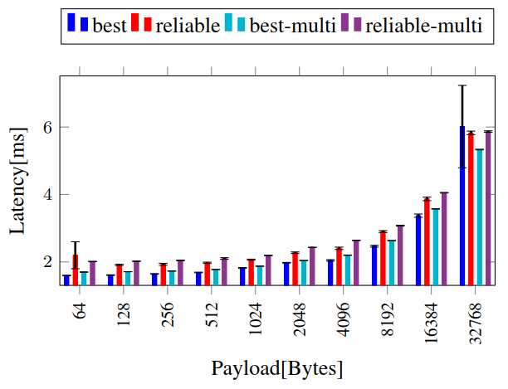
Bandwidth and Latency – DDS: 1 publisher and 27 subscribers
Throughput
Latency
Notes:
Best effort has good throughput because the network is not congested, this is apparent in the figure on the right since 0% of packets are lost (right light blue dash dot).
The increase in throughput for reliable messages with multiple subscribers indicates that the subscriber or the network was a bottleneck in some capacity in the 1-to-1 case and since they are loaded less now more messages can be transmitted.
The higher and eventually constant best effort throughput (best-multi) along with the dropping cpu utilization indicates the bottleneck has something to do with processing large messaging for sending that does not involve the process being monitored.
The throughput for the multi subscriber case is summed across all the subscribers.

Slide 37
Bandwidth and Latency – DDS: 1 publisher and 27 subscribers
Throughput
The throughput for the multi subscriber case is summed across all the subscribers.
Best effort has good throughput because the network is not congested.
The increase in throughput for reliable messages with multiple subscribers indicates that the subscriber node was a bottleneck in some capacity in the 1-to-1 case.
Latency

Slide 38
Bandwidth and Latency – DDS: 1 publisher and 27 subscribers
The throughput for the multi subscriber case is summed across all the subscribers.
Best effort has good throughput because the network is not congested.
The increase in throughput for reliable messages with multiple subscribers indicates that the subscriber node was a bottleneck in some capacity in the 1-to-1 case.
Latency is not significantly impacted when there are multiple subscribers since the network is not congested.
Throughput
Latency

Slide 39
Understanding the impact of Scheduling policies

Slide 40
Background
Linux support two classes of scheduling policies
Completely fair scheduling class
Supports fairness and leads to larger context switch. All processes get time on CPU
Real-time scheduling class
Time is controlled via the priority assigned to the process.
Note that linux does have real-time throttling that ensures that some CPU time is always reserved for completely fair scheduling class.
Thus we can typically not load the CPU to 100% time with real-time tasks
Note it is possible to turn this off, however, there is a chance that interrupts will not get enough time to run leading to a loss of control of keyboard and mouse.

Slide 41
Experiment
Compare DDS 1-to-1 against DDS 1-to-1 with Linux Real-time scheduling
Goal – increase the CPU Utilization to identify bottlenecks
We use the RT Scheduling policy in Linux for this test. RT scheduling policy at 99 priority will not be interrupted by any other process.
The pub/sub process will get more CPU time, allowing more packets to be sent out – increasing the stress on the system.

Slide 42
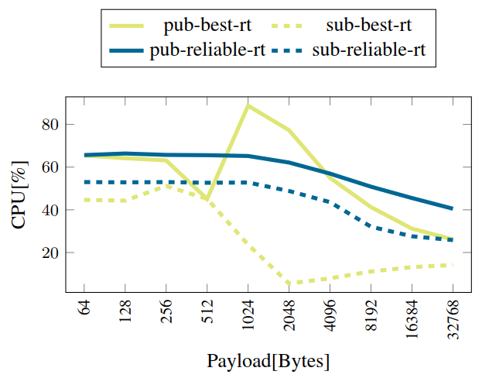
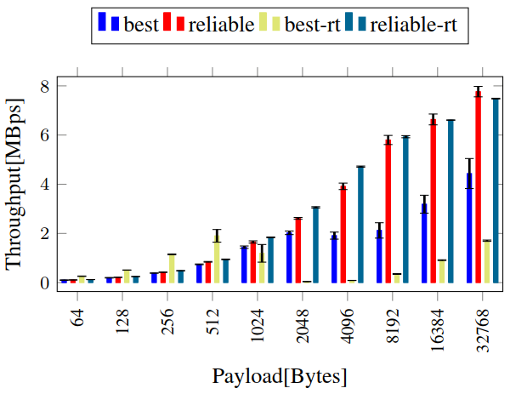
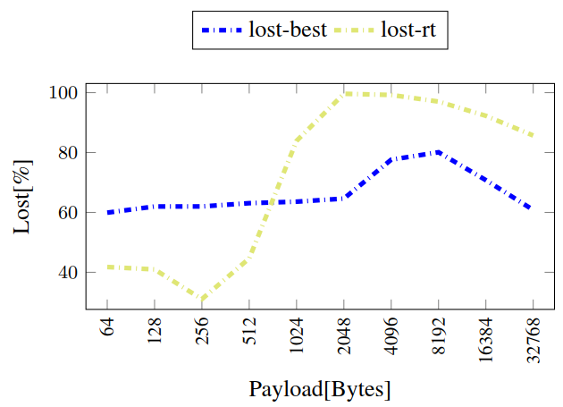
Throughput
Notes:
The drop in best effort throughput is caused by the RT 99 policy. This is because the publisher is able to send packets more frequently, increasing network congestion, resulting in more dropped packets. The throughput begins to recover with larger messages because it has to wait longer before sending another message

Slide 43
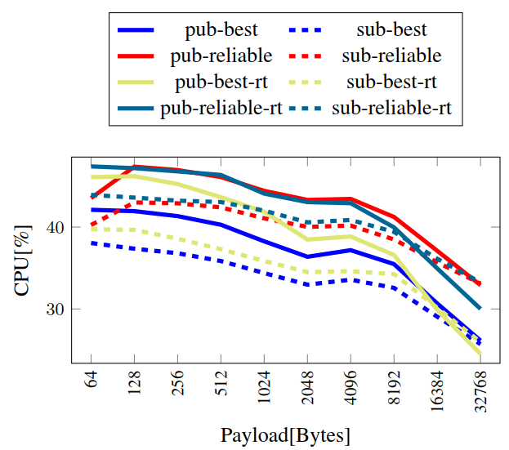
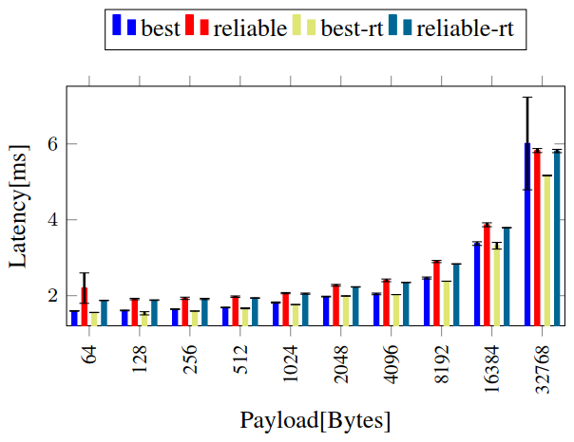
Latency
Notes:
The latency was not significantly impacted by the real time priority, this is because the latency test does not stress the system as can be seen by the low CPU utilization.

Slide 44
Conclusion
Clearly even at real-time cases the throughput of DDS is much lower than flat socket communication (Qperf with TCP).
The latency of best effort is lower than reliable – however at higher packet sizes its throughput degrades because of network congestion and packet loss.
Therefore, best effort can be used at small packet sizes.
However, at large packet sizes reliable policy should be used.
The primary benefit of DDS is the modularity and the ability to plug and play
A custom reliable transport layer (with minimal overhead and built over sockets using TCP) can easily achieve better performance than DDS.
However, the portability and modularity and code reuse advantage of DDS will be lost.
The other non-tangible advantage of DDS is the type safety and built-in-topics like heartbeat which makes the system more resilient.

