Slide 1
Privacy Preserving Energy Transactions Using Blockchains
Abhishek Dubey, Vanderbilt University
Scott Eisele Vanderbilt University
Aron Laszka, University of Houston

Slide 2
Example Application: Private And Decentralized Energy Transactions
Participant 1
PETra Framework
Energy Exchange
Reduces Dependence on the Grid
Conventional energy market
Energy Retailer, or DSO
Energy demand and surplus.
Participant 2
TM
PETra
TM
TM
P
P
TM
TM
P
TM
P
TM
P
TM
P
TM
P
TM
P
TM
Transactive Meter
Application use case for integration of RIAPS and Blockchains

Slide 3
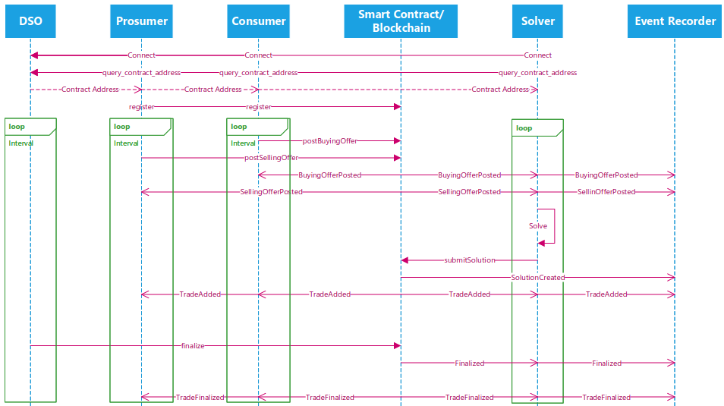
Sequence Diagram

Slide 4
Sequence Diagram

Slide 5
Sequence Diagram

Slide 6
Sequence Diagram

Slide 7
Sequence Diagram

Slide 8
Sequence Diagram

Slide 9
Sequence Diagram

Slide 10
Sequence Diagram

Slide 11
Sequence Diagram

Slide 12
Sequence Diagram

Slide 13
Sequence Diagram

Slide 14
Sequence Diagram

Slide 15
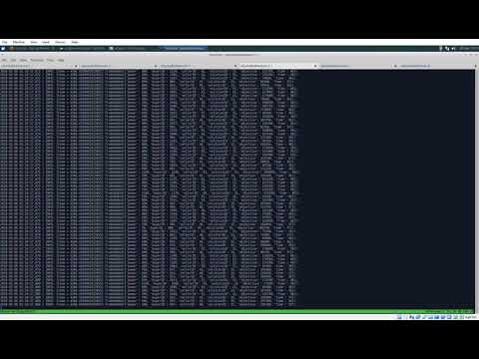
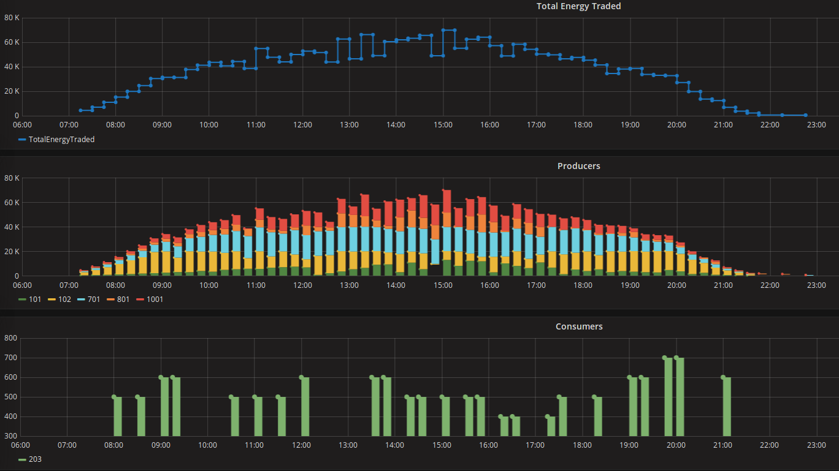
Evaluation
We used real-world energy production / consumption data from a German microgrid provided by Siemens, CT
We deployed our system on a private Ethereum network
5 producers
~97 consumers

