Slide 1
Providing Privacy, Safety, and Security in IoT-Based Transactive Energy Systems using Distributed Ledgers
Abhishek Dubey Vanderbilt University | Aron Laszka University of Houston
In partnership with Siemens, CT

Slide 2
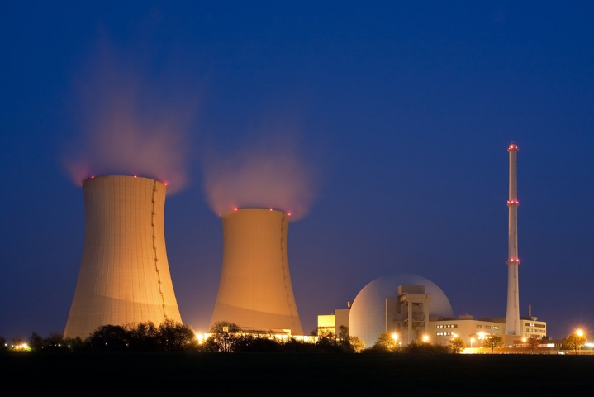

Electrical Energy Networks Are Changing
From centralized to decentralized and distributed energy systems
Changing Generation Mix
Transactive Energy
Electric Cars
Decentralization
DER-s

Slide 3
Decentralization is the big trend

Slide 4
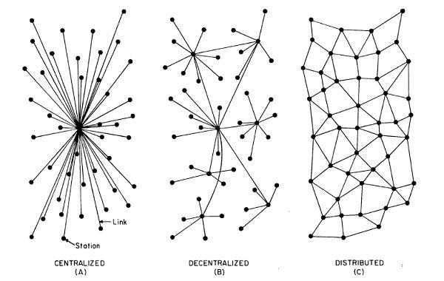
The Evolution of Energy Networks
Traditional networks with transmission system operators, distribution system operators & radial distribution systems to communities

Slide 5
The Evolution of Energy Networks
Advantages of decentralization
Improved cyber & physical reliability by removing single point of failures
Faster decision making by avoiding network penalties due to round-trip to the cloud
Improved scalability
Better integration with hierarchical control systems
Network of distribution feeders with some microgrids with tightly integrated distributed energy resources

Slide 6
The Evolution of Energy Networks
Trend
Traditional networks with transmission system operators, distribution system operators & radial distribution systems to communities
Network of distribution feeders with some microgrids with tightly integrated distributed energy resources
Network of transactive microgrids with limited role of distribution system operators

Slide 7
The trend of decentralization
Trend
Traditional networks with transmission system operators, distribution system operators & radial distribution systems to communities
Network of distribution feeders with some microgrids with tightly integrated distributed energy resources
Network of transactive microgrids with limited role of distribution system operators
This trend of decentralization can be seen around many other cyber-physical system applications, for example: smart manufacturing, smart cities, etc.

Slide 8
Smart Homes With Production and Delayed Consumption Capability are the Key to this new Trend

Slide 9
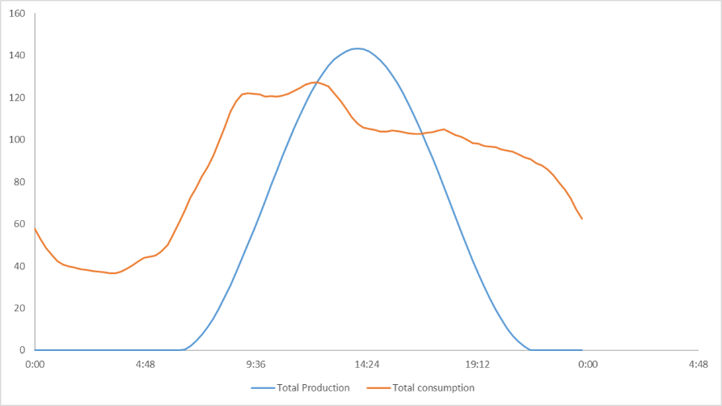
Smart Homes -> Smart Prosumers
Energy Exchange
Reduce Dependence of the Grid
A typical Generation and Consumption profile

Slide 10
Transactive Energy
A local energy market
A time synchronized distributed IoT Platforms problem.
Information privacy
A distributed protocol problem.
Assuring integrity of finalized transactions.
A decentralized management problem
Energy Exchange
Reduce Dependence of the Grid

Slide 11
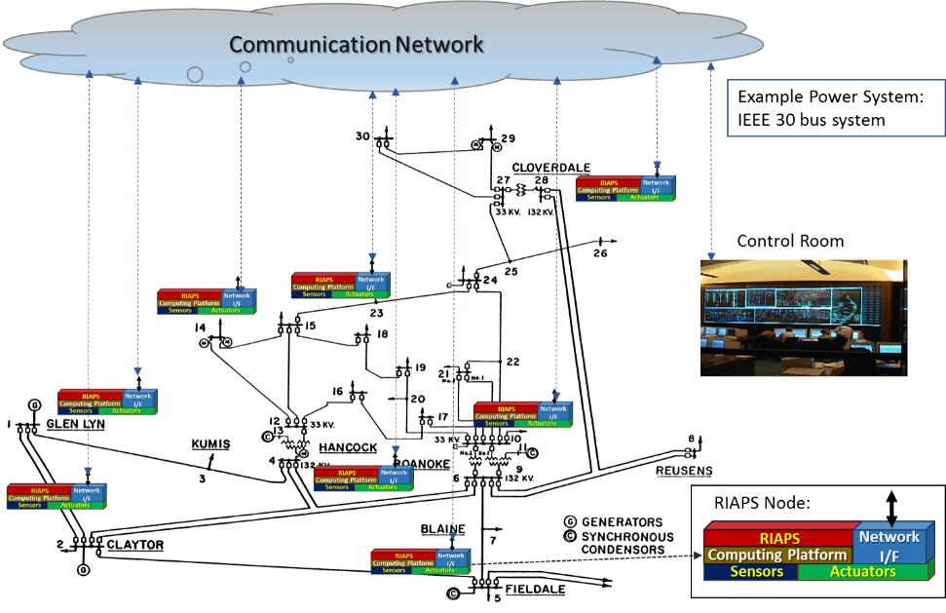

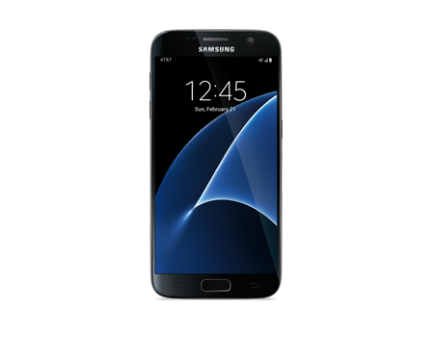
RIAPS: Our baseline system model
At the core of the RIAPS vision is a reusable technology stack to run Smart Grid software applications. A software platform defines:
Programming model (for distributed real-time software) on embedded nodes dispersed throughout the power grid.
Services (for application management, fault tolerance, security, time synchronization, coordination, etc.)
Development toolkit (for building and deploying apps)
Smart Device:
App platform
Device

Slide 12
Petra solution architecture
We introduce PETra, a blockchain-based solution that enables consumers to trade energy without sacrificing their privacy and provides safety and security for the grid. It provides the following.
PETra

Slide 13
Petra solution architecture
We introduce PETra, a blockchain-based solution that enables consumers to trade energy without sacrificing their privacy and provides safety and security for the grid. It provides the following.
Trading Platform
by serving as a database for bids, enables prosumers to find trade partners without communicating with all potential partners
PETra

Slide 14
Petra solution architecture
We introduce PETra, a blockchain-based solution that enables consumers to trade energy without sacrificing their privacy and provides safety and security for the grid. It provides the following.
Trading Platform
Distributed Ledger
by serving as a database for bids, enables prosumers to find trade partners without communicating with all potential partners
stores transactions that specify energy trades, record energy production & consumption, financial records & regulatory policies for the microgrid
PETra

Slide 15
Petra solution architecture
We introduce PETra, a blockchain-based solution that enables consumers to trade energy without sacrificing their privacy and provides safety and security for the grid. It provides the following.
Trading Platform
Distributed Ledger
Controller (Future)
by serving as a database for bids, enables prosumers to find trade partners without communicating with all potential partners
stores transactions that specify energy trades, record energy production & consumption, financial records & regulatory policies for the microgrid
Stabilizes load within the microgrid & controls it based on the load in the rest of the grid
PETra

Slide 16
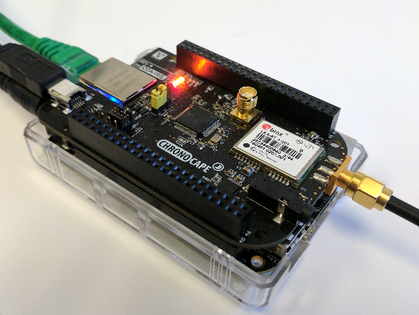
Petra Trading Platform and Distributed Ledger Architecture
We introduce PETra, a blockchain-based solution that enables consumers to trade energy without sacrificing their privacy and provides safety and security for the grid. It provides the following.
A RIAPS Node Participating in Petra-Enabled Transactive Energy Market
PETra

Slide 17
The PETRA Protocol

Slide 18
Trading Platform: Quantized Energy Assets
Assets:
financial: fiat currency (e.g., USD)
energy production
energy consumption

