Slide 1
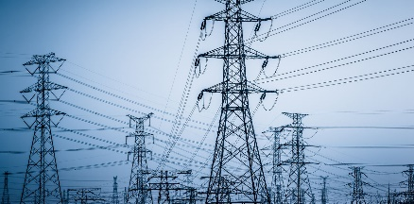


1. Get Consumption Energy Assets moved to an anonymous account
2. Get Production Energy Assets moved to an anonymous account
DSO
buyer
seller
inverter
6. measure energy production/consumption
3 Asynchronous
Notification about new asset
7. sign and publish transaction
4 sign and publish transaction
5 Notification of transaction
Create Consumption Asset
Create Production Asset
Financial transaction
(amount of energy, financial value, etc.)
Energy transaction
(amount of energy, financial transaction ID, etc.)
Block chain

