Slide 1
Example Application: Private And Decentralized Energy Transactions
Participant 1
PETra Framework
Energy Exchange
Reduces Dependence on the Grid
Conventional energy market
Energy Retailer, or DSO
Energy demand and surplus.
Participant 2
TM
PETra
TM
TM
P
P
TM
TM
P
TM
P
TM
P
TM
P
TM
P
TM
P
TM
Transactive Meter
Application use case for integration of RIAPS and Blockchains

Slide 2
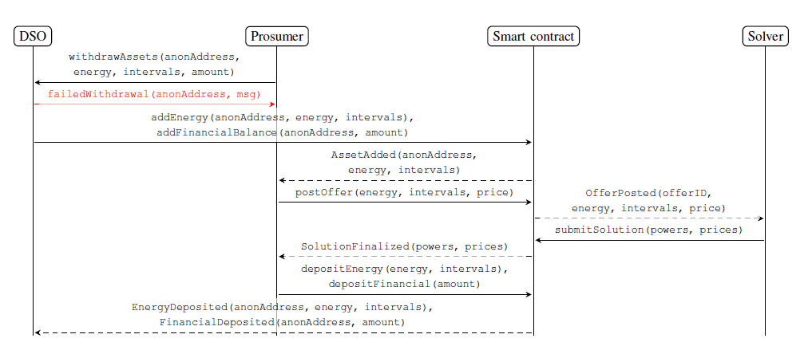
Sequence Diagram

Slide 3
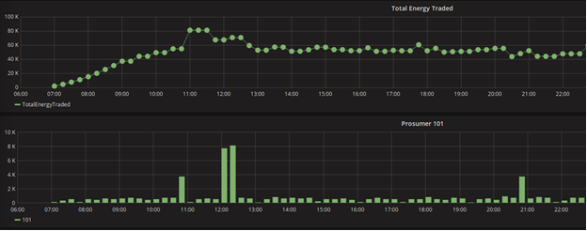
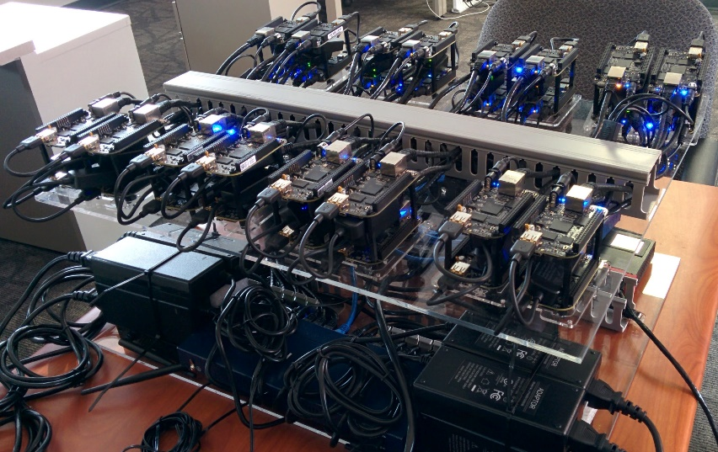
Evaluation
We used real-world energy production / consumption data from a German microgrid provided by Siemens, CT
We deployed our system on a private Ethereum network
90% of trades were closed within 23 seconds or less

