Slide 1

Intro to Vim :)
Scope’s first seminar :
by Jeffrey Hertzog :)
Notes:
Hi guys, I’m going to give a little intro about myself then hop right into it. I’m jeffrey, I’m a junior CS major here at USC. Today I’m going to be giving a talk about my personal FAVORITE text editor vim. I’ve been using it for around a year and a half now and I’m nowhere near being a master.

Slide 2

What is Vim?
Vim is a “modal” text editor
Normal : (command mode)
Insert : (typing mode)
Visual : (highlighting mode)
Notes:
A modal text editor offers multiple modes that are optimized for specific action by the user. Vim has six in total, but three main ones we will talk about:
“modeless” text editor : VScode, eclipse etc

Slide 3
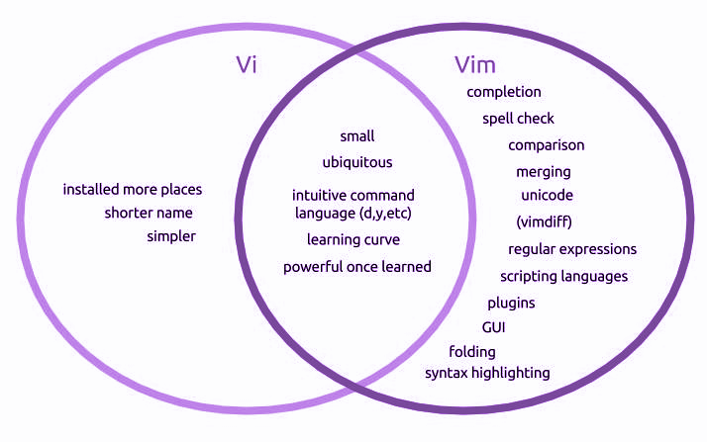

Origins
ed
em (editor for mortals)
ex
vi (extension of ex)
Stevie (ST editor for VI enthusiast)
vim (vi - improved!)
Notes:
After scouring a total of three entire wikipedia articles, I created a brief history of the vim editor. Strap in this is going to be a wild ride. SO BASICALLY Ed was the first editor created for Unix operating systems in 1969 and it had very cryptic commands and was hard to use. Because of these, em, or the “editor for mortals” was released to solve some of these difficulties. This editor was the redesigned to contained a visual mode and many other key features. Vi was an editor released in 1976 as an extension to ex, that became widely popular because it was released for free (unlike many paid editors during this time). Next came an editor called Stevie for the Atari, and finally vim, aka vi-improved, was released for Amiga computer in 1988 and remains a widely popular editor among today’s programmers.

Slide 4
Why should I use vim over modern text editors?
Efficient and Powerful
Ubiquity
Switching between modes and using commands allow the user to edit and move around text extremely fast, and without the use of the mouse.
Very visually simple, no bloated UI elements to get in your way while editing
it’s already everywhere
can have all your configurations and plugins one file away (.vimrc)
Notes:
And now you’re probably thinking, wow I’m never going to need to know any that, and you are honestly probably right, but I think it makes the very good point that, especially taking into consideration how dynamic the tech world is, vim is STILL a useful tool that is still used by many developers today even though it was created in 32 years ago.
One of the main reasons it’s been around for so long is because of how efficient it is, it literally makes you break up with your mouse which saves an UNFATHOMABLE amount of time. It’s also fully customizable and the # of community plugins is endless.
Automatically comes pre installed on Linux/Mac systems. Easy to install and use on windows.

Slide 5
What is Vim?
:set number
Notes:
So this is how a common vim terminal looks when you start it up for the first time. Usually it won’t automatically have line numbers but you can change that with this command below. I’m not really going to be going into vim customization and configuration this seminar but there are plenty of resources online that can help you with that if you are interested.

Slide 6
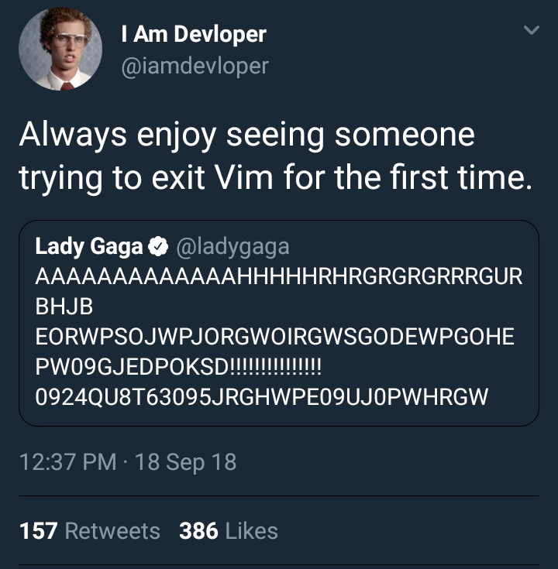
Exiting Vim
:q quit without saving,
(error if you have unsaved changes)
:q! force close, disposes of unsaved changes
:wq save and quit
ZZ another way to say wq
Notes:
Before we get started with commands the I just wanted to address the elephant in the room…. so if you don’t know already, sometimes non-vim users get trapped inside the editor (like scope president claire po) and they don’t know how to exit without messing something up. This often happens when you forget to add a git commit message, it automatically opens the machines default editor (which is usually vim). So I just thought this should be the first we address to prevent more casualties like this from happening .

Slide 7
Basic Movement
use these keys to move around!
h move left
j move down
k move up
l move right
(resist the urge to use the arrow keys)
Notes:
These are the absolute fundamentals for getting around in vim, and as we continue we will learn many of the different ways we can combine these with commands.

Slide 8
Find, n, and N
/{string} where string is the pattern you want to find
n move to next instance
N move to prev. instance
Notes:
Basically the “ctrl + f” of vim, very useful for reading code.

Slide 9
Writing text with insert mode
i I
a A
o O
i
go into insert mode AT cursor location
I
goes into insert mode at BEGINNING of the line
a
go into insert mode AFTER cursor location
A
goes into insert mode at END of the line
o
open a new line in insert mode BELOW current
O
open a new line in insert mode ABOVE current
Notes:
So now you’re probably asking, “how do I even write text?” and that’s a great question because in a text editor, we probably will need to write some text eventually :) ! So you automatically start off in normal mode and have to actually go into insert mode to make changes. There many ways to do this and I’m going to walk you through some of the most useful.
Also if we are in insert mode and we want to go back to normal mode to input commands, we can do that using the escape key.
If you want to get serious with vim I highly recommended remapping your caps lock key to escape to make it faster and easier on your fingers :)

Slide 10
Command Syntax
( verb + noun )
d : delete (action)
w : a word (object)
d + w = deletes a word
what happens if we include #’s?
Notes:
Because we are going to be spending most of our time in normal mode, I really want to get into commands and sort of the “syntax and how the vim language is structured”

Slide 11
Basic Verbs
d → deletes a noun
x → deletes a character
c → “change” (deletes + insert mode)
y → “yank” copies a noun
p → pastes whatever was d/y last
Notes:
repeating these verbs: dd, cc, yy, will affect the entire line

Slide 12
Basic Nouns
w → forward one word
e → to the end of the next word
$ → until the end of the line
0 → to the beginning of the line
f{char} → to the next instance of char

Slide 13
Important!
u → undo last command
ctrl r → redo last command
. → repeat last command
These are also considered verbs!
Notes:
These are some of the most useful commands in vim

Slide 14
Try it!
d4j deletes four lines
4p pastes last deletion four times
c$ deletes to eol, and insert mode
3u undoes the last three changes
ea insert mode at the end of current
word

Slide 15
More Movement
gotta go fast :)
gg → jumps to first line
G → jumps to last line
:n → :5, jumps to line 5
g; → jumps back to place of last edit
{ } → jumps to prev/next paragraph
Notes:
Okay so here are some more SUPER useful movement nouns that you guys can use to jump around your file really easy.

Slide 16
More Nouns
iw → modify the entire word
it → forward three words
i” → inside quotations
ip → inside paragraph
as → a sentence (up to .)
(remember: these can all be used with numbers to do many operations at once)
Notes:
just

Slide 17
Visual Mode
v →
enters “visual mode” when you move around you will select text to modify
shift v→
enters “visual line”
same as visual just selects by entire line
press v or shift v again to exit visual mode
Notes:
just

Slide 18
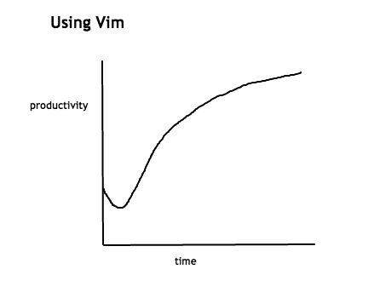
Learning
If you want to learn more and practice vim after this seminar, consider using vimtutor!
Notes:
vimtutor comes co-installed with vim, just type vimtutor in your terminal!

Slide 19
What’s my favorite thing about vim?
Notes:
So before I end this I just wanted to talk about the main reason I like vim

Slide 20
it’s hard
there’s so much to learn and so many unique ways to quickly solve problems that would take exponentially longer if done in a “modern” editor
Notes:
It’s complicated in its simplicity. There is such a large learning curve that once

Slide 21
The end :0
Any questions?
http://www.viemu.com/vi-vim-cheat-sheet.gif
hertzog@usc.edu
https://github.com/j-hertzog
Notes:
The terminal is one of the most powerful tools on your computer, and mastering it will make you a much better programmer without a doubt. Think of vim not as a replacement for your IDE but as a text-editing extension of your terminal. Also because of it’s efficiency vim plugins exists for almost every text editor out there already so if you don’t want to make the jump right away, you can still practice the commands in your IDE.

