Slide 1
Chapter
1
Information Systems in Global Business Today

Slide 2
Management Information Systems
Chapter 1 Information Systems in Global Business Today
The Role of Information Systems in Business Today
How information systems are transforming business
  Increase in wireless technology use, Web sites
  Shifts in media and advertising
  New federal security and accounting laws

Slide 3
Management Information Systems
Chapter 1 Information Systems in Global Business Today
The Role of Information Systems in Business Today
Globalization opportunities
  Internet has drastically reduced costs of operating on global scale
  Presents both challenges and opportunities

Slide 4
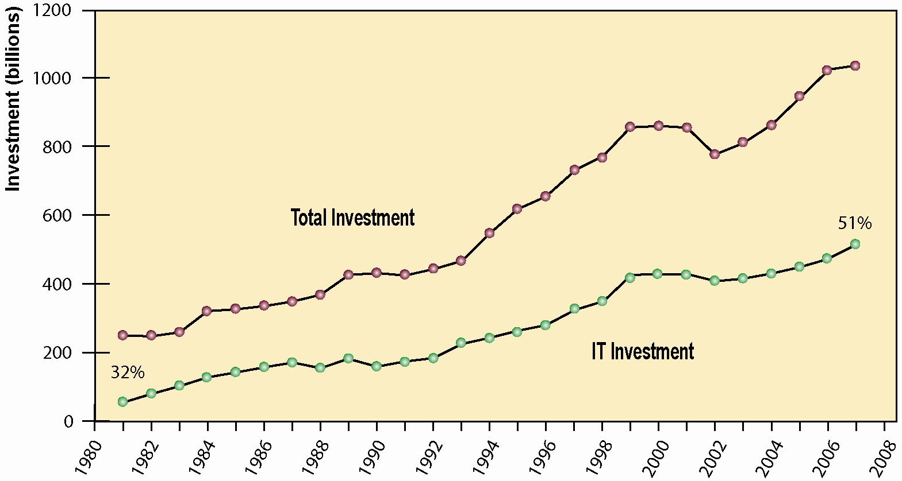
Management Information Systems
Chapter 1 Information Systems in Global Business Today
The Role of Information Systems in Business Today
Information Technology Capital Investment
Information technology investment, defined as hardware, software, and communications equipment, grew from 32% to 51% between 1980 and 2008.
Source: Based on data in U.S. Department of Commerce, Bureau of Economic Analysis, National Income and Product Accounts, 2008.
Figure 1-1
Notes:
More than ½ of investments are in IT.

Slide 5
Management Information Systems
Chapter 1 Information Systems in Global Business Today
The Role of Information Systems in Business Today
In the emerging, fully digital firm
  Significant business relationships are digitally enabled and mediated
  Core business processes are accomplished through digital networks
  Key corporate assets are managed digitally (intellectual property, core competencies, and financial and human assets)
Digital firms offer greater flexibility in organization and management
  Time shifting, space shifting

Slide 6
Management Information Systems
Chapter 1 Information Systems in Global Business Today
The Role of Information Systems in Business Today
Growing interdependence between ability to use information technology and ability to implement corporate strategies and achieve corporate goals
Business firms invest heavily in information systems to achieve six strategic business objectives:
  Operational excellence
  New products, services, and business models
  Customer and supplier intimacy
  Improved decision making
  Competitive advantage
  Survival

Slide 7
Management Information Systems
Chapter 1 Information Systems in Global Business Today
The Role of Information Systems in Business Today
Operational excellence:
  Improvement of efficiency to attain higher profitability
  Information systems, technology an important tool in achieving greater efficiency and productivity
  Wal-Mart’s RetailLink system links suppliers to stores for superior replenishment system

Slide 8
Management Information Systems
Chapter 1 Information Systems in Global Business Today
The Role of Information Systems in Business Today
New products, services, and business models:
  Business model: describes how company produces, delivers, and sells product or service to create wealth
  Information systems and technology a major enabling tool for new products, services, business models
    Examples: Apple’s iPod, iTunes, and iPhone, Netflix’s Internet-based DVD rentals

Slide 9
Management Information Systems
Chapter 1 Information Systems in Global Business Today
The Role of Information Systems in Business Today
Customer and supplier intimacy:
  Serving customers well leads to customers returning, which raises revenues and profits
    Example: High-end hotels that use computers to track customer preferences and use to monitor and customize environment
  Intimacy with suppliers allows them to provide vital inputs, which lowers costs
    Example: J.C.Penney’s information system which links sales records to contract manufacturer

Slide 10
Management Information Systems
Chapter 1 Information Systems in Global Business Today
The Role of Information Systems in Business Today
Improved decision making
  Without accurate information:
    Managers must use forecasts, best guesses, luck
    Leads to:
      Overproduction, underproduction of goods and services
      Misallocation of resources
      Poor response times
    Poor outcomes raise costs, lose customers
  Example: Verizon’s Web-based digital dashboard to provide managers with real-time data on customer complaints, network performance, line outages, etc.

Slide 11
Management Information Systems
Chapter 1 Information Systems in Global Business Today
The Role of Information Systems in Business Today
Competitive advantage
  Delivering better performance
  Charging less for superior products
  Responding to customers and suppliers in real time
  Example: Toyota and TPS (Toyota Production System) enjoy a considerable advantage over competitors – information systems are critical to the implementation of TPS

Slide 12
Management Information Systems
Chapter 1 Information Systems in Global Business Today
The Role of Information Systems in Business Today
Survival
  Information technologies as necessity of business
  May be:
    Industry-level changes, e.g. Citibank’s introduction of ATMs
    Governmental regulations requiring record-keeping
      Examples: Toxic Substances Control Act, Sarbanes-Oxley Act

Slide 13
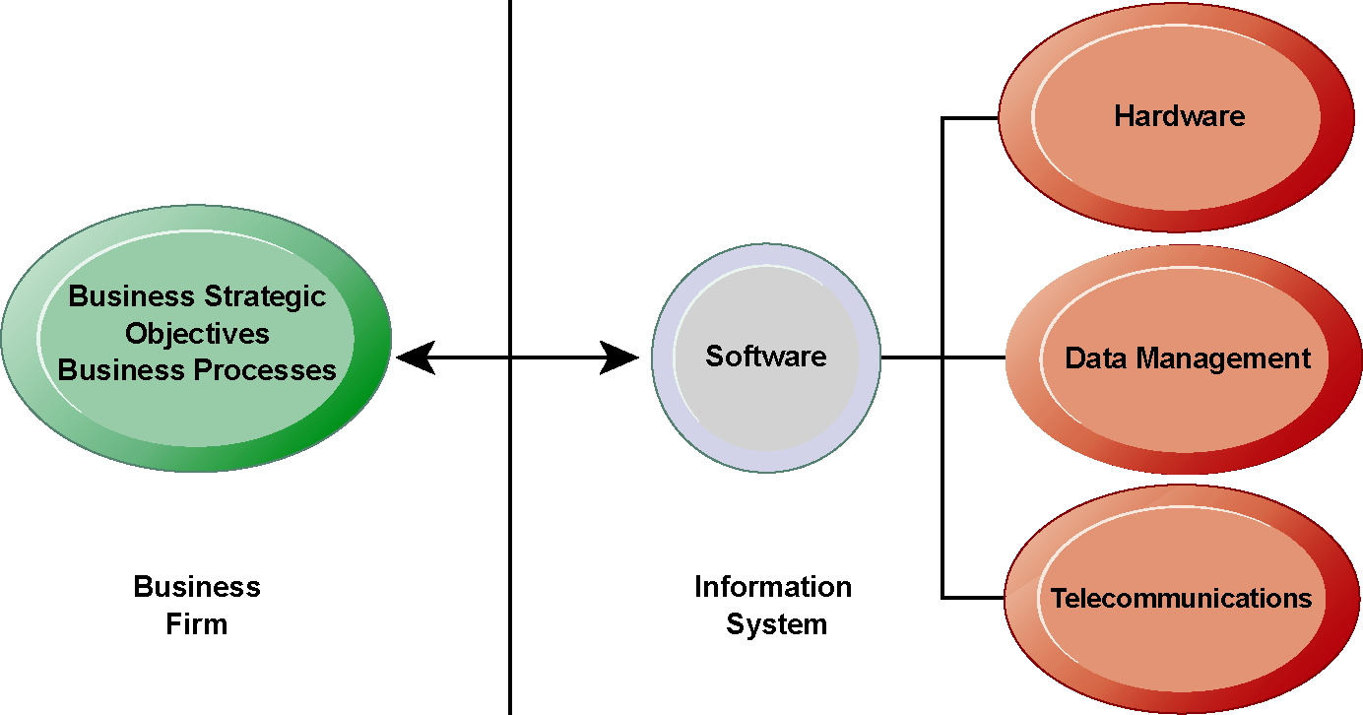
Management Information Systems
Chapter 1 Information Systems in Global Business Today
The Role of Information Systems in Business Today
The Interdependence Between Organizations and Information Technology
In contemporary systems there is a growing interdependence between a firm’s information systems
and its business capabilities. Changes in strategy, rules, and business processes increasingly require changes in hardware, software, databases, and telecommunications. Often, what the organization would like to do depends on what its systems will permit it to do.
Figure 1-2

Slide 14
Management Information Systems
Chapter 1 Information Systems in Global Business Today
Perspectives on Information Systems
Information system:
  Set of interrelated components
  Collect, process, store, and distribute information
  Support decision making, coordination, and control
Information vs. data
  Data are streams of raw facts
  Information is data shaped into meaningful form

Slide 15
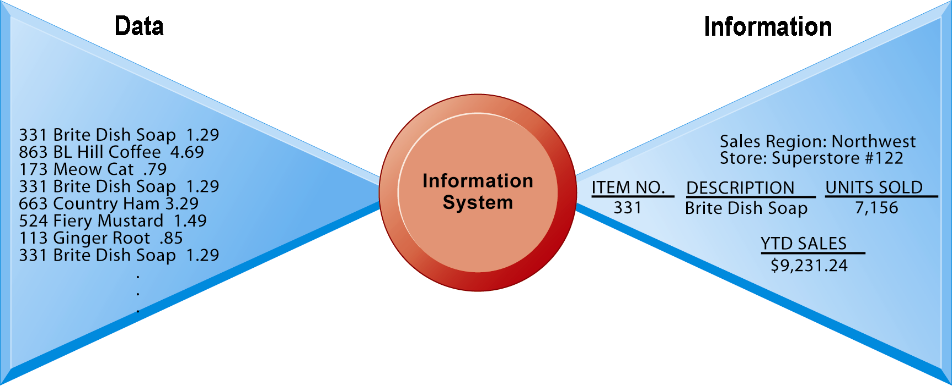
Management Information Systems
Chapter 1 Information Systems in Global Business Today
Perspectives on Information Systems
Data and Information
Raw data from a supermarket checkout counter can be processed and organized to produce meaningful information, such as the total unit sales of dish detergent or the total sales revenue from dish detergent for a specific store or sales territory.
Figure 1-3

Slide 16
Management Information Systems
Chapter 1 Information Systems in Global Business Today
Perspectives on Information Systems
Information system: Three activities produce information organizations need
  Input: Captures raw data from organization or external environment
  Processing: Converts raw data into meaningful form
  Output: Transfers processed information to people or activities that use it

Slide 17
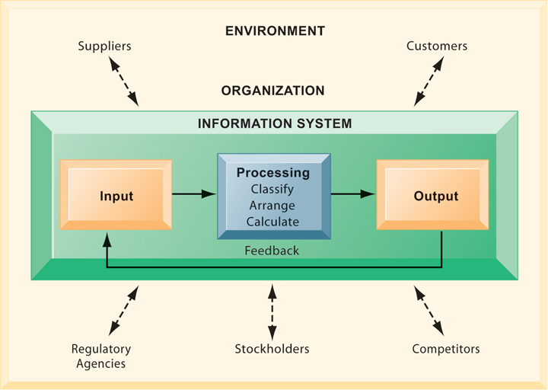
Management Information Systems
Chapter 1 Information Systems in Global Business Today
Perspectives on Information Systems
Functions of an Information System
An information system contains information about an organization and its surrounding environment. Three basic activities—input, processing, and output—produce the information organizations need. Feedback is output returned to appropriate people or activities in the organization to evaluate and refine the input. Environmental actors, such as customers, suppliers, competitors, stockholders, and regulatory agencies, interact with the organization and its information systems.
Figure 1-4

Slide 18
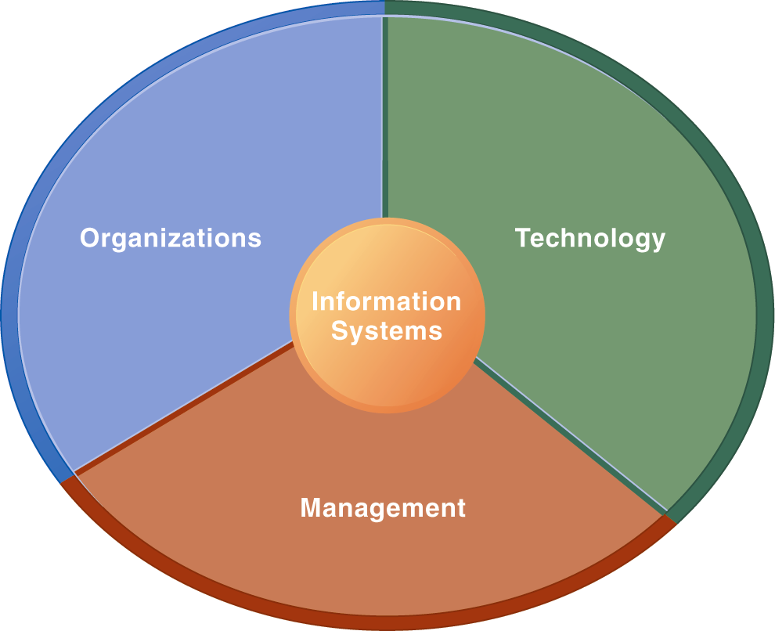
Management Information Systems
Chapter 1 Information Systems in Global Business Today
Perspectives on Information Systems
Information Systems Are More Than Computers
Using information systems effectively requires an understanding of the organization, management, and information technology shaping the systems. An information system creates value for the firm as an organizational and management solution to challenges posed by the environment.
Figure 1-5

Slide 19
Management Information Systems
Chapter 1 Information Systems in Global Business Today
Perspectives on Information Systems
Organizational dimension of information systems
  Hierarchy of authority, responsibility
    Senior management
    Middle management
    Operational management
    Knowledge workers
    Data workers
    Production or service workers

Slide 20
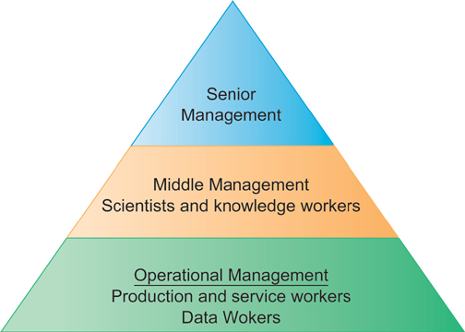
Management Information Systems
Chapter 1 Information Systems in Global Business Today
Perspectives on Information Systems
Levels in a Firm
Business organizations are hierarchies consisting of three principal levels: senior management, middle management, and operational management. Information systems serve each of these levels. Scientists and knowledge workers often work with middle management.
Figure 1-6

Slide 21
Management Information Systems
Chapter 1 Information Systems in Global Business Today
Perspectives on Information Systems
Organizational dimension of information systems (cont.)
  Separation of business functions
    Sales and marketing
    Human resources
    Finance and accounting
    Manufacturing and production
  Unique business processes
  Unique business culture
  Organizational politics

Slide 22
Management Information Systems
Chapter 1 Information Systems in Global Business Today
Perspectives on Information Systems
Management dimension of information systems
  Managers set organizational strategy for responding to business challenges
  In addition, managers must act creatively:
    Creation of new products and services
    Occasionally re-creating the organization

Slide 23
Management Information Systems
Chapter 1 Information Systems in Global Business Today
Perspectives on Information Systems
Technology dimension of information systems
  Computer hardware and software
  Data management technology
  Networking and telecommunications technology
    Networks, the Internet, intranets and extranets, World Wide Web
  IT infrastructure: provides platform that system is built on

Slide 24
Management Information Systems
Chapter 1 Information Systems in Global Business Today
Perspectives on Information Systems
Dimensions of UPS tracking system
  Organizational:
    Procedures for tracking packages and managing inventory and provide information
  Management:
    Monitor service levels and costs
  Technology:
    Handheld computers, bar-code scanners, networks, desktop computers, etc.

Slide 25
Management Information Systems
Chapter 1 Information Systems in Global Business Today
Perspectives on Information Systems
Business perspective on information systems:
  Information system is instrument for creating value
  Investments in information technology will result in superior returns:
    Productivity increases
    Revenue increases
    Superior long-term strategic positioning

Slide 26
Management Information Systems
Chapter 1 Information Systems in Global Business Today
Perspectives on Information Systems
Business information value chain
  Raw data acquired and transformed through stages that add value to that information
  Value of information system determined in part by extent to which it leads to better decisions, greater efficiency, and higher profits
Business perspective: Calls attention to organizational and managerial nature of information systems

Slide 27
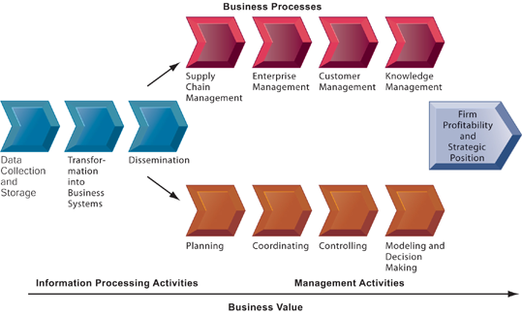
Management Information Systems
Chapter 1 Information Systems in Global Business Today
Perspectives on Information Systems
The Business Information Value Chain
From a business perspective, information systems are part of a series of value-adding activities for acquiring, transforming, and distributing information that managers can use to improve decision making, enhance organizational performance, and, ultimately, increase firm profitability.
Figure 1-7

Slide 28
Management Information Systems
Chapter 1 Information Systems in Global Business Today
Perspectives on Information Systems
Complementary assets:
  Assets required to derive value from a primary investment
  Firms supporting technology investments with investment in complementary assets receive superior returns
  E.g.: invest in technology and the people to make it work properly

Slide 29
Management Information Systems
Chapter 1 Information Systems in Global Business Today
Perspectives on Information Systems
Complementary assets include:
  Organizational investments, e.g.
    Appropriate business model
    Efficient business processes
  Managerial investments, e.g.
    Incentives for management innovation
    Teamwork and collaborative work environments
  Social investments, e.g.
    The Internet and telecommunications infrastructure
    Technology standards

