Slide 1

Chapter
2
Global E-Business: How Businesses Use Information Systems

Slide 2
Management Information Systems
Chapter 2 Global E-Business: How Businesses Use Information Systems
Business Processes and Information Systems
Business processes:
  Workflows of material, information, knowledge
  Sets of activities, steps
  May be tied to functional area or be cross-functional
Businesses: Can be seen as collection of business processes
Business processes may be assets or liabilities

Slide 3
Management Information Systems
Chapter 2 Global E-Business: How Businesses Use Information Systems
Business Processes and Information Systems
Examples of functional business processes
  Manufacturing and production
    Assembling the product
  Sales and marketing
    Identifying customers
  Finance and accounting
    Creating financial statements
  Human resources
    Hiring employees

Slide 4
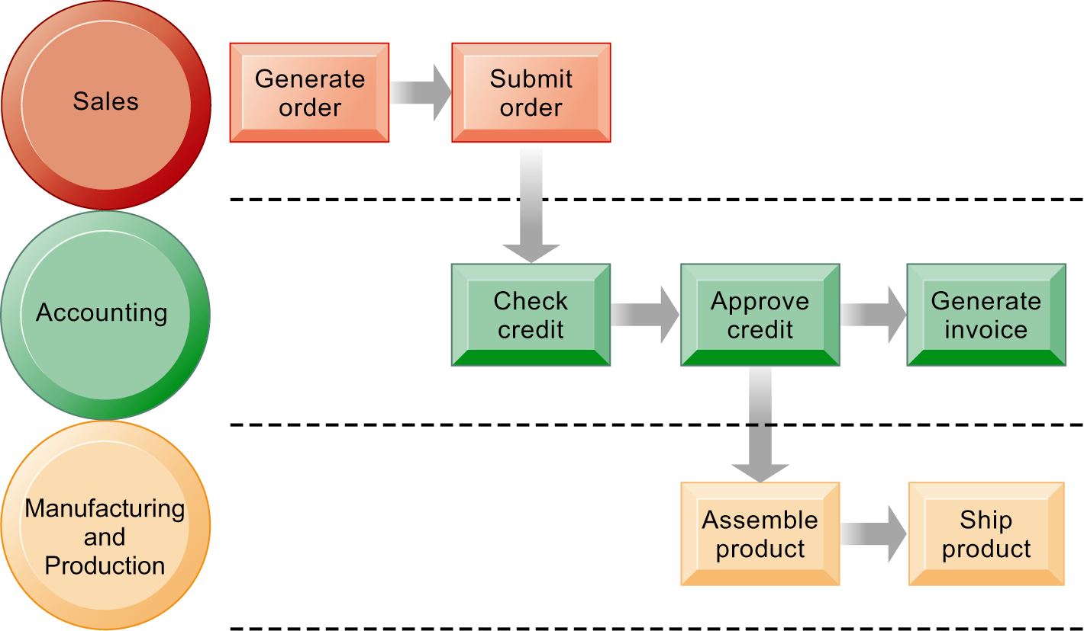
Management Information Systems
Chapter 2 Global E-Business: How Businesses Use Information Systems
Business Processes and Information Systems
The Order Fulfillment Process
Fulfilling a customer order involves a complex set of steps that requires the close coordination of the sales, accounting, and manufacturing functions.
Figure 2-1

Slide 5
Management Information Systems
Chapter 2 Global E-Business: How Businesses Use Information Systems
Business Processes and Information Systems
Information technology enhances business processes in two main ways:
  Increasing efficiency of existing processes
    Automating steps that were manual
  Enabling entirely new processes that are capable of transforming the businesses
    Change flow of information
    Replace sequential steps with parallel steps
    Eliminate delays in decision making

Slide 6
Management Information Systems
Chapter 2 Global E-Business: How Businesses Use Information Systems
Types of Business Information Systems
Transaction processing systems
  Perform and record daily routine transactions necessary to conduct business
    Examples: sales order entry, payroll, shipping
  Allow managers to monitor status of operations and relations with external environment
  Serve operational levels
  Serve predefined, structured goals and decision making
  Typically a major source of data for other systems

Slide 7
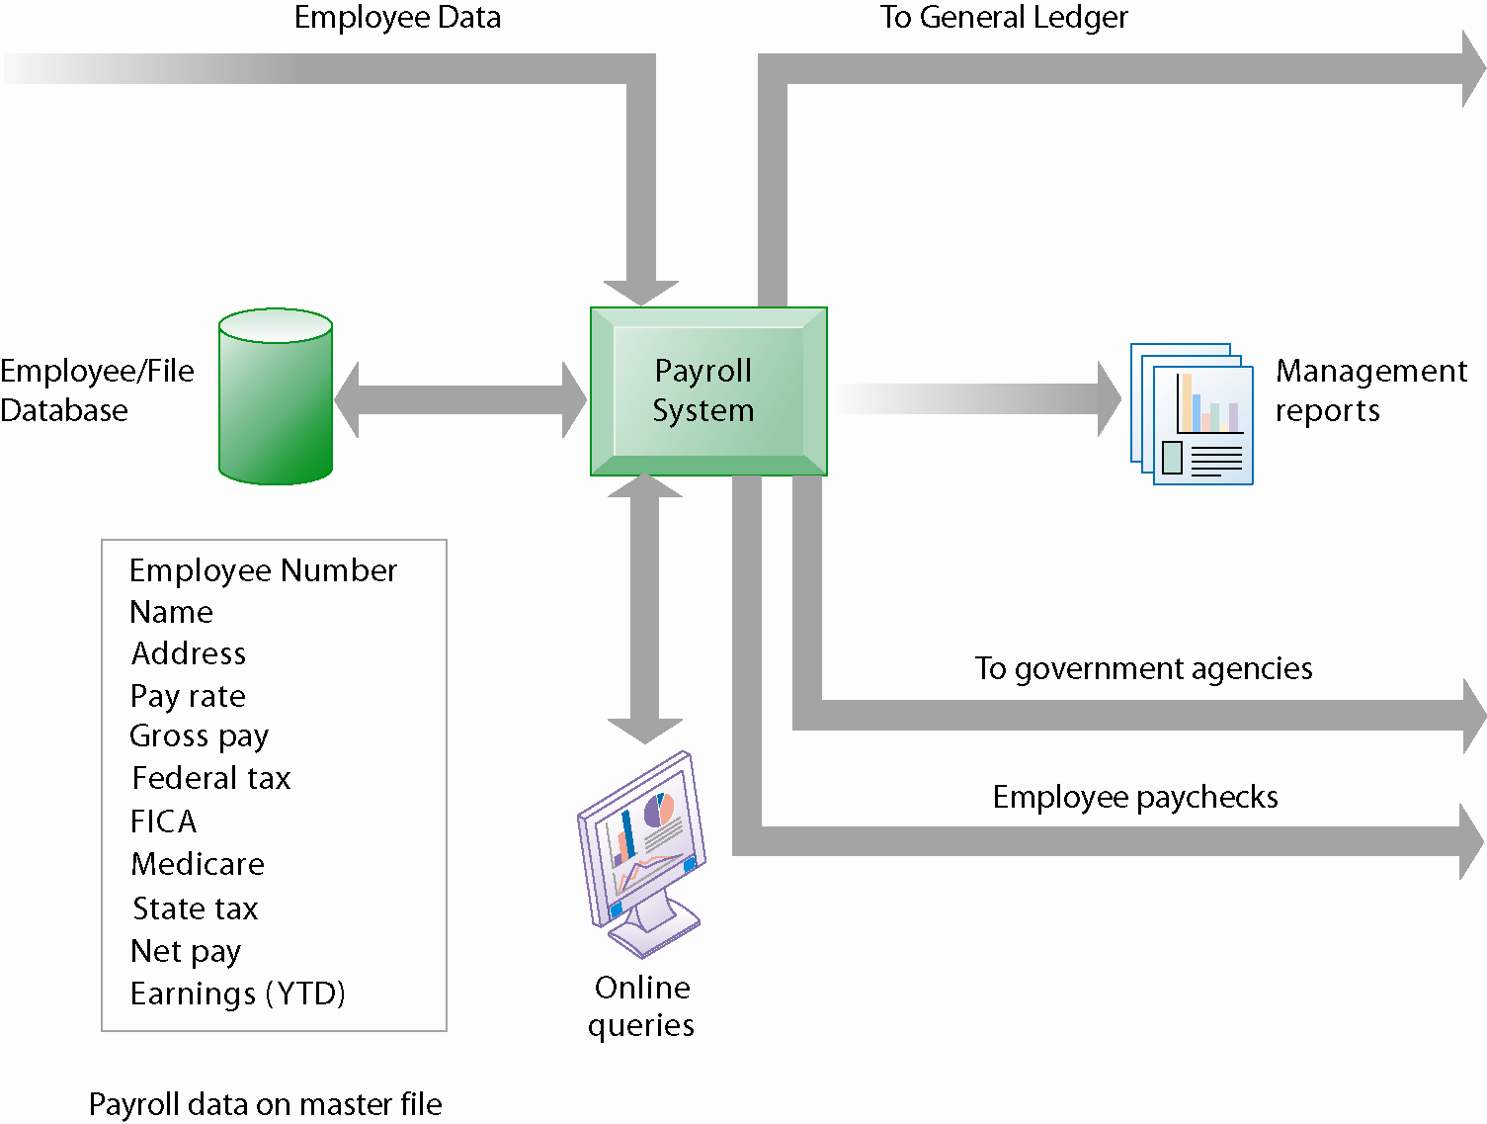
Management Information Systems
Chapter 2 Global E-Business: How Businesses Use Information Systems
Types of Business Information Systems
A Payroll TPS
A TPS for payroll processing captures employee payment transaction data (such as a time card). System outputs include online and hard-copy reports for management and employee paychecks.
Figure 2-2

Slide 8
Management Information Systems
Chapter 2 Global E-Business: How Businesses Use Information Systems
Types of Business Information Systems
Management information systems
  Serve middle management
  Provide reports on firm’s current performance, based on data from TPS
  Provide answers to routine questions with predefined procedure for answering them
  Typically have little analytic capability

Slide 9
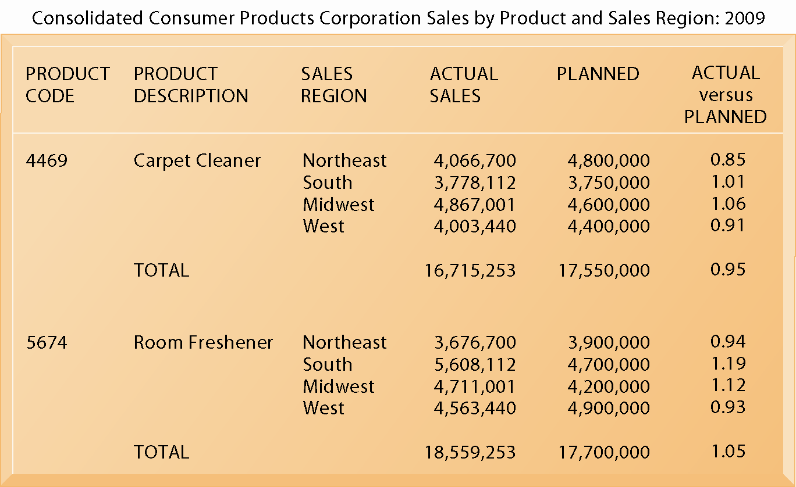
Management Information Systems
Chapter 2 Global E-Business: How Businesses Use Information Systems
Types of Business Information Systems
Sample MIS Report
This report, showing summarized annual sales data, was produced by the MIS in Figure 2-3.
Figure 2-4

Slide 10
Management Information Systems
Chapter 2 Global E-Business: How Businesses Use Information Systems
Types of Business Information Systems
Decision support systems
  Serve middle management
  Support nonroutine decision making
    Example: What is impact on production schedule if December sales doubled?
  Often use external information as well from TPS and MIS
  Model driven DSS
    Voyage-estimating systems
  Data driven DSS
    Intrawest’s marketing analysis systems

Slide 11
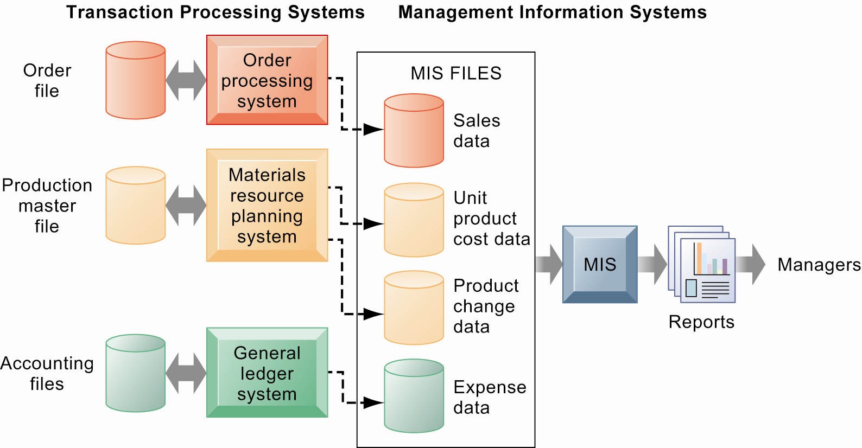
Management Information Systems
Chapter 2 Global E-Business: How Businesses Use Information Systems
Types of Business Information Systems
How Management Information Systems Obtain Their Data from the Organization’s TPS
In the system illustrated by this diagram, three TPS supply summarized transaction data to the MIS reporting system at the end of the time period. Managers gain access to the organizational data through the MIS, which provides them with the appropriate reports.
Figure 2-3

Slide 12
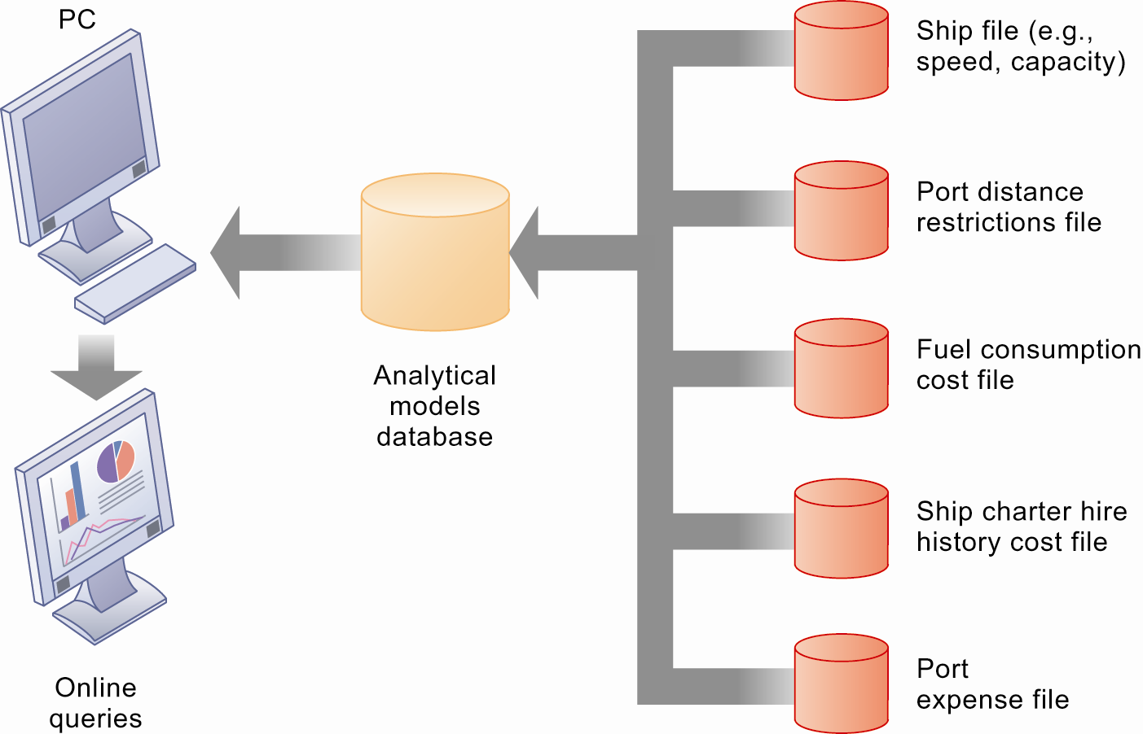
Management Information Systems
Chapter 2 Global E-Business: How Businesses Use Information Systems
Types of Business Information Systems
Voyage-Estimating Decision Support System
This DSS operates on a powerful PC. It is used daily by managers who must develop bids on shipping contracts.
Figure 2-5

Slide 13
Management Information Systems
Chapter 2 Global E-Business: How Businesses Use Information Systems
Types of Business Information Systems
Executive support systems
  Support senior management
  Address nonroutine decisions requiring judgment, evaluation, and insight
  Incorporate data about external events (e.g. new tax laws or competitors) as well as summarized information from internal MIS and DSS
  Example: ESS that provides minute-to-minute view of firm’s financial performance as measured by working capital, accounts receivable, accounts payable, cash flow, and inventory

Slide 14
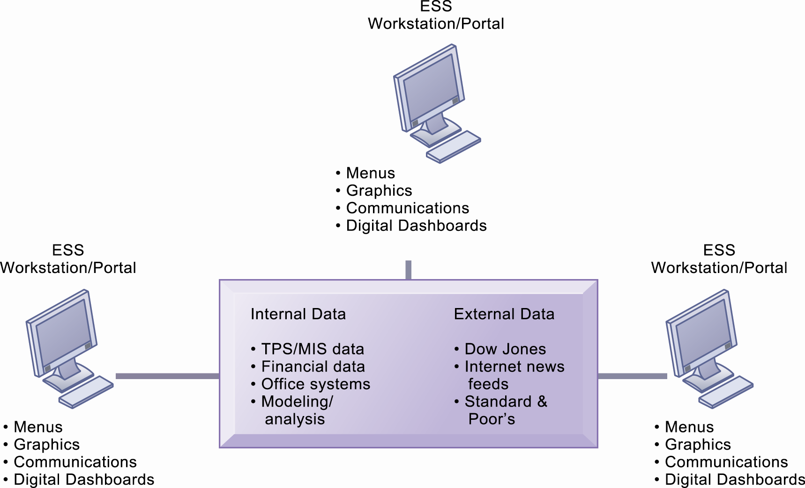
Management Information Systems
Chapter 2 Global E-Business: How Businesses Use Information Systems
Types of Business Information Systems
Model of an Executive Support System
This system pools data from diverse internal and external sources and makes them available to executives in easy-to-use form.
Figure 2-6

Slide 15
Management Information Systems
Chapter 2 Global E-Business: How Businesses Use Information Systems
Types of Business Information Systems
Systems from a constituency perspective
  Transaction processing systems: supporting operational level employees
  Management information systems and decision-support systems: supporting managers
  Executive support systems: supporting executives

Slide 16
Management Information Systems
Chapter 2 Global E-Business: How Businesses Use Information Systems
Types of Business Information Systems
Relationship of systems to one another
  TPS: Major source of data for other systems
  ESS: Recipient of data from lower-level systems
  Data may be exchanged between systems
  In reality, most businesses’ systems only loosely integrated

Slide 17
Management Information Systems
Chapter 2 Global E-Business: How Businesses Use Information Systems
Systems That Span the Enterprise
Enterprise applications
  Span functional areas
  Execute business processes across firm
  Include all levels of management
  Four major applications:
    Enterprise systems
    Supply chain management systems
    Customer relationship management systems
    Knowledge management systems

Slide 18
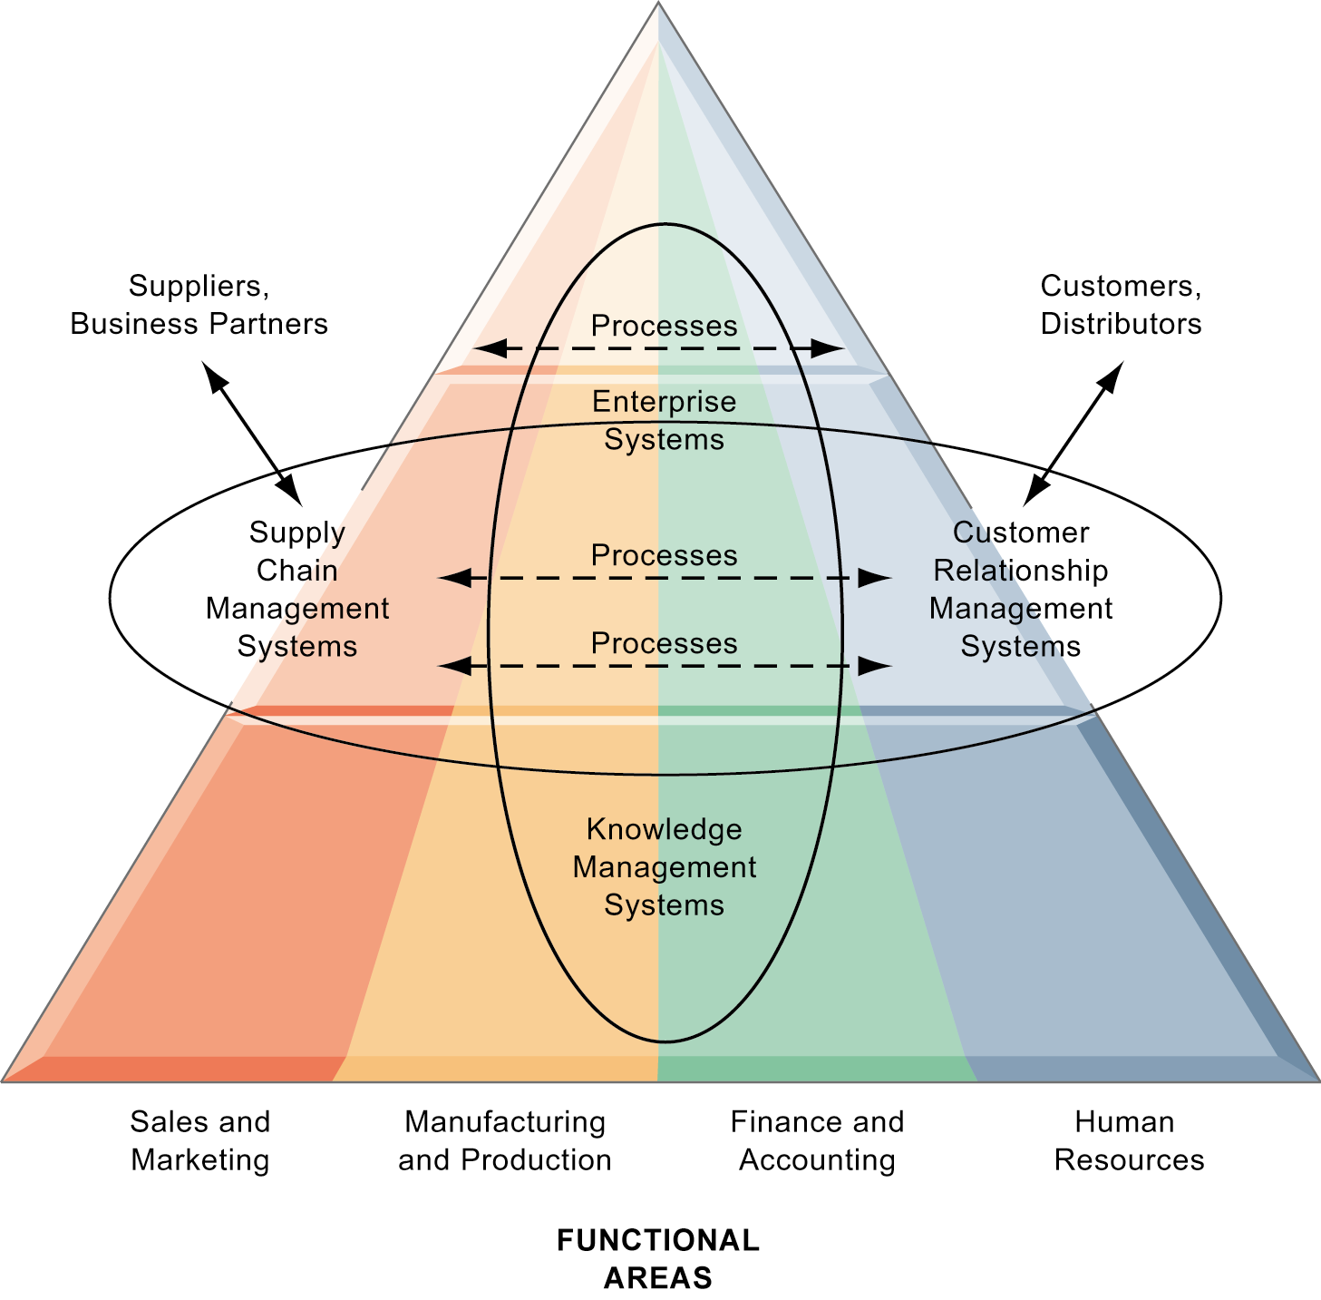
Management Information Systems
Chapter 2 Global E-Business: How Businesses Use Information Systems
Systems That Span the Enterprise
Enterprise Application Architecture
Enterprise applications automate processes that span multiple business functions and organizational levels and may extend outside the organization.
Figure 2-7

Slide 19
Management Information Systems
Chapter 2 Global E-Business: How Businesses Use Information Systems
Systems That Span the Enterprise
Enterprise systems
  Collects data from different firm functions and stores data in single central data repository
  Resolves problem of fragmented, redundant data sets and systems
  Enable:
    Coordination of daily activities
    Efficient response to customer orders (production, inventory)
    Provide valuable information for improving management decision making

Slide 20
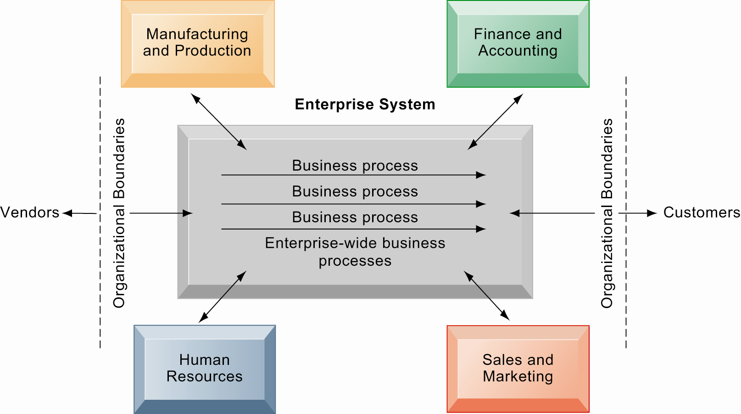
Management Information Systems
Chapter 2 Global E-Business: How Businesses Use Information Systems
Types of Business Information Systems
Enterprise Systems
Enterprise systems integrate the key business processes of an entire firm into a single software system that enables information to flow seamlessly throughout the organization. These systems focus primarily on internal processes but may include transactions with customers and vendors.
Figure 2-8

Slide 21
Management Information Systems
Chapter 2 Global E-Business: How Businesses Use Information Systems
Systems That Span the Enterprise
Supply chain management systems
  Manage firm’s relationships with suppliers
  Share information about
    Orders, production, inventory levels, delivery of products and services
  Goal: Right amount of products to destination with least amount of time and lowest cost
  Integrate supplier manufacturer, distributor, and customer logistics processes

Slide 22
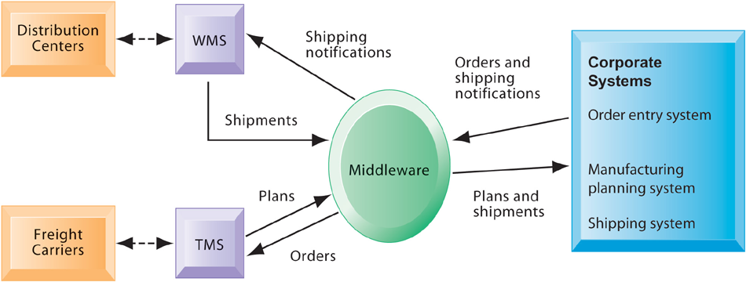
Management Information Systems
Chapter 2 Global E-Business: How Businesses Use Information Systems
Types of Business Information Systems
Example of a Supply Chain Management System
Customer orders, shipping notifications, optimized shipping plans, and other supply chain information flow among Haworth’s Warehouse Management System (WMS), Transportation Management System (TMS), and its back-end corporate systems.
Figure 2-9

Slide 23
Management Information Systems
Chapter 2 Global E-Business: How Businesses Use Information Systems
Systems That Span the Enterprise
Customer relationship management systems:
  Provide information to coordinate all of the business processes that deal with customers in sales, marketing, and service to optimize revenue, customer satisfaction, and customer retention
  Integrate firm’s customer-related processes and consolidate customer information from multiple communication channels

Slide 24
Management Information Systems
Chapter 2 Global E-Business: How Businesses Use Information Systems
Systems That Span the Enterprise
Knowledge management systems
  Support processes for acquiring, creating, storing, distributing, applying, integrating knowledge
  Collect internal knowledge and link to external knowledge
  Include enterprise-wide systems for:
    Managing documents, graphics and other digital knowledge objects
    Directories of employees with expertise
  Easiest to adapt in an intranet

Slide 25
Management Information Systems
Chapter 2 Global E-Business: How Businesses Use Information Systems
Systems That Span the Enterprise
Intranets:
  Internal networks built with same tools and standards as Internet
  Used for internal distribution of information to employees
  Typically utilize private portal providing single point of access to several systems
  May connect to company’s transaction systems

Slide 26
Management Information Systems
Chapter 2 Global E-Business: How Businesses Use Information Systems
Systems That Span the Enterprise
Extranets:
  Intranets extended to authorized users outside the company
  Expedite flow of information between firm and its suppliers and customers
  Can be used to allow different firms to collaborate on product design, marketing, and production

Slide 27
Management Information Systems
Chapter 2 Global E-Business: How Businesses Use Information Systems
Systems That Span the Enterprise
Collaboration and communication systems
  ‘Interaction’ jobs a major part of global economy
  Methods include:
    Internet-based collaboration environments
    E-mail and instant messaging (IM)
    Cell phones and smartphones
    Social networking
    Wikis
    Virtual worlds

Slide 28
Management Information Systems
Chapter 2 Global E-Business: How Businesses Use Information Systems
The Information Systems Function in Business
Information systems department:
  Formal organizational unit responsible for information technology services
  Includes programmers, systems analysts, project leaders, information systems managers
  Often headed by chief information officer (CIO), also includes chief security officer (CSO) and chief knowledge officer (CKO)
End-users:
  Representatives of other departments, for whom applications are developed

