Slide 1
Oracle 10g Database Administrator: Implementation and Administration
Chapter 1
Oracle Architecture Overview

Slide 2
Objectives
Learn about Oracle10g architecture and key Oracle10g software components
Look at the ORACLASS database used in exercises throughout the book
Discover differences between Oracle10g client and server installation options
Learn how to use the Oracle Universal Installer
Examine why to use OFA (Optimal Flexible Architecture)

Slide 3
Introduction to Oracle10g Architecture
The Oracle10g RDBMS software suite includes everything you need to build/maintain a relational DB
The basic software:
Runs the database engine
Manages the data storage for all information in the database
Provides tools to manage users, tables, data integrity, backups, and basic data entry
Includes additional tools and utilities that help monitor the performance and security of the database

Slide 4
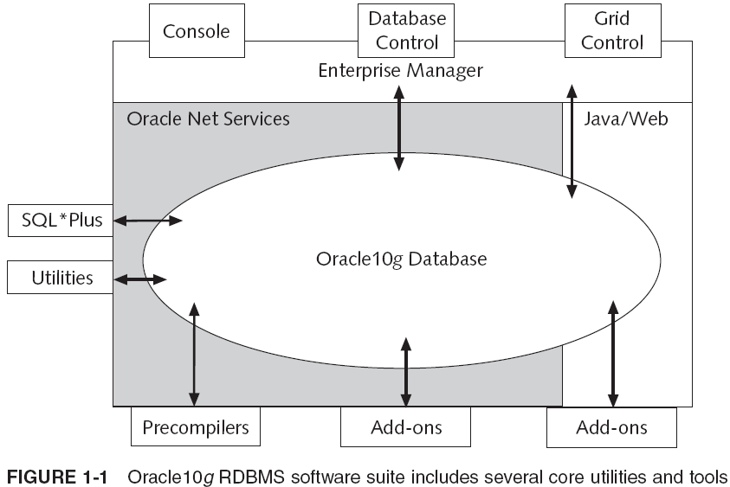
Key Components of the Oracle10g
OEM

Slide 5
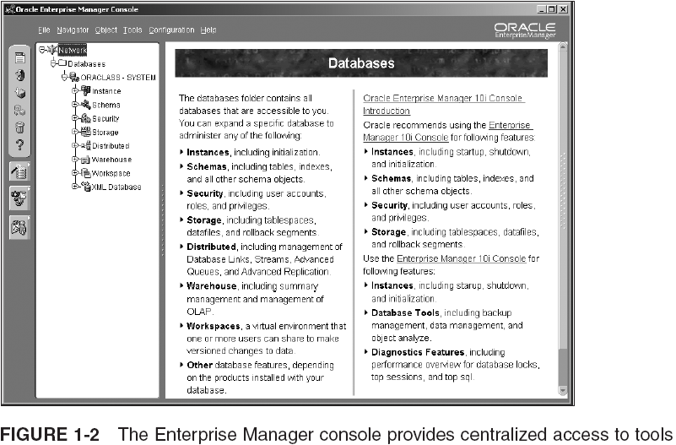
Key Components of Oracle10g (continued)

Slide 6
Running the Database
When you install an Oracle10g DB, you install the software components, create DB files to store your data, and start a set of background processes that allocate memory and handle database activities
Oracle defines a DB as the collection of operating system files that store your data
Database server: combination of DB software, a DB (the files), and DB instance (the SGA and the background processes)
Single-instance server (typical configuration)
Multiple-instance server
Clustered servers

Slide 7
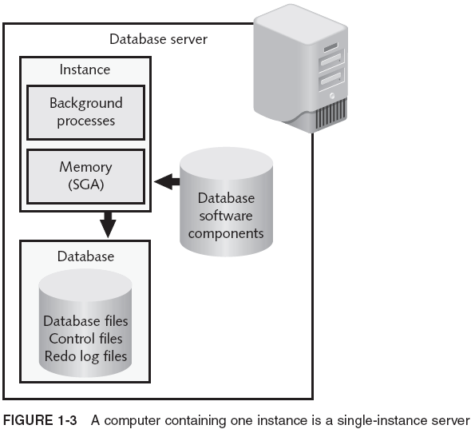
Running the Database (continued)

Slide 8
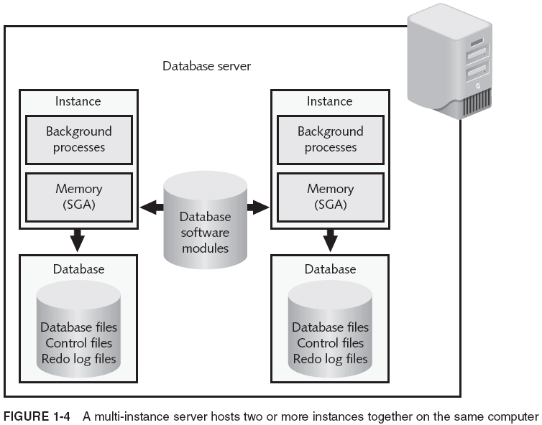
Running the Database (continued)

Slide 9
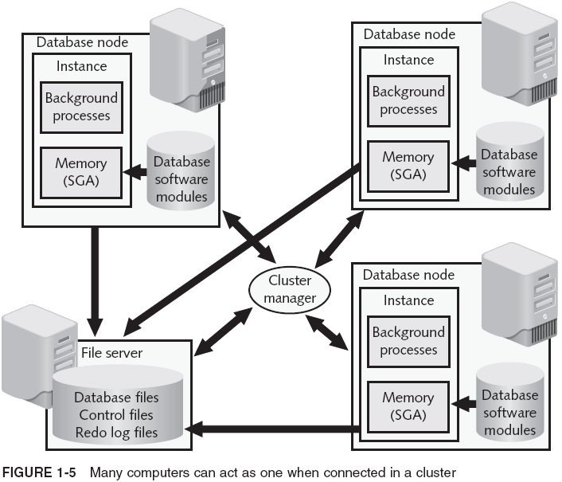
Running the Database (continued)

Slide 10
Running the Database (continued)
When an application that uses the DB is run, it creates a user process that controls the connection to the database process
On the DB side, the process that interacts with the user process is called a server process
Two basic methods to connect these processes:
Dedicated server: connects one user process with one server process
Predefined DBs created on installation are configured in dedicated server mode
Shared Servers: a minimal number of database server processes are shared with multiple connections, between an application and the DB

Slide 11
Some Optional Additions to Oracle10g
Optional features requiring additional license fees:
Oracle Partitioning
Oracle Clusterware
Oracle Spatial
Oracle Data Mining
Oracle COM Automation Feature
Oracle Database Extensions for .NET
Oracle Advanced Security
Oracle Label Security
Oracle Online Analytical Processing (OLAP) Services

Slide 12
Introduction to ORACLASS Database
Main features:
Enterprise Edition software
User: CLASSMATE, password: CLASSPASS
Initially owns no tables or other objects
Required script instructions are included in each chapter
Includes standard users SYSTEM and SYS
Global Globe is a national newspaper chain and you have been hired to design and build its database
You are starting from scratch

Slide 13
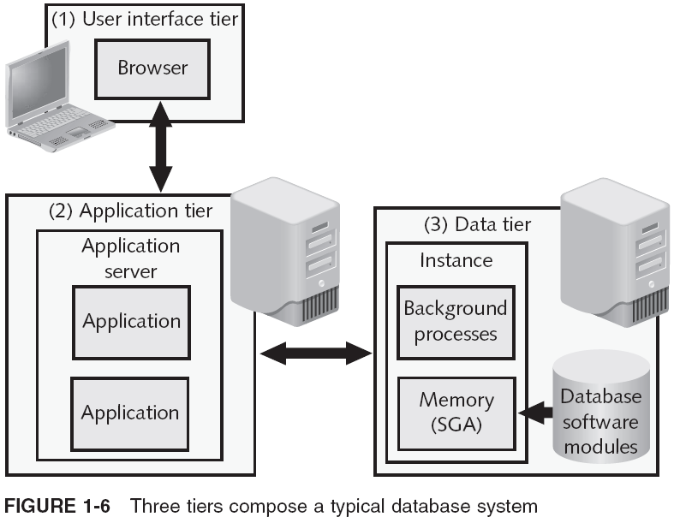
Overview of Oracle10g Installation Options
Multi-tier (or n-tier) means that the data, processing, and user interfaces are divided into separate areas that are fairly independent of one another

Slide 14
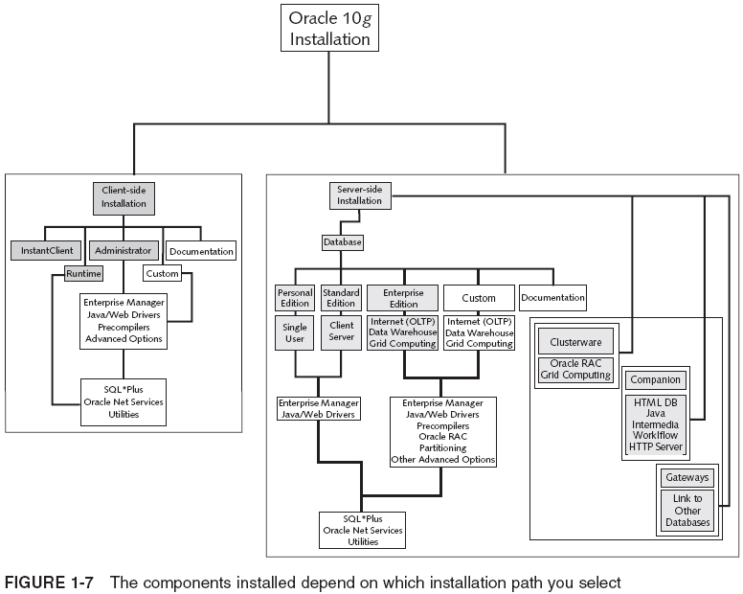
Overview of Oracle10g Installation Options (continued)

Slide 15
Comparing Server-Side Installation Options
Enterprise Edition: includes all major components
Enables multiple users to connect concurrently
Optimized for high data volume is common
Supports multiple DB instances and replication
Standard Edition: provides basic support for multi-user database applications on a smaller scale than that of the Enterprise Edition
Cannot be upgraded with database features
Personal Edition: single-user access to DB instance
Two primary uses: programming and deployment
Notes:
Stress that this book primarily covers the Enterprise Edition of the server-side installation.

Slide 16
Comparing Client-Side Installation Options
Client-side installations facilitate user access to a remote Oracle10g database
Oracle Net Services component on the client side handles communication with remote database
Four variations, including:
Administrator: provides user management tools, including Enterprise Manager, to provide remote management of multiple databases
Runtime: intended primarily for programmers who are developing applications on their own client machines while using a remote database as the connection to the database

Slide 17
The Oracle Universal Installer
Keeps records on your previous installation activity
If you install upgrades/enhancements later, it skips redundant subcomponents
Enables you to view/uninstall components and subcomponents currently
Does not allow you to remove a subcomponent that is still required by installed components

Slide 18
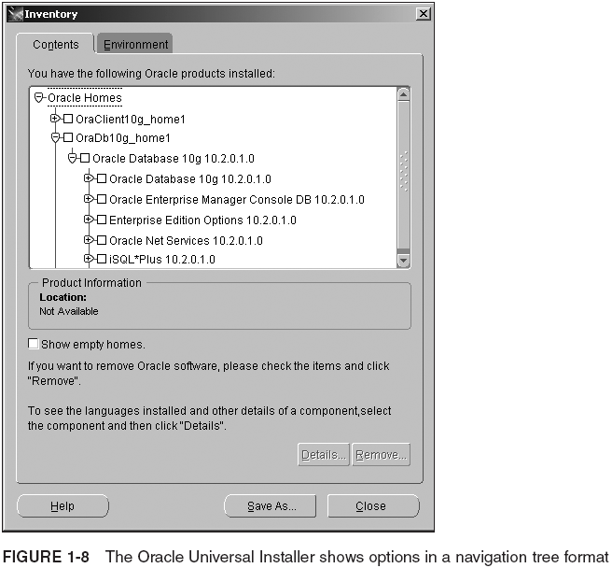
The Oracle Universal Installer (continued)

Slide 19
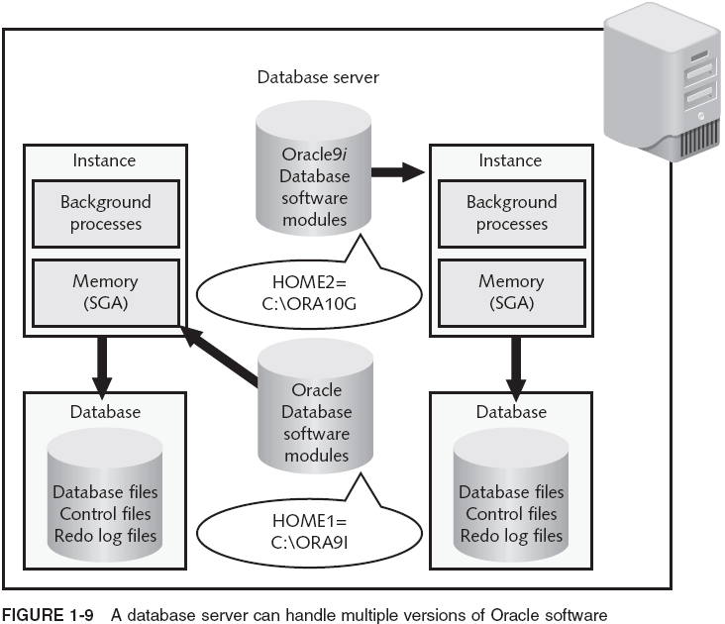
Oracle Home

Slide 20
Oracle Home (continued)
Installer lets you install several versions of Oracle software on a single machine by setting up a separate directory structure for each version and its software components
SILENT MODE installation enables you to run an installation without any human intervention
setup.exe -responseFile <filename> -silent
runInstaller -responseFile <filename> -silent
Installer can also be used to install applications that you write by preparing an installation script with the optional Oracle package called the Software Packager

Slide 21
Description of Optimal Flexible Architecture (OFA)
Provides standards to improve performance by:
Spreading I/O functions across separate devices by separating data from software
Improving performance by separating products into distinct directories that can be located on separate devices to reduce bottlenecks
Speeding up administrative tasks, such as backups, by using naming standards for file types
Improving detection and prevention of fragmentation in datafiles by using naming standards that quickly identify which tablespace and datafile are associated with one another

Slide 22
Directory Structure Standards
SW and DB storage files are under ORACLE_BASE
C:\oracle\product\10.2.0
/app/oracle/product/10.2.0
Directories found under ORACLE_BASE:
Admin/<database name>
db_1
client_1
oradata/<database name>
flash_recovery_area
DB files allow for division by function and by either database instance or software release number

Slide 23
Directory Structure Standards (continued)
Path to Oracle software is called ORACLE_HOME containing Oracle binaries
Defined as a variable within your system
E.g. ORACLE_HOME/bin/runnit.exe
Each installation has its own ORACLE_HOME
Examples:
/app/oracle/product/10.2.0/db 1
C:\oracle\product\10.2.0\db 1
c:\oracle\product\10.2.0\client 1
Contains a bin directory that holds most of the executables

Slide 24
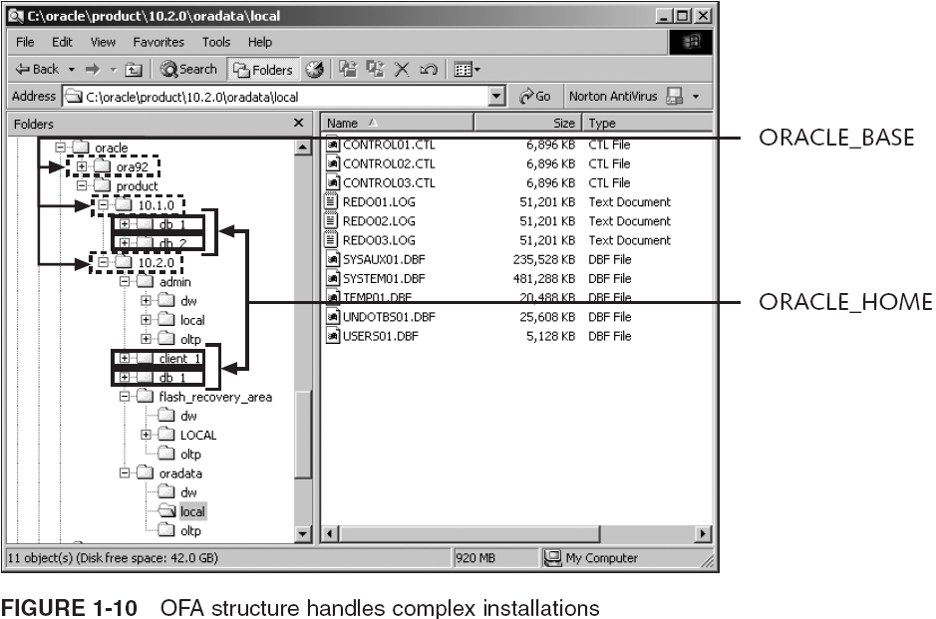
Directory Structure Standards (continued)

Slide 25
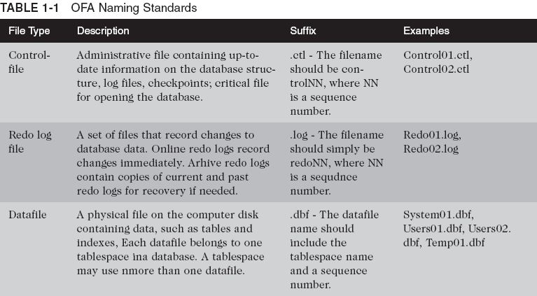
File Naming Standards

Slide 26
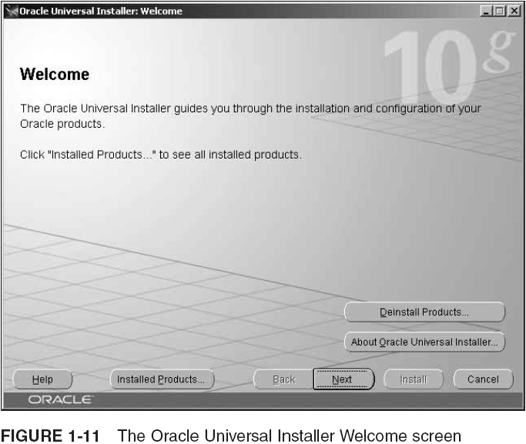
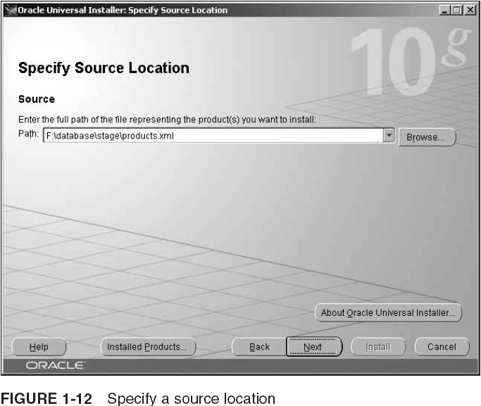
Installing Oracle Software

Slide 27
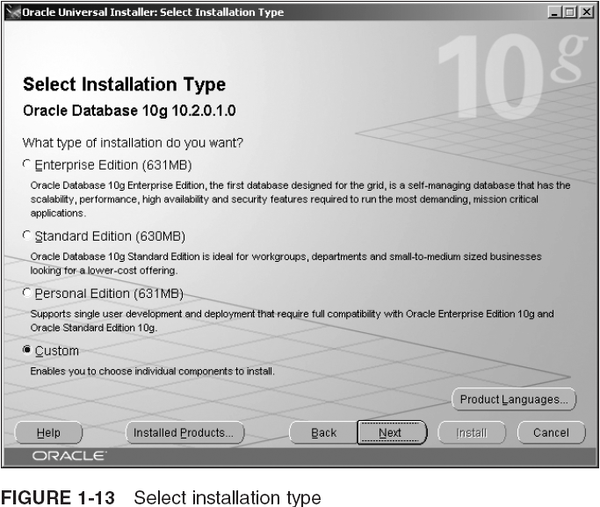
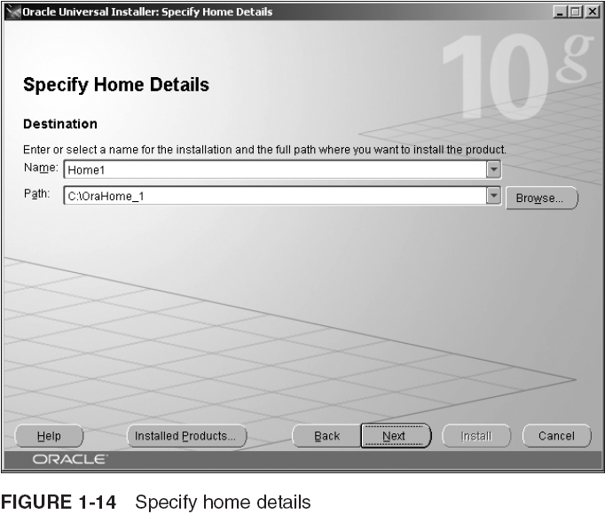
Installing Oracle Software (continued)

Slide 28
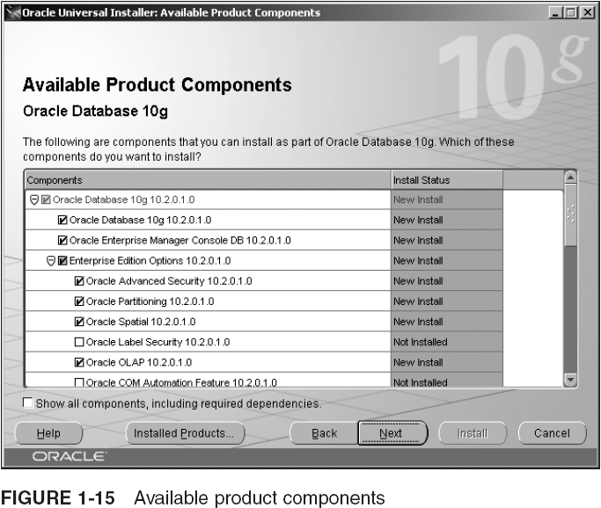
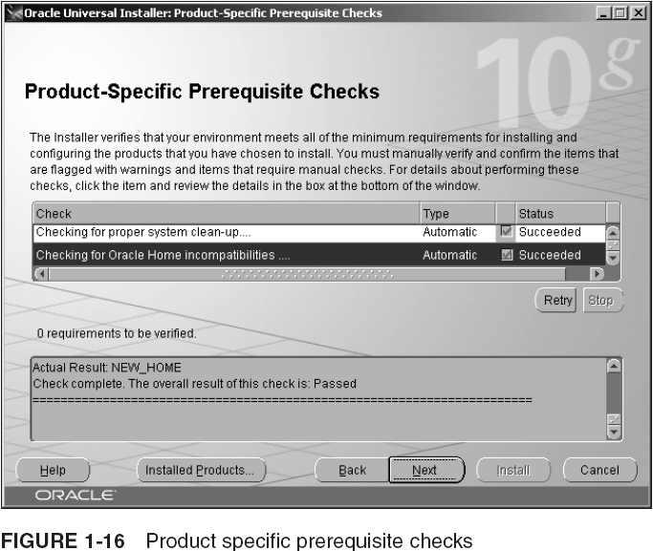
Installing Oracle Software (continued)

Slide 29
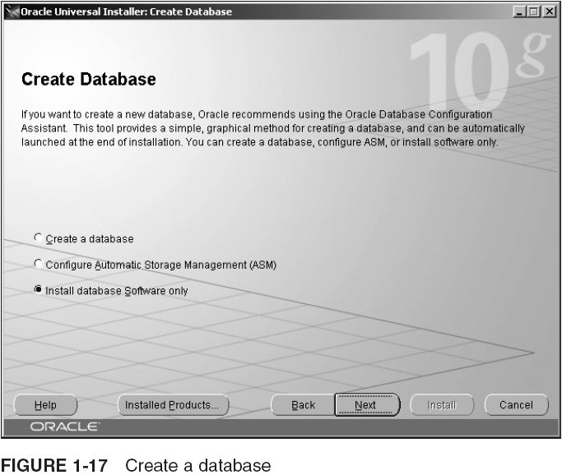
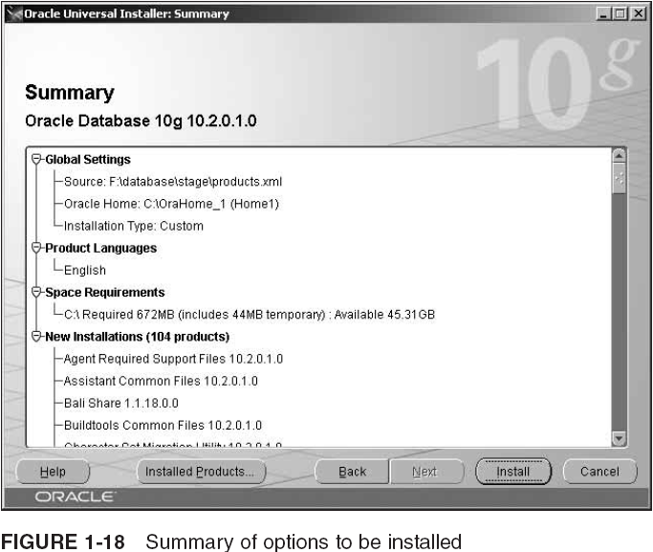
Installing Oracle Software (continued)

Slide 30
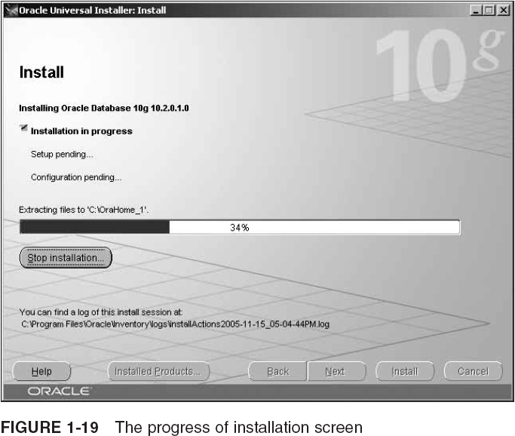
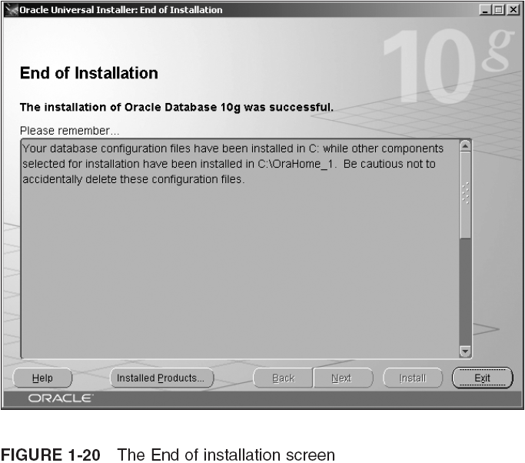
Installing Oracle Software (continued)

Slide 31
Summary
The core Oracle10g RDBMS software includes a suite of products
The basic installation includes many components and subcomponents
The key components of Oracle10g RDBMS software are: Oracle10g database, Oracle Net Services, Java/Web support and tools, Enterprise Manager, SQL*Plus, utilities, and pre-compilers
Additional add-on options to Oracle10g can help increase database functionality and add more tools to the basic tool set provided by the basic version

Slide 32
Summary (continued)
A database instance is made up of the memory area (SGA) and the background processes started on a computer
A database server contains a database instance and the database files that store the database data
A database server can contain a single instance, multiple instances, or can be a combination of multiple servers, called a cluster or grid of computers
Some key optional components are Oracle Spatial, Oracle Partitioning, Oracle Real Application Clusters, Oracle Data Mining, Oracle Advanced Security, Oracle Label Security, and Oracle OLAP services

Slide 33
Summary (continued)
The most complete and robust installation option for the server side is the Enterprise Edition
Other choices: Standard Edition and Personal Edition
On the client side, you can install the Administrator option or the Runtime option
The ORACLASS database is provided for running exercises throughout this book
A running case project develops a database system for a fictional newspaper chain called Global Globe

Slide 34
Summary (continued)
Multi-tier (n-tier) architecture separates different levels of software components
The client-side installation option runs remote applications or remote DBA tasks
The server-side installation option runs a DB server
The client-side installation option has a number of paths: Administrator, Runtime, a custom install, and InstantClient
Oracle Universal Installer is a user-friendly interface for installing/uninstalling Oracle products

Slide 35
Summary (continued)
The Oracle Home Selector feature of the Universal Installer enables the installation of multiple versions of Oracle software on one computer
The Silent Install option pre-builds and runs an installation without any human intervention
Optimal Flexible Architecture (OFA) defines standard names for directory structures, database files, control files, and redo log files
OFA uses the ORACLE_BASE variable to define the root location for all Oracle subdirectories, including Pradata and ORACLE_HOME

