Slide 1
Scalable Configuration Interface
Scalable and easy to implement
  Targeting dense register maps
  Reduces area, wiring and congestion
Half-duplex with request/ack pairs
  Useful for low-speed register accesses
  Latency insensitive!
Inspired by SPI
  Data bus is tri-stated
  Has active-low chip select

Slide 2
SCI signals
N = number of peripherals
SIGNAL | WIDTH | DIRECTION | NOTES
CSN | N | Master->Slave | Master is busy and peripheral is considered selected as long as this signal stays low
REQ | 1 | Master->Slave | Requests are sent over this signal: operation type, address and data. Address and data are LSB first
RESP | 1 | Slave->Master | Data from the Slave during a Read are sent over this signal. Data is sent back LSB first
ACK | 1 | Slave->Master | Ack signal from the Slave to request the Master to reassert the chip select. It is also used as a strobe during Reads

Slide 3
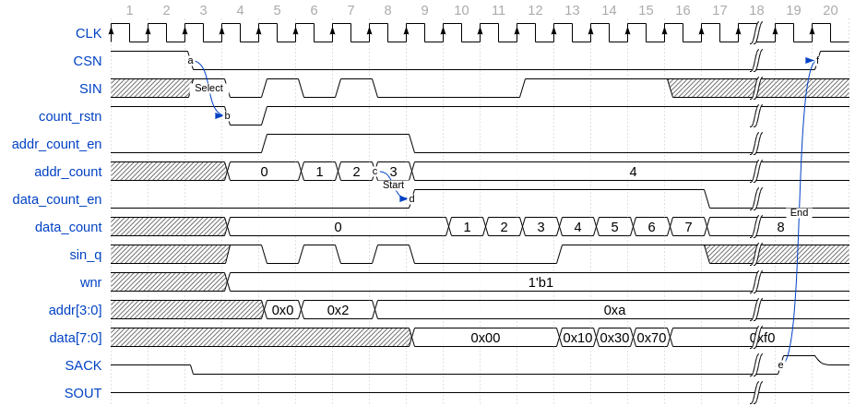
Write example
Example: Write 8’hf0 at address 4’ha
WNR
Address
Data
1’bZ undriven

Slide 4
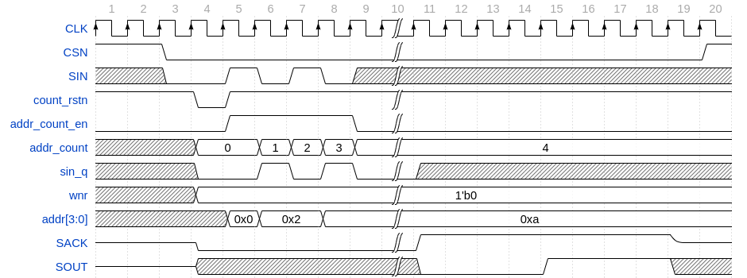
Read example
Example: Read from address 4’ha
WNR
Address
Data is not valid
Data is valid
Data

Slide 5
Architecture
Master
CSN/n+1
/1
/1
/1
Slave#0
Slave#1
Slave#n
REQ/1
RESP/1
3-state
buffers
ACK/1

