Slide 1
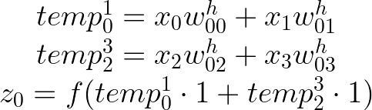
Fully-connected network emulation
X0
H0
z0
O0
y0
X1
H1
z1
X2
O1
y1
H2
X4
z2
Outputs
Inputs
Hidden layer
Output layer

