Slide 1

MODELING Xmas Breaks
Software engineer
Sebas, Miguel, Antonio

Slide 2

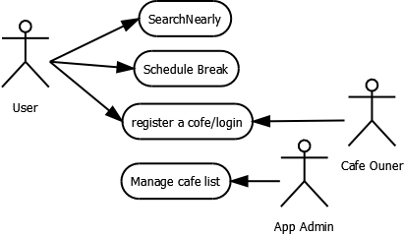
Cases Diagram

Slide 3
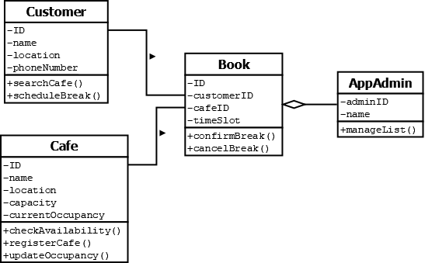
Class Diagram

Slide 4
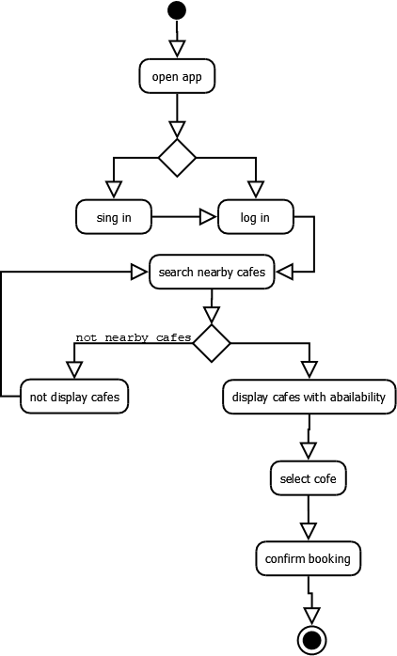
Activity Diagram

