Slide 1
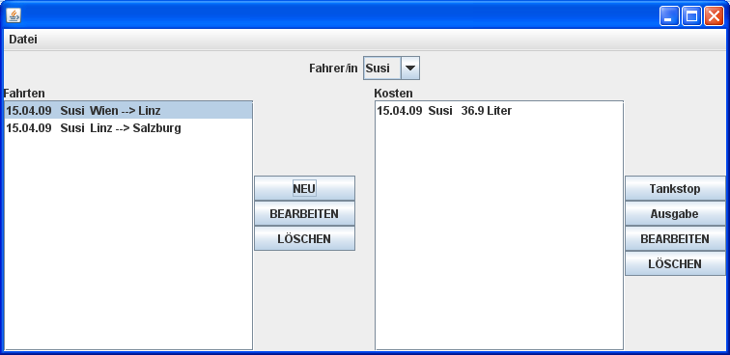
JFrame (BorderLayout)
JPanel (FlowLayout)
im NORTH-Bereich
JPanel (GridLayout(1,10))
Im EAST-Bereich
JList in JScrollPane
im CENTER
JList in JScrollPane
im CENTER
JPanel (GridLayout(2,1))
im CENTER
JPanel (BorderLayout)

