Slide 1
XML
EXTENSIBLE MARKUP LANGUAGE
text-based markup language
standard for data interchange on the web
tags identify the data rather than specify how to display it
puts a label on a piece of data that identifies

Slide 2
Tags and Attributes
<message to="you@yourAddress.com"
from="me@myAddress.com"
subject="XML Is Really Cool">
  <text>
  How many ways is XML cool?
  Let me count the ways...
  </text>
</message>

Slide 3
Empty Tags
<flag value=“true“/>

Slide 4
Comments in XML Files
<!-- This is a comment -->

Slide 5
The XML Prolog
<?xml version="1.0"
encoding="ISO-8859-1"
standalone="yes"?>

Slide 6
Processing Instructions
<!-- PROCESSING INSTRUCTION -->
<?my.presentation.Program
QUERY="exec, tech, all"?>

Slide 7
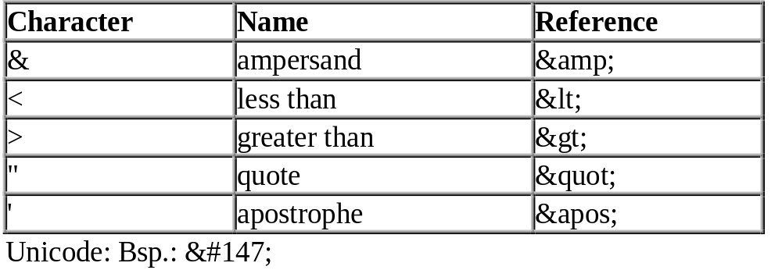
Entities

Slide 8
CDATA
<item>
<![CDATA[
    <config>
    <section name="Allgemein">
    <parameter name="Ansicht" value="normal" />
    <parameter name="Modus" value="standalone" />
    <parameter name="Instanzen" value="3" />
    </section>
    <section name="Verbindung">
    …..
]]></item>

Slide 9
DTD
DATA TYPE DEFINITION
<!-- A SAMPLE set of slides -->
<!DOCTYPE slideshow SYSTEM "slideshow.dtd">
<slideshow ...
<!DOCTYPE slideshow SYSTEM "slideshow1.dtd" [
...local subset definitions here...
]>

Slide 10
DTD
<!ELEMENT slideshow (slide+)>
<!ELEMENT slide (title, item*)>
<!ELEMENT title (#PCDATA)>
<!ELEMENT item (#PCDATA | item)* >
<!ELEMENT flag EMPTY>
<!ELEMENT slideshow (slide+)>
<!ATTLIST slideshow
title CDATA #REQUIRED
date CDATA #IMPLIED
author CDATA "unknown"
>
<!ELEMENT slide (title, item*)>

Slide 11
Using Namespaces
<SL:slideshow
xmlns:SL='http:/www.example.com/slideshow'
...>
...
</SL:slideshow>
<SL:slideshow
xmlns:SL='http:/www.example.com/slideshow'
xmlns:xhtml='urn:...'>
...
</SL:slideshow>

Slide 12
Why Is XML Important?
Plain Text
Data Identification
Stylability (XSL)
Inline Reusability
Linkability
Easily Processed
Hierarchical

Slide 13
How Can You Use XML?
      Traditional data processing, where XML encodes the data for a program to process
      Document-driven programming, where XML documents are containers that build interfaces and applications from existing components
      Archiving--the foundation for document-driven programming--where the customized version of a component is saved (archived) so that it can be used later
      Binding, where the DTD or schema that defines an XML data structure is used to automatically generate a significant portion of the application that will eventually process that data

