Slide 1



“Development of a Software System for Early Detection of Fraudulent Transactions in Small Business Processes”
Degree Program 02.03.03 “Mathematical Software and
Information Systems Administration”
Specialization: “Systems and Internet Programming”
Abstract
Author: A. A. Shumilin, student of group 15.27D-MO11/22b
Academic Supervisor:
Yu. V. Nefedov, Associate Professor, PhD in Economics,
Associate Professor, Department of Digital Economy, Institute for the Development of the Information Society
Moscow, 2026

Slide 2


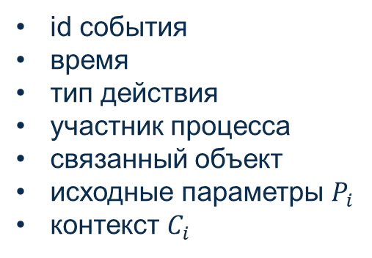






Mathematical Model - Input Data and Features
Event / operation from an external system
Normalization
Feature Vector
id события
время
тип действия
участник процесса
связанный объект
исходные параметры $P_{i}$
контекст $C_{i}$
$$x_{i}=\left(x_{i}^{\text{base}}, x_{i}^{\text{num}}, x_{i}^{\text{proc}}, x_{i}^{\text{hist}}, x_{i}^{\text{ctx}}\right)$$
$$x_{i}^{\text{base}}$$
- Operation type, status, time, employee, etc.
$$x_{i}^{\text{num}}$$
- Amounts, counts, stage duration, linked objects, etc.
$$x_{i}^{\text{proc}}$$
- Workflow compliance, approvals, limit violations, etc.
$$o_{i}=\left\langle id_{i},t_{i},{type}_{i},{actor}_{i},{object}_{i},P_{i},C_{i} \right\rangle$$
$$x_{i}^{\text{hist}}$$
- Deviation from the usual employee, counterparty, or operation profile.
$$x_{i}^{\text{ctx}}$$
- Links to other events
9

Slide 3



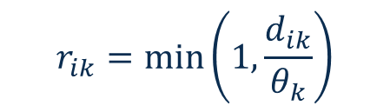


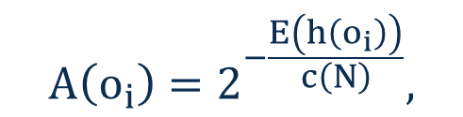
Mathematical Model - Analytical Modules
Rule-based checks detect explicit business-rule violations: missing required fields, approval workflow breaches, exceeded limits, and changes to critical fields after approval.
$$G=\left\{g_{1} , g_{2} , … , g_{m}\right\}, g_{j}\left(o_{i}\right)∈\{0,1\}$$
$$R_{\text{rule}}\left(o_{i}\right)=\frac{\sum_{j=1}^{m}{w_{j}} g_{j}\left(o_{i}\right)}{\sum_{j=1}^{m}{w_{j}}}$$
$$d_{ik}=\frac{\left|x_{ik}−\tilde{x_{k}}\right|}{1.4826 ∗MAD_{k}+ε}$$
Anomaly detection identifies unusual multidimensional feature combinations using Isolation Forest.
Robust risk scoring measures how far an operation deviates from its normal profile based on selected numerical and ordinal features.
$$r_{ik}=\min\left(1,\frac{d_{ik}}{θ_{k}}\right)$$
$$A\left(o_{i}\right)=2^{−\frac{E\left(h\left(o_{i}\right)\right)}{c\left(N\right)}},$$
$$A\left(o_{i}\right)∈\left[0,1\right]$$
$$R_{\text{score}}\left(o_{i}\right)=\frac{\sum_{k=1}^{n}{α_{k}} r_{ik}}{\sum_{k=1}^{n}{α_{k}}}$$
10

Slide 4
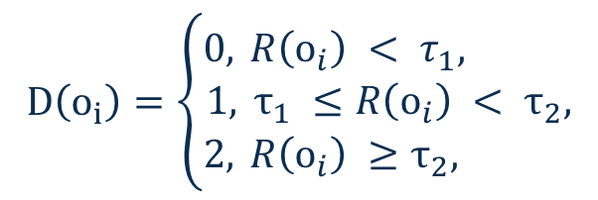


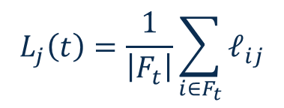
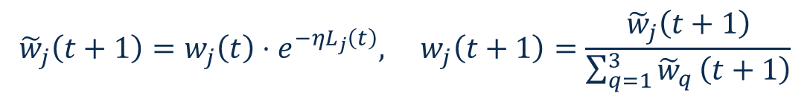
Mathematical Model – Final Risk Assessment and Weight Adaptation
1 The final risk combines three components:
4 Error estimation:
$$R\left(o_{i}\right)=w_{rule}R_{\text{rule}}\left(o_{i}\right)+w_{score}R_{\text{score}}\left(o_{i}\right)+w_{anom}A\left(o_{i}\right)$$
The deviation from the operational assessment is calculated:
$$w_{rule} +w_{score}+w_{anom}=1$$
$$𝓁_{ij}={\left(z_{ij}−y_{i}\right)}^{2}$$
2 Threshold-based operation classification:
$$D\left(o_{i}\right)=\left\{\begin{aligned}0, & R\left(o_{i}\right) < τ_{1}, \\ 1, & τ_{1} ≤R\left(o_{i}\right) < τ_{2}, \\ 2, & R\left(o_{i}\right) ≥τ_{2},\end{aligned}\right.$$
0 – Normal operation
Mean component error:
1 – Suspicious operation
$$L_{j}\left(t\right)=\frac{1}{\left|F_{t}\right|}\sum_{i∈F_{t}}{𝓁_{ij}}$$
2 – Critical operation
3 Feedback:
5 Weight update:
The operation receives an expert assessment:
$${\tilde{w}}_{j}\left(t+1\right)=w_{j}\left(t\right)⋅e^{−ηL_{j}\left(t\right)}, w_{j}\left(t+1\right)=\frac{{\tilde{w}}_{j}\left(t+1\right)}{\sum_{q=1}^{3}{{\tilde{w}}_{q}}\left(t+1\right)}$$
$s_{i}∈${$0;0,5;1$}
11

Slide 5

Thank you for your attention!

