Slide 1
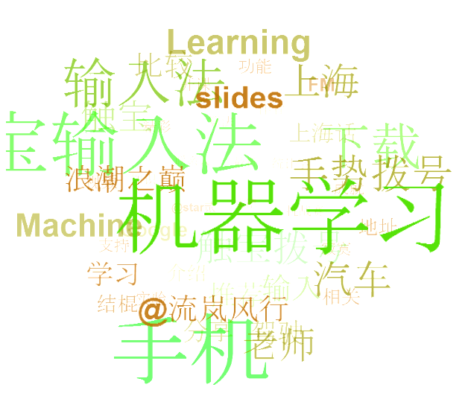
Large Graph Mining - Patterns, Tools and Cascade Analysis

Slide 2
outline
Simple tag cloud
K-Means
Use numpy

Slide 3
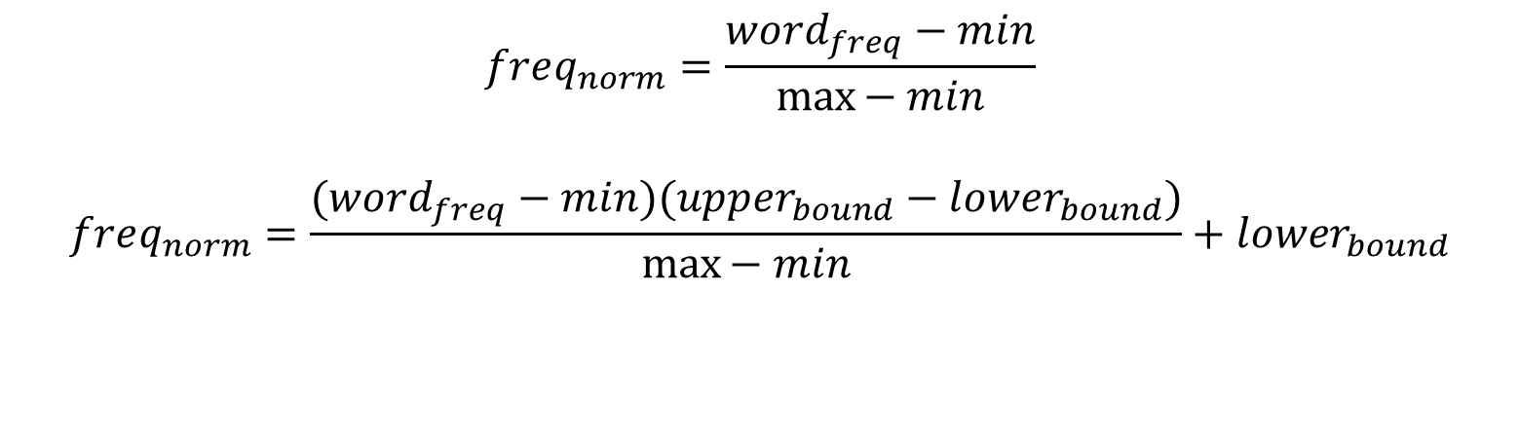
simple tag cloud
$$freq_{norm}=\frac{word_{freq}−min}{\max{− min}}$$
$$freq_{norm}=\frac{(word_{freq}−min)(upper_{bound}−lower_{bound})}{\max{− min}}+lower_{bound}$$

Slide 4
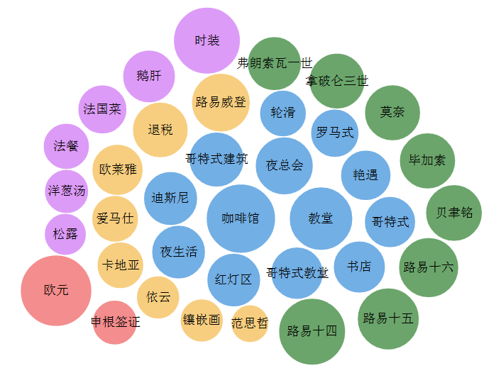
Notes:
http://www.zijiyou.com/region/4e8c0928d0c2ff4823000aab

Slide 5
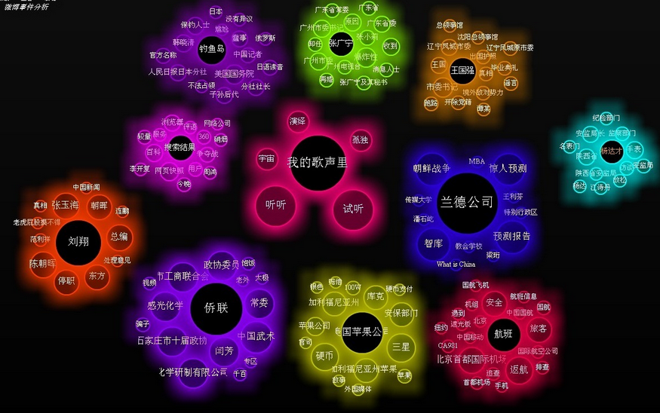
Notes:
拓尔思
http://ww2.sinaimg.cn/large/6be1518fjw1dw7utus2etj.jpg

Slide 6
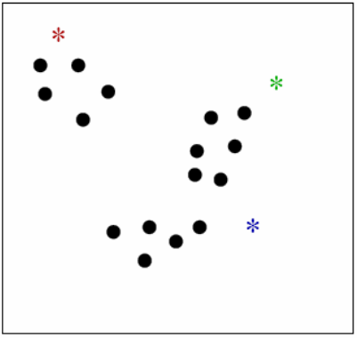
K-Means Algorithm
K = # of clusters (given);
One “mean” per cluster
• Initialize means
(e.g. by picking k samples at random)
• Iterate:
(1) assign each point to nearest mean
(2) move “mean” to center of its cluster

Slide 7
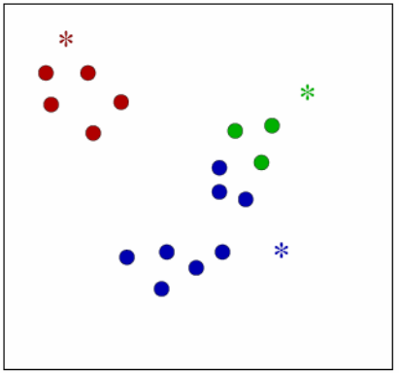
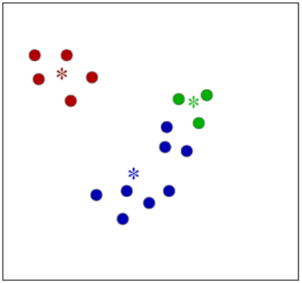
Means Update

Slide 8
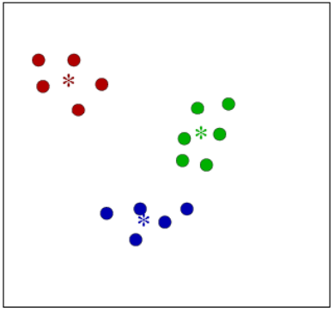
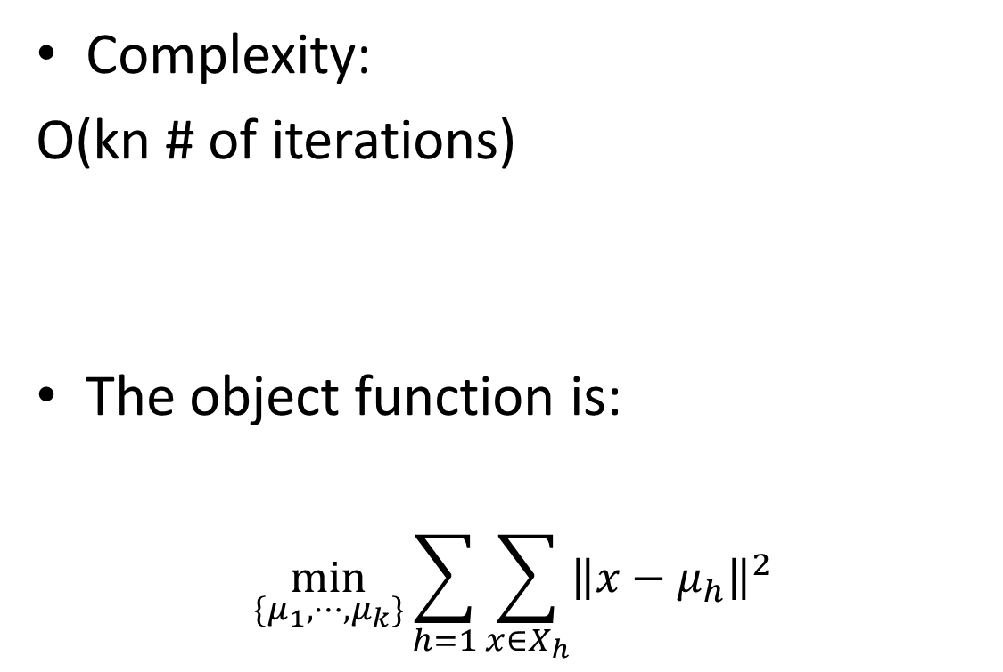
K-Means Algorithm
Complexity:
O(kn # of iterations)
The object function is:
$$\min_{\{μ_{1},⋯, μ_{k}\}}{\sum_{h=1}{\sum_{x∈X_{h}}{{\left\|x−μ_{h}\right\|}^{2}}}}$$

Slide 9
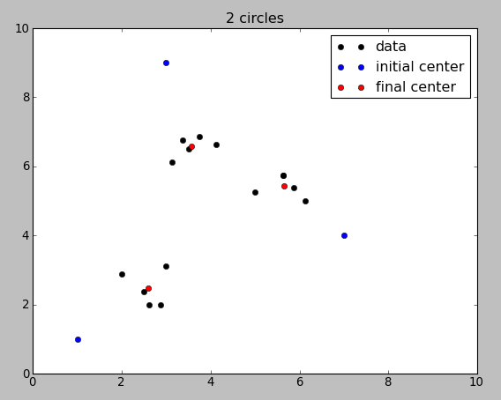
K-Means in Python
Simple k-means code using numpy and matplotlib

Slide 10
Find related words
9.10 weibo corpus sample
Example:
# 钓鱼岛 是 中国 的 #~ 我是 热血 爱国 好青年
这样的 第一个 教师节 也算是 难忘 了 。
100 cases
50：钓鱼岛是中国的
50：教师节

Slide 11
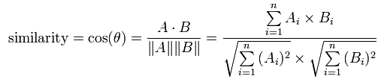
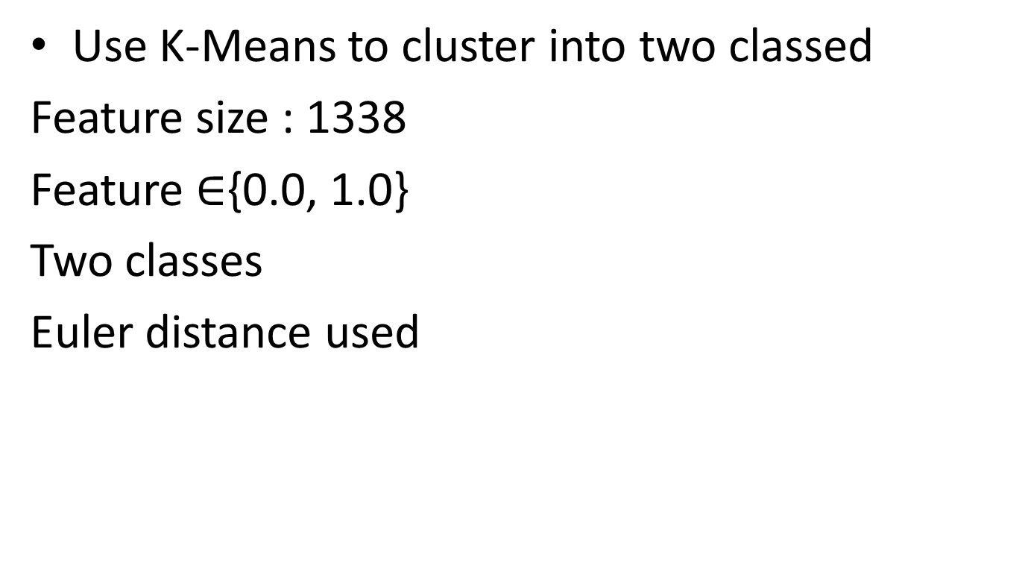
Find related words
Use K-Means to cluster into two classed
Feature size : 1338
Feature $∈${0.0, 1.0}
Two classes
Euler distance used

Slide 12
Find related words
Pycluster used
labels, error, nfound = Pycluster.kcluster(weibo, 2)
Average accuracy: 0.933

Slide 13
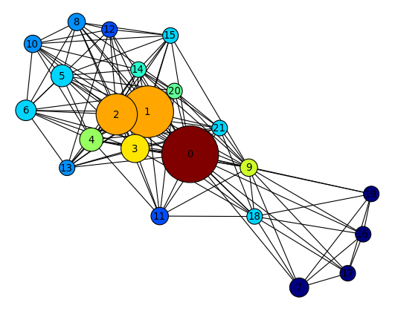
Draw the result
0 钓鱼岛
1 中国
2 日本
3 领土
4 政府
5 我们
6 就是
7 有本事
8 日本人
9 小日本
10 明天
11 国有化
12 谴责
13 问题
14 退让
15 起来
16 垃圾
17 滚蛋
18 历史
19 破烂
20 固有
21 主权

Slide 14
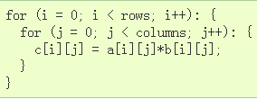
Numpy and matplotlib
NumPy is the fundamental package for scientific computing in Python.
C = A*B

Slide 15
Install them!
1、安装ipython
sudo apt-get install ipython
2、安装matplotlib
sudo apt-get install python-matplotlib
3、启动绘图环境
ipython -pylab
4、安装pycluster
sudo pip install pycluster
5、安装networkx
sudo easy_install networkx

