Slide 1

React JS
Project Based
Lazy Learning
May 2023

Slide 2
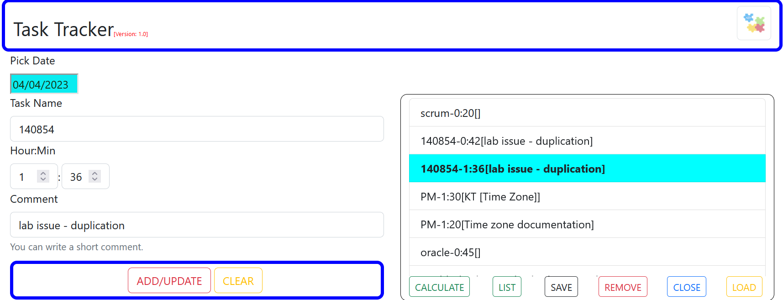
What will we build?

Slide 3
Demo

Slide 4
Overview
Frontend
[React]
Backend
[Java API]
Backend and DB are not the focus of the project. Hence they will be supplied in a containerized form and they can be downloaded from Docker Hub by using the docker-compose file.
DB
[PostgreSQL]
If you want a copy of the source code for the backend, let me know.
The docker-compose is available via slack: #react-hackathon.
Backend will create the required tables: weeks and tasks, under the schema: public, within the DB: tracker.
Backend serves 2 APIs:
Fetch tasks: /tracker/api/get?week=value
Save/update tasks: /tacker/api/save
If you are interested to host your app in the cloud and have your changes deployed automatically, we can do that on the final day.

Slide 5

Setup
Activities | Comment
- Have a GitHub account. - Install Git Bash. | To Keep track of your changes and to serve the CI/CD later [Optional]
Have a Docker hub account | To serve the CI/CD later [Optional]
Install Visual Studio Code [VSCode]. You may add the following extensions afterwards via VSCode sidebar icon: - Auto Close Tag. - Auto Rename Tag. - Color Highlight. - Dev Containers. - Docker. - Prettier-Code Formatter. - ES7+ React/Redux/... - IntelliCode. - Yaml. | https://code.visualstudio.com/download IDE [Recommended]
- Have a google cloud account. - Install gcloud client (cli). | To host our application in a K8 cluster. https://cloud.google.com/ To communicate with gcloud: https://cloud.google.com/sdk/docs/install [Optional]
Have azure devops account | https://dev.azure.com To support CI/CD [Optional]
Have Docker-Desktop | Run backend containers
Have Postman or SoapUI | Verify backend is working properly.
Install if you don’t have: Node.js [LTS] | https://nodejs.org/en/download This should include npm

Slide 6
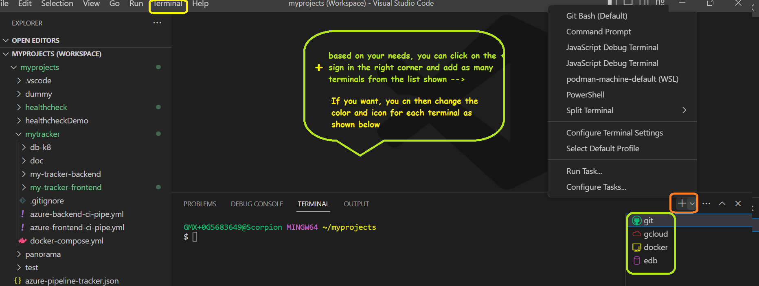
Customize your VSCode Terminals [Optional]

Slide 7
Verify backend working as expected.

Slide 8
27-5/05/2023
27-5/05/2023
Download the backend images. The docker-compose is available via slack: #react-hackathon.
You can download images either by: running cmd from the appropriate directory→ docker-compose up or by selecting the file within VSCode→right click → Compose Up
Backend will create the required tables: weeks and tasks, under the schema: public, within the DB: tracker.
Using postman/SoapUI, you can verify both saving and loading of records.
Backend should serves 2 APIs on your localhost at port: 8500
Save/update tasks: /tacker/api/save
Fetch tasks: /tracker/api/get?week=27-5/05/2023
For testing, a copy of post request is available via slack: #react-hackathon.
- Header required for save: content-type: application/json. - Header required for get: accept: application/json.

Slide 9
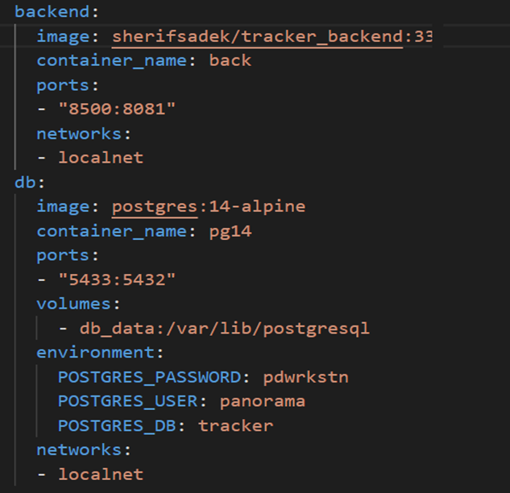
Docker Compose
If you are interested, you can access the local DB through pgadmin at port 5433. Credentials are listed above.

Slide 10
Why React
Front End JS Library
Learn curve not steep
Efficient Design [Virtual DOM]
Usability:
Composed of Components
Widely used.
Facebook supported
Data flow is unidirectional

Slide 11
Kick off our template application
Create a folder called hackathon-react
cd to hackathon-react
//install and run the package
hackathon-react\>npm install create-react/app
hackathon-react\> node ./node_modules/create-react-app/index.js tracker-frontend
OR
//install and run the package [recommended]
hackathon-react\> npx create-react-app tracker-frontend
//start the application
hackathon-react\> npm start

Slide 12
Customize the template project to our needs and get familiar with the project structure.

Slide 13
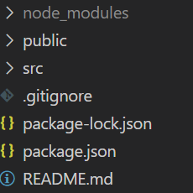
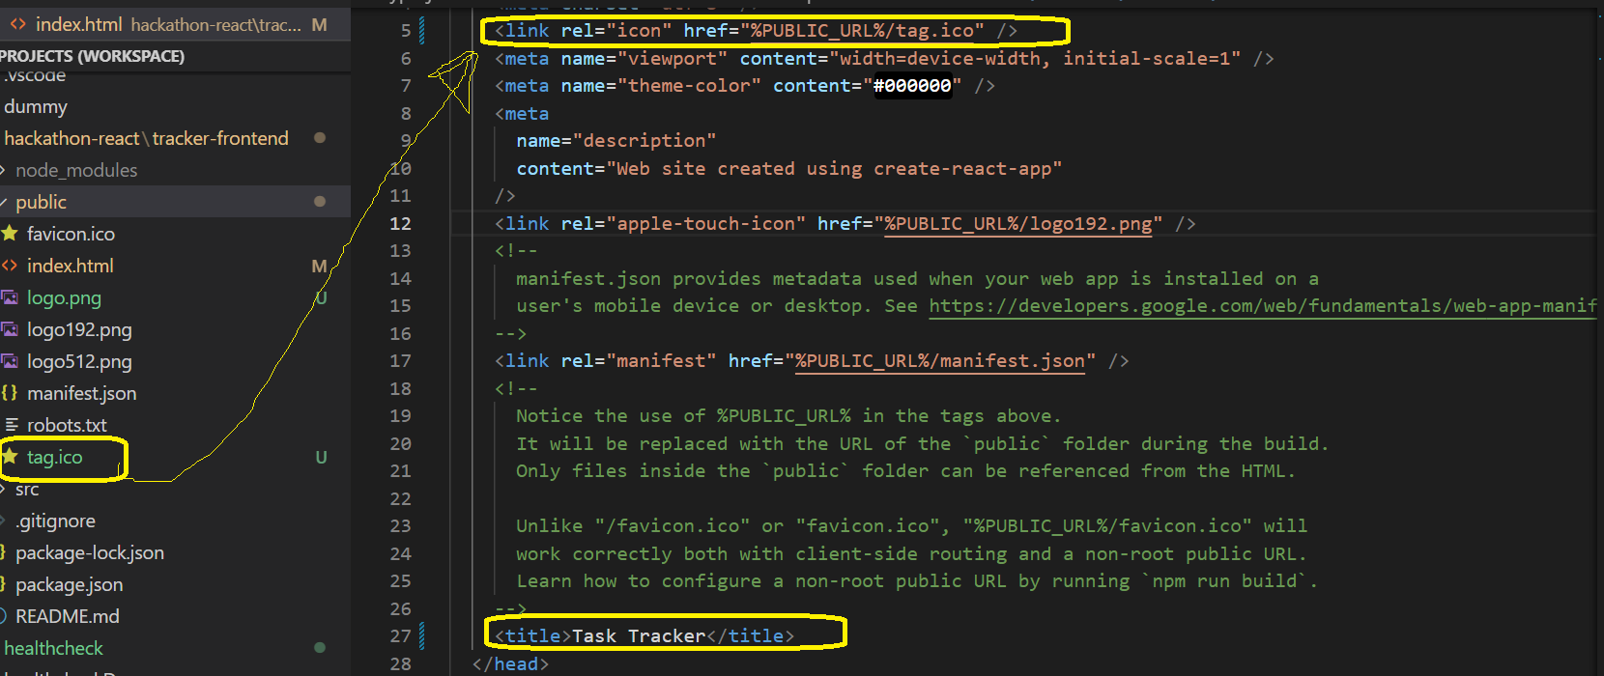
1- Change icon and title.
Component | Importance
node_modules | Like .m2 [libraries]
public | static files
src | Dynamic code
package.json | Like pom.xml [high level]
package-lock.json | Detailed pom.xml file
Open index.html under public and update as shown →
You can get the ico via
slack: #react-hackathon.
Copy the file under public
and remove favicon.ico.

Slide 14

React Component - 1
Create an agnostic Component
Render as Web element
Render as a Mobile element

Slide 15
React Component - 2
function
Create an agnostic Component
Class
Render as Web element

Slide 16
Preparation - 1
VSCode
Cmd Line & IDE
Webpack
Bundle Tool [import/export]
WDS
Web Server[hot deployment]
Babel
Transpiler [convert JS to old version
supported by browsers]
Node.js
Required by other tools
npm [ similar to Maven]
Create a new folder: mytracker
cd to mytracker
Create a local git Repo and synch with github

Slide 17
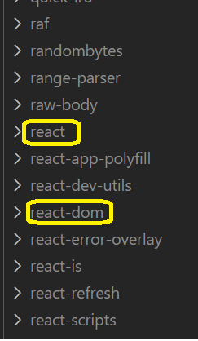
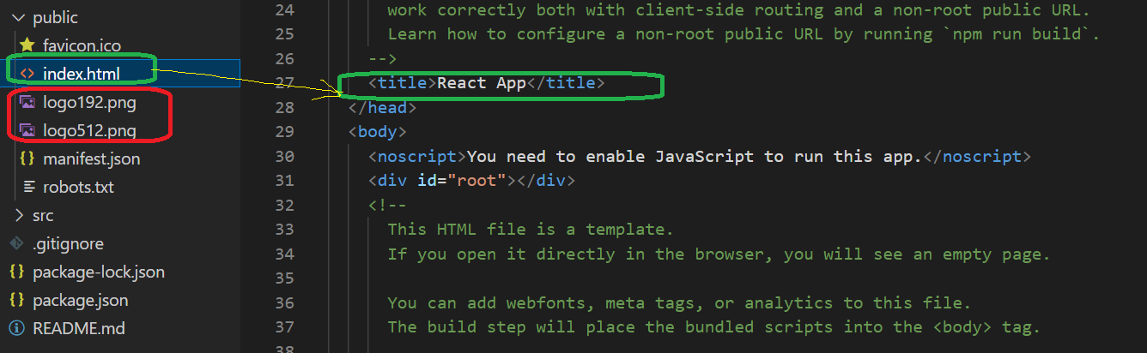
Tour & Customization - 1

Slide 18
Tour & Customization - 1
index.js
Access the root element and render the application’s main component as a child.
Index.html
<div id=“root”/>
App.js
Create the application’s main component

Slide 19
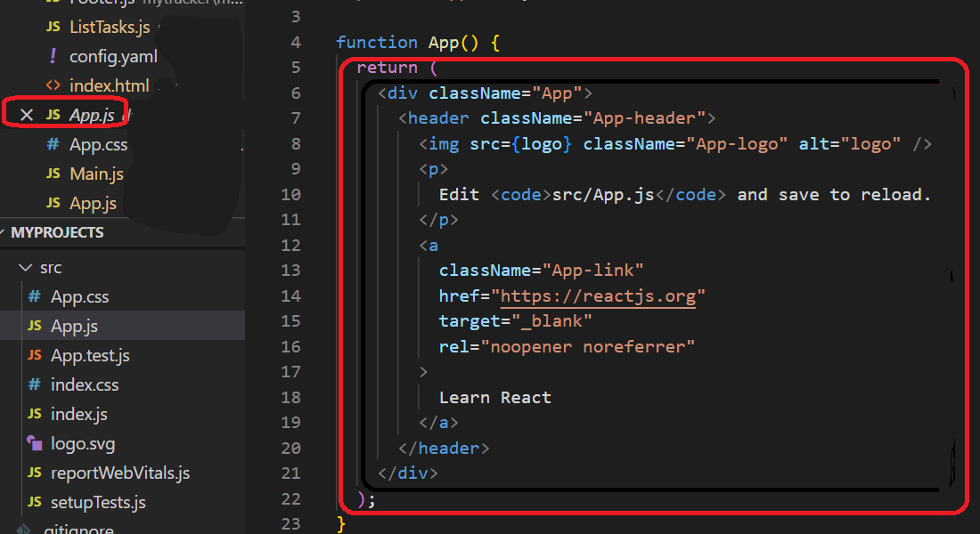
Tour & Customization - 2
~main()

Slide 20
React Component - 3
function
function App ()
{
}
return React.createElement (“h1” , {}, “My Tracker”);
return React.createElement (“h1” , {style:{"color":"yellow", "background-color":"blue"}}, “My Tracker”);
Type: h1
{}: properties
My Tracker: Children: Text, other elements
Import React from ‘react’;
function App ()
{
}
const ver = <span style=
{{'font-size': '0.3em',"color" :"red“ }}>Version: 1.0</span>;
return React.createElement (“h1” , {}, “My Tracker“, ver);

Slide 21
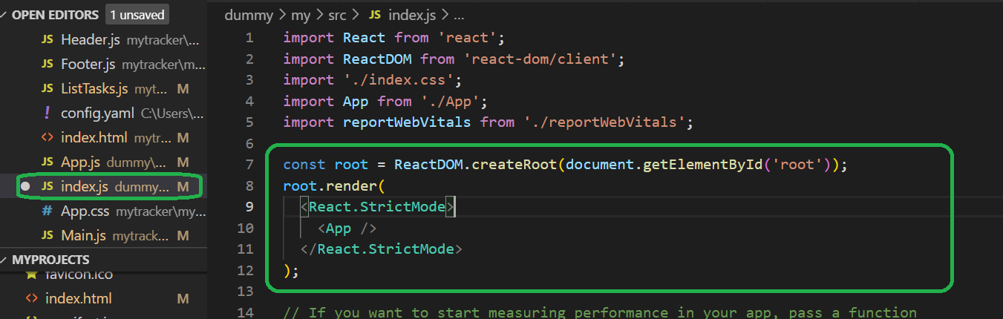
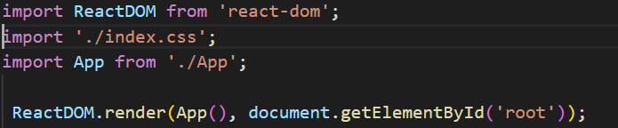
Component - Render
No need to change for Project
For educational purpose
Why <React.StrictMode/>?
Identify deprecate methods, unsafe state changes, potential race conditions, etc..

