Slide 1


React JS
18
Project Based
Lazy Learning
May 2023
Sherif Sadek

Slide 2
Purpose
Lay Foundation
Practice
Axioms
We have limited time
You need to get your hands dirty to learn
You will forget everything two weeks from now unless…
No Expert in the room
Every Day
Recording Link to be posted in slack
Slides Covered to be posted in slack

Slide 3
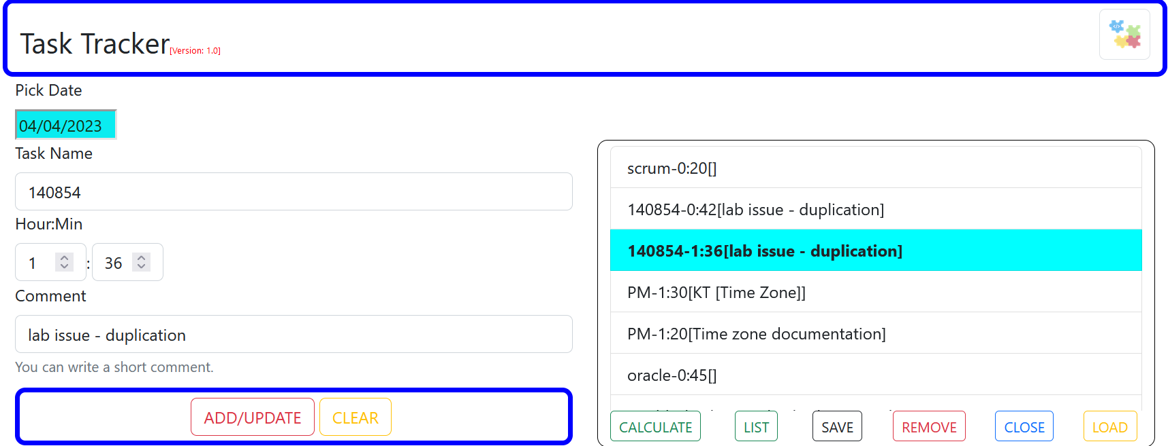
What will we build?

Slide 4
Demo

Slide 5
Overview
Frontend
[React]
Backend
[Java API]
Backend and DB are not the focus of the project. Hence they will be supplied in a containerized form and they can be downloaded from Docker Hub by using the docker-compose file.
DB
[PostgreSQL]
If you want a copy of the source code for the backend, let me know.
The docker-compose is available among: react-hackathon.7z
Backend will create the required tables: weeks and tasks, under the schema: public, within the DB: tracker.
Backend serves 2 APIs:
Fetch tasks: /tracker/api/get?week=value
Save/update tasks: /tacker/api/save
If you are interested to host your app in the cloud and have your changes deployed automatically, we can do that on the final day.

Slide 6

Setup
Activities | Comment
- Have a GitHub account. - Install Git Bash. | To Keep track of your changes and to serve the CI/CD later [Optional]
Have a Docker hub account | To serve the CI/CD later [Optional]
Install Visual Studio Code [VSCode]. You may add the following extensions afterwards via VSCode sidebar icon: - React Developer Tools - Auto Close Tag. - Auto Rename Tag. - Color Highlight. - Dev Containers. - Docker. - Prettier-Code Formatter. - ES7+ React/Redux/... - IntelliCode. - Yaml. - Blackbox | https://code.visualstudio.com/download IDE
- Have a google cloud account. - Install gcloud client (cli). | To host our application in a K8 cluster. https://cloud.google.com/ To communicate with gcloud: https://cloud.google.com/sdk/docs/install [Optional]
Have azure devops account | https://dev.azure.com To support CI/CD [Optional]
Have Docker-Desktop | Run backend containers
Have Postman or SoapUI | Verify backend is working properly.
Install if you don’t have: Node.js [LTS] | https://nodejs.org/en/download This should include npm

Slide 7
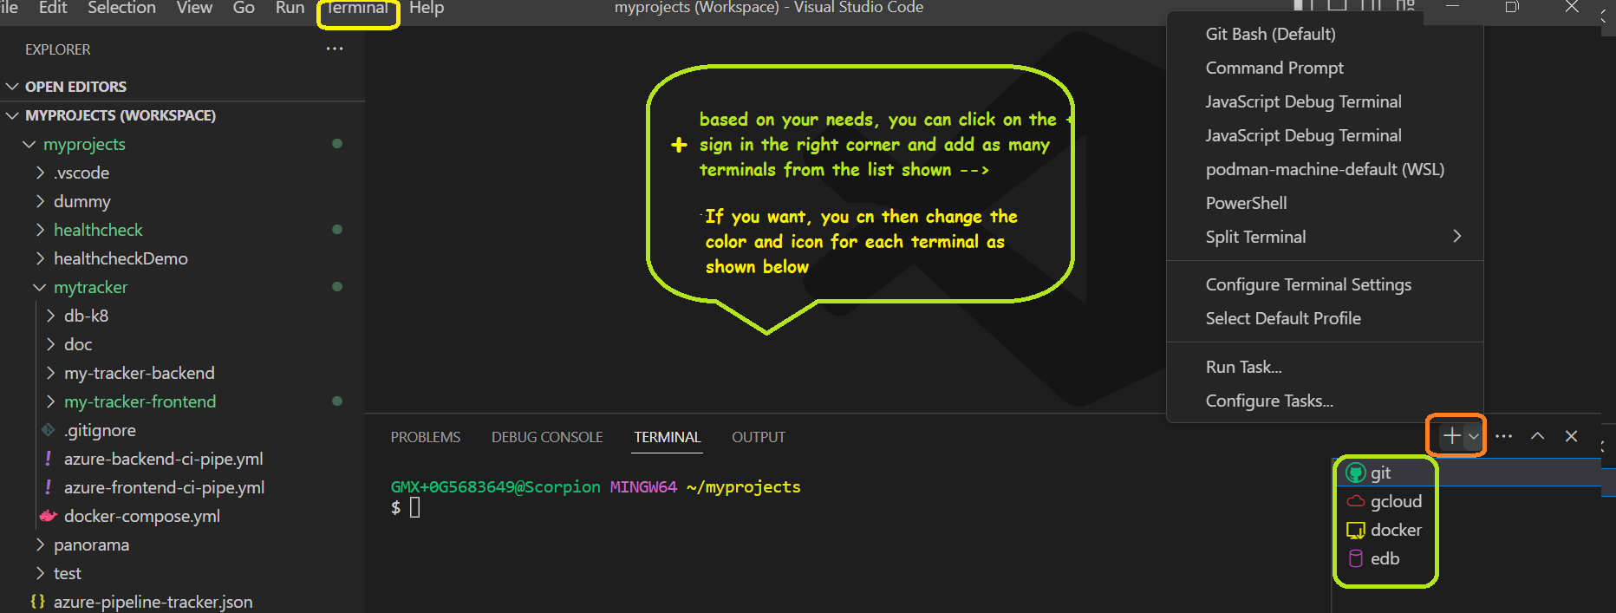
Customize your VSCode Terminals [Optional]

Slide 8
Verify backend working as expected.

Slide 9
27-5/05/2023
27-5/05/2023
Download the backend images. The docker-compose is available among: react-hackathon.7z
You can download images either by: running cmd from the appropriate directory→ docker-compose up or by selecting the file within VSCode→right click → Compose Up
Backend will create the required tables: weeks and tasks, under the schema: public, within the DB: tracker.
Using postman/SoapUI, you can verify both saving and loading of records.
Backend should serves 2 APIs on your localhost at port: 8500
Save/update tasks: /tacker/api/save
Fetch tasks: /tracker/api/get?week=27-5/05/2023
For testing, a copy of a POST request is available among: react-hackathon.7z. The file is called test.json
- Header required for save: content-type: application/json. - Header required for get: accept: application/json.

Slide 10
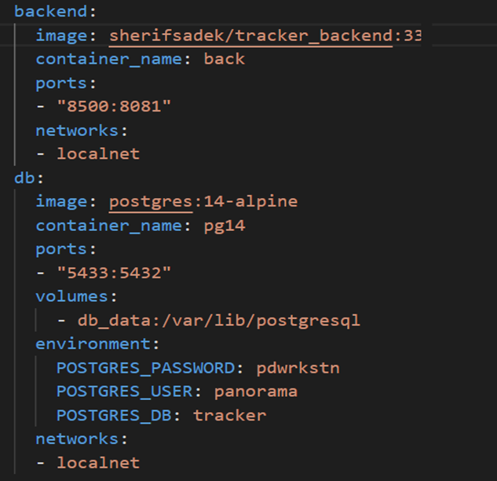
Docker Compose
If you are interested, you can access the local DB through pgadmin at port 5433. Credentials are listed above.
Backend is accessible at port: 8500

Slide 11

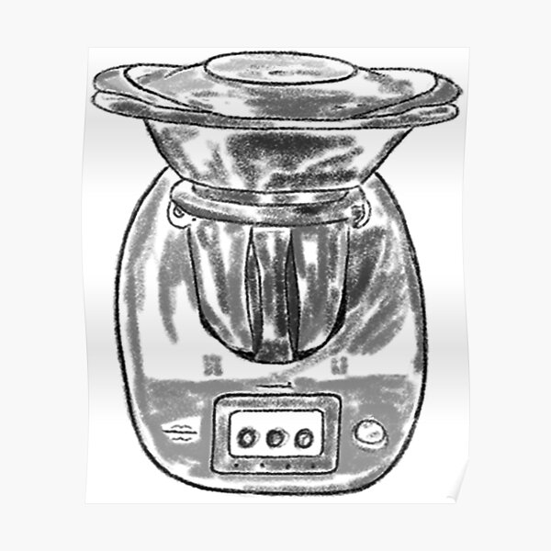


React?
Front End JS Library
Learn curve not steep
Efficient Design [Virtual DOM]
Widely used: Facebook supported
Usability: Composed of Components
Data flow is unidirectional
A
B
C
D
E
F

Slide 12
Kick off our template application
Create a folder called hackathon-react
cd to hackathon-react
//install and run the package
hackathon-react\>npm install create-react-app
hackathon-react\> node ./node_modules/create-react-app/index.js tracker-frontend
OR
//install and run the package [recommended]
hackathon-react\> npx create-react-app tracker-frontend
cd to tracker-frontend
//start the application
tacker-frontend\> npm start

Slide 13
Customize the template project to our needs and get familiar with the project structure.

Slide 14
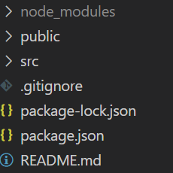
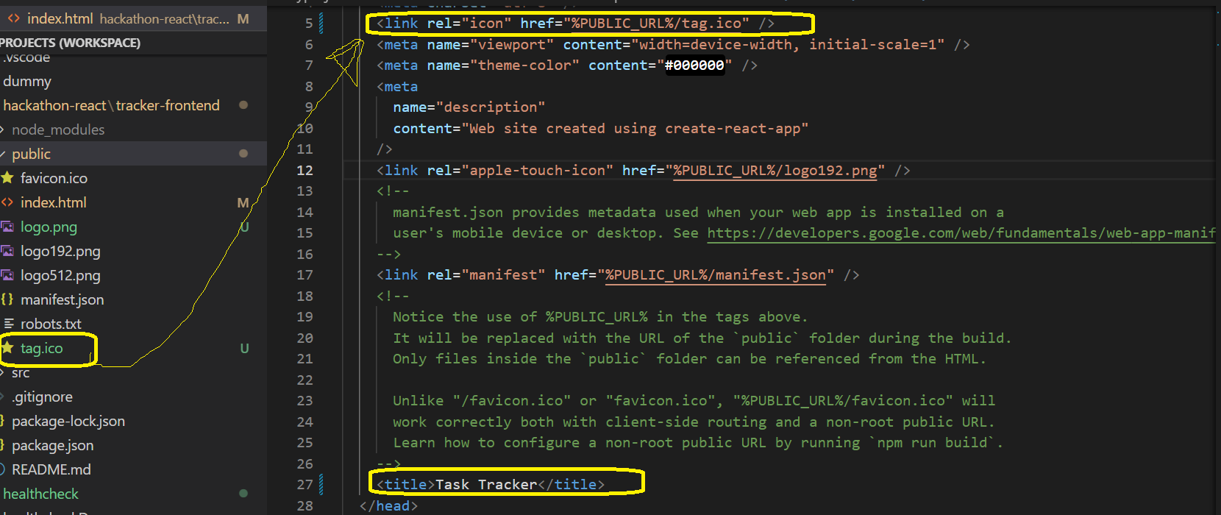
1- Change icon and title.
Component | Importance
node_modules | Like .m2 [libraries]
public | static files
src | Dynamic code
package.json | Like pom.xml [high level]
package-lock.json | Detailed pom.xml file
Open index.html under public and update as shown →
Get the tag.ico file from
react-hackathon.7z
Copy the file under public
and remove favicon.ico.

Slide 15
2- push your code to GitHub.
[Optional]
There are many ways to do:
One way would be to create a new repo on GitHub: hackathon-react
Open git terminal
Change directory to hackathon-react
You can copy from createRepo
[react-hackathon.7z] Update the account-name first
//run the following echo "# hackathon-react project" >> README.md //create a readme file git init //initialize local repo git add . –A //add all changes to staging area starting with the current directory. git commit -m “initial commit" //commit all staged items git remote add origin git@github.com:account-name/hackathon-react //define remote repo git branch -M main //rename the master branch to main [you can keep master though] git push -u origin main //push to main [later, git push Is enough as you have defined the upstream branch using –u]
From now on, you can deliver your changes anytime you please. Will not remind you again.

Slide 16
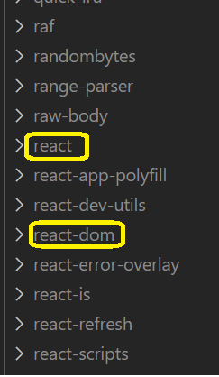
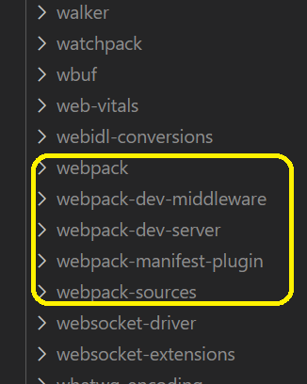
The most important libraries
we will use
Explicitly via import
Implicitly: required to use import
Bundling tool helping us to use “import“ as it searches within node_modules. Otherwise, we need to specify location of libraries explicitly.

Slide 17
Do we need Node.js, webpack or VSCode to build a React app?
The answer should be the same if I ask you, do we need eclipse, maven or hibernate to build a Java app?
Let’s have a simple example to illustrate how this can be done and understand a bit about Components.

Slide 18
Change directory to hackathon-react
Create a folder test
Create an html file within that folder as below
<!doctype html>
<head>
<title>Test</title>
<link type="text/css" rel="stylesheet" href="app.css"/>
<script src="https://unpkg.com/react@16/umd/react.production.min.js"></script>
<script src="https://unpkg.com/react-dom@16/umd/react-dom.production.min.js"></script>
</head>
<body>
<div id="root"/>
<script src="./app.js"></script>
</body>
</html>
You can copy links from simple_react_links.js under snippets
Create app.css file in the same folder as below [decoration step]
header :
{
color: red;
}
Create app.js file in the same folder as below
const h1Element = React.createElement('h1', {className:'header'},'A Simple React Example');
h1: //type - The element I want to create
{}: //properties of the element to create
A Simple React Example: //Children: Text, other elements
Where to add this new element to our html?
Append the following to app.js
View html in the browser
ReactDOM.render(h1Element, document.getElementById('root'));

Slide 19


React /ReactDOM ?
Create an
environment
agnostic element: React.createElement
Render as DOM element: ReactDOM.render
Render as a Mobile element
Render as a …
function
How to create an
environment
agnostic element
Class

Slide 20
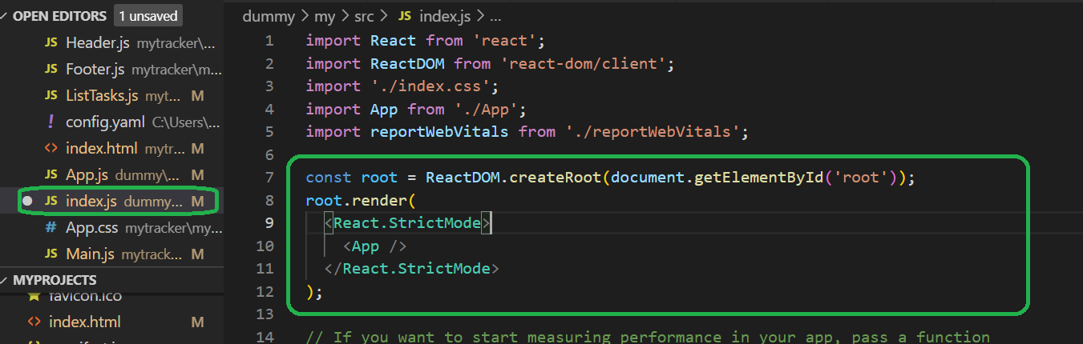
Check Our Project
index.js
Access the root element and render the application’s main component as a child.
Index.html
<div id=“root”/>
-
X X X
App: a function component that will create a react element. It refers to our project main component. This will be our focus.
Thus, we don’t need to be bothered by index.html and index.js anymore.
What we see highlighted above is an enhanced flavor of what we did earlier. It’s just rendering - let’s verify.
Comment the highlighted part, add the snippet below and test:
ReactDOM.render(App(), document.getElementById('root')); Don’t forget to have: import ReactDOM from 'react-dom';
Why <React.StrictMode/>?
Add checks to development phase such as identify deprecate methods and unsafe state changes

Slide 21
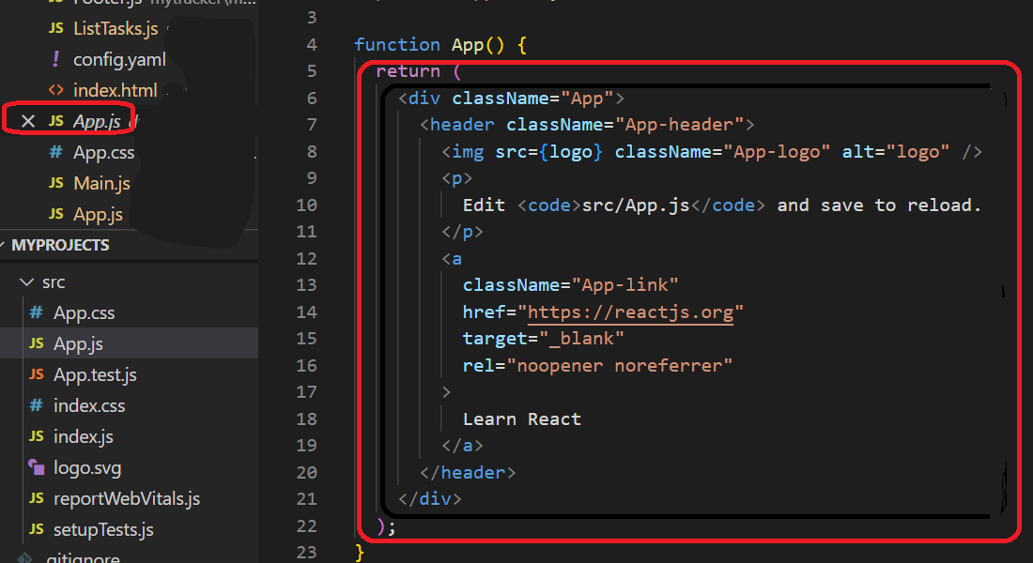
Check Our Project - Continue
Main Component
X X X X X
X X X X X
Replace App() body by
return React.createElement('h1', {className:'header'},'A Simple React Example');
update app.css file and add
header :
{
color: red;
}

Slide 22
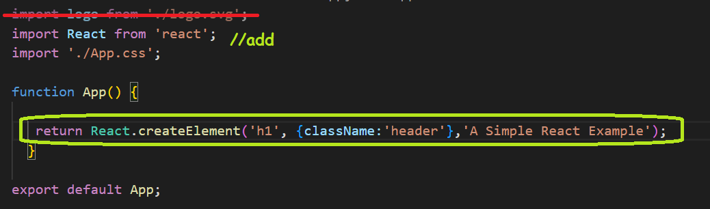
Check Our Project - Continue
Main Component
This is just for understanding how things are running, but we don't need to bother with this basic approach to create and render components
So, it’s ok now to revert the index.js to its original code.

Slide 23
What about <App/>? We are using it rather than using App().

Slide 24

Check Our Project - Continue
return React.createElement('h1', {className:'header'},'A Simple React Example');
JSX does the trick of simplifying the code to a format we are used to, html, and uses React.createElement under the hood.
JSX
h1 Element
return (<h1 className='header'>A Simple React Example</h1>);
ReactDOM.render(App(), document.getElementById('root'));
JSX handles our customized component as App, as well as html ones as h1
JSX
root.render(<App/>);
Customized
Component

Slide 25
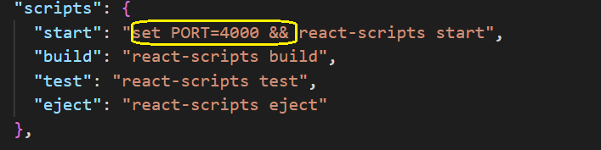
Before we start building the project, we want to run the server at a different port: 4000
Stop the server, ctr-c
Update package.json
Start the server, npm start

Slide 26
Recap
React
Library
Design
Data follow - unidirectional
Efficient [Virtual DOM]
Development
create-react-app
Hot Deployment Server
Node.js?
Transpiler
npm
Webpack
Indirect usage
libraries
Standard folder structure
node_modules
public
package
src
React
ReactDOM
images
html
Create react element
Render element
Function
Class
JSX

Slide 27
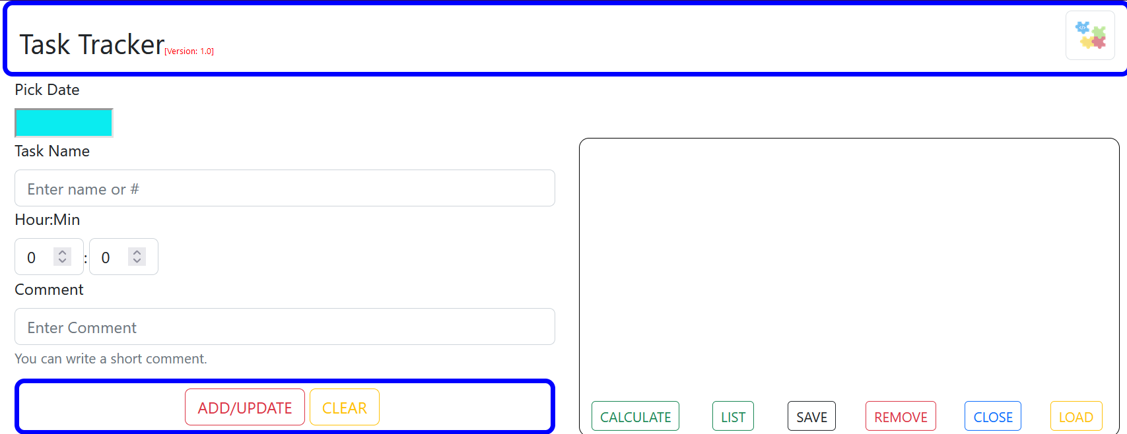
Our Project - Layout
Header
Main
ListTasks
Index.js
Note: A better design would have been
App.js
Main.js
Header.js
X
Header.js
ListTasks.js

Slide 28
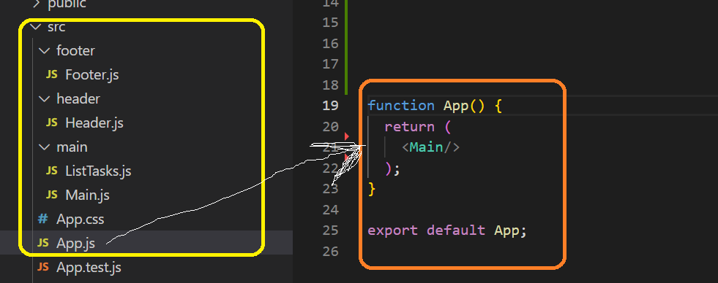
Our Project - Layout
Build folder Structure.
Update App.js
//Don’t forget to import Main import Main from './main/Main';

Slide 29

Our Project - Header
Build Header.js
const Header = (props) => {
} export default Header;
Write method using the => approach for succinctly
props: think of as an object holding the data passing from parent component to Header.
Export default to be able to import this method within other files.
Update Main.js and include Header in Main.js
//update Main.js
function Main() {
}
export default Main;
OR
//update Main.js
const Main =() =>{
}
export default Main;
//update Main.js and add Header
import Header from './header/Header';
function Main() {
return (<Header/>);
}
export default Main ;

Slide 30
Our Project - Header
Override App.css by copying the one available among: react-hackathon.7z. This is not our focus, so let’s copy it over.
const Header = (props) => {
const ver = <span className="version">[Version: {props.version}
]</span>;
return(
<h3 className='topParag'>Task Tracker{ver}</h3>
);
}
export default Header;
version: Value is passed from the parent component
const: for variables, we usually use const or let. You can’t override a const variable.
{ver}: is defined as a variable to simplify our tag. To include JS code within tags, use {}.
<h3>: as an html tag is defined in lower cap to distinguish from Component.
Test your changes
//update Main.js
function Main() {
return ( <Header version = '1.0'/> ); //pass the version
}

Slide 31
Our Project - Header
Will use Bootstrap: Install react-bootstrap & bootstrap css
Change directory to tracker-frontend
npm install bootstrap
npm install react-bootstrap
//add imports to Header.js
import 'bootstrap/dist/css/bootstrap.css';
import Container from 'react-bootstrap/Container';
import Image from 'react-bootstrap/Image';
import Row from 'react-bootstrap/Row';
import Col from 'react-bootstrap/Col';
//update your Header.js return ()
Test your changes
return(
<Container className={props.className}>
<Row>
<Col>
<h3 className='topParag'>Task Tracker{ver}</h3>
</Col>
<Col className="right">
<Image src="logo.png" className="logo" />
</Col>
</Row>
</Container>
);
What’s missing?
pass in className: 'general-border'
copy logo.png from: react-hackathon.7z and paste it under the public folder

Slide 32
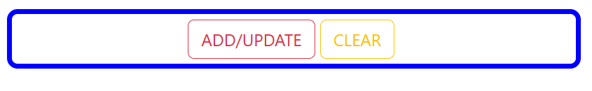
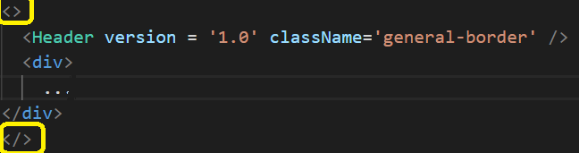
Our Project – Main-Controls
//add imports to Main.js
import Button from 'react-bootstrap/Button';
import 'bootstrap/dist/css/bootstrap.css';
//Update Main()
Test your changes
What’s going wrong?
const Main = () => {
return (
<Header version = '1.0' className='general-border' />
<div className = 'general-border center'>
<Button type=“submit” className="text-uppercase btn-outline-
danger gap" variant='none'> add/update
</Button>
<Button type=“reset” className="text-uppercase btn-outline-
warning" variant='none’ > clear
</Button>
</div>
); } export default Main;
Main() Error
<>: return must return one element only. One way is to use <> to wrap elements. You may use <div>or other suitable html wrapping tag instead.

Slide 33
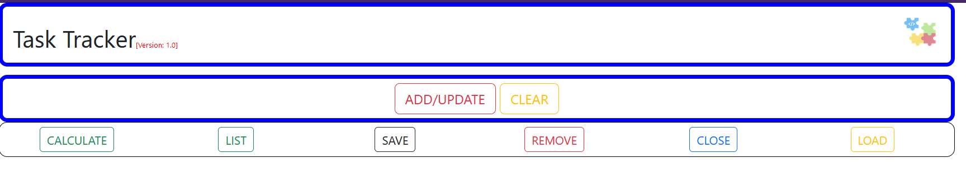
Our Project – List_Tasks
Add Controls
//Add your ListTasks()
Copy your Main.js to your ListTasks.js and customize it to meet our needs
You can get a copy of current ListTask.js, ListTasks-1.js
Update your Main.js to add ListTasks and pass ClassName: list-border
Test your changes

Slide 34
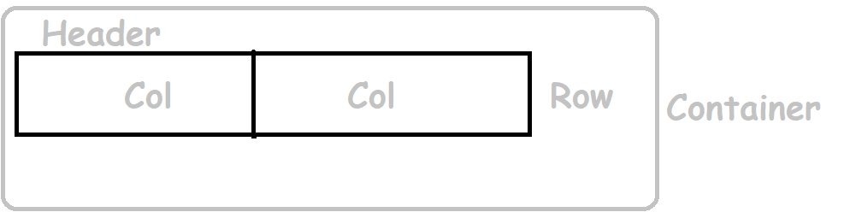
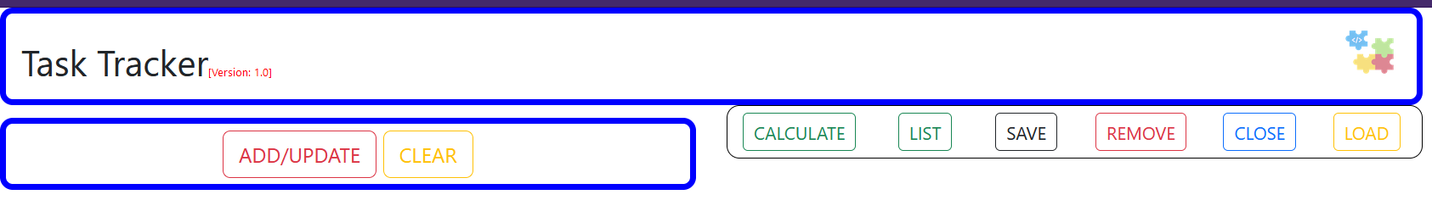
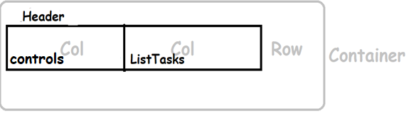

Our Project – Main
Build Layout [side by side]
//Update Main() – build layout and add liskTasks component
return (
<Container>
<Header version = '1.0' className='general-border' />
</Container>
);
<Row>
<Col>
</Col>
<Col>
</Col>
</Row>
<div>
….
</div>
<ListTasks className = "list-border"/>
Notice that we have removed <> and it’s sufficient to use <container>
Don’t forget to add the required imports.
Test your changes

Slide 35
Add Entry Elements

Slide 36
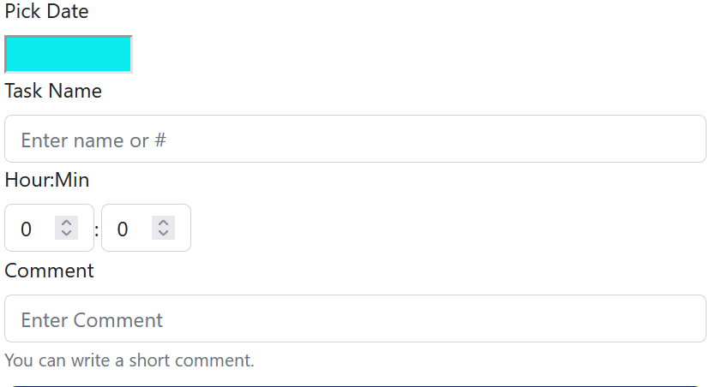
Our Project – Main
Add Entry Elements
//Update your Main() - Add Date Picker
<Row>
<Col>
<Form>
<Form.Group >
<Form.Label>Pick Date</Form.Label>
<DatePicker className='datePicker' />
</Form.Group>
</Form>
<div className='general-border center'>
//install required library
npm install react-datepicker
//Update your Main() - Add imports
Test your changes
import DatePicker from 'react-datepicker';
import 'react-datepicker/dist/react-datepicker.css';
import Form from 'react-bootstrap/Form’;

Slide 37
Our Project – Main
//Update your Main() - Add Task Name
<Form.Group controlId="formTaskName">
<Form.Label>Task Name</Form.Label>
<Form.Control type="text" placeholder="Enter name
or #" />
</Form.Group>
</Form>
Test your changes

Slide 38
Our Project – Main
//Update your Main() - Add Hour:Min
<Form.Group controlId="formTaskHour" className="control-inline">
<Form.Label className="control-block label">Hour:Min</Form.Label>
<Form.Control
type="number"
step="1"
min="0"
max="24"
className="control-inline"
defaultValue='0'/>
</Form.Group>
<Form.Group controlId="formTaskMin" className="control-inline">
<Form.Label className="control-dot">:</Form.Label>
<Form.Control
type="number"
step="1"
min="0"
className="control-inline"
max="59"
defaultValue = '0' />
</Form.Group>
</Form>
Better to write yourself.
Still, you can copy from hour_min.js under snippets
Test your changes

Slide 39
Our Project – Main
//Update your Main() - Add comment
<Form.Group controlId="formComment">
<Form.Label>Comment</Form.Label>
<Form.Control type="text" placeholder="Enter Comment" />
<Form.Text className="text-muted">
You can write a short comment.
</Form.Text>
</Form.Group>
</Form>
Test your changes

Slide 40
Data Binding & Events

Slide 41
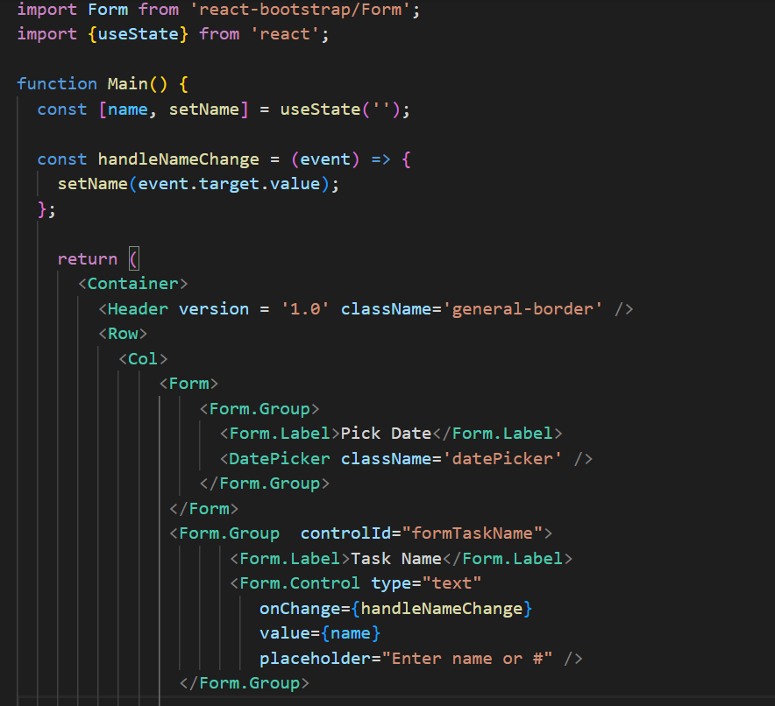
Our Project – Main
Data Binding
Define a 1-way data binding using state Variables via useState()
Take Task Name as an example.
Hook
const [name, setName] = useState('');
state variable
Method to update Variable
Initial value
Test your changes

Slide 42
Our Project – Main
Data Binding
The input name field is linked to name.
If you type any character, you can’t as the field value is bounded to the state name.
State name is ’’ and it hasn’t changed.
If setName() is called somehow with a value X, then the input field will get repainted and will display X.

Slide 43
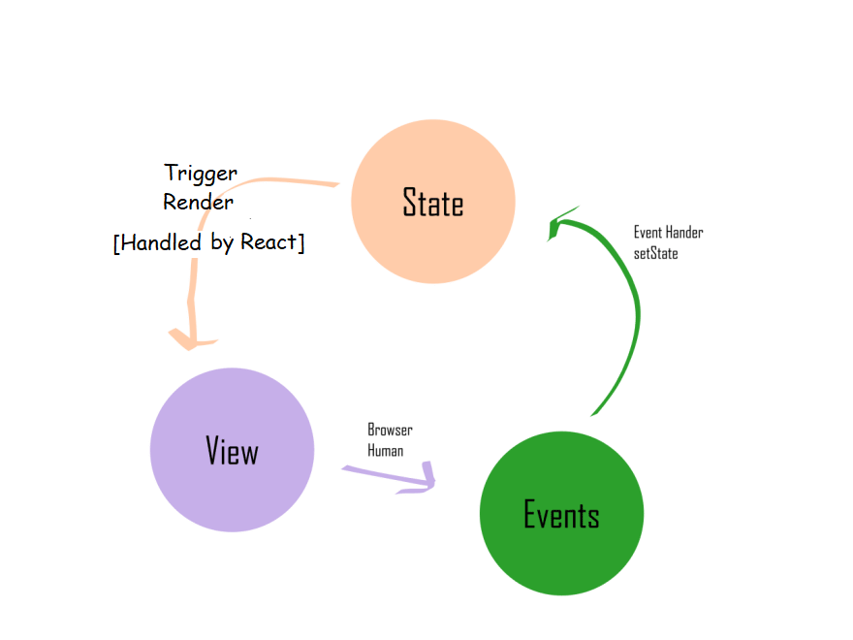
Our Project – Main
To manipulate form elements, define a 2-way data binding.
setName (‘React’);
Can we call setName(‘React’) directly within the Code

Slide 44
Our Project – Main
//Update your Main() - handle DatePicker
//update the DatePicker Element
<Form>
<Form.Group>
<Form.Label>Pick Date</Form.Label>
<DatePicker className='datePicker'
selected={selectedDate}
onChange={date => handleDateChange(date)}/>
</Form.Group>
</Form>
//add the useState
const [selectedDate, setSelectedDate] = useState('');
//add handleDateChange
const handleDateChange = (date) => {
setSelectedDate(date);
};
Test your changes

Slide 45
Recap
import Child from ./…;
Create Components Tree
<Child v1 = ‘value’/>
Index
Header
App
Main
ListTasks
Child
props
const Child = ( ) =>
{
}
Extra libraries
alert(props.v1);
npm
<h1> {props.v1} </h1>
Bootstrap
X
Date Picker
props.v1 = ‘x’;
//read Only
Entry Elements
; export default Child;
OR
props
Form
Form.Group
function Child ( )
{
}
Form.Group
Const x = 9;
Form.Label
X
Form.Control
updateProject(‘no way’);
//Continuous request
// for repaint
Data Binding
value = {project}
return (
//elements to draw
);
Hooks
onChange: handleChange
<div>
1
handleChange()
<h1> {x} </h1>
<h2> ???? </h2>
useState
variable: project
</div>
Initial value: panorama
R
Function handle to update: updateProject
export default Child;

Slide 46
Pass Form Data

Slide 47
Our Project – Main/ListTasks
//pass Data to ListTasks – Just name and Date for time being
//Update Main()
<ListTasks className = "list-border" name = {name} week= {selectedDate}/>
//Update ListTasks()
const ListTasks = (props) => {
alert(props.name);
return (
Test your changes?
What do you notice if you type?
Component Life Cycle States
Pop is displayed in the following cases: -page Reload -name changes -date changes
Initialized
Before Rendering
Our Case – 1 Scenario
Mounted
Directly after being rendered
When name state changes
Updating
When prop or states change
Main() repaint including children such as ListTasks
Unmounted
Component removed from the page
Alert is displayed

Slide 48
Our Project – Main/ListTasks
//pass Data to ListTasks – Continue
//Update ListTasks()
Hook
//add import
import {useEffect } from 'react’;
//with the change below, it will update only when component is mounted and later when name value changes. We can prevent the mount action if needed and we will do in few slides ahead.
const ListTasks = (props) => {
useEffect(() => {
alert(props.name); } , [props.name]);
return (
useEffect() controls execution. In the above case, it will be executed upon page reload, i.e when component is mounted and when the condition changes. The condition here is props.name

Slide 49
Our Project – Notes
Based on Observations
For 2-Way Data Binding, any change to an input field would be applied to the corresponding state
Repaint of a component will lead to its children repaint.
Repaint will increase when we consider Comment, hour and min entries we haven’t handled so far. Use UseEffect to control what got executed.
We need to create a const with state handling for each element
Children are repainted without any interference as one’s click
This is a training project, let’s handle other elements in a different way.

Slide 50

Our Project – Other Approach
Controlled update
//update Form tag
<Form onSubmit={update} >
const update = (event) =>
{
//prevent page reload
event.preventDefault();
updateValues(event);
}
//compile values via an object rather than sending each element separately
//myKey will be vital in update process [might not discuss in hackathon though]
const [task, setTask] = useState({name:'',hour:0,min:0,comment:‘’, myKey: 0});
const updateValues = (event)=>
{
task.name = name;
task.hour = event.target.formTaskHour.value;
task.min = event.target.formTaskMin.value;
task.comment = event.target.formTaskComment.value;
}
<ListTasks className = "list-border“ week ={selectedDate} task = {task}/>
//Update ListTasks() – you can keep or remove useEffect()
const ListTasks = (props) => {
alert(props.task.name);
return (
No popup if you click on Add/Update.
Call setTask(task), so React can detect changes
and trigger repaint.

Slide 51
Our Project – Other Approach
Controlled update
Fix Issue
const update = (event) =>
{
//prevent page reload
event.preventDefault();
updateValues(event);
setTask(task);
}
Test your changes
React wont realize an object change. It does shallow comparison, i.e. reference comparison.
const updateValues = (event)=>
{
const task = {name:'',hour:0,min:0,comment:'',myKey:0};
task.name = name;
task.hour = event.target.formTaskHour.value;
task.min = event.target.formTaskMin.value;
task.comment = event.target.formTaskComment.value;
return task;
}
Create a new Task Object
const update = (event) =>
{
//prevent page reload
event.preventDefault();
const newTask = updateValues(event);
setTask(newTask);
}
Test your changes

Slide 52
Our Project – Other Approach
Fix Issue
Controlled update
Popup displayed on page reload [component mount] and while changing a task name. We will update the code to make it only changes upon task change. While mounting, task.name is blank so it popup would not be displayed
Test your changes
//change purpose: don’t display unless the task changes only //and not on mounting
const ListTasks = (props) => {
useEffect(() => {displayAlert();},[props.task]);
const displayAlert = () =>
{
if (props.task.name.trim().length > 0)
{
alert(props.task.name);
}
}

Slide 53
Debugging

Slide 54
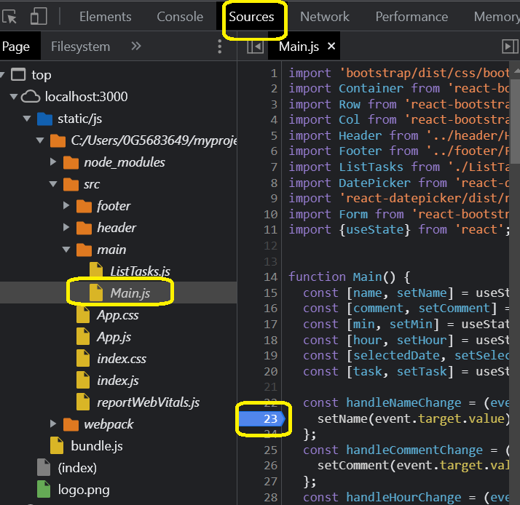
Our Project – Debug
You can debug using browser – Developer Tools

Slide 55
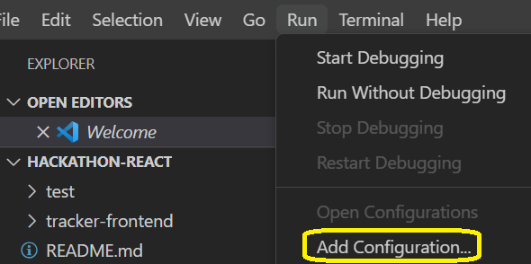
Our Project – Debug
Debugging via VSCode
Pre-Requisite: extension [React Developer Tools].
Assume you have the folder, hackathon-react or tracker-frontend as the opened folder in your IDE, , do the following:
Select Node.js
Update launch.json
"configurations": [
{ //debug using chrome. However, //you can use “firefox” instead. Vscode
//may prompt you to install required
//debugger extension.
"type": "chrome",
"request": "launch",
"name": "Debug CRA",
"url": "http://localhost:4000",
"webRoot": "${workspaceFolder}",
"sourceMapPathOverrides": {
"webpack:///src/*": "${webRoot}/src/*"
}}]
Better to copy snippet from [launch.js]
Stop the server if it’s running [Recommended]
npm start
Add Breakpoint(s)
F5 [Start Debugger]

Slide 56
Our Project – Validation
[Simple Validation [Opportunity to practice debugging ]
//Update Main()
const update = (event) =>
{ //prevent page reload
event.preventDefault();
const myTask = updateValues(event);
if (validate (task))
{
setTask (myTask);
}}
const validate = (task) =>
{
let result = true;
let error = 'Missing info:';
if (task.name.trim() === '')
{
result = false;
error += ' [Task Name]';
}
if (task.hour === 0 || task.min === 0)
{
result = false;
error += ' [Time Spent]';
}
if (selectedDate === '')
{
result = false;
error += ' [Date]';
}
if (!result)
{
alert(error);
}
return result;
}
Better to copy code and not write from scratch. [validate.js]
Please check your changes and make sure you should get an error if no value is supplied for either date, time or name.
//Possible Fix for hour and min to work as //expected
if (task.hour === ‘0’ && task.min === ‘0’)

Slide 57
Pile Tasks and Display

Slide 58
Our Project – Pass Week
//both inputs
4/3/2023
4/9/2023
// should yield
3-9/4/2023
npm install moment //install library from cmd line under tracker-frontend
Const [week, setWeek] = useState(‘’); //define const with state
//Update Main() – add import
import moment from "moment";
//Update Main() – update handleDateChange and value to pass
const handleDateChange = (date) => {
const startOfWeek = moment(date).startOf('isoWeek');
const endOfWeek = moment(date).endOf("isoWeek");
const weekText = startOfWeek.format("D") + "-" + endOfWeek.format("D") + "/" +
startOfWeek.format("MM") + "/" + startOfWeek.format("YYYY");
setSelectedDate(date);
setWeek(weekText);
};
Do you need the code to be shared?
<ListTasks className = "list-border" task = {task} week= {week}/>
//Update ListTasks() to verify it works properly
const displayAlert = () =>
{
if (props.task.name.trim().length > 0)
{
alert(props.week);
}
}
Test your changes

Slide 59
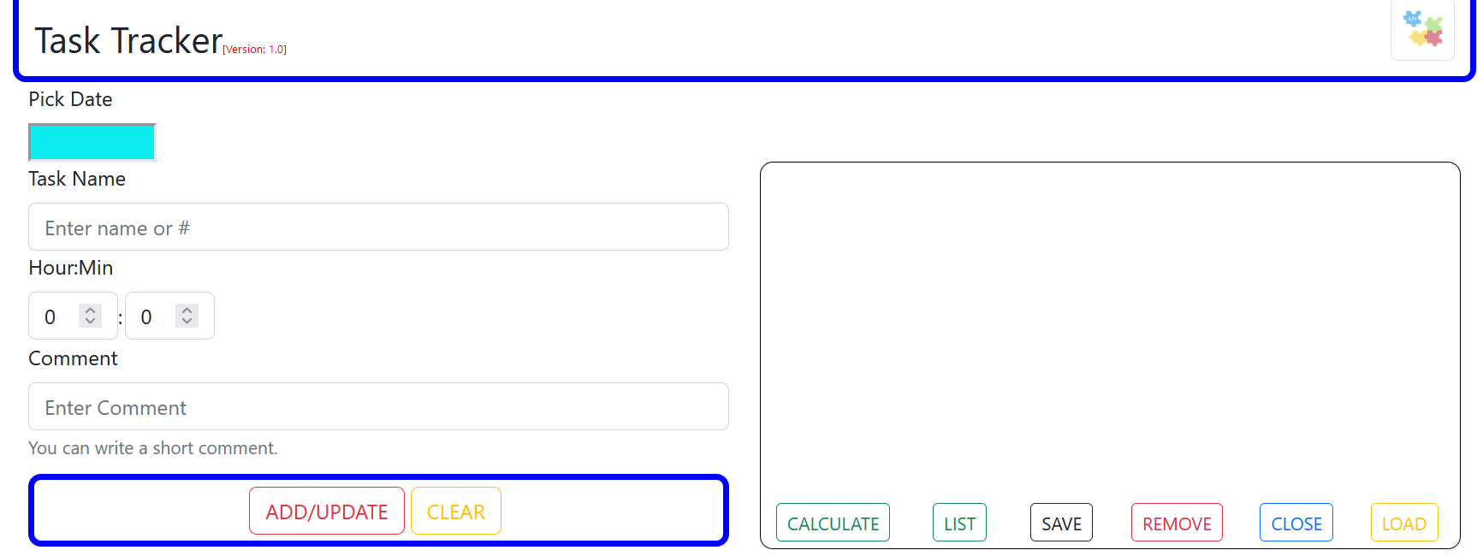

Recap
value = {name}
onChange= handleNameChange
A key to understand what’s going on and resolve bugs is to play with Debugger.
controlId = TaskCommentId
//stateful constants
const [name, setName] = useState (‘’) ;
const [Comment, setComment] = useState (‘’) ;
Type in Task Name
Fire event
handleNameChange(event)
setName()
Repaint Main
[execute Main]
Repaint ListTasks
[execute ListTasks]
To control execution of code like x()
[useEffect( x() , [Condition Change])]
React is smart to skip repainting
If the name value hasn’t changed.
Type in comment
Click Add/update
Fire submit(event)
update(event)
setComment
Repaint ListTasks
[execute ListTasks]
To control execution of code like x()
[useEffect( x() , [Condition Change])]
Submit & Reset Buttons have to be enclosed within the Form tags.
For Easier Data Transfer
Compile Form Elements
within an object
Shallow comparison between objects’ references.
To trigger update
Create a new Object with the new update
Call the Set() passing the new Object

Slide 60
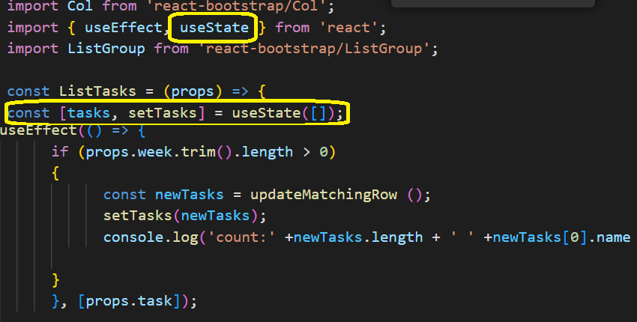
Our Project – Add Task to List
//Update ListTasks()
Just adding a task to a memory list
We don’t need displayAlert() anymore, we will write some useful code. Remove it.
To verify, we will log the tasks count and the name of the latest task being added.
For now, simplicity, a task with a unique name shuld be added to the list, otherwise it should update an existing task.
Better to copy code and not write from scratch: [updateMatchingRow.js]
Hold tasks in memory
Add/update record when week is not blank

Slide 61
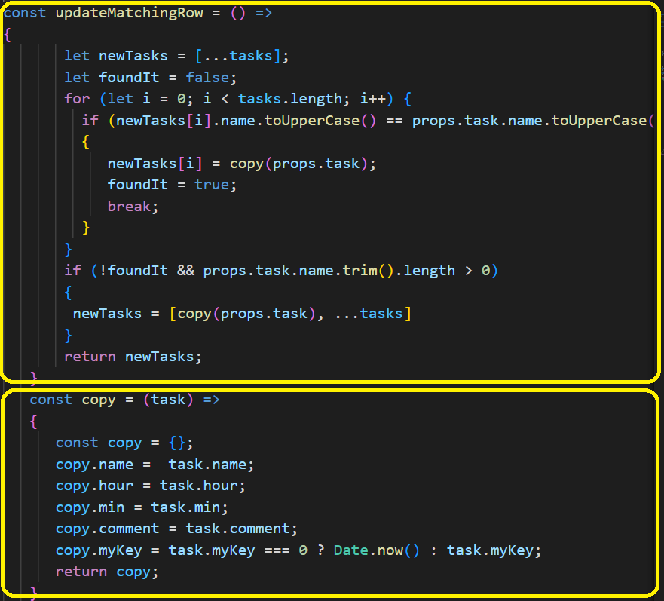
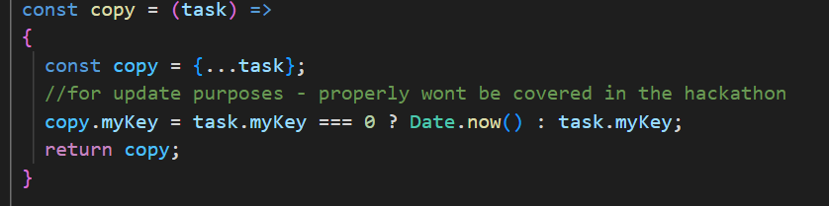
Our Project – Add Task to List
update task when task name already exists
Add task when task name is unique
Insert the new task in the front
… : spreading array elements
[succinct approach]
Why copy?
To avoid bugs and unexpected behavior that can creep into the code from dealing with a mutable object. Data should be changed in one place only.
Any other suggestions for copy?

Slide 62
Our Project – Display List
//remove the log statement
Console.log('count:' +tasks.length + ' ' +tasks[0].name + ' ' + tasks[0].hour +' ' + tasks[0].min+' ' + tasks[0].comment);
//add required imports
import ListGroup from 'react-bootstrap/ListGroup';
//update the return statement
return (
<Container className={props.className}>
<div style={{ height: ‘320px', overflowY: 'scroll' }}>
<ListGroup>
{
tasks.map(
(text, index) =>
(<ListGroup.Item
key={index}>{text.name}-{text.hour}:{text.min}[{text.comment}]
</ListGroup.Item>)
)
}
</ListGroup>
</div>
A copy of the code found in [displayList-1.js]
Scrollable container
Go over a list and process each
Text: refers to each element processed in list
Index: an index assigned to each element processed
Insert the new task in the front
Each element mapped to a list item with a key. Key is important for better performance
Test your changes

Slide 63
[DB] Read/Write

Slide 64
Our Project – SaveWeek
//update listTasks, create weekId to save the value returned from DB
const [weekId, setWeekId] = useState(0);
const save = (e) => {
const week = props.week;
const id = weekId !== "undefined" ? weekId : 0;
fetch("http://localhost:8500/tracker/api/save", {
method: "POST",
headers: {
"Content-Type": "application/json",
},
body: JSON.stringify({ id, week, tasks }),
})
.then((response) => {
if (response.ok) {
return response.json();
}
})
.then((data) => setWeekId(data))
.catch((error) => alert(error));
};
A copy of the code found in [save.js]
Prepare request body to be similar to what we have in test.js
Post Request with appropriate header
Change request to json format
Promise Object
Success case
updating weekId.
Handling communication error
//add click action
<Button className="text-uppercase btn-outline-dark btn-sm gap" variant='none' onClick={save} >
save
</Button>
Test your changes

Slide 65
Our Project – LoadWeek
const load = (e) => {
if (
props.week == "" ||
props.week === "undefined" ||
props.week === null
) {
alert("Please, Enter Date");
return;
}
fetch(`http://localhost:8500/tracker/api/get?week=${props.week} `,
{
method: "GET",
headers: {
accept: "application/json",
},
})
.then((response) => response.json())
.then((data) => {
const { id, tasks } = data; //deconstruct
setTasks(tasks);
if (id === 0 || id === null) {
alert("Week doesn't exist.");
}
setWeekId(id);
})
.catch((error) => alert(error));
};
A copy of the code found in [load.js]
Make sure you fetch when you have a valid value
Get Request with appropriate header
Change response to json format
Success case
updating our tasks.
Displaying info message when no data found
Save week id value to use later in update request
Failure Case Example: communication error
//add click action
<Button className="text-uppercase btn-outline-warning btn-sm gap" variant='none' onClick={load}> load
</Button>
Test your changes

Slide 66
Child triggers Parent

Slide 67
Our Project – Close [1]
Upon close, we want to:
Save Tasks // we have this method already
Clear all elements [elements in Main(), Date Picker, Task List, weekId]
We don’t have clear method defined to clear elements in Main(), So, we need a way to access the Clear Button in Main() and trigger the click()
This should clear all inputs in Main() other than Date Piker and Name as these two are associated with states.
//update Main()
import {useState, useRef} from 'react';
const clearButtonRef = useRef(null);
<Button ref={clearButtonRef} type = "reset" className="text-uppercase btn-outline-warning" variant='none' >
clear
<ListTasks className = "list-border" task = {task} taskState= {taskState} week= {week} clearButtonRef={clearButtonRef}
//update ListTasks(), add required operations
const close = (event) =>
{
save(event);
clear();
}
const clear = () =>
{
props.clearButtonRef.current.click();
}
//update listTasks, add click action
<Button className="text-uppercase btn-outline-primary btn-sm gap" variant='none' onClick={close}>
close
</Button>
Test your changes

Slide 68
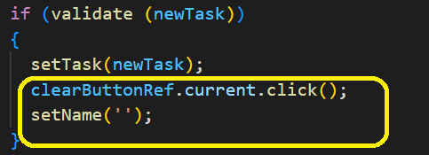
Our Project – Close [2]
Clearing the date and name fields
//update Main()
const clearBoundedElements = () =>
{
setSelectedDate(‘’);
setName(‘’);
}
<ListTasks className = "list-border" task = {task} taskState= {taskState} week= {week} clearButtonRef={clearButtonRef} clearBoundedElements ={clearBoundedElements}
//update ListTasks()
const clear = () =>
{
props.clearButtonRef.current.click();
props. clearBoundedElements();
}
Clearing Tasks list & weekId
//update ListTasks()
const clear = () =>
{
props.clearButtonRef.current.click();
setTasks([]);
setWeekId(0);
props. clearBoundedElements();
}
Test your changes
Optional: to clear after adding
a task to list

Slide 69
Child passes data upward

Slide 70
Our Project – Populate Main
//update ListTasks()
//should populate on double click
<ListGroup.Item
onDoubleClick={() => {props.populate(text);}}
key={index}>{text.name}-{text.hour}:{text.min}[{text.comment}]
//update Main()
import $ from 'jquery’;
const populate = (data) =>
{
setName(data.name); //bounded field case – no need for jQuery
$('#formTaskHour').val(data.hour); //not bounded field case
$('#formTaskMin').val(data.min);
$('#formTaskComment').val(data.comment);
task.myKey = data.myKey;
}
//pass the prop
<ListTasks className = "list-border" task = {task} week= {week} clearButtonRef={clearButtonRef} clearBoundedElements ={clearBoundedElements} populate={populate}
npm install jquery //install jquery
Test your changes

Slide 71

Recap
Insert/Read
Asynch call
DB
fetch
promise
Successful
Error
Deep Copy of y
const x = […y];
//spreading of elements
Want to trigger a parent component to
update data or execute code, pass function handle as props
Back Tick
`${parameter}`
Selects properties from object
const { id, tasks } = data;
//deconstruct
Want to trigger action in parent component as button click, pass in element reference as props
Use map() to go through a list
and to process each element
Add Key to your display list
for enhanced performancem

Slide 72
Highlight
Flash Message
Property Files
Routing
Context
Embellishment

Slide 73
Our Project – Highlight Selection
Highlight the row selected for update
What we need to do?
Highlight Row upon double click [change background and font size]
Clear selection after updating
//add a new state variable
const [selectedRowHighlighted, setSelectedRowHighlighted] = useState('');
//add styling and update doubleClick event
{tasks.map((text, index) => (
<ListGroup.Item
style=
{{
fontWeight: selectedRowHighlighted === index ?'bold’ :'normal',
backgroundColor: selectedRowHighlighted === index ?'cyan': 'white'
}}
onDoubleClick={() => {props.populate(text);setSelectedRowHighlighted(index);}}
//clear selection
useEffect(() => {
if (props.week.trim().length > 0)
{ const newTasks = updateMatchingRow ();
setTasks(newTasks);
clearSelection(); }
}, [props.task]);
const clearSelection = () =>
{setSelectedRowHighlighted('');
}
Test your changes

Slide 74
Our Project – Highlight Selection
More Highlighting
Highlight the row selected for removal
What we need to do?
Highlight Row upon single click [change background and font size]
Clear selection after removal
//update listTasks - add click event per task
onDoubleClick={() => {props.populate(text);setSelectedRowHighlighted(index);}}
onClick={() => setSelectedRowHighlighted(index)}
//update listTasks – remove row and clear afterwards
const removeRow = () =>
{
tasks.splice(selectedRowHighlighted, 1);
setSelectedRowHighlighted(-1);
}
Test your changes
//add remove event
<Button className="text-uppercase btn-outline-danger btn-sm gap" variant='none' onClick={removeRow}>
Remove
</Button>

Slide 75
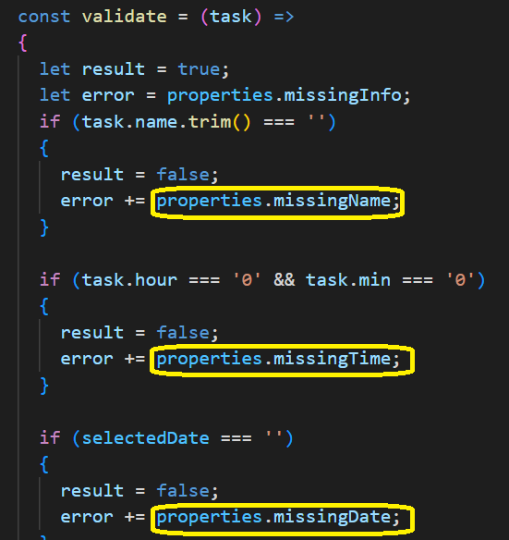
Our Project – Using property file
//create messageProperties.js under main folder
export const properties = {
missingInfo: "Missing Info:",
missingName: " [Task Name]",
missingTime: " [Time Spent]",
missingDate: " [Date]"
};
//update Main()
import { properties } from './messageProperties.js’;
Test your changes

Slide 76
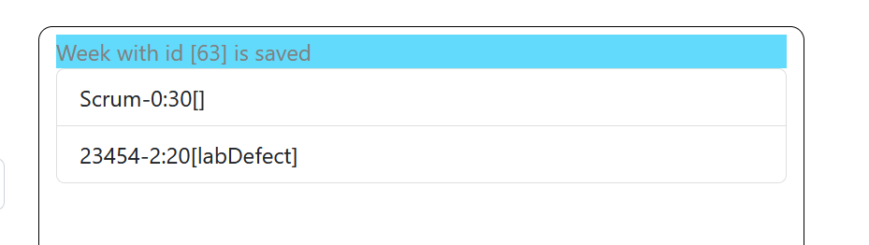
Our Project – Flash Save Message
//update messageProperties.js
missingTime: " [Time Spent]",
missingDate: " [Date]“,
savedData: "Week with id [0] is saved"
};
//update ListTasks() imports
import { properties } from './messageProperties.js’;
//update ListTasks() add a stateful message
const [message, setMessage] = useState('');
//update ListTasks() save success snippet
.then((data) =>
{
setWeekId(data);
setATimedMessage(data); //show for limited time
})
//update ListTasks() addATimedMessage
const setATimedMessage = (id) =>
{
const msg = properties.savedData.replace("[0]", `[${id}]`);
setMessage(msg);
setTimeout( () => {setMessage('');}, 3000);
}
Test your changes
//update ListTasks() show return message if not blank
<Container className={props.className}>
<div className='messageArea'>{message}</div>
<div style={{ height: ‘320px', overflowY: 'scroll' }}>

Slide 77
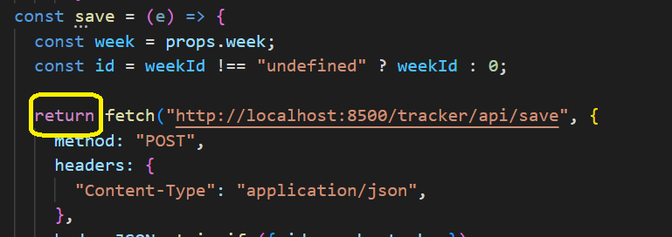
Our Project – Close [3]
Does Close Action still work as expected?
Enter Tasks for a specific week,
close it,
notice the weekId for the saved week,
add tasks for a new week &
notice the id of the new week saved.
Displaying saved weekId highlighted a bug.
Can you use Debugger to figure out what’s wrong?
clear() is called before save() completes its operation.
FIX
//update ListTasks(), update close()
const close = (event) =>
{
save(event) .then(data => clear());
}
Test your changes

Slide 78
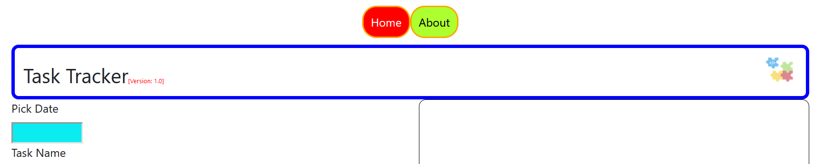
Our Project – Routing
npm install react-router-dom
//Update App(), add imports
Import {BrowserRouter, NavLink, Routes, Route} from "react-router-dom";
import About from './main/About';
//update App()
function App() {
return (
<BrowserRouter>
<nav>
<NavLink className ="nav1" to="">Home</NavLink>
<NavLink className ="nav1 nav2" to="about">About</NavLink>
</nav>
<Routes>
<Route path="" element={<Main />} />
<Route path="about" element={<About />} />
</Routes>
</BrowserRouter>
);}export default App;
Anchors
default
Same name
Navigate to
//add About.js under main folder
import Container from 'react-bootstrap/Container';
const About = () =>
{ return
(<Container>This is a Hackathon project V1.0</Container>);
}; export default About;
Test your changes

Slide 79
Our Project – Context -1
Hook
Pass data to child components without using props - Global Sharing
//update parent component: App.js – update import statements
import {useState, useRef, useContext} from 'react';
//update parent component: App.js – Create and export Context. Enclose the child components that can read the context
export const prjContext = createContext('');
function App() {
return (
<BrowserRouter>
<prjContext.Provider value = '[Sherif]'>
<nav>
<NavLink className ="nav1" to="/">Home</NavLink>
<NavLink className ="nav1 nav2" to="about">About</NavLink>
</nav>
<Routes>
<Route path="" element={<Main />} />
<Route path="about" element={<About />} />
</Routes>
</prjContext.Provider>
</BrowserRouter>
);

Slide 80
Our Project – Context - 2
//update child components: Main.js – update import statements
import {useState, useRef, useContext} from 'react';
import { prjContext } from '../App';
//update child components: Main.js – read Context and display
const identifer = useContext(prjContext);
return (
<Container>
<Header version = {'1.0' + identifer} className='general-border' />
<Row>
//update child components: About.js – update import statements
import {useState, useRef, useContext} from 'react';
import { prjContext } from '../App';
//update child components: About.js – read Context and display
const About = () =>
{
const identifer = useContext(prjContext);
return (<Container> This is a Hackathon project V1.0 for {identifer}</Container>);
};
export default About;
Test your changes

Slide 81
Dockerize tracker-frontend
Copy .dockerignore and Dockerfile under tracker-frontend
//Create a docker image. Use docker extension or cmd line to run commands Change directory to tracker-frontend
Run command ➔ docker build –t tracker-frontend:1.0 .
//update Docker-compose to add tracker-frontend
version: '3.7'
networks:
localnet:
volumes:
db_data:
services:
web:
image: tracker_frontend:1.0
container_name: front
ports:
- "8000:3000"
networks: #optional
- localnet #optional
backend:
image: sherifsadek/tracker_backend:33
container_name: back
ports:
- "8500:8081"
networks:
- localnet
//create container for service called web and run in the //background without affecting other services
docker-compose up -d --no-deps web
Test your changes

Slide 82
Hosting our application in the Cloud by automating build and deployment

Slide 83
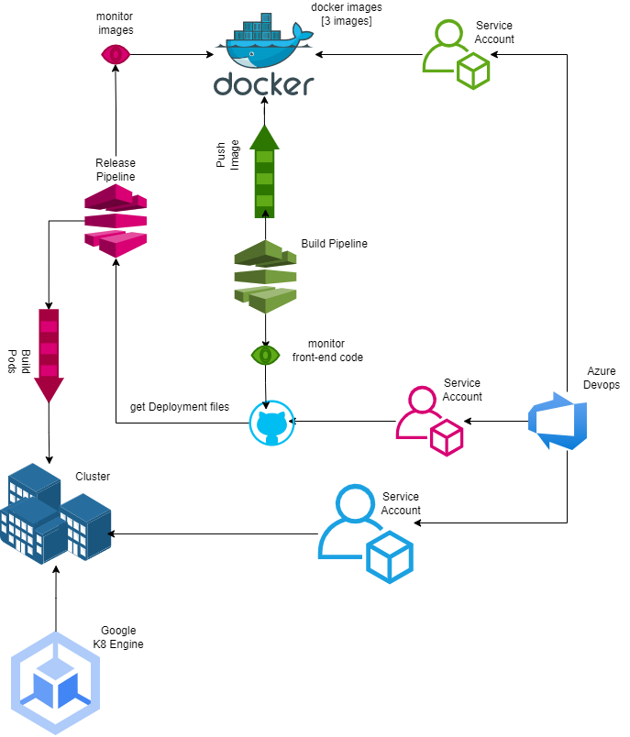
Process Overview

Slide 84
Process Overview
1

Slide 85
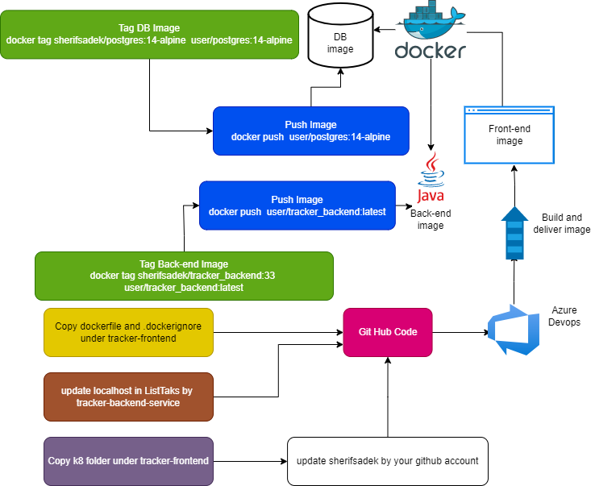
Host Docker Images in Docker Hub
1

Slide 86
Host Docker Images in Docker Hub
1

Slide 87
Host Docker Images in Docker Hub
1

Slide 88
Host Docker Images in Docker Hub
1

Slide 89

Process Overview
2

Slide 90
Google Kubernetes Setup
And Connecting to Azure Devops
2
Through Google Account:
Create a google project
create a Google cluster. [you can select defaults ]
Through cmd line, you can run: gcloud init
If you don’t have an existing configuration, create one based on your google account and project name
We need to create a google service Account and give it access on our cluster. You need the Cluster IP, beside the secret created during the following steps to feed Azure Devops.
Follow the instructions here:
https://cloud.google.com/architecture/creating-cicd-pipeline-vsts-kubernetes-engine#connect_azure_pipelines_to_the_development_cluster
Brief about the above steps
Create service account
Create a secret for that service account
Create a rolebinding to give that account an admin prev on that cluster
Get the IP of that cluster.
Get the secret being created.
Feed IP & Secret to Azure Devops Service Account

Slide 91
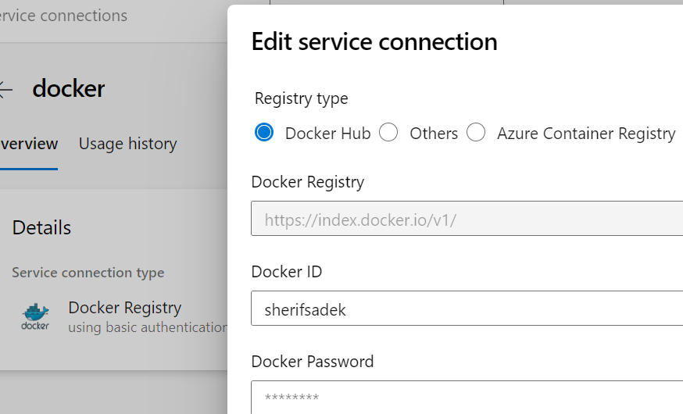
Process Overview
3
Should be established when creating the account

Slide 92
Process Overview
4

Slide 93
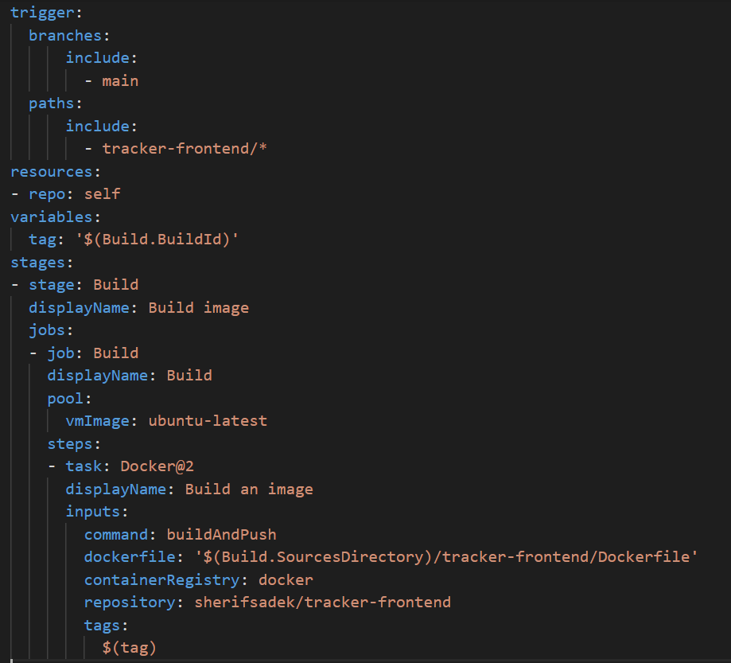
Pipeline
4
New PipeLine → github → user/tracker_fronend→ Docker [build docker image] → keep Default → verify and configure.
You can override code using azure-frontend-ci-pipe.yaml
Branch we are interested in
The directory I want to monitor
Replace sherifsadek by your github account
Tag is incremented everytime it creates an image

Slide 94
Process Overview
5

Slide 95
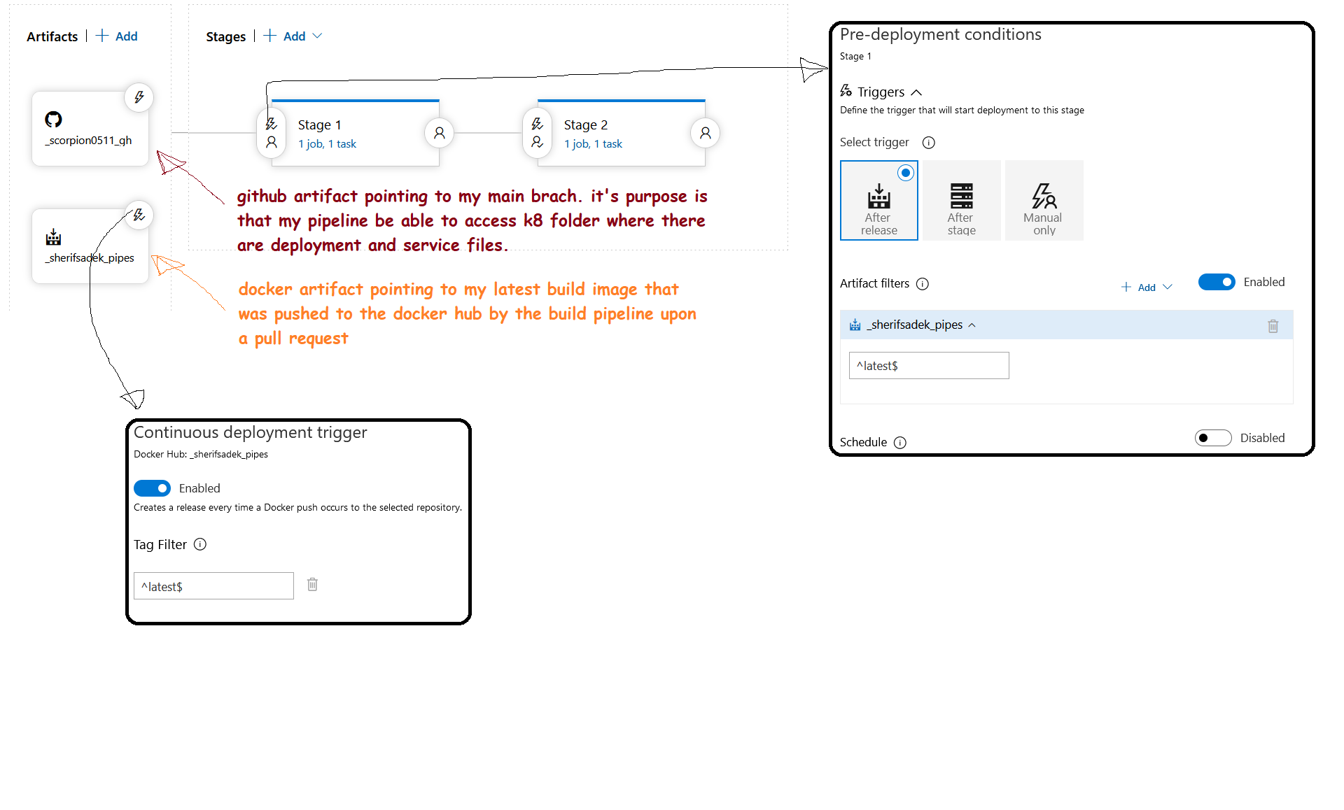
Release Pipeline
5
An overview of our Release Pipeline and details will follow

Slide 96
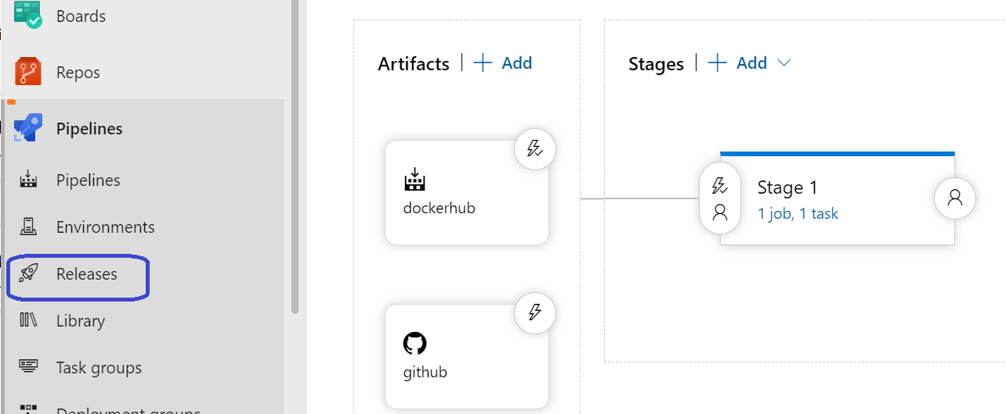
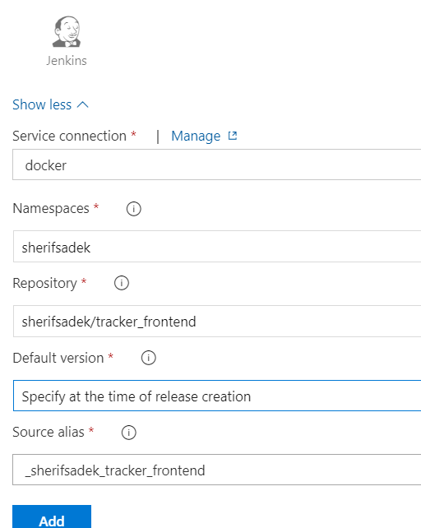
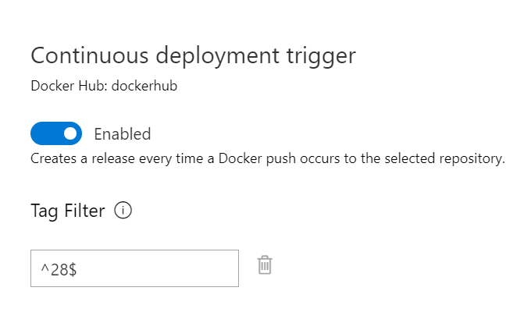
Release Pipeline
5-1
When to trigger a release.
We can adjust.
Example, you should tailor according o your hub

Slide 97
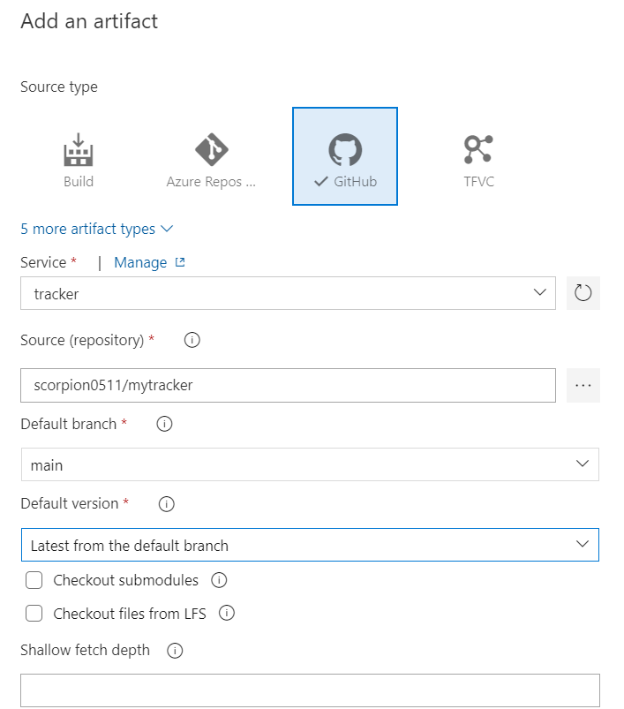
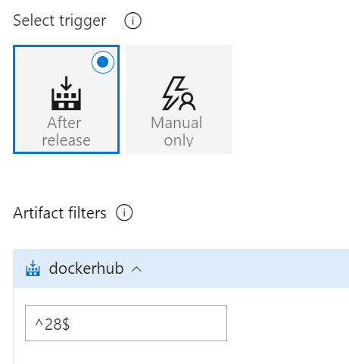
Release Pipeline
5-2
Example, you should tailor according o your hub

Slide 98
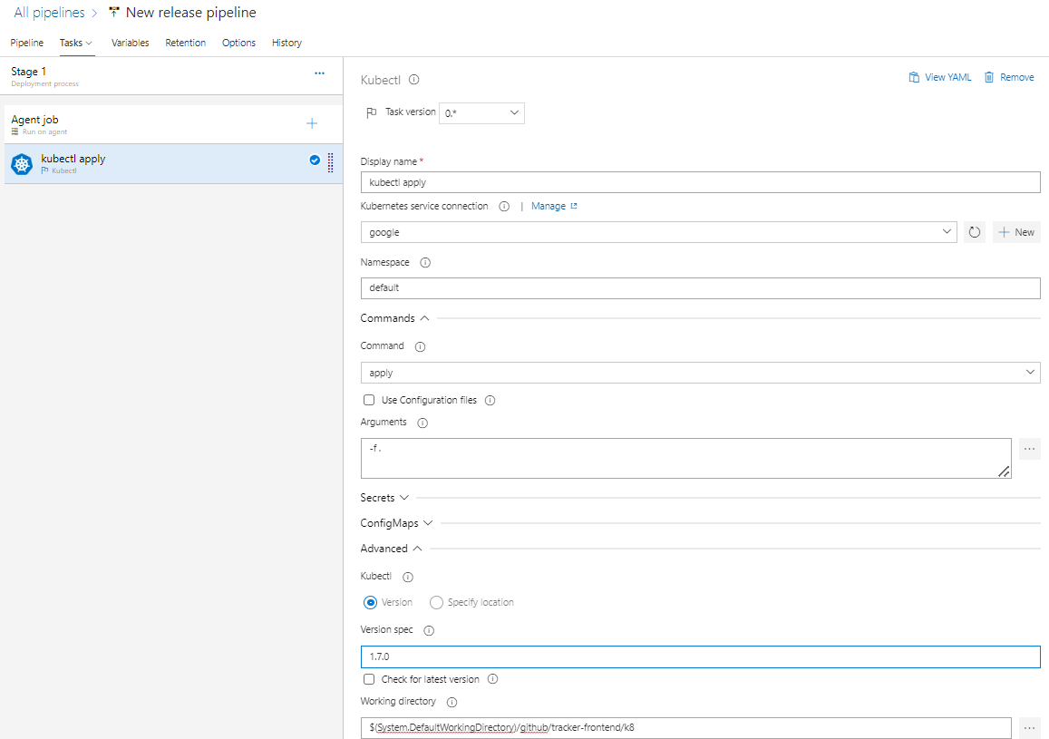
Release Pipeline
5-3
Then you can hit create Release based on this configuration.
You may need to create release every time you change something in the Release Pipeline configuration.
Point to k8 folder

Slide 99
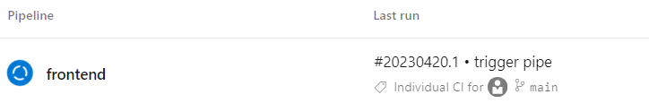
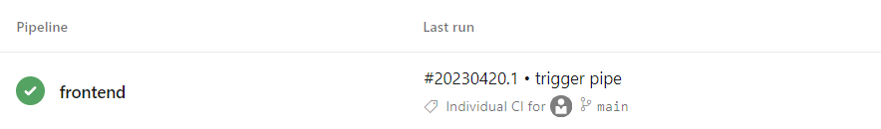

Automatic Build and Deployment in Action
Change Code in tracker-frontend
Pipeline runs
Pipeline succeeded and pushed
Image to docker hub
Release Pipe was configured to run when an image with tag 35 is pushed to docker hub
Pods are deployed to Google K8

Slide 100
