Slide 1

React JS
Project Based
Lazy Learning
May 2023

Slide 2
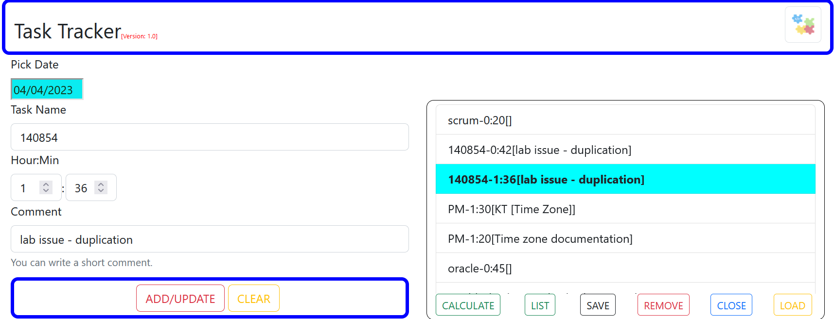
What will we build?

Slide 3
Demo

Slide 4
Overview
Frontend
[React]
Backend
[Java API]
Backend and DB are not the focus of the project. Hence they will be supplied in a containerized form and they can be downloaded from Docker Hub by using the docker-compose file.
DB
[PostgreSQL]
If you want a copy of the source code for the backend, let me know.
The docker-compose is available among: react-hackathon.7z
Backend will create the required tables: weeks and tasks, under the schema: public, within the DB: tracker.
Backend serves 2 APIs:
Fetch tasks: /tracker/api/get?week=value
Save/update tasks: /tacker/api/save
If you are interested to host your app in the cloud and have your changes deployed automatically, we can do that on the final day.

Slide 5

Setup
Activities | Comment
- Have a GitHub account. - Install Git Bash. | To Keep track of your changes and to serve the CI/CD later [Optional]
Have a Docker hub account | To serve the CI/CD later [Optional]
Install Visual Studio Code [VSCode]. You may add the following extensions afterwards via VSCode sidebar icon: - Auto Close Tag. - Auto Rename Tag. - Color Highlight. - Dev Containers. - Docker. - Prettier-Code Formatter. - ES7+ React/Redux/... - IntelliCode. - Yaml. - Blackbox | https://code.visualstudio.com/download IDE [Recommended]
- Have a google cloud account. - Install gcloud client (cli). | To host our application in a K8 cluster. https://cloud.google.com/ To communicate with gcloud: https://cloud.google.com/sdk/docs/install [Optional]
Have azure devops account | https://dev.azure.com To support CI/CD [Optional]
Have Docker-Desktop | Run backend containers
Have Postman or SoapUI | Verify backend is working properly.
Install if you don’t have: Node.js [LTS] | https://nodejs.org/en/download This should include npm

Slide 6
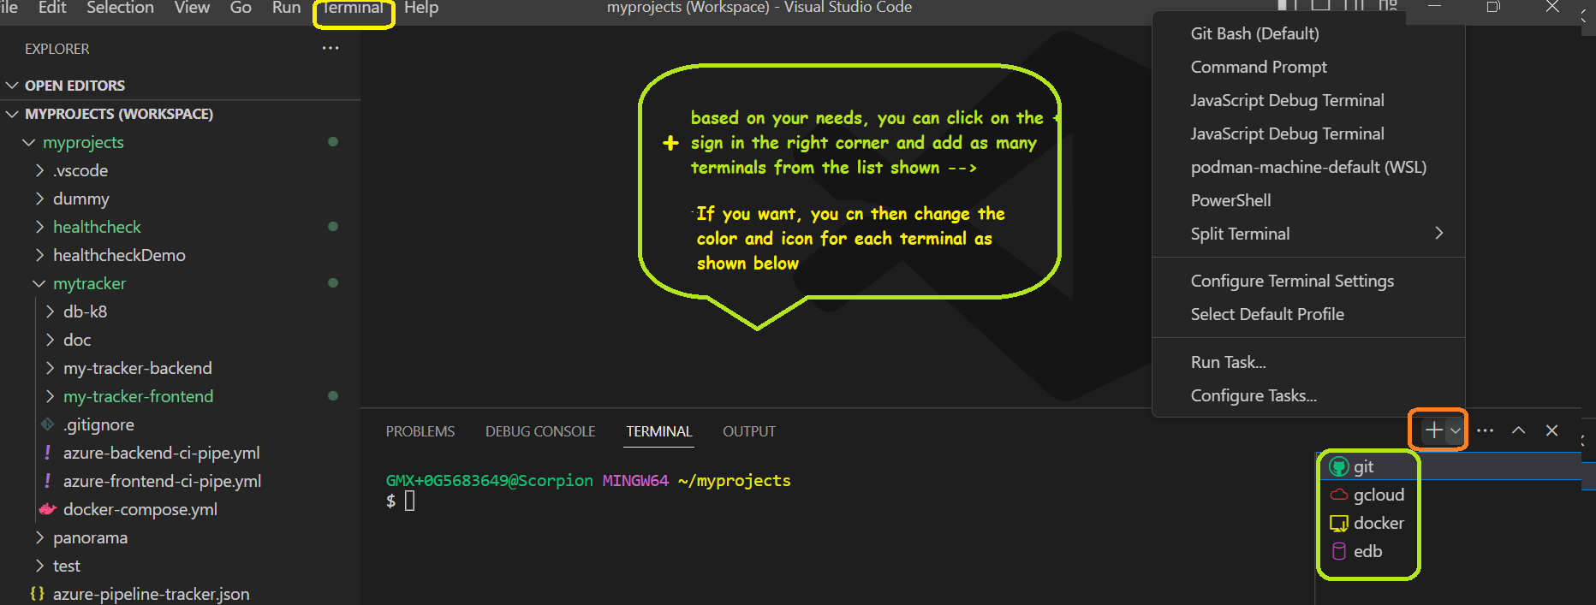
Customize your VSCode Terminals [Optional]

Slide 7
Verify backend working as expected.

Slide 8
27-5/05/2023
27-5/05/2023
Download the backend images. The docker-compose is available among: react-hackathon.7z
You can download images either by: running cmd from the appropriate directory→ docker-compose up or by selecting the file within VSCode→right click → Compose Up
Backend will create the required tables: weeks and tasks, under the schema: public, within the DB: tracker.
Using postman/SoapUI, you can verify both saving and loading of records.
Backend should serves 2 APIs on your localhost at port: 8500
Save/update tasks: /tacker/api/save
Fetch tasks: /tracker/api/get?week=27-5/05/2023
For testing, a copy of post request is available among: react-hackathon.7z.
- Header required for save: content-type: application/json. - Header required for get: accept: application/json.

Slide 9
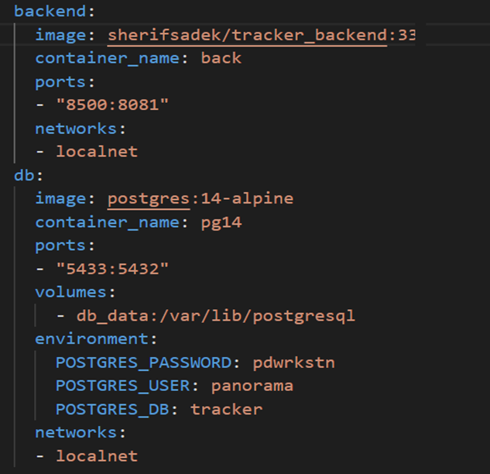
Docker Compose
If you are interested, you can access the local DB through pgadmin at port 5433. Credentials are listed above.

Slide 10
Why React
Front End JS Library
Learn curve not steep
Efficient Design [Virtual DOM]
Usability:
Composed of Components
Widely used.
Facebook supported
Data flow is unidirectional

Slide 11
Kick off our template application
Create a folder called hackathon-react
cd to hackathon-react
//install and run the package
hackathon-react\>npm install create-react/app
hackathon-react\> node ./node_modules/create-react-app/index.js tracker-frontend
OR
//install and run the package [recommended]
hackathon-react\> npx create-react-app tracker-frontend
//start the application
hackathon-react\> npm start

Slide 12
Customize the template project to our needs and get familiar with the project structure.

Slide 13
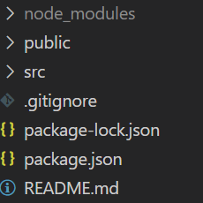
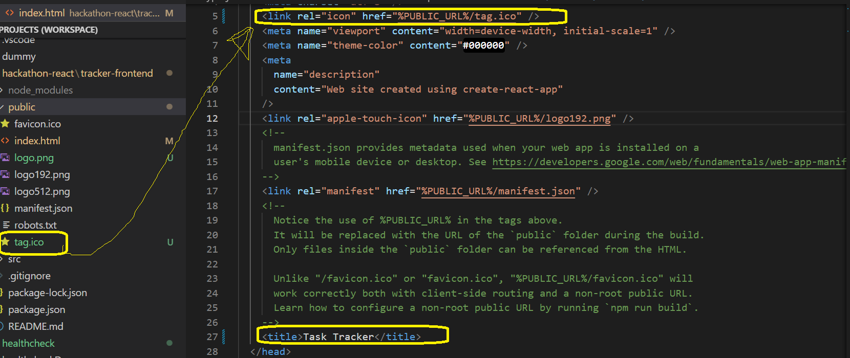
1- Change icon and title.
Component | Importance
node_modules | Like .m2 [libraries]
public | static files
src | Dynamic code
package.json | Like pom.xml [high level]
package-lock.json | Detailed pom.xml file
Open index.html under public and update as shown →
You can get the ico via
react-hackathon.7z
Copy the file under public
and remove favicon.ico.

Slide 14
2- push your code to GitHub.
[Optional]
There are many ways to do:
One way would be to create a new repo on GitHub: hackathon-react
Open git terminal
Change directory to hackathon-react
Create a .dockerignore file and add node_modules to it [if no ignore file was created by creact-react-app under tracker-frontend]
echo “./tracker-frontend/node_modules” > .dockerignore
//run the following echo "# hackathon-react project" >> README.md //create a readme file git init //initialize local repo git add . –A //add all changes to staging area starting with the current directory. git commit -m “initial commit" //commit all staged items git remote add origin git@github.com:account-name/hackathon-react //define remote repo git branch -M main //rename the master branch to main [you can keep master though] git push -u origin main //push to main [later, git push Is enough as you have defined the upstream branch using –u]
From now on, you can deliver your changes anytime you please. Will not remind you again.

Slide 15
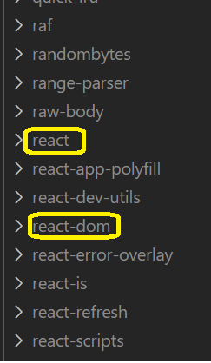
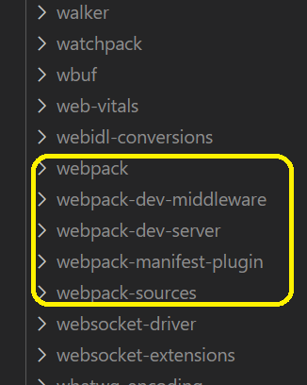
The most important libraries
we will use
Explicitly via import
Implicitly: required to use import
Bundling tool helping us to use “import“ as it searches within node_modules. Otherwise, we need to specify location of libraries explicitly.

Slide 16
Do we need Node.js, webpack or VSCode to build a React app?
The answer should be the same if I ask you, do we need eclipse, maven or hibernate to build a Java app?
Let’s have a simple example to illustrate how this can be done and understand a bit about Components.

Slide 17
Change directory to hackathon-react
Create a folder test
Create an html file within that folder as below
<!doctype html>
<head>
<title>Test</title>
<link type="text/css" rel="stylesheet" href="app.css"/>
<script src="https://unpkg.com/react@16/umd/react.production.min.js"></script>
<script src="https://unpkg.com/react-dom@16/umd/react-dom.production.min.js"></script>
</head>
<body>
<div id="root"/>
<script src="./app.js"></script>
</body>
</html>
Create app.css file in the same folder as below [decoration step]
header :
{
color: red;
}
Create app.js file in the same folder as below
const h1Element = React.createElement('h1', {className:'header'},'A Simple React Example');
h1: //type - The element I want to create
{}: //properties of the element to create
A Simple React Example: //Children: Text, other elements
Where to add this new element to our html?
Append the following to app.js
View html in the browser
ReactDOM.render(h1Element, document.getElementById('root'));

Slide 18

React Component - 1
Create an agnostic Component
Render as Web element
Render as a Mobile element
Render as a …
function
Create an agnostic Component
Class

Slide 19
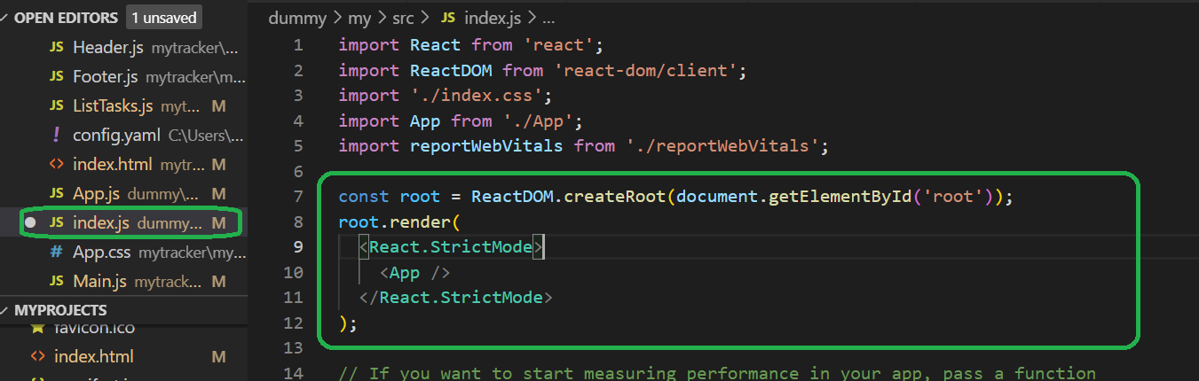
Check Our Project
index.js
Access the root element and render the application’s main component as a child.
Index.html
<div id=“root”/>
-
X X X
App: a function creating component we will add and it refers to our project main component. This will be our focus.
Thus, you don’t need to be bothered by index.html and index.js anymore.
What we see highlighted above is a flavor of what we did.
Replace this highlighted part with the snippet below and test:
ReactDOM.render(App(), document.getElementById('root')); Don’t forget to add: import ReactDOM from 'react-dom';
Why <React.StrictMode/>?
Identify deprecate methods, unsafe state changes, etc..

Slide 20
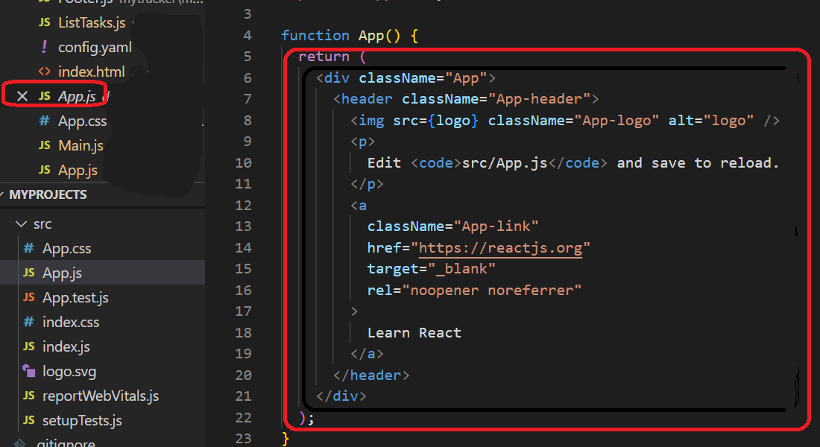
Check Our Project - Continue
Main Component
X X X X X
X X X X X
Replace App() body by
return React.createElement('h1', {className:'header'},'A Simple React Example');
update app.css file and add
header :
{
color: red;
}

Slide 21
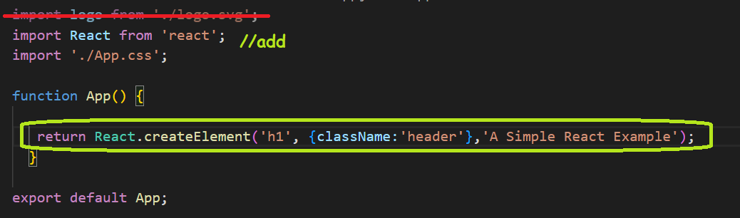
Check Our Project - Continue
Main Component
Note that ReactDom.render is not supported in version 18 and browser is handling our code as if it is written in version 17.
You can use version 16.2 for react and reactDom, but you will need to stop server, run npm reinstall afterwards, and then npm start
This is just for understanding how things are running, but we don't need to bother with this basic approach to create and render components
So, it’s ok now to revert the index.js to its original code.

Slide 22
Check Our Project - Continue
return React.createElement('h1', {className:'header'},'A Simple React Example');
JSX does the trick of simplifying the code to a format we are used to and to create the React.createElement behind under the hood.
JSX
Creating Element
return (<h1 className='header'>A Simple React Example</h1>);
ReactDOM.render(App(), document.getElementById('root'));
JSX
Invoking/Adding Element
root.render(<App/>);

Slide 23
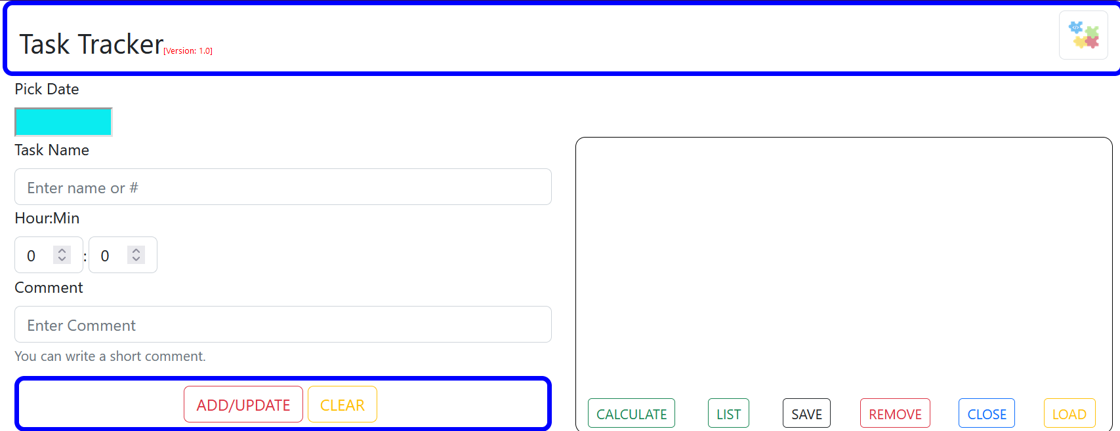
Our Project - Layout
Header
Main
ListTasks
Footer
Index.js
App.js
Main.js
Header.js
ListTasks.js
Footer.js

Slide 24
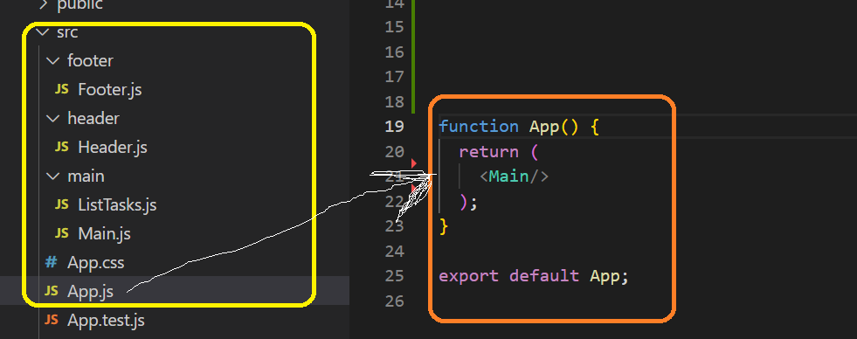
Our Project - Layout

Slide 25
Our Project - Header
Build Header.js
const Header = (props) => {
} export default Header;
Write method using the => approach for succinctly
props: think of as an object that holds a pointer to data passing from parent component to Header
Export default to be able to invoke this method within other files.
import React from 'react';
import './App.css';
import Header from './header/Header';
function Main() {
return (<Header/>);
} export default Main ;
export default App;
Invoking/Adding Element to App.js

Slide 26
Our Project - Header
Override App.css by copying the one available among: react-hackathon.7z. This is not our focus, so let’s copy it over.
const Header = (props) => {
const ver = <span className="version">[Version: {props.version}
]</span>;
return(
<h3 className='topParag'>Task Tracker{ver}</h3>
);
}
version: Value is passed from the parent component
const: for variables, we usually use const or let. You can’t override a const variable.
{ver}: is defined as a variable to simplify our tag. To include JS code within tags, use {}.
<h3>: as an html tag is defined in lower cap to distinguish from Component.
Test your changes
function Main() {
return ( <Header version = '1.0'/> ); //pass the version
}

Slide 27
Our Project - Header
Need bootstrap, so I need to install react-bootstrap & bootstrap css
Change directory to tracker-frontend
npm install bootstrap
npm install react-bootstrap
//add imports to Header.js
import 'bootstrap/dist/css/bootstrap.css';
import Container from 'react-bootstrap/Container';
import Image from 'react-bootstrap/Image';
import Row from 'react-bootstrap/Row';
import Col from 'react-bootstrap/Col';
//update your Header.js return ()
Test your changes
return(
<Container className={props.className}>
<Row>
<Col>
<h3 className='topParag'>Task Tracker{ver}</h3>
</Col>
<Col className="right">
<Image src="logo.png" className="logo" />
</Col>
</Row>
</Container>
);
What’s missing?

Slide 28
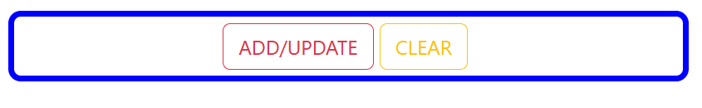
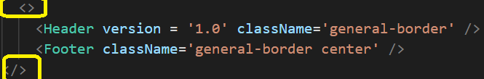
Our Project - Footer
//add imports to Footer.js
import Button from 'react-bootstrap/Button';
import 'bootstrap/dist/css/bootstrap.css';
import Container from 'react-bootstrap/Container';
//Add your Footer()
Test your changes
const Footer = (props) => {
return (
<Container className = {props.className} >
<Button className="text-uppercase btn-outline-danger gap"
variant='none'> add/update
</Button>
<Button className="text-uppercase btn-outline-warning"
variant='none’ > clear
</Button>
</Container>
); } export default Footer;
What’s missing?
Main() Error
<>: return must return one element only. One way is to use <> to wrap elements. You may use <div>or other suitable html wrapping tag instead.

Slide 29
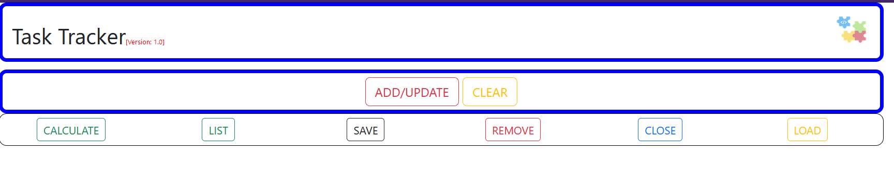
Our Project – List_Tasks
//Add your ListTasks()
Copy your Footer.js to your ListTasks.js and update it to meet our needs
We can share a copy of current ListTask.js via slack: #react-hackathon
Update your Main.js to add ListTasks and pass className: list-border
Test your changes

Slide 30
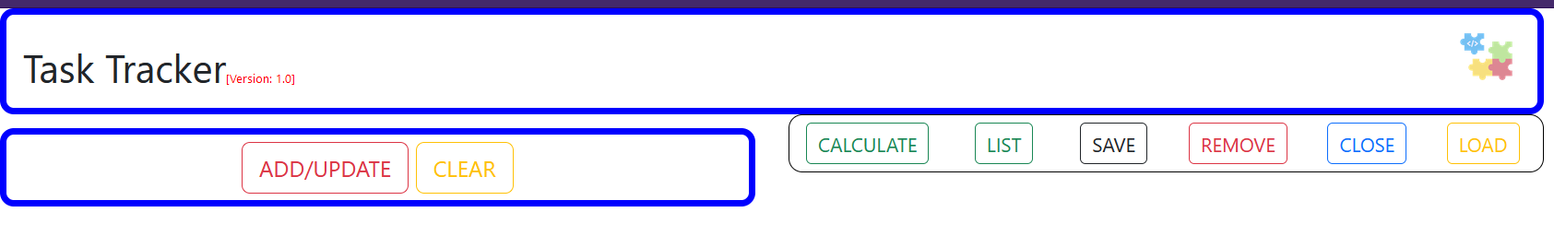
Our Project – Main
//Update your Main()
return (
<Container>
<Header version = '1.0' className='general-border' />
<Row>
<Col>
<Footer className='general-border center' />
</Col>
<Col>
<ListTasks className = "list-border"/>
</Col>
</Row>
</Container>
);
Notice that we have removed <> and it’s sufficient to use <container>
Don’t forget to add the required imports.
Test your changes

Slide 31
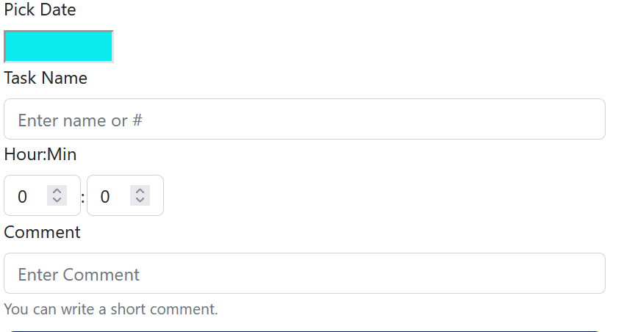
Our Project – Main
//Update your Main() - Add Date Picker
<Col>
<Form>
<Form.Group >
<Form.Label>Pick Date</Form.Label>
<DatePicker className='datePicker' />
</Form.Group>
</Form>
<Footer className='general-border center' />
</Col>
//Update your Main() - Add imports
import DatePicker from 'react-datepicker';
import 'react-datepicker/dist/react-datepicker.css';
import Form from 'react-bootstrap/Form';
//install required library
npm install react-datepicker
Test your changes

Slide 32
Our Project – Main
//Update your Main() - Add Task Name
…
<Form.Group controlId="formTaskName">
<Form.Label>Task Name</Form.Label>
<Form.Control type="text" placeholder="Enter name
or #" />
</Form.Group>
</Form>
<Footer className='general-border center' />
</Col>
Test your changes

Slide 33
Our Project – Main
//Update your Main() - Add Hour:Min
…
<Form.Group controlId="formTaskTime">
<Form.Label className="control-block label">Hour:Min</Form.Label>
<Form.Control
type="number"
step="1"
min="0"
max="24"
placeholder="0"
className="control-inline"/>
<Form.Label className="control-dot">:</Form.Label>
<Form.Control
className="control-inline"
type=“number"
step="1"
min="0"
max="59"
placeholder="0"/>
</Form.Group>
</Form>
<Footer className='general-border center' />
</Col>
Test your changes

Slide 34
Our Project – Main
//Update your Main() - Add comment
…
<Form.Group controlId="formComment">
<Form.Label>Comment</Form.Label>
<Form.Control type="text" placeholder="Enter Comment" />
<Form.Text className="text-muted">
You can write a short comment.
</Form.Text>
</Form.Group>
</Form>
<Footer className='general-border center' />
</Col>
Test your changes

Slide 35
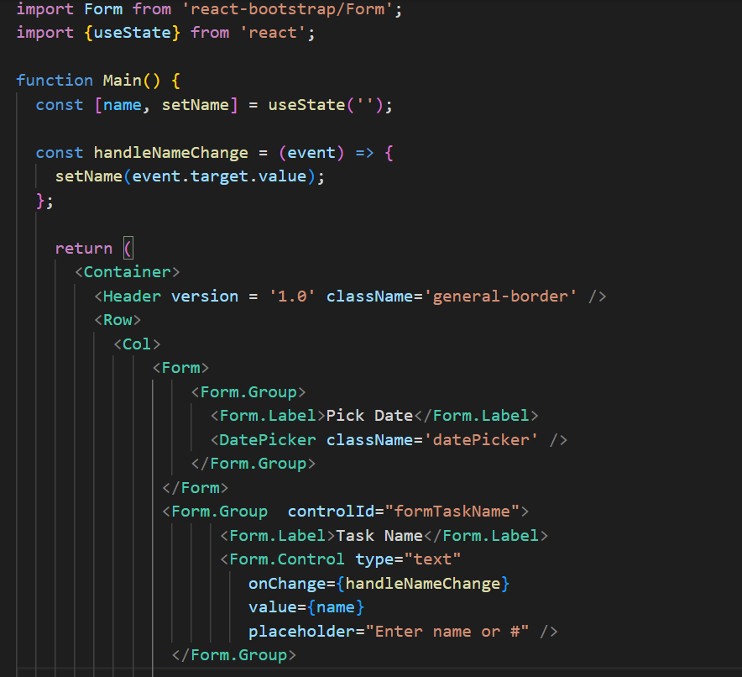
Our Project – Main
To manipulate form elements values [Read/Update], define state handling mechanism
Take Task Name as an example, and apply the change below for other elements as well.
const [name, setName] = useState('');
state variable
Method to update
Initial value
We can share a copy of current Main.js via slack:
#react-hackathon

Slide 36
Our Project – Main
//Add Clear Action
//Update Main() -
…
const clearDisplay = () => {
setName('');
setHour(0);
setMin(0);
setComment('');
};
return (
…
<Footer className='general-border center' clear = {clearDisplay}/>
//Update Footer() -
…
<Button className="text-uppercase btn-outline-warning"
variant='none' onClick={props.clear}> clear
</Button>
Test your changes

