Slide 1
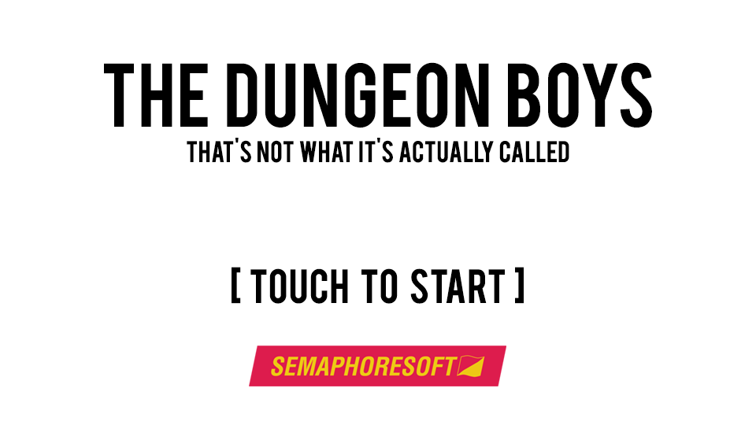
Title Screen

Slide 2
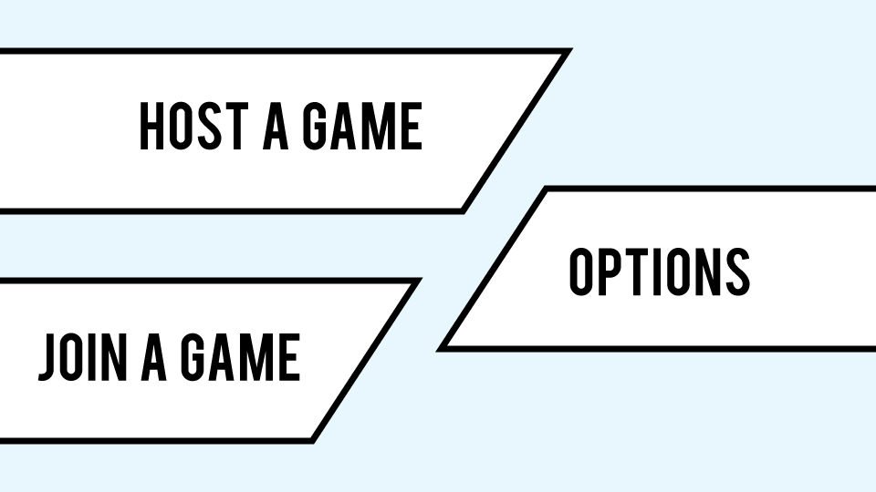
Main Menu

Slide 3
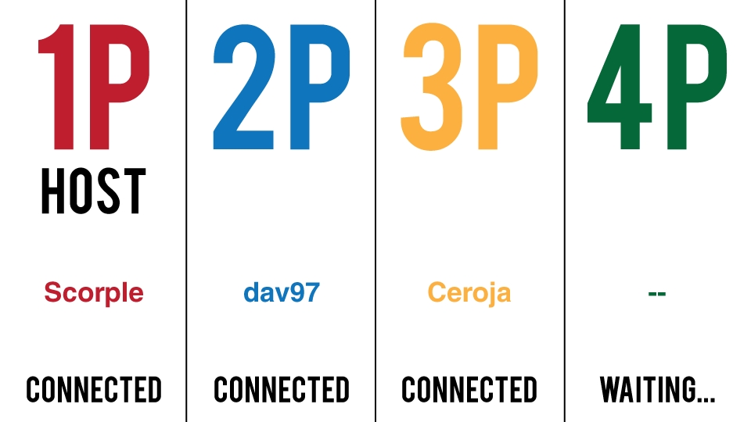
Connection Lobby

Slide 4
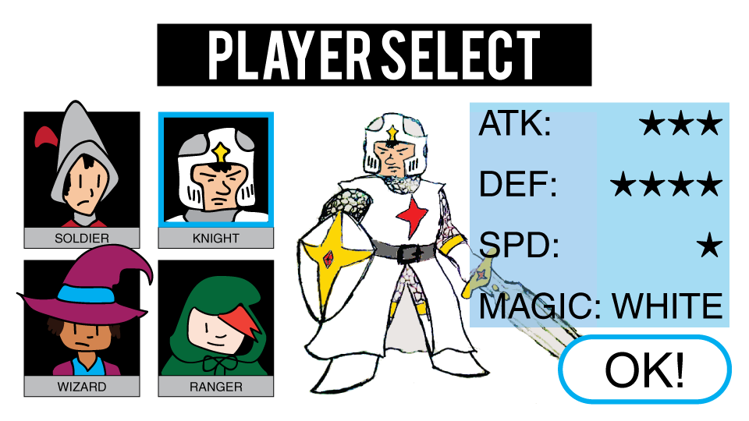
Choose a character to play as

Slide 5
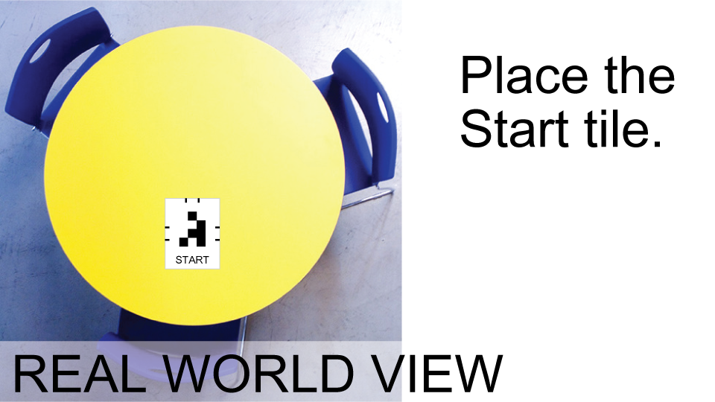
Also place the player tokens

Slide 6
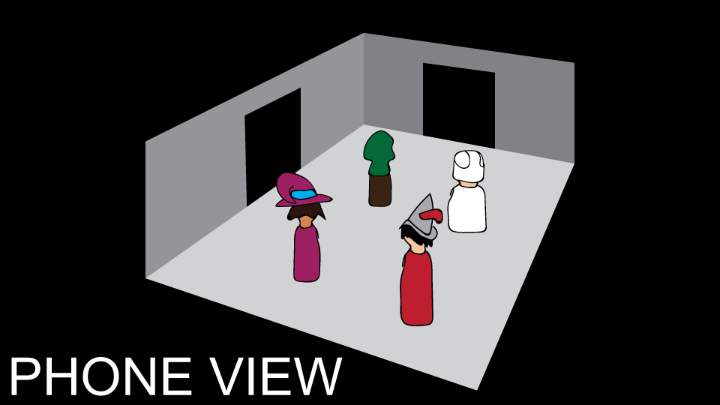
Players enter the dungeon

Slide 7
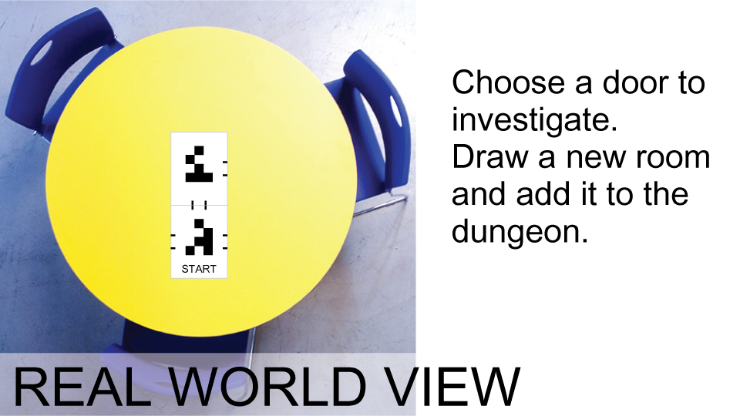

Slide 8
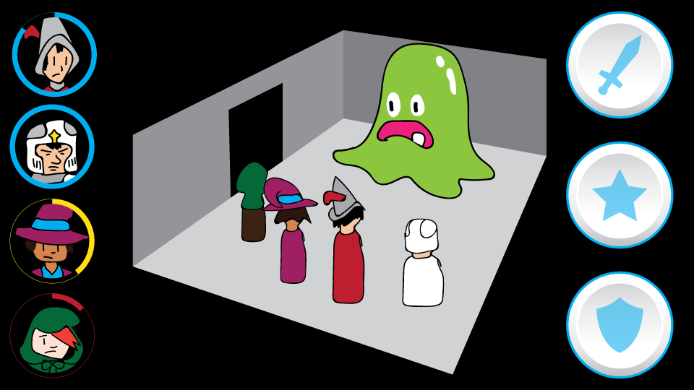
Each room will contain an encounter of sorts. This could consist of combat, a trap, or something else.

