Slide 1



Informing, Instructing, or Ignoring: challenges and considerations for automation in CNI
Kelsey Collington
School of Computing Science
k.collington.1@research.gla.ac.uk
SANS 2024
02.05.24

Slide 2

Overview
Background and Research Problem
Research Question(s)
Interviews and Findings
Future Research
k.collington.1@research.gla.ac.uk | SANS 2024

Slide 3
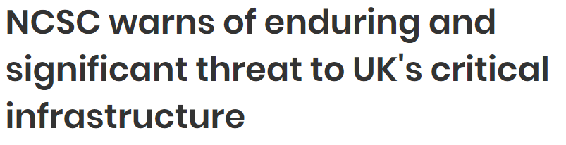


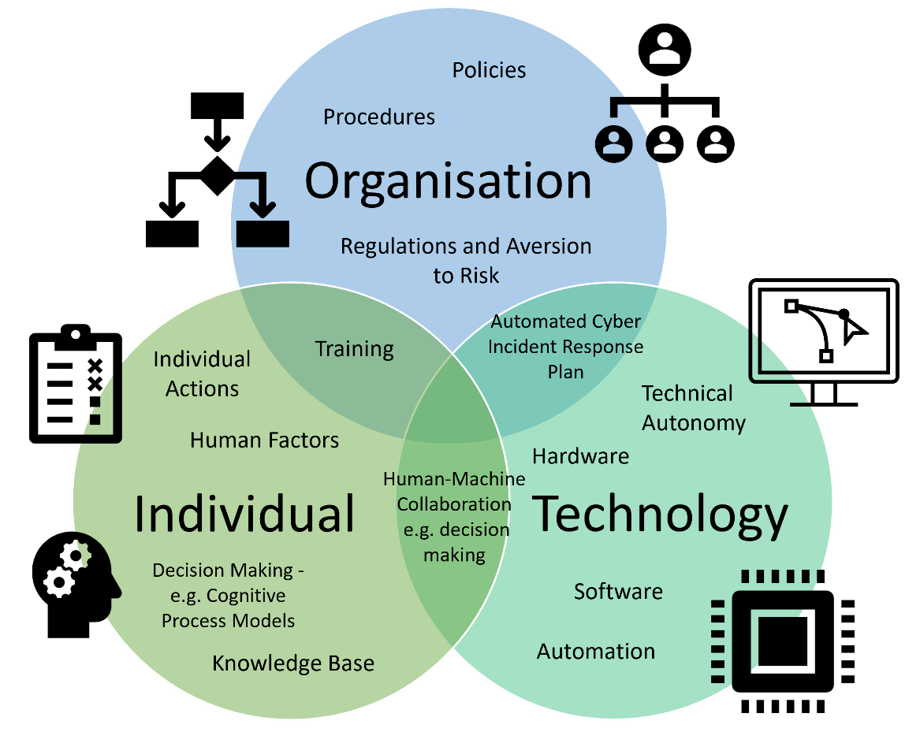
Background and Research Problem
Research Problem
Research Question(s)
Interviews and Findings
Future Research
Critical National Infrastructure (CNI) is vulnerable to cyber attacks
Digital resilience required to withstand, respond and recover while maintaining an acceptable level of service
ML/AI for detection, protection and response
Research focus on ML/AI from a technical perspective
Resilience requires a holistic approach
k.collington.1@research.gla.ac.uk | SANS 2024

Slide 4
Background and Research Problem
Research Problem
Research Question(s)
Interviews and Findings
Future Research
Why is a technical focus a problem in CNI?
  Significant organisational constraints – SAFETY
    Reliant on human-in-the-loop/human-machine interaction
Technical solutions to enable digital resilience need to consider the person and organisation if they are to be successfully integrated
A. L. Alberti, V. Agarwal, I. Gutowska, C. J. Palmer, and C. R. E. de Oliveira, "Automation levels for nuclear reactor operations: A revised perspective," Progress in Nuclear Energy, vol. 157, 2023, DOI: 10.1016/j.pnucene.2022.104559.
k.collington.1@research.gla.ac.uk | SANS 2024

Slide 5
Research Questions
Research Problem
Research Question(s)
Interviews and Findings
Future Research
How can we increase the level of automation in cyber security protection, detection, and response?
  How can human-machine interaction be integrated?
    What are the existing benefits and challenges to the use of ML based software?
k.collington.1@research.gla.ac.uk | SANS 2024

Slide 6
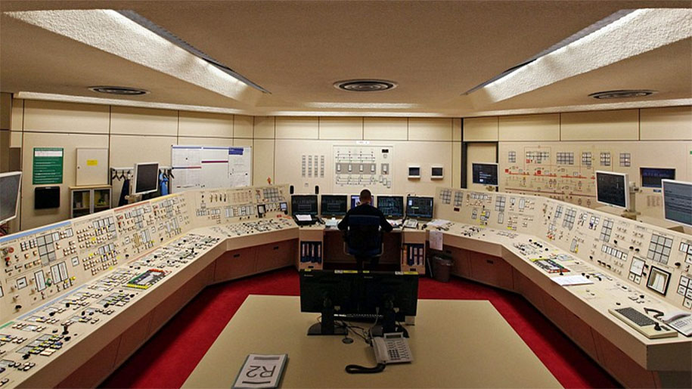
Interviews
Research Problem
Research Question(s)
Interviews and Findings
Future Research
Participants: ICS and Cyber Security Personnel from Nuclear Industry
Requirement: Significant CNI ICS experience and knowledge and involved in any of the cyber security stages (identify to recovery)
Method: Semi-Structured Interviews, lasting between 1-2 hours. Interviews transcribed then coded.
k.collington.1@research.gla.ac.uk | SANS 2024

Slide 7
Research Problem
Research Question(s)
Interviews and Findings
Future Research
Preliminary Findings
Perceptions of automation:
  Risk to Reward Ratio
  Fully automated systems cannot accommodate the required nuances in their decision-making
    Responses need to consider:
      the function and safety level of the process
      the consequences of shutting down a process(es)
k.collington.1@research.gla.ac.uk | SANS 2024

Slide 8
Research Problem
Research Question(s)
Interviews and Findings
Future Research
Preliminary Findings
Barriers and challenges with machine learning:
  Compatibility and backwards compatibility
  Substantialising
  False Positives
    Number of false positives
    Alert/Alarm Verification
    Quality of Alert Information
k.collington.1@research.gla.ac.uk | SANS 2024

Slide 9
Research Problem
Research Question(s)
Interviews and Findings
Future Research
Preliminary Findings
Benefits of machine learning
  Pattern recognition and potential to reduce data overload
  Zero Day attacks
Alert/Alarm Purpose
  What is the operator expected to do with the alert/alarm information is it designed to: inform, instruct, or be ignored?
k.collington.1@research.gla.ac.uk | SANS 2024

Slide 10
Research Problem
Research Question(s)
Interviews and Findings
Future Research
Future Research
How do ICS control room operators respond to machine assistance in decision-making?
How can you design ML software to elicit appropriate levels of trust?
  Do certain design features lead to over or under-reliance?
k.collington.1@research.gla.ac.uk | SANS 2024

Slide 11

Summary
CNI industries are at significant risk to cyber attacks
Digital resilience needs to be approached holistically
Pre-liminary findings have similarities with existing literature, but also some novel results
Key consideration: what is the end user expected to do?
Perceived benefits of introducing ML: information overload, limited resources
Perceived challenges: capturing complexity of decision-making, false positives, and ensuring appropriate response
k.collington.1@research.gla.ac.uk | SANS 2024

Slide 12
Thank you for listening!
Kelsey Collington
k.collington.1@research.gla.ac.uk

