Slide 1


Open Resource Allocation to Service Function Chains Emulator
Theviyanthan K.

Slide 2
Background

Slide 3
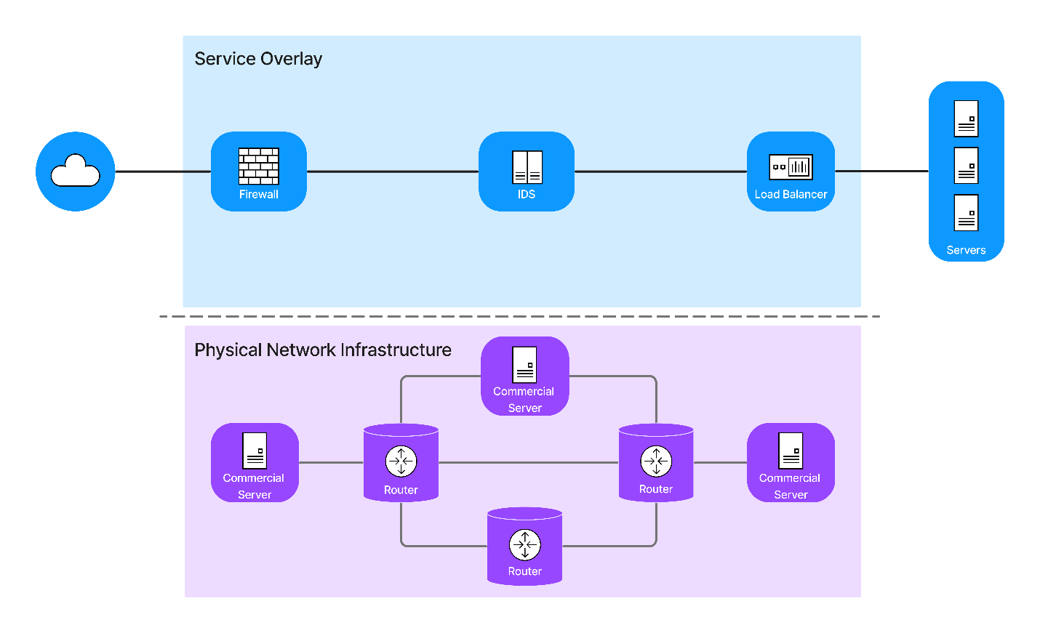
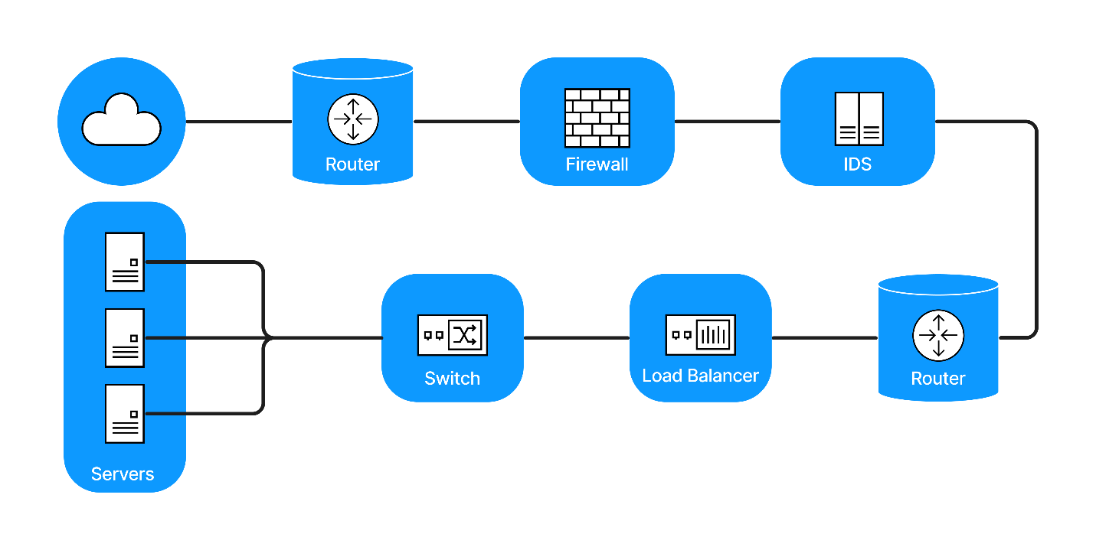
What are Service Function Chains (SFCs)?
SFCs combine both Network Function Virtualization and Software Defined Networking and create a service overlay over the physical network.
A traditional network:
A Service Function Chain:

Slide 4
Network Function Virtualization Resource Allocation (NFV-RA)
The NFV-RA problem deals with the composition of and resource allocation to SFCs.
It is composed of three sub-problems:
Virtual Network Function (VNF) Chain Composition (VNF-CC)
Virtual Network Function Forwarding Graph Embedding (VNF-FGE)
Virtual Network Function Scheduling (VNF-SCH)

Slide 5
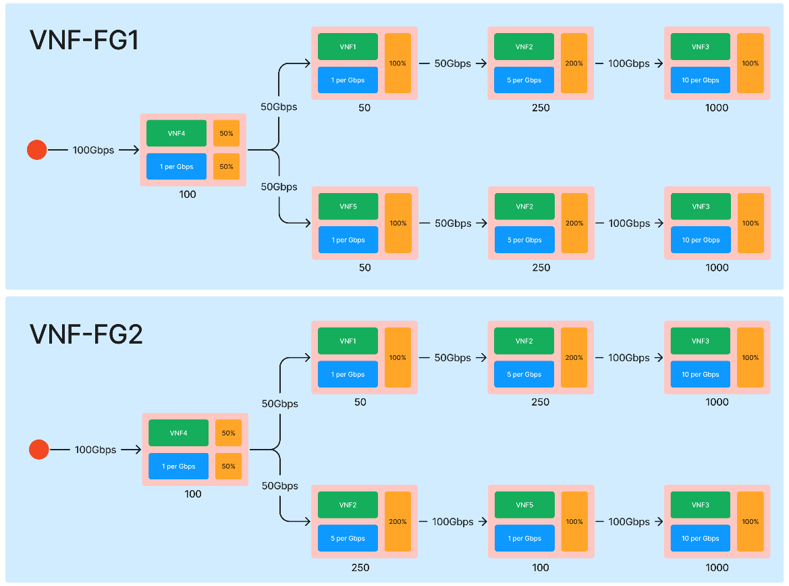

Slide 6
What am I trying to do?

Slide 7
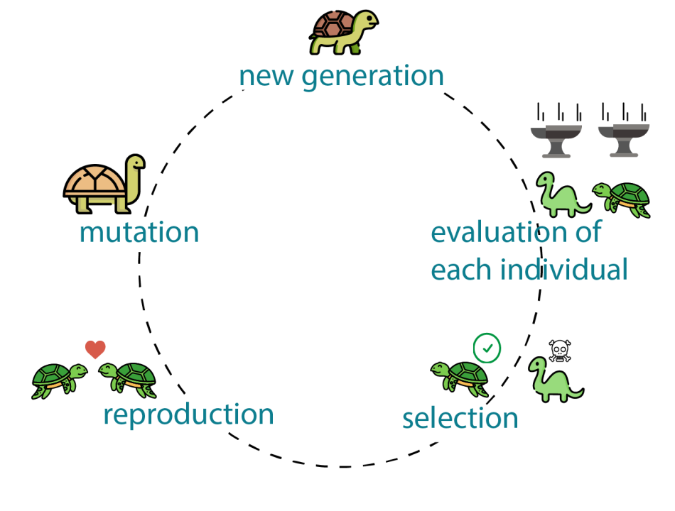


My Research
Evaluation is done on a live network, so it is going to be time-consuming.
I plan to use Genetic Algorithms to solve the VNF-CC and VNF-FGE problems.

Slide 8
Why do I need OpenRASE

Slide 9
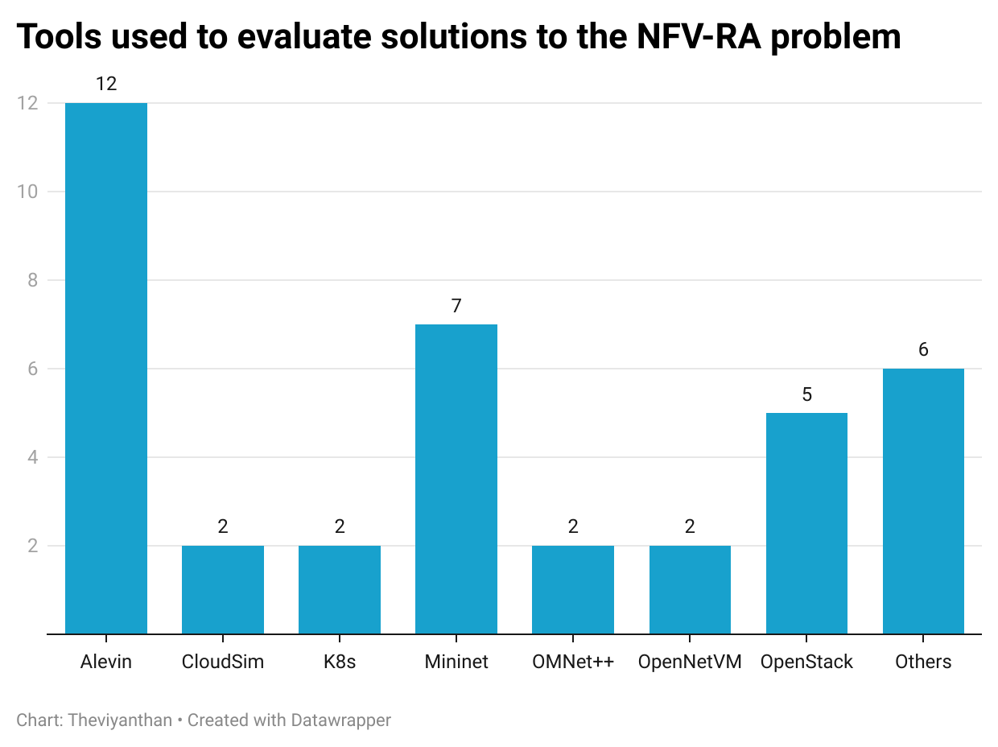
Tools used in literature
Simulators

Slide 10
Why can’t I use a simulator?
Simulators don’t provide high fidelity.
A major challenge in online experimentation is excessive time consumption.
The use of simulators nullifies this challenge.
This means an algorithm that runs fast on a simulator may not necessarily be fast on a real network.
An algorithm’s ability to adapt to an uncertain environment cannot be tested.

Slide 11
Why do I need an emulator?
Emulators offer higher fidelity than simulators.
They are closer to real networks. So, online experimentations on emulators consume time just like real networks.
This means that an algorithm’s ability to address such challenges can be tested with high fidelity.
Provides a more uncertain environment than a simulator.

Slide 12
How does OpenRASE work?

Slide 13
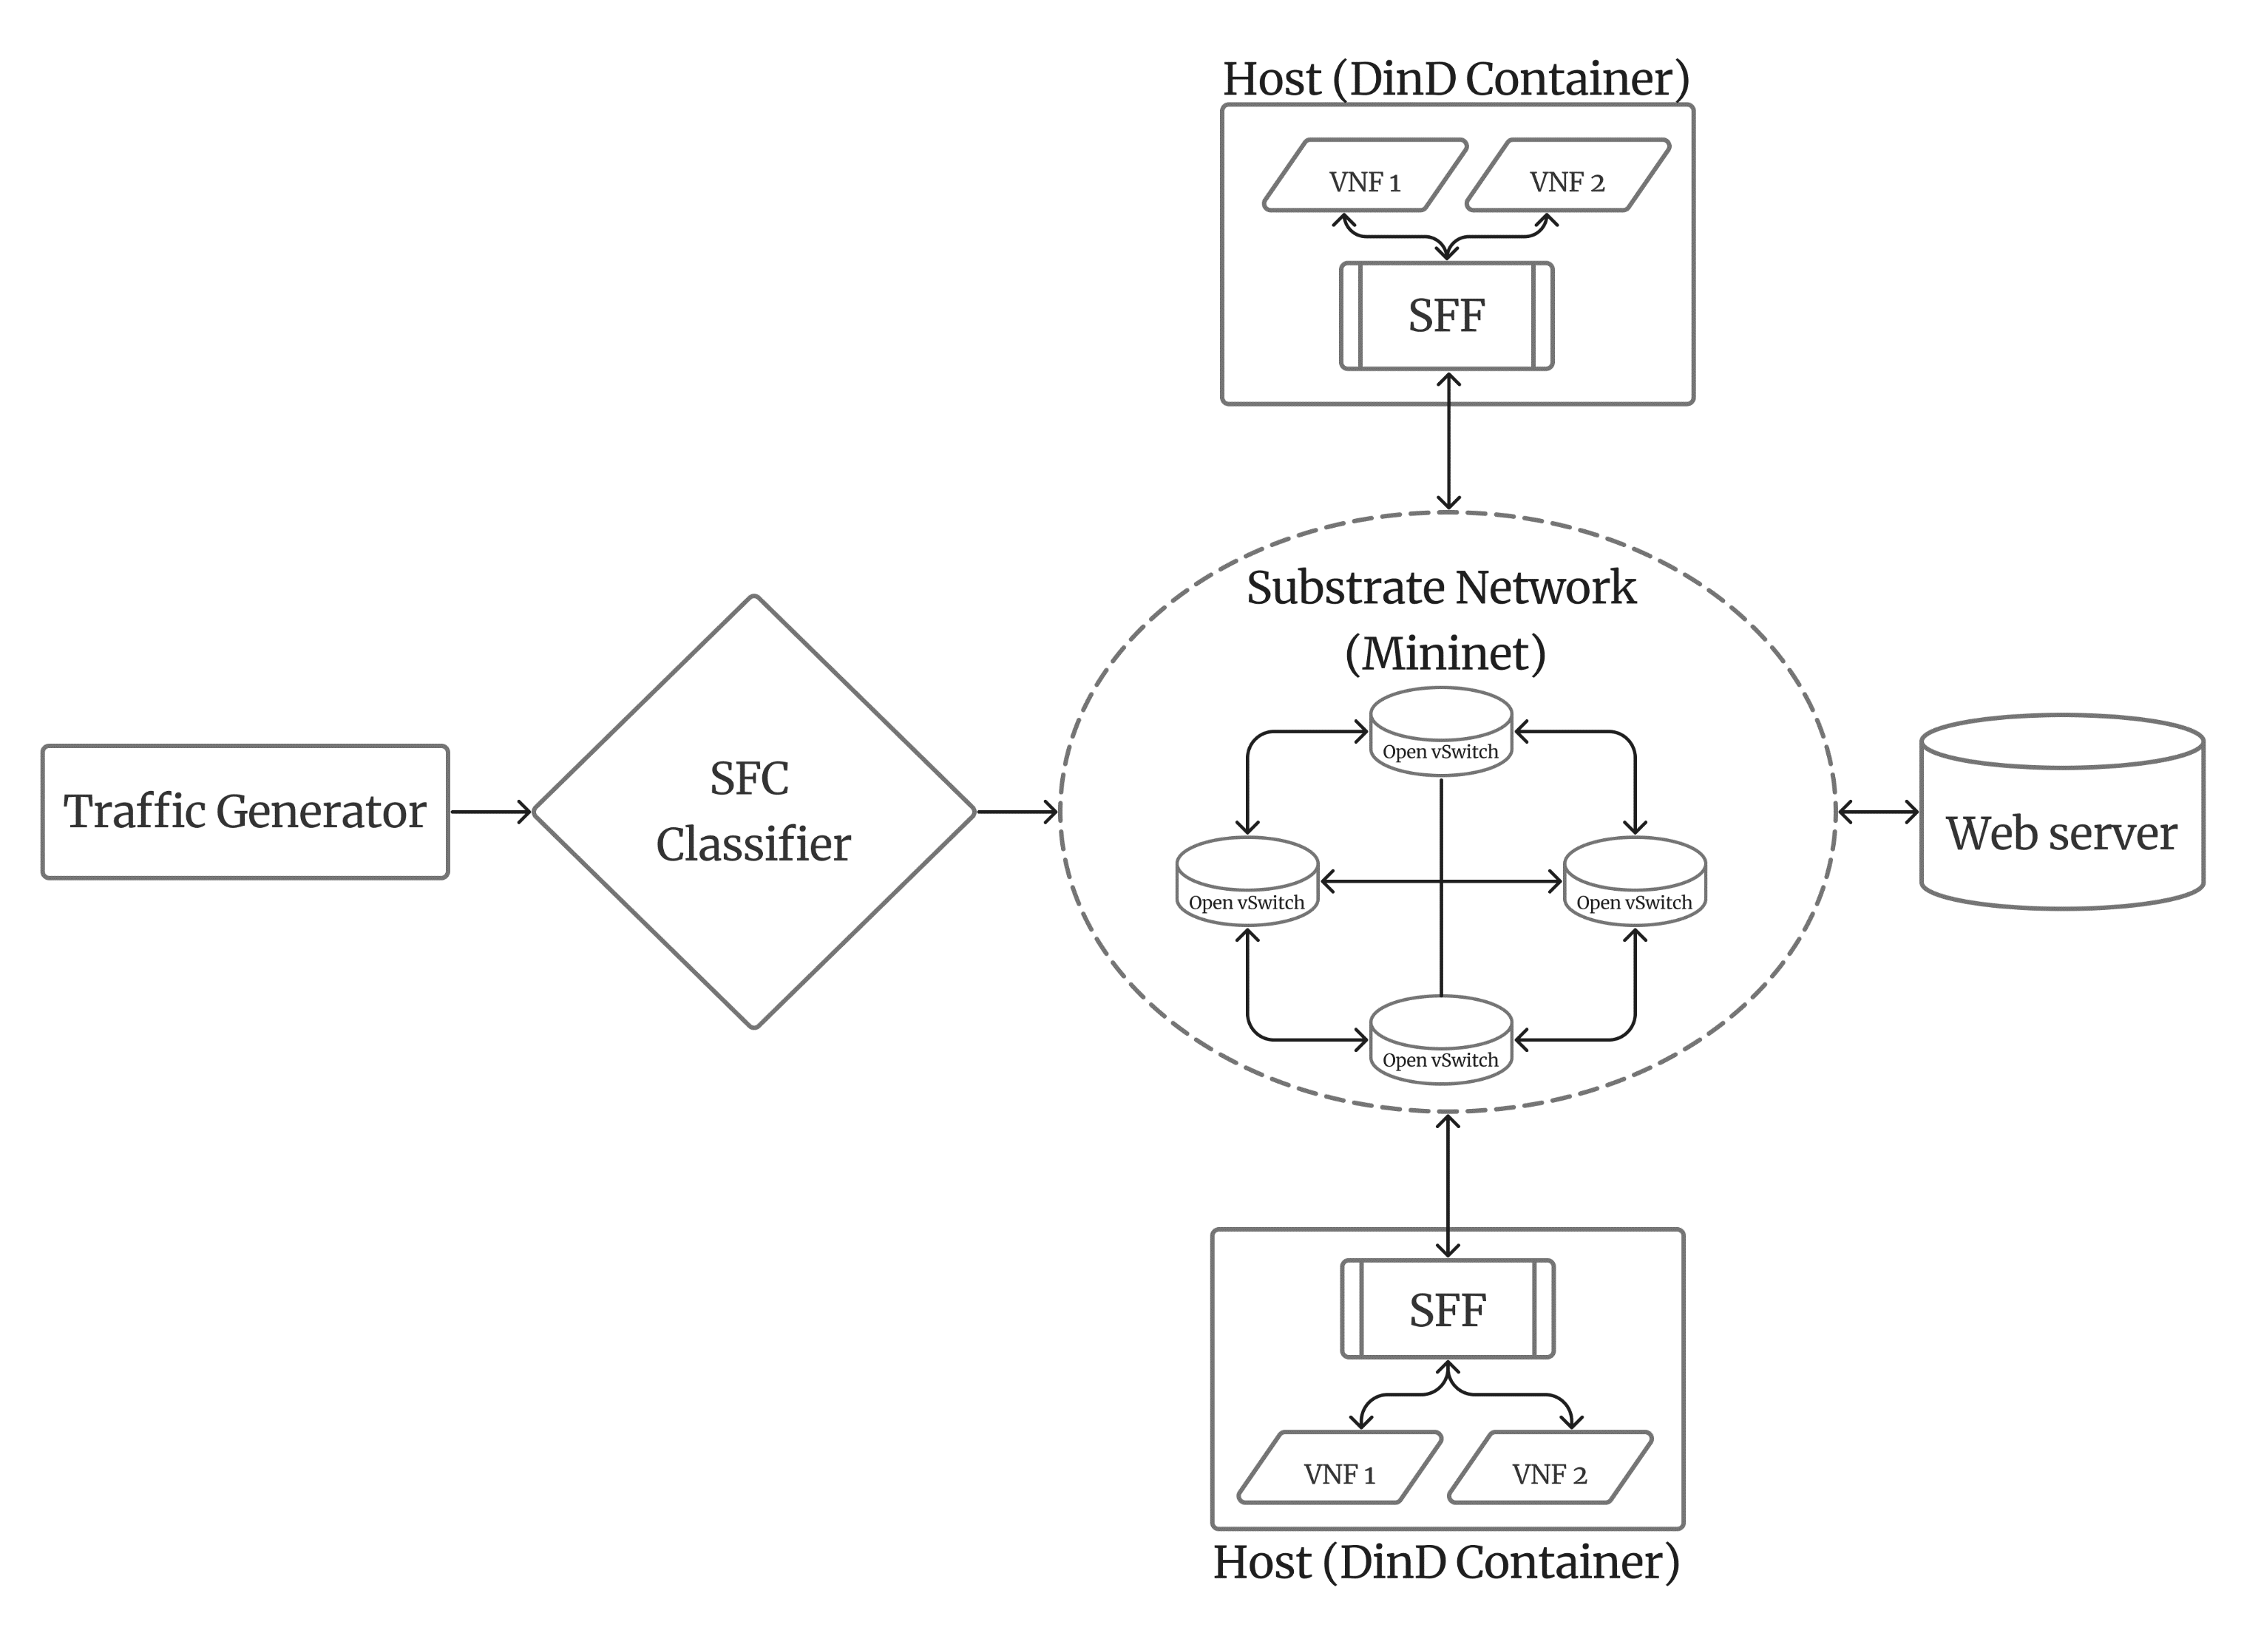
Architecture
Built on top of Mininet.​
Uses Docker to virtualize network functions.​
Uses the Ryu SDN controller.​
HTTP based.​

Slide 14
Future Work
Evaluating OpenRASE
Developing Genetic Algorithms on top of OpenRASE

Slide 15
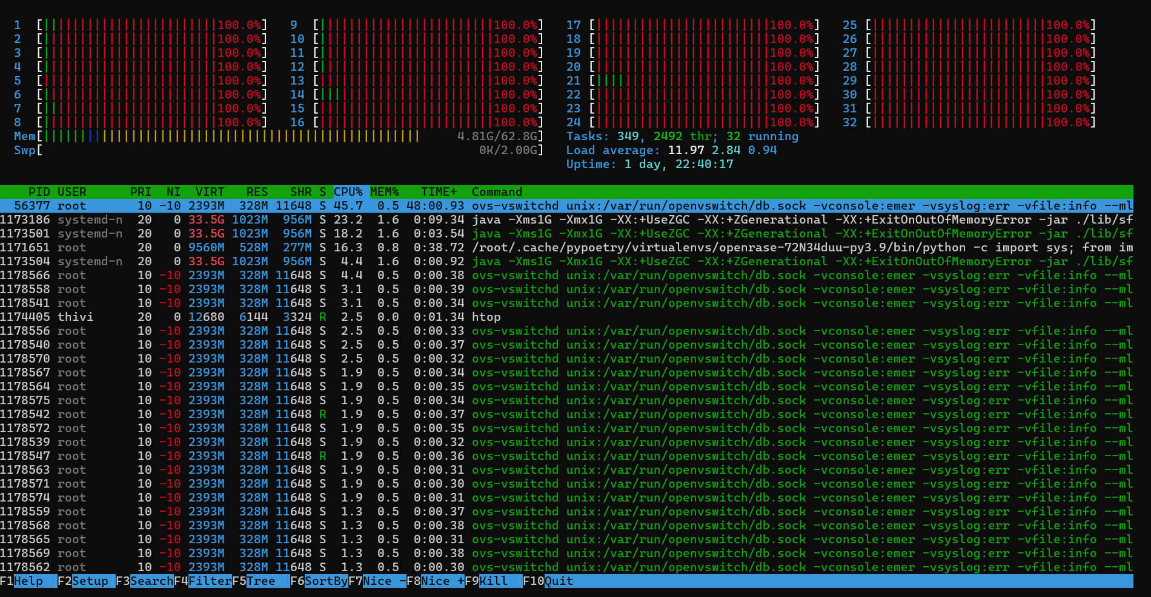
Challenges
Running a 4ary fat tree topology with a Ryu controller running the REST router app exhausts all CPU cores.

Slide 16
Questions?

Slide 17
Appendix

Slide 18
ALEVIN vs. OpenRASE
 | ALEVIN | OpenRASE
Test | Simulated | Emulated.
Hosts | Simulated | Docker containers as hosts
Switches | Simulated | Open vSwitches using Mininet
VNFs | Simulated & abstract | 7 distinct, real VNFs. Allows addition of more VNFs
VNF resource requirements | Arbitrary, static, & user-specified | VNF demands are calibrated through benchmarking
VNF behavior | Static | Dynamic based on input traffic
Deployment | Simulated | Emulated real code deployment using Docker containers and Mininet
Programming language | Java based | Python based
Tool resource requirements | Low | High
Use case | Rapid designing and prototyping | High-fidelity testing
New resource demands and metrics | Can be added | Adding new demands and metrics need changes to the emulator

Slide 19
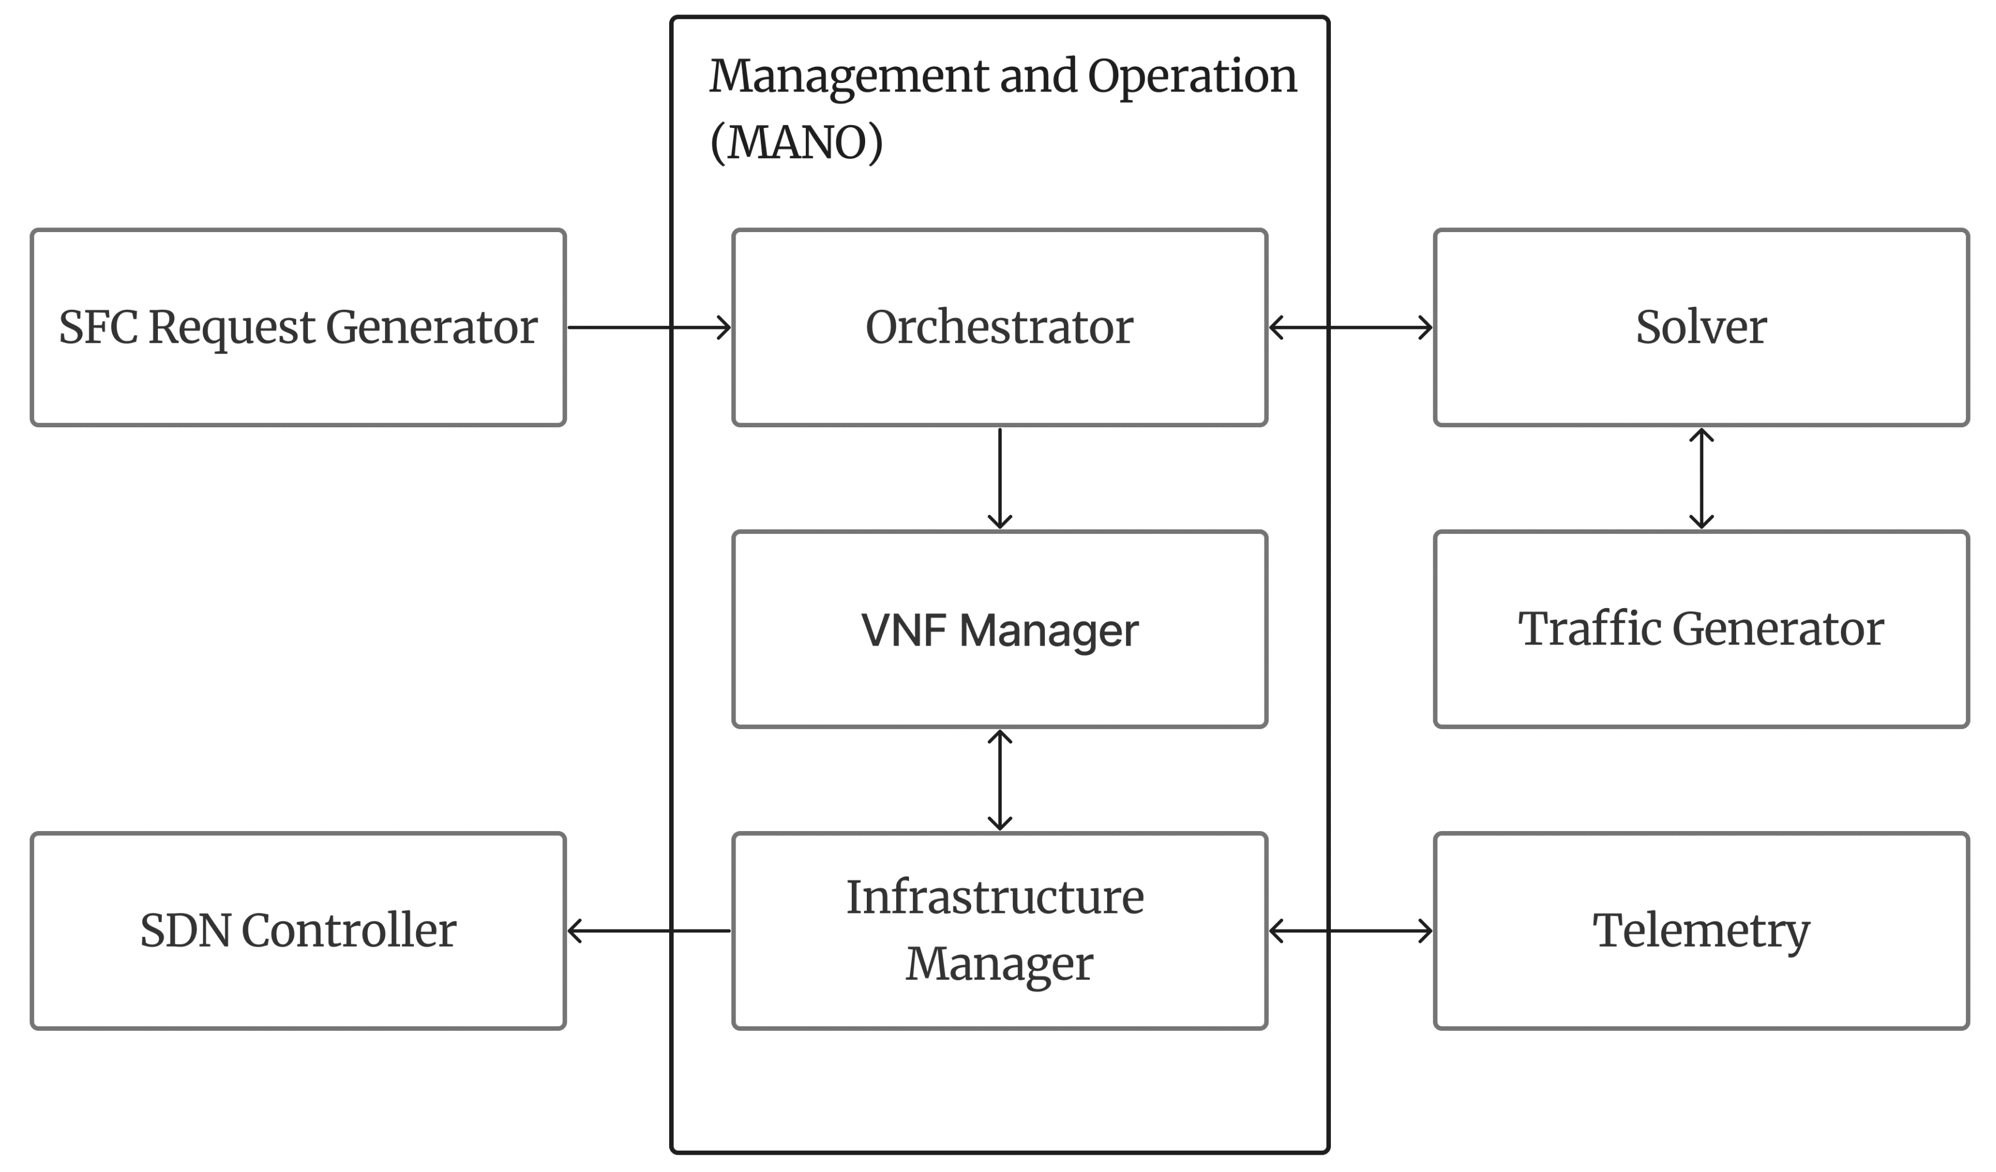
Design

