Slide 1


Welcome to SANS – Part Deux
🎉

Slide 2
Program and Details : https://scot-ans.github.io/
paul.harvey@glasgow.ac.uk
Liquid & Lunch will be outside this room
We are taking photos!

Slide 3

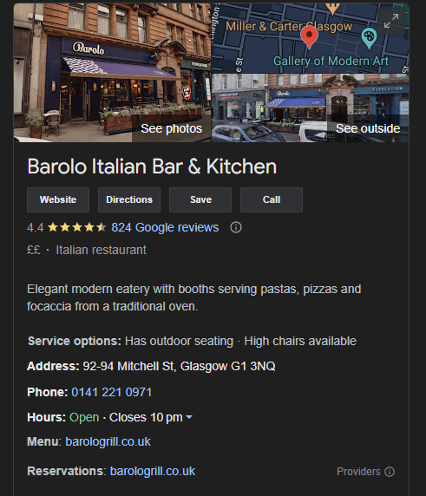
Reservation from 18.30 May 2nd

Slide 4


Slide 5


Part 1
Part 2

