Slide 1
SE Business Toolkit Site Innovation Readiness Toolkit Alpha Testing
Jan 24th & 25th 2021

Slide 2
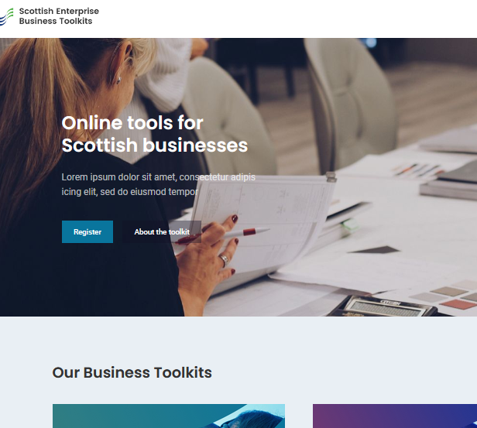
What we tested
We tested the SE Business Toolkit site https://se-toolkits.mtcserver17.com
Customers fill in a questionnaire and get an action plan based on their answers

Slide 3
Who we tested with
We tested with:
6 potential customers
Using Video calls (Microsoft Teams)

Slide 4
Results Summary
The site is nice and clear, but the initial toolkit view is a little bit vague
The questionnaire is good, but some questions could have the option text tweaked
The initial views of the Action Plan was:
Too vague for users and did not lead them deeper into the detail
Once people clicked through to detailed content, (after being prompted), they appreciated the level of detail.

Slide 5
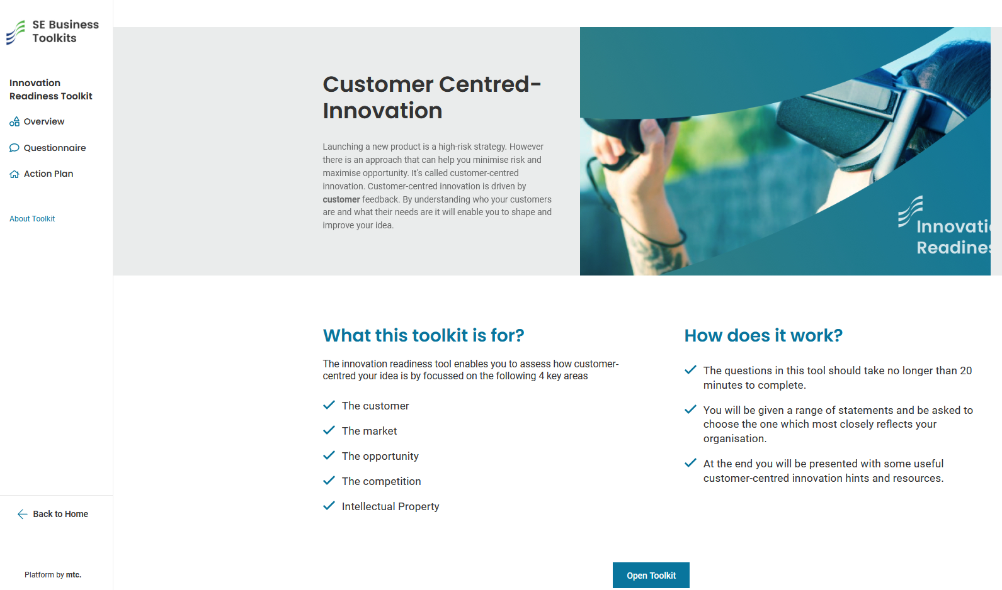
Toolkit Page
Nice and clear
Hero banner text (Customer Centered-Innovation….) was too wordy and most people would rather not have this section
The Bullet points are too vague
The “Open Toolkit” button is below the fold for most users.

Slide 6
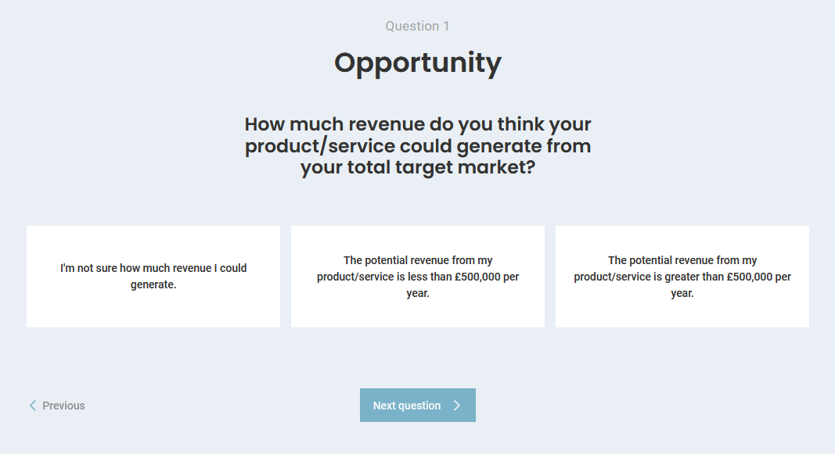
Questions
Questions are mostly good
A progress indicator, (3 of 14 etc.…), was expected
Some options might not be relevant to all users (like IP), but there was no 'does not apply' option

Slide 7
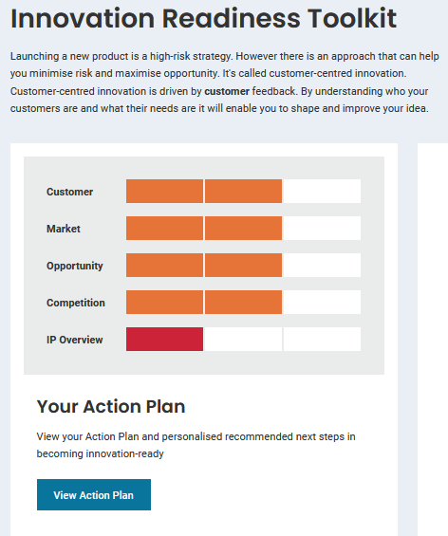
Overview / Dashboard
The Activity plan DID NOT leap off the page at users. It was not appealing enough to make them want to click on it. The graphics were too blocky and lacked meaning for many.

Slide 8
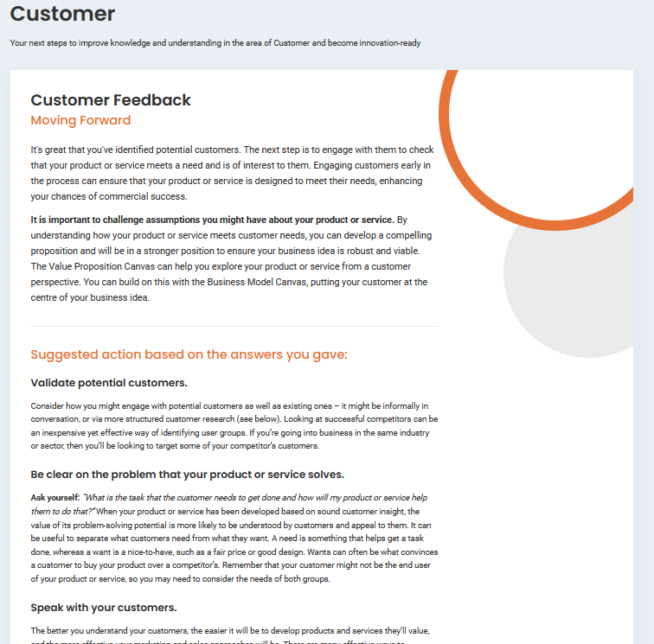
Details
Most people found the detail pages quite good and welcomed the text and the links.

Slide 9
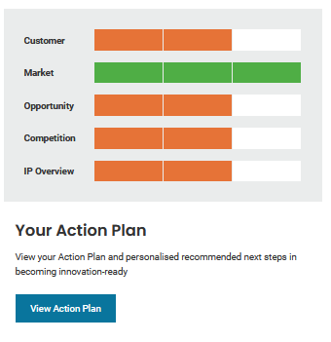
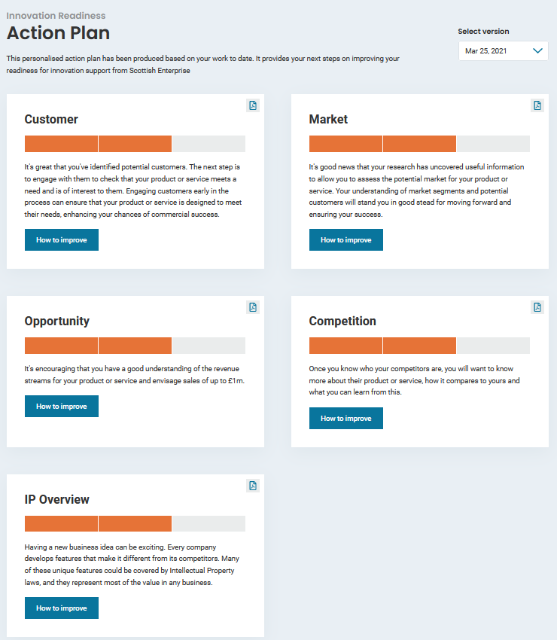
Recommendations
Concentrate on improving the Action Plan design, to communicate more information to customers, so they click into it.

Slide 10
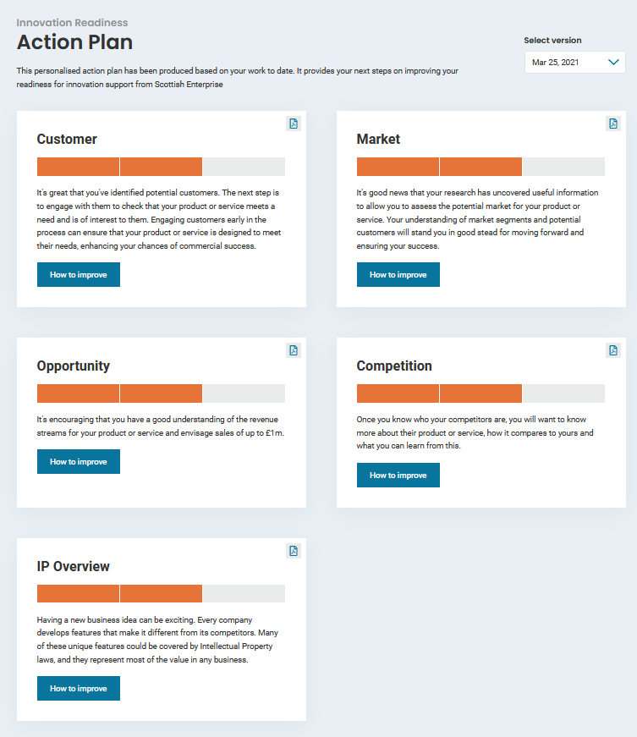
Action Plan
The headings were vague and did not communicate well to users
The meaning of the graphs were not quickly obvious to most. Their intention was not clear to users.

Slide 11
fin

